Slide 1
PROJECT TITLE – KEYLOGGER AND SECURITY
CAPSTONE PROJECT
Presented By:
M.DHANUSH – Jeppiaar Institute Of Technology (Department Of Information Technology)

Slide 2
OUTLINE
Problem Statement (Should not include solution)
Proposed System/Solution
System Development Approach (Technology Used)
Algorithm & Deployment
Result (Output Image)
Conclusion
Future Scope
References

Slide 3
Problem Statement
In an era where digital privacy and security are paramount concerns, the need for robust, secure keylogger solutions has become increasingly apparent. Keyloggers, while serving legitimate purposes such as employee monitoring or parental controls, also pose significant risks when wielded maliciously, potentially leading to data breaches and privacy violations. Therefore, the challenge lies in crafting a keylogger solution that not only captures keystrokes effectively but also prioritizes security, legitimacy, and user privacy. This entails developing mechanisms to securely encrypt and store captured data, ensuring compliance with legal and ethical standards, and implementing measures to resist detection and maintain system integrity. Moreover, the solution must be resource-efficient, compatible with diverse operating environments, and equipped with update mechanisms to address evolving threats. Balancing these technical, legal, and ethical considerations is essential to create a keylogger solution that fosters trust and confidence among users while mitigating the risks associated with misuse or abuse.

Slide 4
Proposed Solution
System Architecture Design:
- Keylogging Module Implementation:
- Develop a robust keylogging component to capture keystrokes from various input sources, ensuring reliability and efficiency.
Encryption and Data Protection:
- Integrate encryption mechanisms using AES for encrypting logged keystrokes, ensuring confidentiality and integrity of data.
Authentication and Access Control:
- Implement user authentication using secure password hashing and role-based access control (RBAC) to restrict access to authorized users.
Security Monitoring and Auditing:
- Incorporate logging and auditing capabilities to track system activities, detect security incidents, and facilitate forensic analysis..

Slide 5
System Approach
The "System Approach" for keylogger and security:
Deployment and Deployment
Maintenance and Updates
Keylogging Module
Continuous Improvement
Security Monitoring and Auditing
Monitoring and Feedback

Slide 6
Algorithm & Deployment
Algorithm Selection:
Problem Understanding, Evaluation Criteria
Algorithm Exploration, Algorithm Comparison and Performance Analysis
Data Input:
Keystrokes from Physical Keyboards, Input from Web Browsers and Online Forms, Input from Command-Line Interfaces (CLI) and
Input from Web Browsers and Online Forms
Training Process:
Data Collection and Preprocessing, Training Loop ,Model Deployment and Monitoring
Data Collection and Preparation and Data Augmentation
Prediction Process:
Data Collection and Preprocessing
Feature Selection and Engineering
Model Training and Evaluation
Prediction Generation
Model Deployment and Monitoring

Slide 7
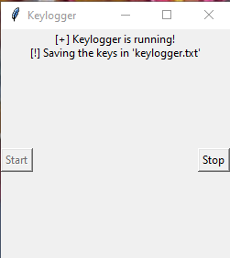
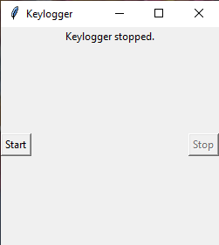
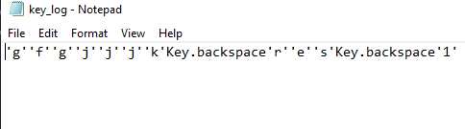
Result

Slide 8
Conclusion
The suggested keylogger system with integrated security features offers a thorough approach to securely record and safeguard private user data while upholding its availability, confidentiality, and integrity. The system protects logged data from manipulation and unauthorised access by utilising a modular architecture, strong encryption technologies, strict authentication and access control measures, and extensive security monitoring.

Slide 9
Future scope
Integration with AI and Machine Learning: Incorporating machine learning algorithms for anomaly detection and behavior analysis to enhance threat detection capabilities.
Improved User Experience: Enhancing user interfaces for easier configuration and monitoring of security measures.
Cloud-Based Solutions: Developing cloud-based keylogger solutions for scalability and remote access.
User Education and Awareness: Providing educational resources and training to users to promote responsible and secure usage of keylogger solutions.

Slide 10
References
"Practical Malware Analysis: The Hands-On Guide to Dissecting Malicious Software" By Michael Sikorski and Andrew Honig ,No Starch Press Publication in 2012

Slide 11
THANK YOU

