Slide 1
DevOps

Slide 2
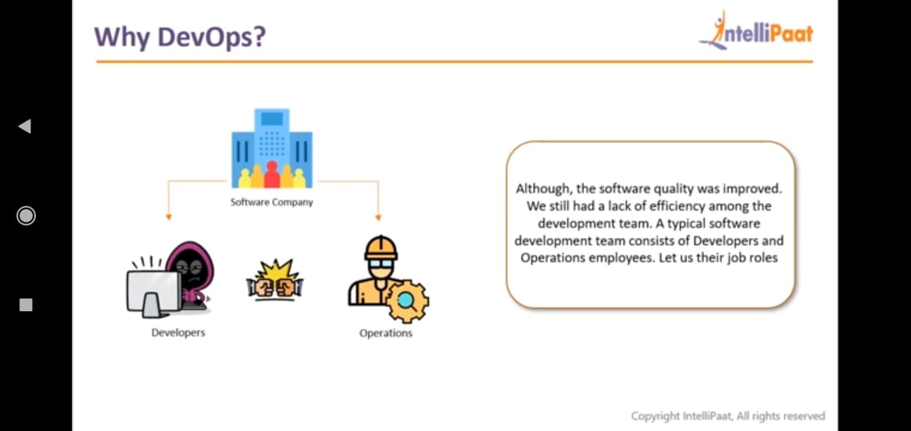
Why DevOps

Slide 3
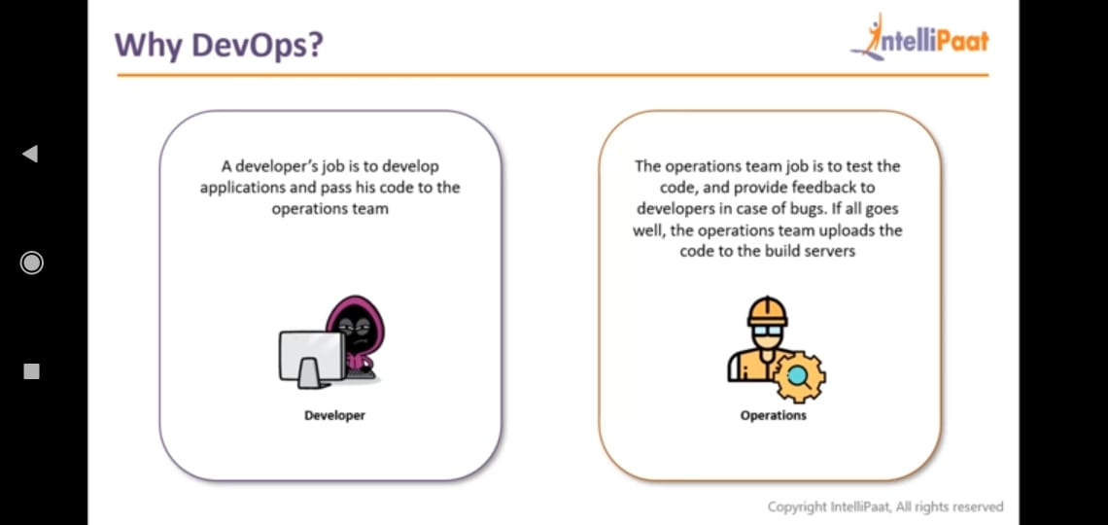
Roles

Slide 4
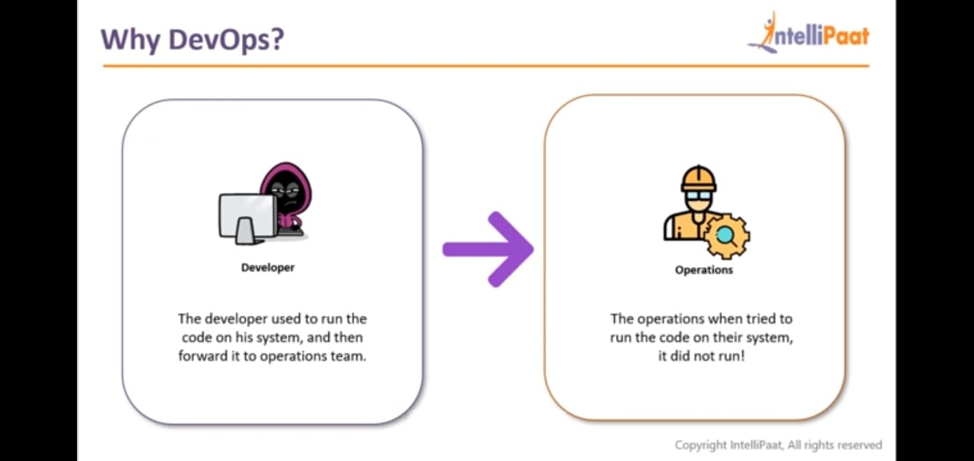
Problem

Slide 5
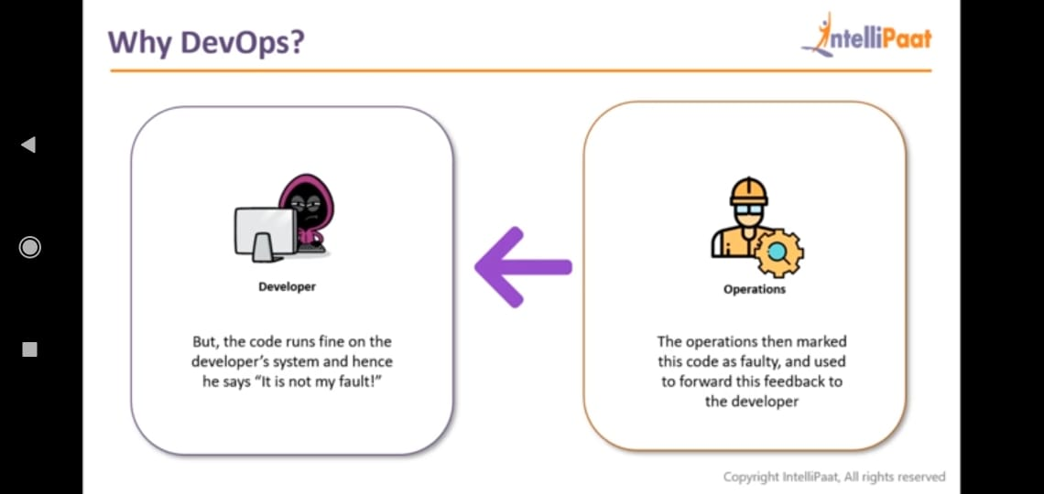
Escalations and Problems

Slide 6
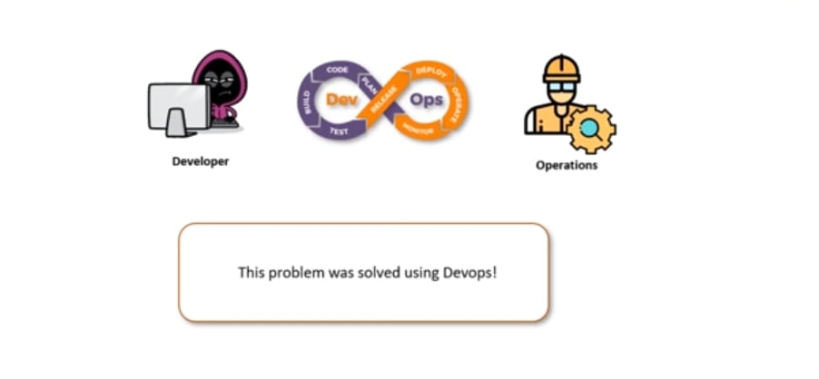
Solution→DevOps

Slide 7
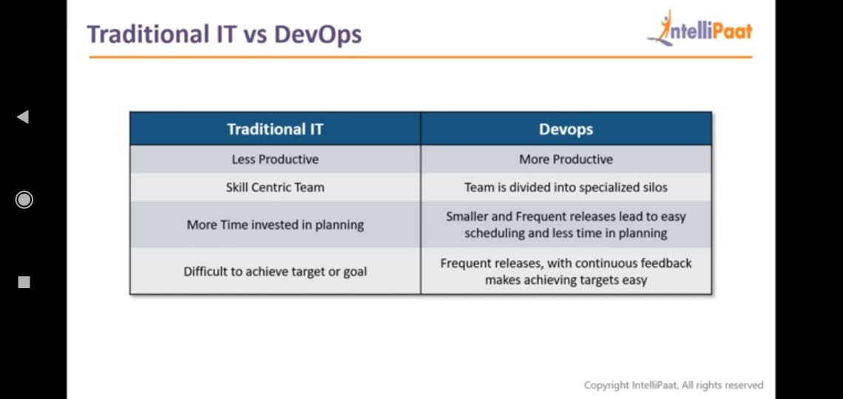

Slide 8
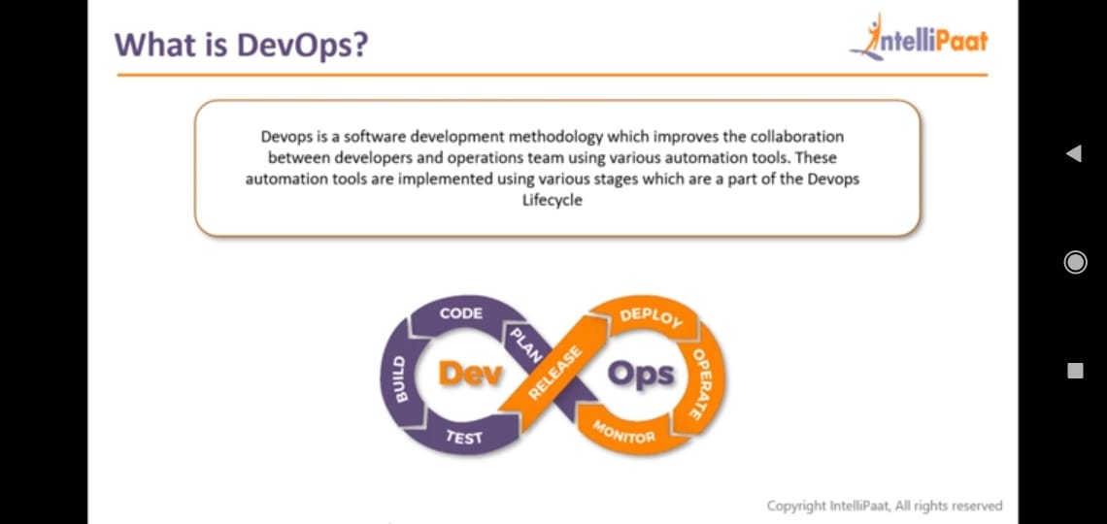
What is DevOps

Slide 9
What is DevOps
DevOps is the practice of development and operations engineers participating together in the entire service lifecycle, from design through the development process to the production support.

Slide 10
The benefits of DevOps
Technical benefits:
Continuous software delivery
Less complexity to manage
Faster resolution of problems
Cultural benefits:
Happier, more productive teams
Higher employee engagement
Greater professional development opportunities
Business benefits:
Faster delivery of features
More stable operating environments
Improved communication and collaboration
More time to innovate (rather than fix/maintain)
Notes:
(analogy – automation in car manufacturing )

Slide 11
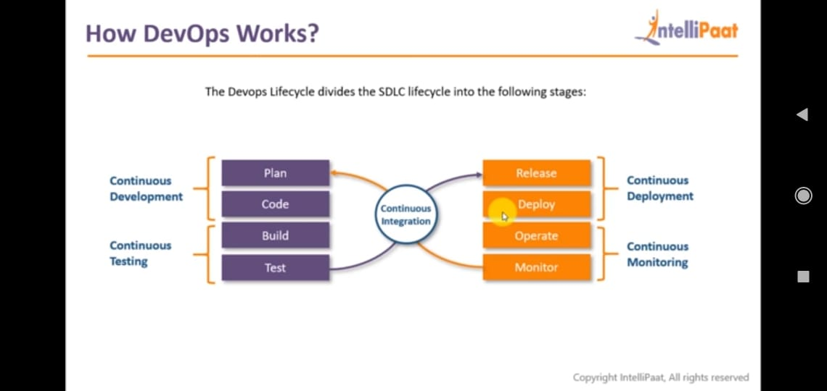
DevOps-Stages

Slide 12
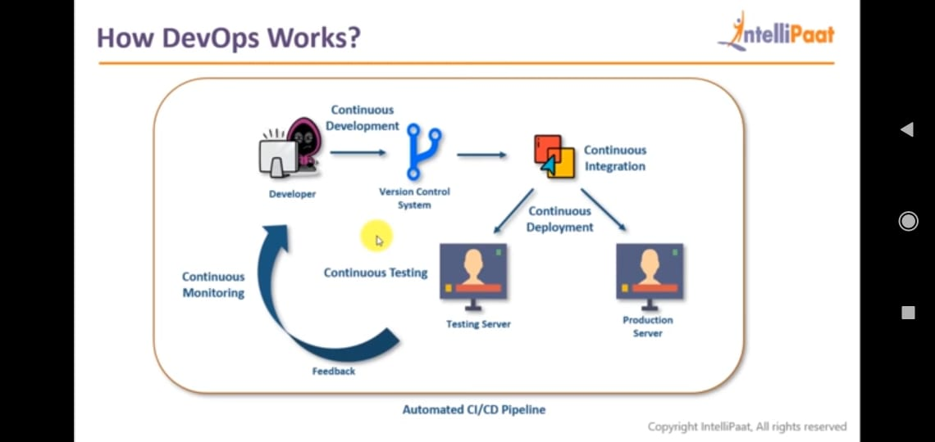
Process

Slide 13
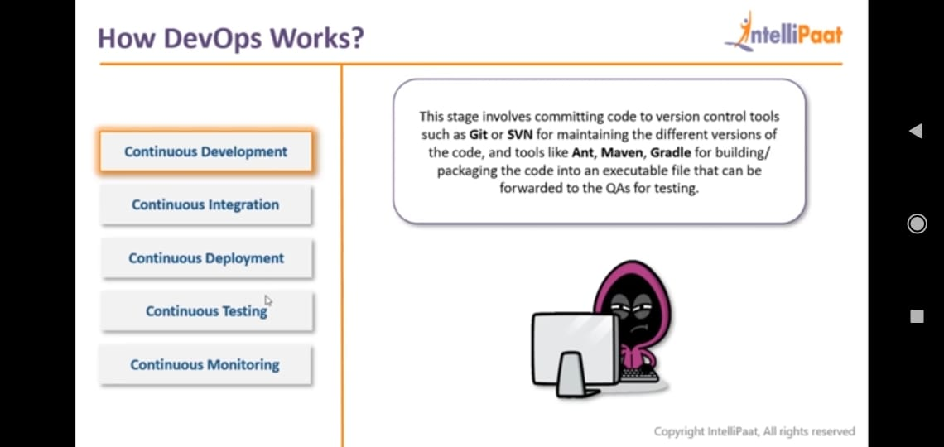
Continuous Development

Slide 14
DevOps Divisions
CI – Continuous Integration
CD – Continuous Delivery
CD – Continuous Deployment

Slide 15

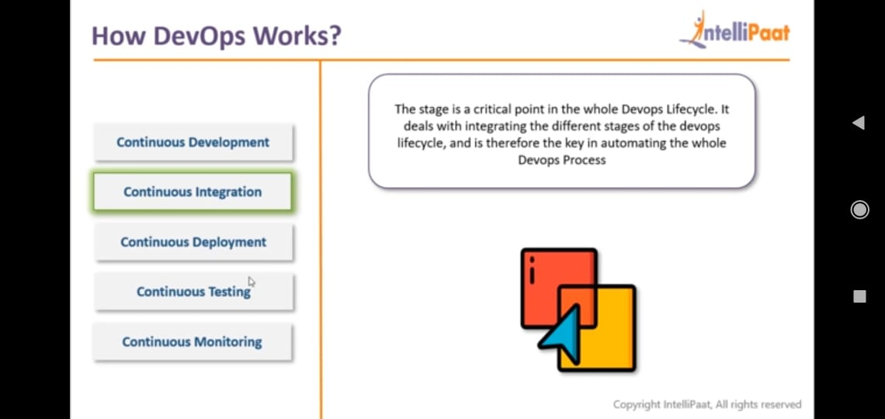
Continuous Integration

Slide 16
Continuous Integration vs Continuous Delivery vs Continuous Deployment
Continuous Integration basically just means that the developer's working copies are synchronized with a shared mainline several times a day.
Continuous Delivery is described as the logical evolution of continuous integration: Always be able to put a product into production!
Continuous Deployment is described as the logical next step after continuous delivery: Automatically deploy the product into production whenever it passes QA!

Slide 17
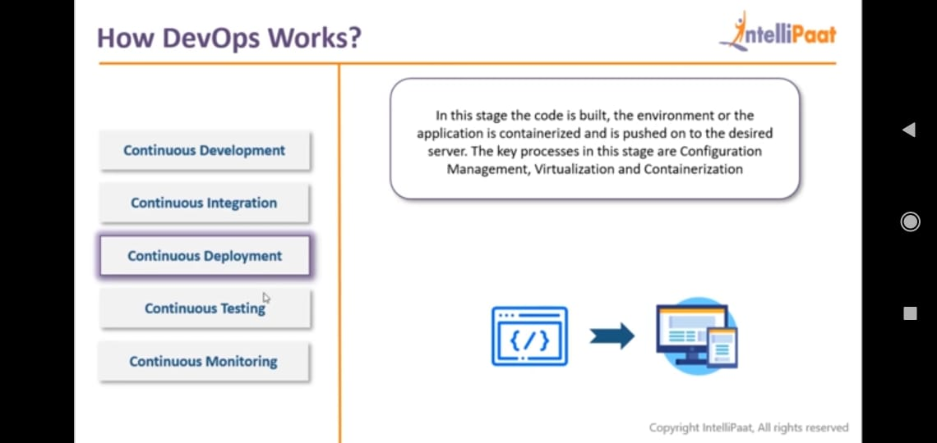
Continuous Deployment

Slide 18
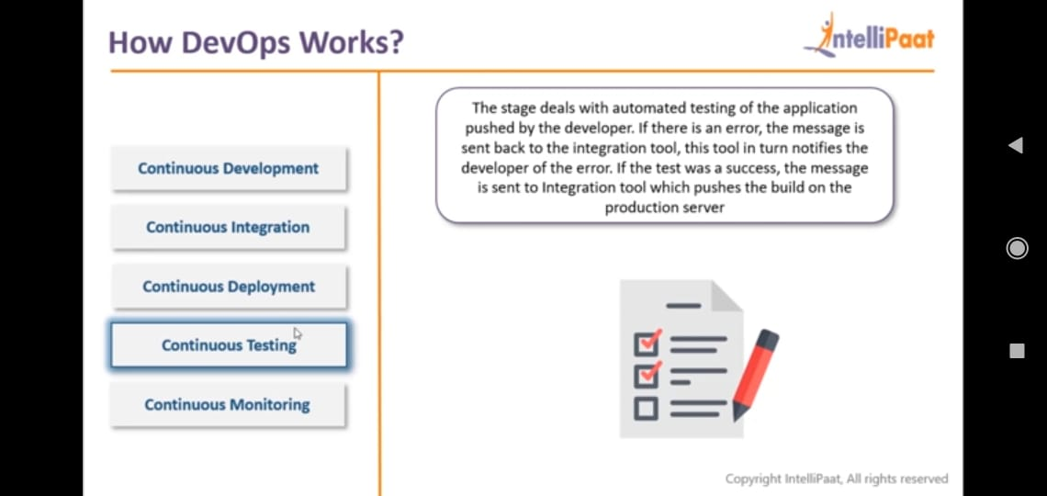
Continuous testing

Slide 19
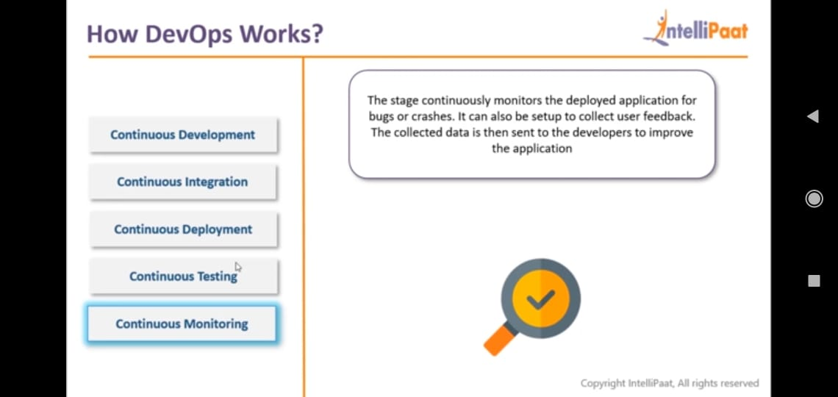
Continuous Monitoring

Slide 20
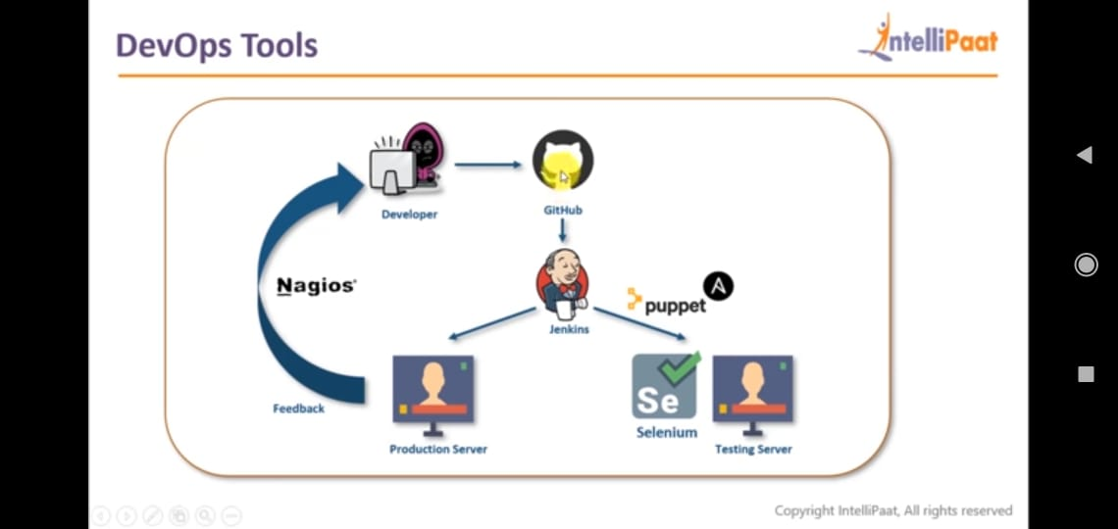
DevOps Tools

Slide 21
DevOps Tools
TDD→ TestNG/Junit
Maven
eclEmma
SonarQube
GitHub
Jenkins
Selenium
BDD

Slide 22
Benefits of Test Driven Development (TDD)

Slide 23
Build and Project management Tools
Ant
Maven
Gradle

Slide 24
Maven pom.xml
Consist of 4 major things
Project Info
Dependencies
Plugins
Repository

Slide 25
SonarQube
Sonar covers below code quality
Unit tests
Duplicate code
Potential bugs
Complex code
Coding standards
Comments

Slide 26
Github
Git offers a decentralized model
Git is fast and excellent for managing large open source projects with many collaborators.
GitHub lets you connect with and follow other developers, sort of like Facebook for software developers.

Slide 27
BDD
Behavior Driven Development (BDD) is a software development process that originally emerged from Test Driven Development (TDD).
BDD uses examples to illustrate the behavior of the system. These examples include −
  Converted into executable specifications.
  Used as the acceptance tests.

Slide 28
TDD vs BDD
TDD describes how the software works.
On the other hand, BDD −
  Describes how the end user uses the software.

Slide 29
Story and Scenarios
Story
As a customer,
I want to withdraw cash from an ATM,
so that I do not have to wait in line at the bank.

Slide 30
Story and Scenario
Scenario 1 − Account is in credit
  Given the account is in credit
  And the card is valid
  And the dispenser contains cash
  When the customer requests cash
  Then ensure the account is debited
  And ensure cash is dispensed
  And ensure the card is returned

Slide 31
Story and Scenario
Scenario 2 − Account is overdrawn past the overdraft limit
  Given the account is overdrawn
  And the card is valid
  When the customer requests cash
  Then ensure a rejection message is displayed
  And ensure cash is not dispensed
  And ensure the card is returned

Slide 32
Docker
With Docker containers, you can also ensure that developers don’t need an identical production environment set up.
Can use their own system to run Docker containers on VirtualBox.
Beauty of Docker is that you can run the same container on Amazon EC2 instances

Slide 33
AWS
Cloud provider
  IAAS(Infrastructure As A Service)
  PAAS(Platform As A Service)
  SAAS(Software As A Service)

