Slide 1
Factory Adjuster Simulation
Discrete-Event Simulation
Software Engineering Project
Team members:
Dhanya Gautam 24je0613
Dharavat Hrishikesh 24je0614
Dhruv Thakkar 24je0615
Dipesh Jain 24je0616
Dwibhashyam S S S Aravind 24je0617
Gattu Sri Harsha 24je0618
Notes:
Introduce the project name and its purpose. Fill in team member names and guide name on this slide.

Slide 2
Problem Statement
Random failures
Failure intervals are sampled from a normal distribution centered on MTTF.
THE PROBLEM
A factory has different categories of machines, such as lathe, turning, drilling and soldering machines, in different numbers per category. These machines require frequent adjustments and repair. Each category fails after continuous operation, with a failure profile given by its mean time to failure (MTTF). A pool of adjusters, some expert in more than one machine type, keeps the machines running.
Goal: see how average machine utilization and adjuster utilization depend on the number of machines, the number of adjusters and MTTF, so that the optimum number of adjusters can be determined.
Limited adjusters
A pool of multi-skilled adjusters repairs failed machines.
Skill mismatch
Only a compatible adjuster (skill for the machine category) can repair a machine.
Waiting queues
Failed machines wait when no compatible adjuster is idle.
Single-run uncertainty
One run may not be typical; experiments use repeated seeded runs.
Capacity planning
Machine count, MTTF and adjuster count change utilization.
Factory Adjuster Simulation | 2
Notes:
Read the statement box, then the six problems. Every problem on the right is one that the simulator helps study.

Slide 3
Objectives
Main objective: simulate machine failures and adjuster repairs on a virtual timeline to see how machine and adjuster utilization depend on machines, adjusters and MTTF.
Sample failure intervals from a normal distribution centered on MTTF (SD 10% of MTTF, at least 0.1 s).
Repair a failed machine with a compatible idle adjuster; otherwise it waits.
1
2
Dispatch waiting machines in waiting-list order; fewest-skills adjuster first, then lexically smaller ID.
Configure machine groups and adjusters (skills) with duration, warm-up and seed.
3
4
Report utilization, failures, waiting machines/queue length, downtime and per-machine efficiency.
Save runs in MongoDB; a failed save adds database_warning and keeps the result.
5
6
Compare staffing with /experiment: replications and the lowest adjuster count meeting fixed thresholds.
7
Factory Adjuster Simulation | 3
Notes:
State the main objective first, then the seven specific objectives.

Slide 4
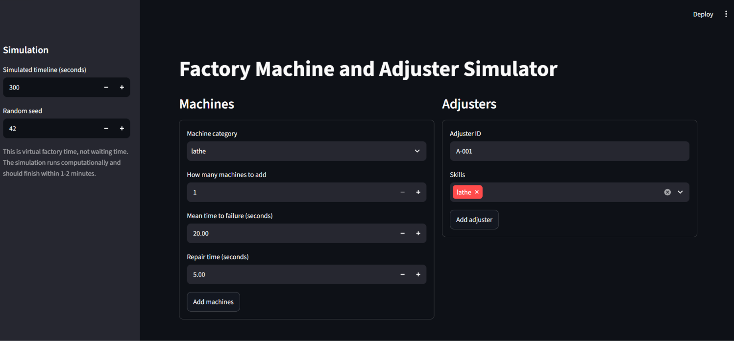
Introduction
What is Factory Adjuster Simulation?
A discrete-event simulation for factory machines that fail and are repaired by a pool of multi-skilled adjusters.
It processes failure and repair-completion events on a virtual timeline and reports machine uptime and adjuster busy time.
The Streamlit dashboard calls a FastAPI service; it currently invokes /simulate, and /experiment is available through the API.
It supports scenario evaluation and staffing comparisons; it is not a live factory control system.
The service can persist simulation runs in MongoDB (best-effort).
Actors: Factory analyst/operator · Streamlit dashboard · FastAPI service · MongoDB
Factory Adjuster Simulation | 4
Notes:
Machines break, adjusters fix them, and the simulator estimates utilization, waiting and downtime without touching a real factory.

Slide 5
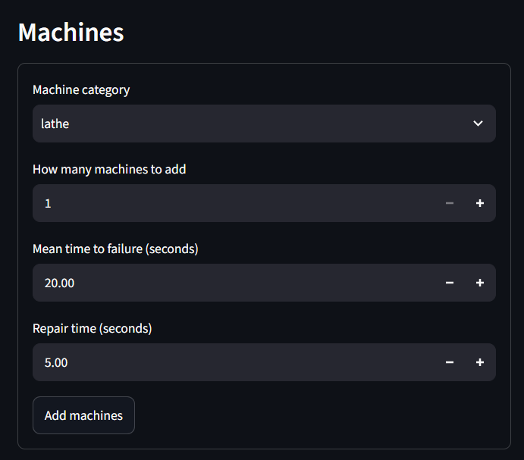
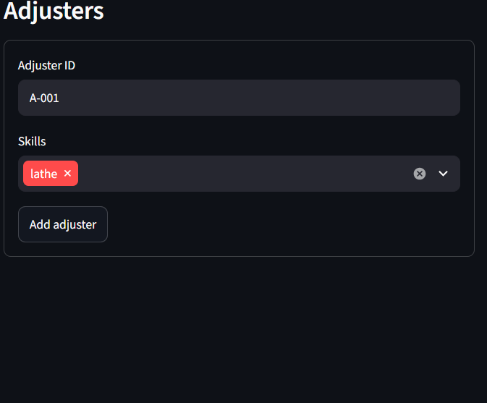
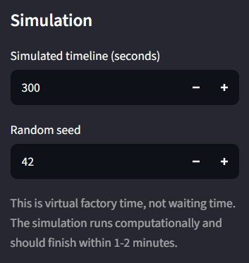
User Activities: Configuration
[ Insert screenshot ]
Machine group form
[ Insert screenshot ]
Adjuster form
[ Insert screenshot ]
Duration and seed inputs
then
then
Add machine groups
Add adjusters and skills
Set duration and seed
Factory Adjuster Simulation | 5
Notes:
The dashboard blocks running when no machine groups exist and checks unique adjuster IDs.

Slide 6
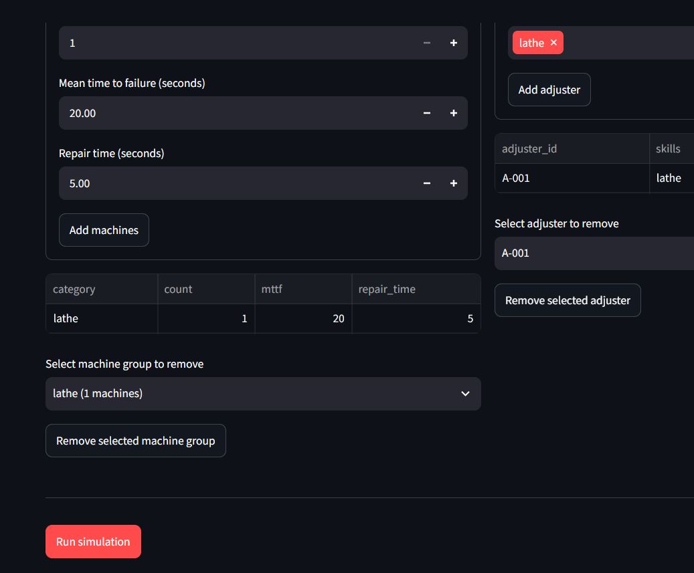
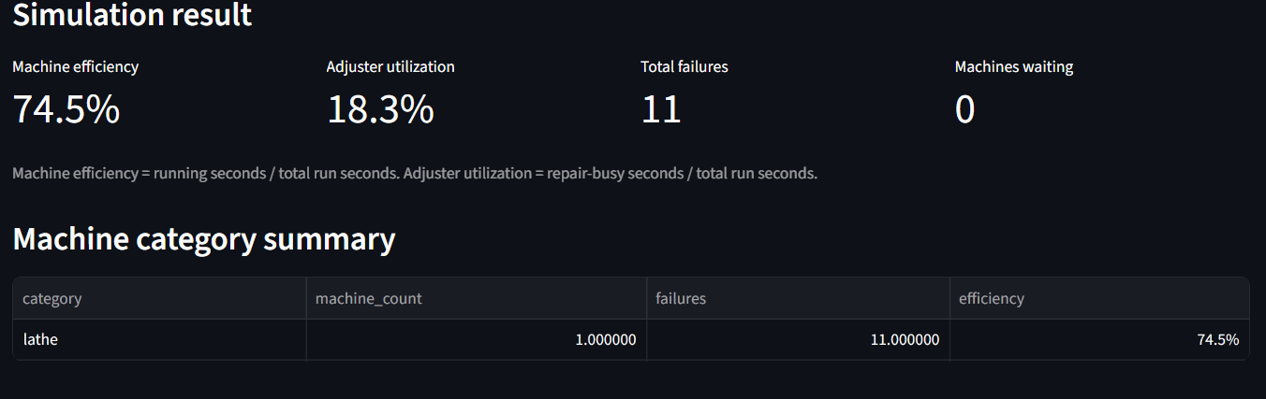
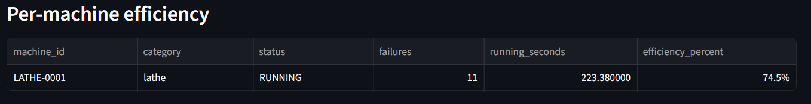
User Activities: Running a Simulation
View aggregate and category metrics
[ Insert screenshot ]
Run button
POST /simulate
Run simulation
results
Replace each box with a screenshot from the running app.
View per-machine results
Factory Adjuster Simulation | 6
Notes:
The dashboard calls /simulate and displays the returned metrics.

Slide 7
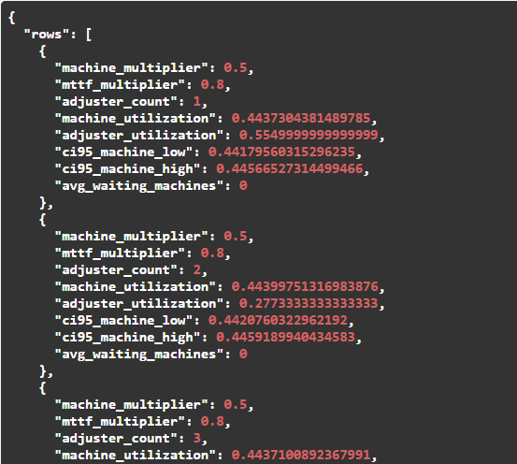
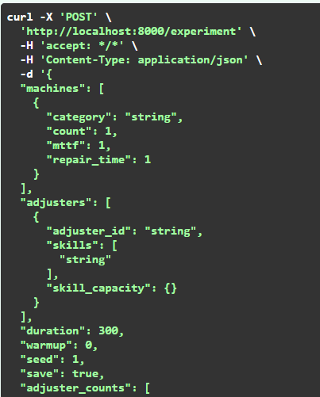
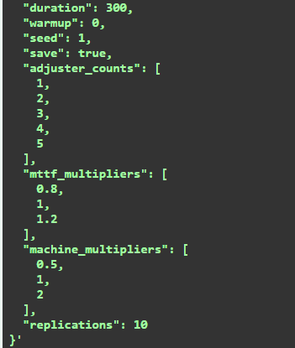
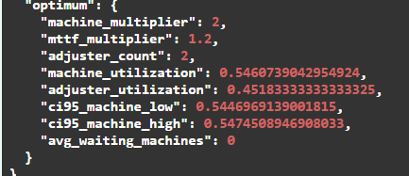
User Activities: Experiments via API
[ Insert screenshot ]
API request to /experiment
request
rows
Compare factor combinations
Call POST /experiment
Read the optimum
Factory Adjuster Simulation | 7
Notes:
Experiments are available through the API only; the dashboard does not expose them yet.

Slide 8
Major Modules
1 Machine groups
2 Adjusters
3 Simulation engine
Category, count, MTTF and fixed repair time.
ID and one or more machine-category skills.
Failure and repair events, Gaussian failure intervals, least-skilled dispatch.
Input · POST /simulate
Input · POST /simulate
Core · Simulator
4 Results and metrics
5 Experiments
6 Service, UI and storage
Utilization, failures, waiting machines/queue length, downtime, efficiency.
Machine-count and MTTF multipliers, adjuster count, replications, optimum.
FastAPI validation, Streamlit dashboard, MongoDB best-effort save.
Output · dashboard
API only · POST /experiment
GET /health · UI · DB
Modules are connected through the FastAPI service; saved runs go to the simulation_runs collection.
Factory Adjuster Simulation | 8
Notes:
Six modules connected through the API; events are ordered by time with a sequence number for ties.

Slide 9
API Documentation
Method | Endpoint | Input | Purpose and output
GET | /health | None | Service availability check
POST | /simulate | Machine groups, adjusters, duration, warm-up, seed, save | Validates and simulates; returns overall and per-category machine utilization, adjuster utilization, counts, failures, waiting machines/queue length, downtime, per-machine status/efficiency; database_warning if saving fails; 4xx on invalid input
POST | /experiment | Machine-count and MTTF multipliers, adjuster counts, replications | Row summaries with uncertainty; optimum = lowest adjuster count meeting fixed utilization/waiting thresholds, else highest machine utilization
Request and response schemas are defined in the FastAPI service; Pydantic validates positive machine count, MTTF and repair time. The dashboard currently calls /simulate only.
Factory Adjuster Simulation | 9
Notes:
Three endpoints. /simulate runs one scenario; /experiment runs factor combinations.

Slide 10
Tech Stack and Architecture
Streamlit UI
FastAPI
Simulator
MongoDB
Dashboard
Validation, orchestration
Event-driven core
Saved runs
Streamlit dashboard calls FastAPI over HTTP JSON; saving to MongoDB is best-effort.
Layer | Technology | Used for
Frontend | Streamlit dashboard | Collects scenario data and presents the returned metrics
Service | FastAPI | Validates requests, runs simulation/experiments, returns JSON results
Simulation | Simulator (seeded) | Failure and repair-completion events on a virtual timeline
Database | MongoDB | Stores saved run input and output (simulation_runs)
Client | HTTP JSON | Dashboard-to-API calls
Example categories:
lathe
turning
drilling
soldering
etc.
Factory Adjuster Simulation | 10
Notes:
UI, API, simulation core and persistence are separate modules.

Slide 11
SRS: Functional Requirements
Scenario and simulation
Results and service
FR-1 Scenario setup (implemented with UI guard): The system shall accept machine groups with category, positive machine count, positive MTTF, and positive fixed repair time through /simulate. The dashboard disables running when machine groups are absent; the API itself does not currently reject an empty machine list.
FR-2 Adjuster setup: The system shall accept adjusters with one or more machine-category skills. The API requires each adjuster to have a skill; unique IDs are checked by the UI only and should also be validated by the API.
FR-3 Timeline and reproducibility: The system shall accept a positive simulation duration, warm-up period shorter than duration, and random seed. Identical valid inputs and seed should reproduce the same sampled run, subject to implementation/runtime consistency.
FR-4 Failure scheduling: The simulation shall schedule each machine’s first failure and subsequent failures from positive Gaussian intervals centered on that machine’s MTTF.
FR-5 Failure handling: On failure, the machine shall stop accumulating running time and become assigned for repair if a compatible idle adjuster exists; otherwise it shall wait.
FR-6 Dispatch: The system shall dispatch waiting compatible machines to idle skilled adjusters. Selection shall favor the adjuster with the fewest skills, then adjuster ID. Compatible waiting work shall be considered in waiting order.
FR-7 Repair completion: On repair completion, the adjuster shall become idle, the machine shall resume operation, and a new failure shall be scheduled.
FR-8 Results: /simulate shall return overall and per-category machine utilization, adjuster utilization, counts, failures, waiting machines/queue length, downtime, and per-machine status/efficiency.
FR-9 Persistence: When save=true, the service shall attempt to save input and results in MongoDB. A persistence failure shall not discard the computed result and shall be reported as a warning.
FR-10 Experiments: /experiment shall evaluate the requested combinations of machine-count multiplier, MTTF multiplier, and adjuster count, summarize repeated runs, and report an optimum using configured selection criteria.
FR-11 Dashboard: The UI shall let a user add/remove machine groups and adjusters, set simulation duration and seed, run a simulation, and view aggregate/category/machine metrics.
FR-12 Validation (partial): The API rejects warm-up greater than or equal to duration, an empty adjuster list, and adjusters without skills. Pydantic validates positive machine count, MTTF, and repair time. Empty machine lists, duplicate IDs, and category/skill mismatches are not currently rejected by the API.
Factory Adjuster Simulation | 11
Notes:
Numbering follows the specification document.

Slide 12
SRS: Non-Functional Requirements
NFR-1 Performance
NFR-2 Reproducibility
Simulation time shall depend on the number of events and scenario size rather than waiting for virtual time to pass; the timeline is simulated computationally.
A seed shall initialize the pseudo-random generator for repeatable experiments.
NFR-3 Separation of concerns
NFR-4 Data protection
UI, API validation/orchestration, simulation logic, and persistence shall remain separate modules.
Database credentials shall be supplied through environment configuration and excluded from version control.
NFR-5 Interpretability
Returned measures shall define their observation interval and denominator; experiment outputs shall retain scenario factors and uncertainty summaries.
Factory Adjuster Simulation | 12
Notes:
Follows the specification document.

Slide 13
UML: Use Case Diagram
Factory simulation system
Configure machine groups
Streamlit dashboard
Configure adjusters and skills
Factory analyst / operator
Run simulation
Review utilization and failures
Factory simulation API
Compare staffing experiments
MongoDB
Persist run
How to read: Ovals are actions inside the system; boxes on the right are supporting systems. Experiments are called through the API only.
Factory Adjuster Simulation | 13
Notes:
One actor. Comparing experiments goes through the API, not the dashboard.

Slide 14
Class Diagram
MachineConfig
Scenario
AdjusterConfig
+category: str
+count: int
+mttf: float
+repair_min: float
+repair_max: float
1..*
1
+machine_configs: List[MachineConfig]
+adjusters: List[AdjusterConfig]
+duration: float
+warmup: float
+seed: int
1
1..*
+adjuster_id: str
+skills: List[str]
+skill_capacity: dict
consumes
Machine
Simulator
Adjuster
+machine_id: str
+category: str
+mttf: float
+status: str
+running_since: float
+running_time: float
+failures: int
creates
+run_simulation(scenario) dict
+run_replications(scenario, replications) dict
creates
+adjuster_id: str
+skills: set
+status: str
+busy_time: float
calls
StreamlitDashboard
FastAPIService
MongoPersistence
+configure_scenario()
+run_simulation()
+display_results()
HTTP
JSON
+health() dict
+simulate(payload) dict
+experiment(payload) dict
optionally
saves
+get_database()
+save_run(result, scenario)
Classes follow the specification document.
Factory Adjuster Simulation | 14
Notes:
Scenario contains machine and adjuster configs; the simulator creates machines and adjusters; the service calls the simulator and optionally saves.

Slide 15
UML: Activity Diagram, Simulation Run
Start
Configure machine groups, adjusters, duration, seed
Submit scenario
Request valid?
Yes
Build machines, adjusters, failure
Next event within
duration?
No
Compute utilization, failures, waiting, downtime
No
Yes
Return validation error
Stop machine running interval; increment failures
Failure
Event type
Repair
complete
End repair; free adjuster; resume machine
Save requested?
No
Yes
End
Compatible idle
adjuster?
No
Schedule next failure
Attempt MongoDB persistence
Yes
Select least-skilled eligible adjuster; begin repair
Mark machine WAITING; enqueue
Dispatch compatible waiting work
Attach persistence warning if save fails
Return results
Factory Adjuster Simulation | 15
Notes:
Full /simulate flow: validation, event loop, failure and repair handling, then results and optional save.

Slide 16
UML: Edge Case, Machine Fails, No Adjuster
Idle adjuster with required skill?
Machine is RUNNING
Failure event occurs
Close running interval; increment failures
No
Set machine WAITING
Compatible adjuster becomes IDLE?
Schedule repair completion
Assign: machine REPAIR, adjuster BUSY
Choose earliest compatible waiting machine
Yes
Append to waiting list
No
Remain waiting; uptime does not accrue
How to read: No means all adjusters are busy or none has the required skill. A waiting machine earns no uptime until it is repaired.
Factory Adjuster Simulation | 16

Slide 17
UML: State Chart Diagrams
Machine
initial failure event
scheduled
FAILURE event /
stop uptime, increment count
no compatible idle
adjuster
simulation horizon
simulation horizon
RUNNING
FAILED
WAITING
compatible idle
adjuster selected
REPAIR_DONE /
release adjuster, schedule next failure
compatible adjuster becomes
idle / dispatch
REPAIR
simulation horizon
Adjuster
assigned compatible failed machine
IDLE
BUSY
simulation horizon
simulation horizon
repair completes
How to read: FAILED is transient: it lasts only while the system chooses between repair and waiting. At the simulation horizon any state ends the run.
Factory Adjuster Simulation | 17
Notes:
State charts for the machine and adjuster lifecycles from the specification.

Slide 18
UML: Sequence Diagram, Simulation Execution
Analyst
Streamlit UI
FastAPI
Simulator
MongoDB
Configure machines, adjusters, duration, seed
Run simulation
POST /simulate (scenario, save=true)
Validate payload and warm-up
run_simulation(Scenario)
Generate entities and FAILURE events
loop [Each event within duration]
Process failure / repair completion / dispatch
Calculate utilization and waiting metrics
Result object
opt [Save requested]
Insert scenario and result
alt [Persistence succeeds]
Insert acknowledgment
[Persistence fails]
Error
Add database_warning
JSON results
Show utilization, failures, waiters, details
How to read: A save failure does not discard the computed result; it adds database_warning.
Factory Adjuster Simulation | 18
Notes:
Follows the specification sequence diagram.

Slide 19
UML: Sequence Diagram, Experiment (API)
Analyst (API client)
FastAPI
Simulator
POST /experiment (machine-count, MTTF, adjuster-count factors)
Build factor combinations
Run seeded replications per row
Row summaries
Select optimum: lowest adjuster count meeting thresholds, else highest machine utilization
Rows and optimum
How to read: Experiments are available through the API only; the dashboard does not expose them yet.
Factory Adjuster Simulation | 19
Notes:
Experiment flow through the API.

Slide 20
UML: Sequence Diagram, Failure and Repair
Event queue
Simulator
Waiting list
Machine
Adjuster
FAILURE(machine, time)
Stop uptime; mark FAILED; count failure
Find idle adjusters with the required skill
alt [compatible idle adjuster]
Choose fewest skills; ID breaks ties
Machine REPAIR; adjuster BUSY
Schedule REPAIR_DONE
else [none available]
Mark machine WAITING
Append to waiting list
On any REPAIR_DONE
Finish repair; credit busy time; set IDLE
Resume; schedule next Gaussian failure
Dispatch scans the waiting list in order and assigns the first compatible machine.
Factory Adjuster Simulation | 20
Notes:
Normal flow from the specification.

Slide 21
DFD Level 0: Context Diagram
0
Factory Adjuster
Simulation
Analyst
Machine groups, adjusters, duration, seed
Experiment factors (API)
Run input, output
MongoDB
Results and metrics
Ack / error
Validation error
database_warning
How to read: Boxes are external parties, the circle is the whole system, arrows are data. Level 1 opens the circle.
Factory Adjuster Simulation | 21
Notes:
Derived from the specification. Only data crossing the boundary is shown.

Slide 22
DFD Level 1: Main Processes
1.0 Validate and build scenario
D1 Scenario
2.0 Simulate events and dispatch
Analyst
D2 Simulation state
3.0 Compute metrics, save run
D3 simulation_runs (MongoDB)
4.0 Run experiments (API)
How to read: 1.0 validates · 2.0 runs failures, queue, repairs · 3.0 metrics and best-effort save · 4.0 factor combinations and optimum. Stores are indicative.
Factory Adjuster Simulation | 22
Notes:
Derived from the specification: four processes and three stores.

Slide 23
DFD Level 2: Process 2.0 (Simulation)
D1 Scenario
2.1 Schedule failure (positive Gaussian interval)
2.2 Close running interval; increment failures
2.3 Select least-skilled eligible adjuster; else mark WAITING
next event
2.6 Dispatch compatible waiting work
2.5 End repair; free adjuster; resume machine; schedule next failure
2.4 Repair for fixed repair time
D2 Simulation state
How to read: Top row left to right, down, then bottom row right to left; the loop returns to the next event.
Factory Adjuster Simulation | 23
Notes:
Process 2.0 opened into six sub-processes.

Slide 24
DFD Level 2: Process 4.0 (Experiment)
D1 Scenario
4.1 Build factor combinations
4.2 Apply machine-count and MTTF multipliers
4.3 Run seeded replications
4.6 Select lowest adjuster count (else highest machine utilization)
4.5 Check fixed utilization/waiting thresholds
4.4 Summarize repeated runs with uncertainty
Row summaries and selected optimum
How to read: Top row builds and runs the grid; bottom row summarizes, checks thresholds and selects the optimum.
Factory Adjuster Simulation | 24
Notes:
Process 4.0 opened into six sub-processes.

Slide 25
Test Cases
Simulation behavior
# | Scenario | Expected result
1 | Valid request with a fixed seed | Deterministic metrics for a fixed seed
2 | Failure with a compatible idle adjuster | Starts repair immediately
3 | Failure without a compatible idle adjuster | Machine enters the wait list
4 | Repair completion | Adjuster idle, machine resumes, next failure scheduled
5 | Invalid warm-up or missing skills | Clear client error (HTTP 4xx)
API, UI and persistence
Layer | Scenario | Expected result
API | Database outage during save | Preserves the computed simulation result and includes a warning
API | POST /experiment | Each factor combination, confidence bounds and optimum
UI | Run with no machine groups | Run button disabled
UI | Duplicate adjuster ID | Blocked by the UI check
Factory Adjuster Simulation | 25
Notes:
Scenarios follow the acceptance criteria in the specification. No measured results are claimed.

Slide 26
Current Limitations and Future Scope
Horizon accounting
Warm-up
Appears to omit running and busy time for intervals still in progress at the horizon. Next: close each running interval at duration; credit in-progress repair/busy intervals only through duration.
Not applied consistently to newly started intervals. Next: clip every measured interval to [warmup, duration].
Dispatch model
skill_capacity
Separate waiting list and adjuster status; single-queue invariant not implemented literally. Next: document the compatible FIFO policy or match the single-queue rule.
Accepted and persisted but has no effect on assignment. Next: define it (concurrent jobs or proficiency) and implement it, or remove it.
UI coverage
API validation
Experiment configuration is available through the API but not exposed in the UI. Next: expose warm-up, replications, experiment factors and thresholds.
Empty machine lists, duplicate IDs and category/skill mismatches are not rejected. Next: validate categories, IDs and experiment bounds.
Also planned: configurable experiment thresholds with a distinct “no feasible staffing level” result, automated tests, and clearer metrics terminology.
Factory Adjuster Simulation | 26
Notes:
Limitations come from the specification. Precision-sensitive staffing decisions need the horizon fix first.

Slide 27
Thank You
Questions?
Notes:
Summarize in three sentences and invite questions.

