Slide 1
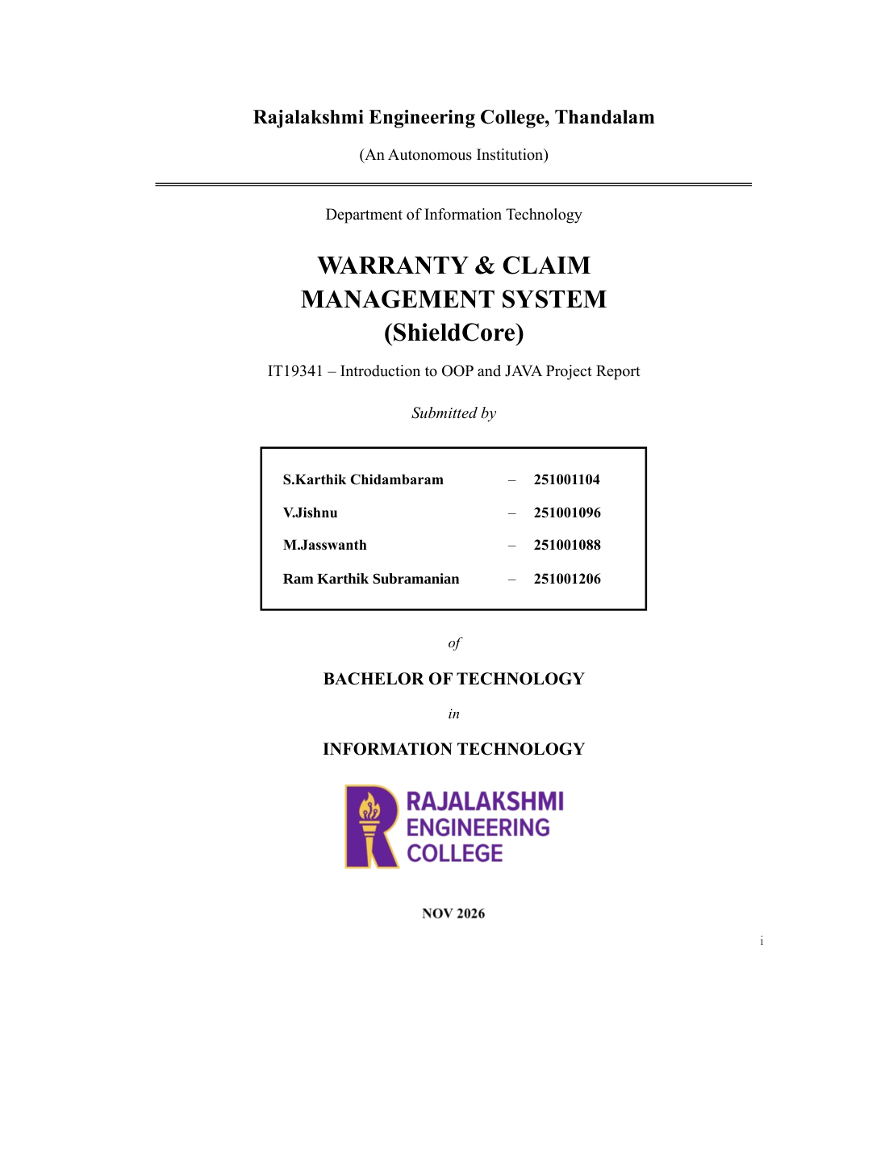
STUDENT SKILL & INTERNSHIP
SHARING PLATFORM
Java and DBMS Mini Project Report
Abrami.G
Akshaya.G
Akshaya.S
Dhanya.B

Slide 2
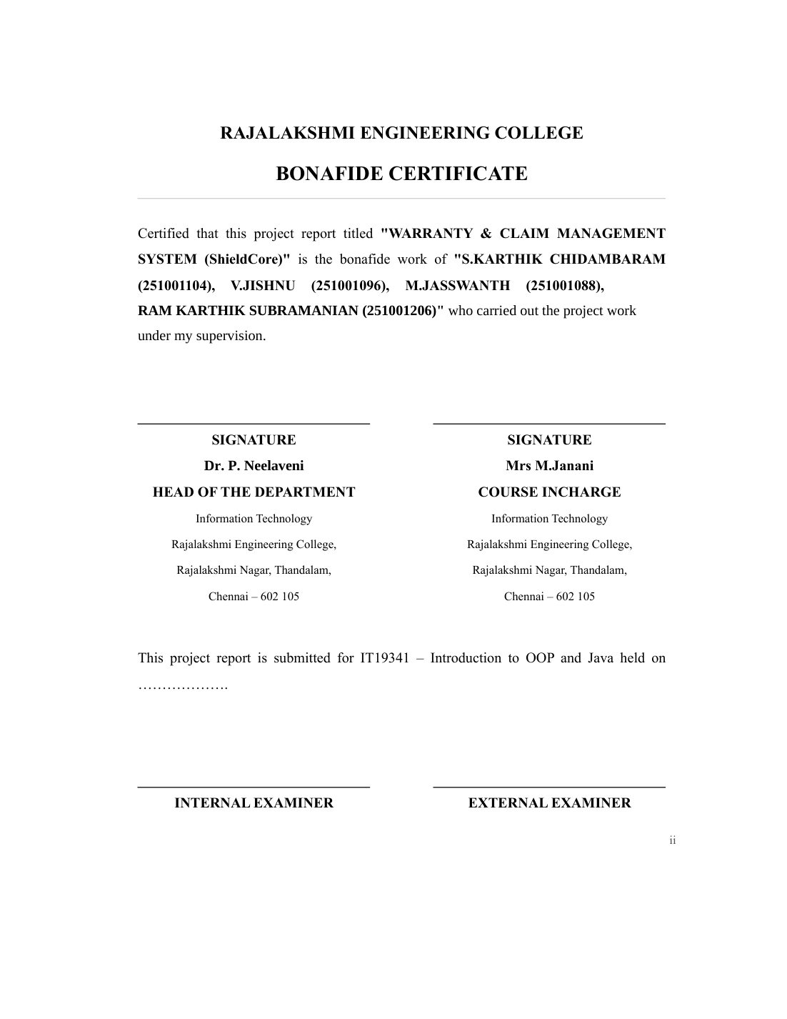
Certified that this project report titled “STUDENT SKILL & INTERNSHIP SHARING
PLATFORM” is the bonafide work of “ABRAMI.G, AKSHAYA.G, AKSHAYA.S,
DHANYA.B” who carried out the project work under my supervision.

Slide 3
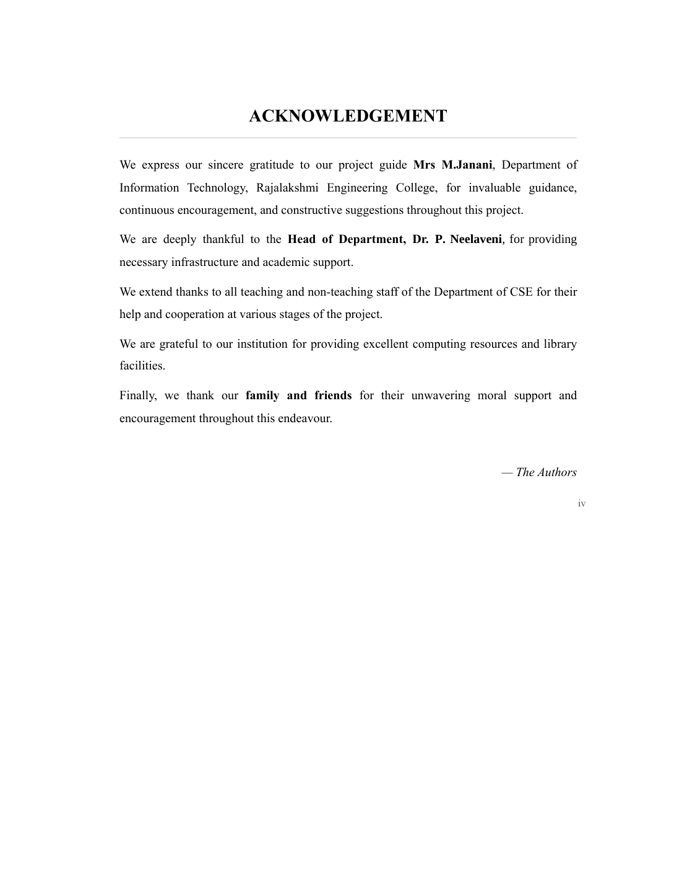

Slide 4
CODE QUEST | STUDENT SKILL & INTERNSHIP SHARING PLATFORM
Project Overview
What the platform does
• Brings student skills, peer skill discovery and internship opportunities into one place.
• Lets students maintain profiles, share skills, apply and track applications.
Technology split
• Frontend: Java Swing desktop interface.
• Backend: MySQL relational DBMS.
• Connectivity: JDBC connects Java screens to MySQL.
Presentation coverage
• System workflow and Java modules.
• Database design, relationships, SQL tables and sample queries.
• Testing, benefits and future enhancements.
CODE QUEST • JAVA FRONTEND + MYSQL DBMS BACKEND 04

Slide 5
CODE QUEST | STUDENT SKILL & INTERNSHIP SHARING PLATFORM
Abstract
The Student Skill & Internship Sharing Platform is a desktop application that helps students showcase their skills, discover other students with similar or complementary skills, and find and share internship opportunities. Students can register, add skills with proficiency levels, search for peers by skill, view internships matching their skills, apply and track application status.
Core technologies
• Java Swing builds the graphical user interface.
• MySQL stores application records in relational tables.
• JDBC sends SQL commands and returns database results.
Main outcome
• A centralized, database-driven platform for skills and internships.
CODE QUEST • JAVA FRONTEND + MYSQL DBMS BACKEND 05

Slide 6
CODE QUEST | STUDENT SKILL & INTERNSHIP SHARING PLATFORM
Problem Statement & Objectives
Problem
• Internship information is scattered across notice boards, social media and word of mouth.
• Students lack a common place to showcase skills and find peers with specific abilities.
• Applications can be difficult to organize and track.
Objectives
• Provide one platform to share student skills and internship details.
• Store information consistently in a DBMS backend.
• Provide an easy-to-use Java graphical interface.
• Match students with internships based on their skills.
• Track applications and prevent duplicate applications using constraints.
CODE QUEST • JAVA FRONTEND + MYSQL DBMS BACKEND 06

Slide 7
CODE QUEST | STUDENT SKILL & INTERNSHIP SHARING PLATFORM
Scope & Key Features
Student accounts
My Skills
Registration and login with student details.
Add, update and remove skills with Beginner, Intermediate or Advanced levels.
Skill Sharing
Internships
Search for students by skill and view relevant profile details.
Browse open opportunities and filter by matching skills.
Share Internship
Applications
Post company, skill, duration, stipend and last-date details.
Apply, view status and withdraw applications still marked Applied.
CODE QUEST • JAVA FRONTEND + MYSQL DBMS BACKEND 07

Slide 8
CODE QUEST | STUDENT SKILL & INTERNSHIP SHARING PLATFORM
System Requirements
Software
• Frontend: Java JDK 11 or above with Swing.
• Backend: MySQL 8.0 DBMS.
• Connectivity: JDBC – MySQL Connector/J.
• IDE: NetBeans, Eclipse, IntelliJ or VS Code.
Hardware
• Intel i3 processor or above.
• 4 GB RAM and approximately 500 MB free disk space.
Operating system
• Windows 10/11, Linux or macOS.
CODE QUEST • JAVA FRONTEND + MYSQL DBMS BACKEND 08

Slide 9
CODE QUEST | STUDENT SKILL & INTERNSHIP SHARING PLATFORM
System Architecture & Data Flow
USER • STUDENT
↓
FRONTEND • JAVA SWING
Login | My Skills | Skill Sharing | Internships | Applications
↓
JDBC CONNECTIVITY • DBConnection.java
↓
BACKEND • MYSQL DBMS
students | skills | student_skills | companies | internships | applications
Flow: User input → Java validation → JDBC PreparedStatement → MySQL processing → ResultSet / confirmation shown in the GUI.
CODE QUEST • JAVA FRONTEND + MYSQL DBMS BACKEND 09

Slide 10
CODE QUEST | STUDENT SKILL & INTERNSHIP SHARING PLATFORM
Module Description
1. Login / Registration
Creates student accounts and authenticates users (students table).
2. My Skills
Adds, updates and removes skills and proficiency levels (skills, student_skills).
3. Skill Sharing
Finds students with a selected skill and displays profile details.
4. Internship
Lists open internships and filters opportunities by matching skills.
5. Share Internship
Allows students to post opportunities and company details.
6. Application Tracking
Displays status and allows withdrawal while status is Applied.
CODE QUEST • JAVA FRONTEND + MYSQL DBMS BACKEND 10

Slide 11
CODE QUEST | STUDENT SKILL & INTERNSHIP SHARING PLATFORM
Database Design – MySQL Backend
Database name: skill_internship_db
TABLE | PRIMARY KEY | PURPOSE
students | student_id | Student details and login
skills | skill_id | Master list of skills
student_skills | student_id + skill_id | Skills held by each student
companies | company_id | Companies offering internships
internships | internship_id | Internship postings
applications | application_id | Applications and status
Normalization: The database design follows Third Normal Form (3NF). Junction tables remove repeating groups and keep relationships consistent.
CODE QUEST • JAVA FRONTEND + MYSQL DBMS BACKEND 11

Slide 12
CODE QUEST | STUDENT SKILL & INTERNSHIP SHARING PLATFORM
ER Relationships & Integrity
STUDENTS 1 ───< STUDENT_SKILLS >─── 1 SKILLS
COMPANIES 1 ───< INTERNSHIPS >─── 1 SKILLS
STUDENTS 1 ───< APPLICATIONS >─── 1 INTERNSHIPS
Integrity constraints
• PRIMARY KEY uniquely identifies each row.
• FOREIGN KEY maintains valid relationships.
• NOT NULL ensures required values are entered.
• UNIQUE prevents duplicate email addresses and repeated applications.
• ENUM limits proficiency and application status to allowed values.
CODE QUEST • JAVA FRONTEND + MYSQL DBMS BACKEND 12

Slide 13
CODE QUEST | STUDENT SKILL & INTERNSHIP SHARING PLATFORM
SQL Script – Database & Core Tables
CREATE DATABASE IF NOT EXISTS skill_internship_db;
USE skill_internship_db;
CREATE TABLE students (
student_id INT AUTO_INCREMENT PRIMARY KEY,
name VARCHAR(60) NOT NULL,
email VARCHAR(80) NOT NULL UNIQUE,
password VARCHAR(80) NOT NULL,
department VARCHAR(50),
year_of_study INT,
phone VARCHAR(15)
);
CREATE TABLE skills (
skill_id INT AUTO_INCREMENT PRIMARY KEY,
skill_name VARCHAR(50) NOT NULL UNIQUE,
category VARCHAR(40)
);
CODE QUEST • JAVA FRONTEND + MYSQL DBMS BACKEND 13

Slide 14
CODE QUEST | STUDENT SKILL & INTERNSHIP SHARING PLATFORM
SQL Script – Relationships & Internship Tables
CREATE TABLE student_skills (
student_id INT NOT NULL,
skill_id INT NOT NULL,
level ENUM('Beginner','Intermediate','Advanced')
DEFAULT 'Beginner',
PRIMARY KEY (student_id, skill_id),
FOREIGN KEY (student_id)
REFERENCES students(student_id) ON DELETE CASCADE,
FOREIGN KEY (skill_id)
REFERENCES skills(skill_id) ON DELETE CASCADE
);
CREATE TABLE companies (
company_id INT AUTO_INCREMENT PRIMARY KEY,
company_name VARCHAR(80) NOT NULL UNIQUE,
location VARCHAR(60)
);
CREATE TABLE internships (
internship_id INT AUTO_INCREMENT PRIMARY KEY,
company_id INT NOT NULL,
title VARCHAR(80) NOT NULL,
description VARCHAR(255),
required_skill_id INT NOT NULL,
duration_months INT,
stipend DECIMAL(10,2) DEFAULT 0,
last_date DATE,
FOREIGN KEY (company_id) REFERENCES companies(company_id),
FOREIGN KEY (required_skill_id) REFERENCES skills(skill_id)
);
CODE QUEST • JAVA FRONTEND + MYSQL DBMS BACKEND 14

Slide 15
CODE QUEST | STUDENT SKILL & INTERNSHIP SHARING PLATFORM
SQL Script – Applications Table
CREATE TABLE applications (
application_id INT AUTO_INCREMENT PRIMARY KEY,
student_id INT NOT NULL,
internship_id INT NOT NULL,
applied_on TIMESTAMP DEFAULT CURRENT_TIMESTAMP,
status ENUM('Applied','Shortlisted','Selected','Rejected')
DEFAULT 'Applied',
FOREIGN KEY (student_id)
REFERENCES students(student_id) ON DELETE CASCADE,
FOREIGN KEY (internship_id)
REFERENCES internships(internship_id) ON DELETE CASCADE,
UNIQUE (student_id, internship_id)
);
Why this design?
• The composite UNIQUE rule blocks duplicate applications by the same student.
• Foreign keys keep student and internship references valid.
CODE QUEST • JAVA FRONTEND + MYSQL DBMS BACKEND 15

Slide 16
CODE QUEST | STUDENT SKILL & INTERNSHIP SHARING PLATFORM
Sample SQL Queries
Find students with a selected skill
SELECT s.name, s.department, sk.skill_name
FROM students s
JOIN student_skills ss ON s.student_id=ss.student_id
JOIN skills sk ON sk.skill_id=ss.skill_id
WHERE sk.skill_name='Java';
List internships with company names
SELECT i.title, c.company_name, i.stipend, i.last_date
FROM internships i
JOIN companies c ON i.company_id=c.company_id;
Show a student's applications
SELECT a.application_id, i.title, a.status
FROM applications a
JOIN internships i ON a.internship_id=i.internship_id
WHERE a.student_id=?;
CODE QUEST • JAVA FRONTEND + MYSQL DBMS BACKEND 16

Slide 17
CODE QUEST | STUDENT SKILL & INTERNSHIP SHARING PLATFORM
Java Frontend & JDBC Connectivity
Java Swing interface
• LoginFrame and RegisterFrame manage user access.
• DashboardFrame provides navigation to skills, internships and applications.
• JTable displays database records in structured form.
JDBC database operations
• DBConnection.java opens a MySQL connection.
• PreparedStatement executes parameterized SQL safely.
• ResultSet reads query results for display in the interface.
Connection example:
Connection c = DriverManager.getConnection(DB_URL, USER, PASS);
CODE QUEST • JAVA FRONTEND + MYSQL DBMS BACKEND 17

Slide 18
CODE QUEST | STUDENT SKILL & INTERNSHIP SHARING PLATFORM
Implementation & Execution Steps
1
Create the database and tables by running the SQL script in MySQL.
2
Add MySQL Connector/J to the Java project libraries.
3
Configure database URL, username and password in DBConnection.java.
4
Compile the Java source files and run Main.java.
5
Register or log in, add skills, browse internships and apply.
6
Verify records and application status in MySQL.
CODE QUEST • JAVA FRONTEND + MYSQL DBMS BACKEND 18

Slide 19
CODE QUEST | STUDENT SKILL & INTERNSHIP SHARING PLATFORM
Testing & Validation
TEST | EXPECTED RESULT
Valid login | Dashboard opens
Invalid login | Error message is displayed
Duplicate registration | Existing email is rejected
Add / update skill | Skill appears with correct level
Search by skill | Matching students are listed
Apply for internship | Application saved as Applied
Duplicate application | Duplicate is blocked by UNIQUE constraint
Withdraw application | Only Applied status can be withdrawn
CODE QUEST • JAVA FRONTEND + MYSQL DBMS BACKEND 19

Slide 20
CODE QUEST | STUDENT SKILL & INTERNSHIP SHARING PLATFORM
Advantages & Future Enhancements
Advantages
• Centralized storage for skills and internship information.
• Primary keys, foreign keys and unique constraints protect data integrity.
• Skill-based matching helps students find relevant opportunities.
• PreparedStatement supports safer database operations.
Future enhancements
• Use secure password hashing and role-based Admin / Company accounts.
• Add resume uploads and email or SMS notifications.
• Include internship ratings and reviews.
• Extend the platform to web or mobile while retaining the database.
CODE QUEST • JAVA FRONTEND + MYSQL DBMS BACKEND 20

Slide 21
CODE QUEST | STUDENT SKILL & INTERNSHIP SHARING PLATFORM
Conclusion
The Student Skill & Internship Sharing Platform demonstrates how a Java Swing frontend can work with a MySQL DBMS backend through JDBC. It provides a common place to manage student skills, discover internships, submit applications and track their status.
Key concepts demonstrated
• Java Swing GUI and object-oriented programming.
• JDBC connectivity and PreparedStatement.
• Relational database design, 3NF, keys and constraints.
• SQL joins, filtering and application tracking.
THANK YOU
CODE QUEST • JAVA FRONTEND + MYSQL DBMS BACKEND 21

