Slide 1
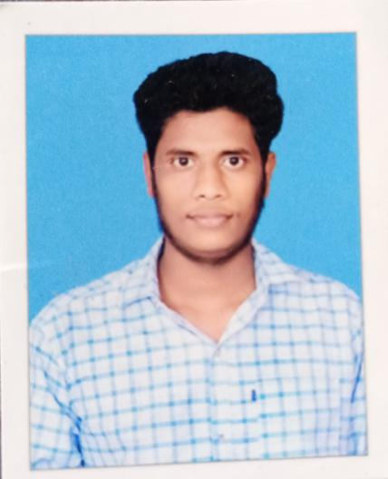
VADDADI DHANYALA PRASANNA KUMAR
Who am I:
Bachelor of Technology in Electrical And Electronics Engineering (EEE)
Enthusiastic about technology and continuous learning
Effective written and verbal communicator
Additional Technical Skills
Programming Languages: Java, Python,sql
Databases: MySQL
Back-end Technologies: Spring / Spring Boot
Testing Frameworks: Junit, Sonar Qube
Tools: Eclipse / Spring tool suite, MySQL Workbench, PyCharm, Postman
HCL Projects
HCL Employee onboarding (Mock project):
To develop a Spring boot application with RESTful API’s for fetching the data between microservices and updating the data in database by handling the exceptions
Tools: MySQL Workbench ,Eclipse/sts, Postman
HCL Journey
Joined HCL as Graduate Engineer Trainee
Underwent 1 month Boot Camp Training on C language
Underwent technical training on java, spring boot
Underwent technical training on Python and Libraries(Numpy,Pandas)
Hands on Experience on Java, Python
Assessment Records
Java Hacker Rank assessment- 73%

