Slide 1

YOUTUBE ANALYSIS

Slide 2
Introduction
YouTube is one of the largest video-sharing platforms globally, with billions of users and vast content.
Understanding engagement drivers on YouTube, such as views, likes, and comments, is valuable for content creators, marketers, and researchers.
By using YouTube's APIs, we can collect extensive data on video performance.
This analysis aims to explore engagement metrics through data gathered from YouTube APIs.
The goal is to identify factors influencing video popularity.
Findings can help optimize content strategy and improve audience engagement on the platform.

Slide 3
To collect data from YouTube, you need to set up an API. Here are the steps you can follow:
Go to Google Cloud Console.
Click on the project drop-down at the top, then “New Project”.
Enter a project name and click “Create”.
In the Google Cloud Console, navigate to “APIs & Services” > “Library”.
Search for “YouTube Data API v3” and click on it.
Click “Enable”.
Go to “APIs & Services” > “Credentials”.
Click “+ CREATE CREDENTIALS” and select “API key”.
Copy the generated API key.

Slide 4
Methodology
Data Collection: Data was sourced using the YouTube Data API via Google Cloud Console.
Key metrics gathered: View count, like count, comment count, and video details.
Data Processing: Addressed missing values (e.g., "No description" for missing entries).
Converted date formats and processed tags for accurate analysis.
Tools Used: Pandas, Matplotlib, Seaborn (for visualization).
Google API Client Library for Python.

Slide 5
Analysis
Descriptive Statistics: Average view count: ~2.1 million; high variability (standard deviation: 4.36 million).
Average likes: ~59,400; average comments: ~3,185.
Distribution Analysis: Engagement metrics are highly skewed; only a few videos dominate with high views and likes.
Correlation Insights: Strong positive correlation between engagement metrics:
Likes and comments (0.87).
Views and likes (0.76).
Impact of Publish Time: Peak publishing hours (11 AM - 4 PM) noted, but content quality matters more for high views. Entertainment , People & Blogs, and Music categories have the highest number of trending videos

Slide 6
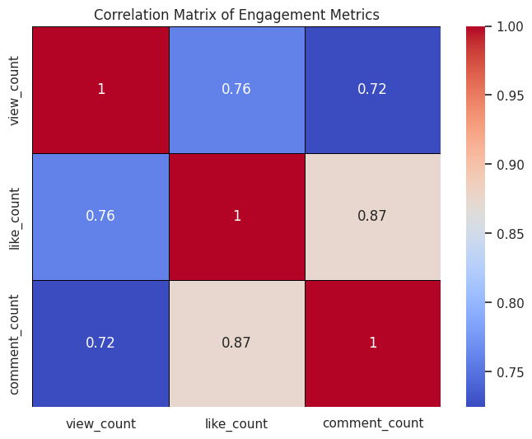

Slide 7
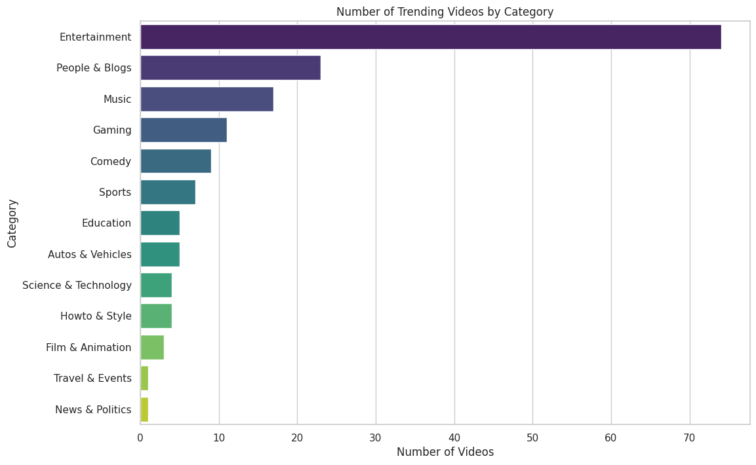

Slide 8
Result
Engagement Correlation: High view counts are linked to more likes and comments, with a strong relationship between likes and comments (0.87).
Skewed Distribution: metrics implies that content creators should aim to produce videos that capture a larger audience, as a few videos generate the bulk of the engagement.
Publish Time Impact : Popular videos are often posted between 11 AM and 4 PM, but content quality plays a larger role in view counts.
Boosting Engagement: Increasing likes may encourage more comments, supporting overall interaction growth.

Slide 9
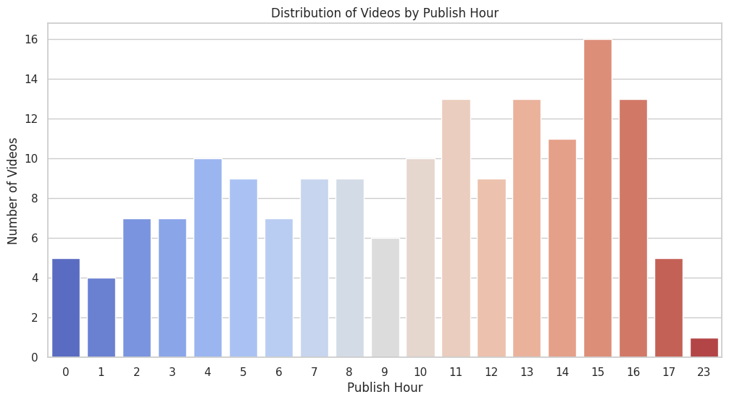

Slide 10
Conculsion & Future work
Encourage Engagement: Promoting likes and comments can significantly boost engagement metrics, as these interactions are strongly correlated with higher view counts.
Focus on Video Length: Creating longer videos (60 minutes) is linked with higher engagement, particularly in terms of views, likes, and comments.
Optimize Upload Timing: Uploading videos during peak hours (11 AM – 4 PM) can help maximize initial views and engagement, leveraging the high activity period of the platform.

Slide 11
THANK YOU

