Slide 1
Model-Driven Web Application Code Generation
A Comparative Study with Pure LLM Approaches
Software Requirements Analysis and Design
May 2026

Slide 2
Background & Problem Statement
The Challenge: LLMs can generate code from natural language, but face critical issues in practice:
Limitations of Pure LLM Generation
Structural Inconsistency — different structures across runs Import & Dependency Errors — non-compilable output Business Rule Violations — overlooked constraints Low Reproducibility — same prompt → different code
Our Hypothesis
Domain models provide deterministic structure LLMs excel at business logic completion Combining both → reliable, consistent code Feedback loops can automatically correct errors
Research Question: Can model-driven constraints significantly improve LLM-generated code quality?
2 / 10

Slide 3
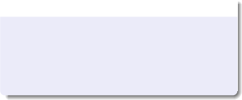
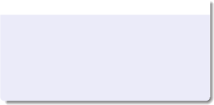

Method Overview: Two Approaches Compared
Model-Driven Method (Ours)
Pure LLM Method (Baseline)
LLM Direct Generation
YAML Domain Model
Model Parser → Pydantic IR
Jinja2 Skeleton Generator
LLM Business Logic Filler
Bidirectional Feedback Loop
Complete Web App
Natural Language Description
Application Code
errors
Single-stage generation No structural constraints
No feedback correction
3 / 10

Slide 4
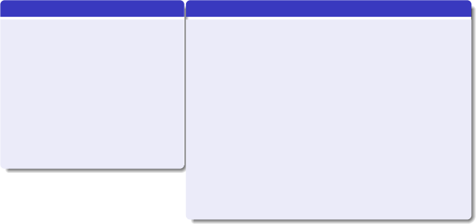
System Architecture & Tech Stack
Technology Stack Core Pipeline Components
LLM: DeepSeek V3
(OpenAI-compatible API)
Backend: FastAPI +
SQLAlchemy + SQLite
Frontend: React 18 + TypeScript + Vite + Tailwind CSS
Templates: Jinja2
IR: Pydantic
Testing: pytest (25 tests)
CI/CD: GitHub Actions
Parser: YAML → Pydantic IR (Entity, Attribute, Relationship, BusinessRule)
SQL Generator: IR → SQL DDL (CREATE TABLE with constraints)
API Generator: IR → FastAPI (models, routes, schemas, main)
UI Generator: IR → React (ListPage, FormPage, App, API client)
LLM Filler: DeepSeek fills # LLM FILL: markers in skeleton
Feedback Loop: py compile → import check → LLM fix
→ repeat
Evaluator: Structure + Compilability + Consistency scoring
4 / 10

Slide 5

Domain Model & Code Generation
YAML Domain Model
Case Study: Student Course Selection System
Scale Entities Rules Output Files
# Small: Student + Course + Enrollment (3 entities , 3 relationships , 2 business rules) name: student_course_system_small description: > A simple student course selection system . Students can browse available courses and enroll . The system tracks enrollment s and prevents over - capacity enrollment . entities: - name: Student attributes: - name: id type: integer primary_key: true - name: name type: string required: true max_length: 100 - name: email type: string required: true unique: true max_length: 200 relationships: - type: many_to_many target: Course through: Enrollment
Small | 3 | 2 5 backend + 8 frontend
Medium | 6 | 6 5 backend + 14 frontend
Large | 11 | 10 5 backend + 24 frontend
Generated Artifacts (per entity)
Backend: SQL DDL + ORM Model + Pydantic Schema
(Base/Create/Update/Response) + 5 CRUD Endpoints
Frontend: ListPage (search + table + delete) + FormPage (create/edit with validation) + API Client
LLM Fill Markers in Routes
r ₅ / ₁₀
@ router_3. post ("/", response_model=EnrollmentResponse)

Slide 6


Innovation: Bidirectional Feedback Mechanism
Algorithm Key Design Principles
¹ Targeted Fixing: Only error-causing files are sent to LLM
² Model Context: Error messages + domain model constraints
³ Minimal Changes: LLM instructed to make surgical fixes
⁴ Bounded Iterations: Max 3 rounds prevents infinite loops
⁵ Structural Integrity: Model constraints prevent architectural drift
def feedback_loop(model , code_dir , max_iter =3): for i in range(1, max_iter + 1): # 1 . Check code for errors file_errors = {} for f in code_dir . glob ("**/* . py"): r = subprocess. run ( [sys . executable , " -m", "py_compile", f], capture_output=True) if r . return code != 0: file_errors[f] = [r . stderr] # 2 . Import check r = subprocess. run ([sys. executable , "-c", f"sys . path . insert(0,’{code_dir}’);" "from main import app"], capture_output=True) if r . return code != 0: file_errors[" main. py "] = [r. stderr] # 3 . Success? if not file_errors: return FeedbackResult(i, pass=True) # 4 . Fix ONLY files with errors for file , errors in file_errors . items(): fixed = call_llm(fix_prompt . format( model_context=model , errors=errors , code=file. read_text ())) file . write_text(fixed) return FeedbackResult(max_iter , pass=False)
Why It Works — Comparison
 | Generic | Self- | Our Feedback
Debug 6 / 10

Slide 7
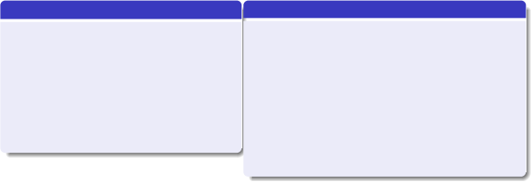

Experimental Setup
Experiment Design Evaluation Metrics
Factor 1: Method (Model-Driven vs. 1. Structure Score (0–1)
Pure LLM)
Factor 2: Model Size (Small / Medium / Large)
Replications: 3 runs per combination
Total: 2 × 3 × 3 = 18 experimental units
LLM: DeepSeek V3, consistent
temperature per method
Entity/table/endpoint/component count matches model
2. Compilability Score (0–1)
Python syntax (py compile)
Module import (from main import app)
Frontend build (npm install && npm run build)
3. Consistency Score (0–1)
Pairwise SequenceMatcher similarity across N runs
Timing Decomposition (Model-Driven, Small Model)
Stage
Time (s)
%
API Calls
Model Parsing + Validation < 0.1 < 0.1% 0
Skeleton Generation (Jinja2) ~ 0 1 < 0 1% 0
7 / 10

Slide 8
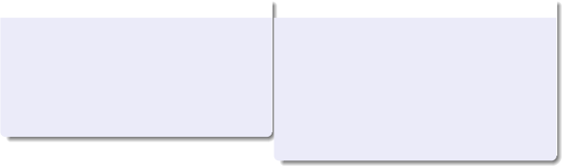
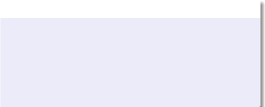

Experimental Results
Structure & Compilability Scores Score Comparison Chart
Metric MD Pure LLM ∆ Structure 1.000
LLM
MD
Structure
Compilability
Consistency
1.000 1.000
0.984
0.917 0.333
0.481
+0.083
+0.667
+0.503
0.917
Compil
MD
1.000
Time (avg) | 164s | 380s | –56%
Feedback Iters | 1 | N/A | N/A
0.333 | LLM 0.4 0.6 0.8 1.0
MD
Consist 0.984
0.481
LLM
Pure LLM Error Patterns (3/3 runs failed)
ModuleNotFoundError: No module named ’backend’
ImportError: attempted relative import
ModuleNotFoundError: No module
Key Result
Model-driven approach achieves 100%
compilability.
Pure LLM achieves only 33.3% — syntax passes,
but imports always fail.
named ’email validator’ ⁸ / ¹⁰

Slide 9

Analysis & Insights
Why Model-Driven Wins | Why Pure LLM Fails
¹ Deterministic Structure: Templates guarantee correct file organization
¹ Import Fragility: LLM guesses module structure inconsistently
² Import Consistency: Absolute imports, generated once, never modified by LLM
² Structural Drift: 48% consistency means 3 runs produce 3 architectures
³ Type Safety: Platform-specific type mapping (SQL vs ORM vs Pydantic vs TS)
³ Dependency Hallucination: References non-existent modules
⁴ LLM Scope: Fill business logic only — structural code is template-generated
⁴ No Self-Correction: Syntax passes, but integration fails silently
⁵ Feedback Efficiency: Errors localized to specific files; targeted fixes only
⁵ Context Window Limits: Large models exceed effective prompt capacity
Feedback Loop Impact
Run
Initial
Errors
Iterations to Fix
Final Errors
1
2
1 (type import) 1
1 (default formatting) 1
⁰ ₉ / ₁₀ 0

Slide 10
Conclusion & Contributions
Summary of Findings | Contributions
¹ Model-Driven Approach: 100% compilability, 98.4% consistency, 164s avg time ² Pure LLM Baseline: 33.3% compilability, 48.1% consistency, 380s avg time ³ Feedback Mechanism: Converges in 1 iteration; model context prevents drift ⁴ Scalability: Linear scaling with model size; constant API call count (1–2) | ¹ Complete model-driven code generation pipeline (YAML → Full-Stack App) ² Novel bidirectional feedback mechanism ³ Systematic experimental comparison (3 sizes × 2 methods × 3 runs) ⁴ Open-source implementation + reproducible experiments ⁵ Quantitative evidence: models + LLM > LLM alone
Innovation Contribution
Bidirectional Feedback Mechanism: Model-constrained, targeted error correction Prevents structural degradation during fixing | Future Directions
 | Multi-LLM comparison (GPT-4, Claude) Runtime test integration in feedback loop Model-diff-drive n inc re me nta l rege ne ratio n 10 / 10
Converges in 1 iteration (3-iteration max bound) Generalizable to other MDE + LLM pipelines
Additional application domains

