Slide 1
Read Me
Download and install OpenCV & python IDLE before trying this project.
Do not modify the project code or change the video path.
Import the missing libraries numpy , math and cv2.
Before you start make sure you got imutils Python package
Enjoy! :)

Slide 2
LakeDiamond
Shape detection
14 - 12 - 2018

Slide 3
Table of Content
Introduction
Algorithm methodology
Contour Detection
Approximation of contours
4.1 Shape trace of contours
Classification of edges
Conclusion

Slide 4
1
INTRODUCTION

Slide 5
Shape recognition
Process
The classification of shapes
According to the number of lines forming their outline
The approximation of contours
Using approxPolyDP function based on the Douglas-Peucker algorithm.
The extraction of contours
Allow us to extract one by one the objects

Slide 6
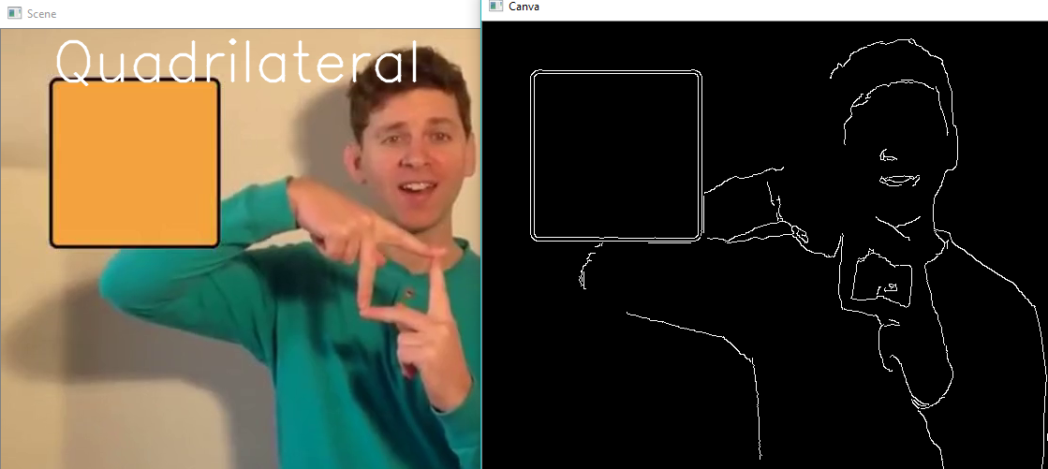
Edge detection
Edge detection refers to the process of identifying and locating sharp discontinuities in an image.
Different Methods of edge detection are available:
Robert’s Cross operator
II. Sobel Operator
III. Prewitt Operator
IV. Laplacian of Gaussian Filter
V. Canny’s Edge Detection Algorithm

Slide 7
2
Algorithms’ methodology

Slide 8
Algorithm methodology
1
3
5
Start
Step 2 :
Finally :
Convert image to gray-scale
Apply range filter
Apply Ramer-Douglas-Peucker(RDP) algorithm
Step 1 :
Step 3 :
Apply adaptive histogram equalization
Extract edge map via Canny edge detector algorithm
2
4

Slide 9
2
Contour detection methodology

Slide 10
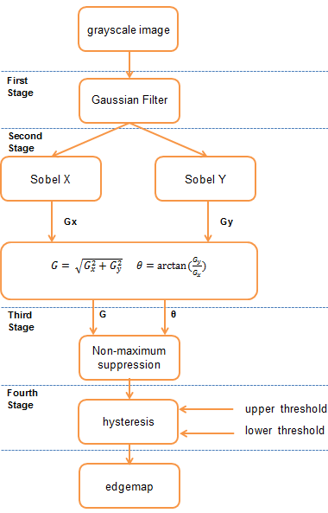
Canny edge algorithm description
Definition
A multi-stage edge detector.
Uses a Gaussian filter in order to reduce the intensity of the gradients.

Slide 11
Canny edge algorithm Process
Smoothing: Gaussian filter
5 steps
Apply Gaussian filter to smooth the image in order to remove the noise
Edge detector operator
Find the intensity gradients of the image
The edge thinning
Apply non-maximum suppression to get rid of filter defaults
Potential edges
Apply double threshold to determine potential edges
Edge map
Track edge by hysteresis:
Finalize the detection of edges by suppressing all the other edges that are weak and not connected to strong edges.

Slide 12
Parameters Principles
3- Adjustable parameters
The size of Gaussian parameters
Thresholds
Smaller filters cause less blurring, and allow detection of small, sharp lines.
A larger filter causes more blurring, smearing out the value of a given pixel over a larger area of the image.
=> The noisier the image, the greater the width
The use of two thresholds with hysteresis allows more flexibility:
The low and high threshold for the hysteresis thresholding.

Slide 13
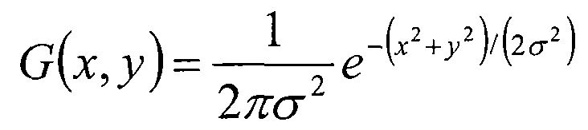
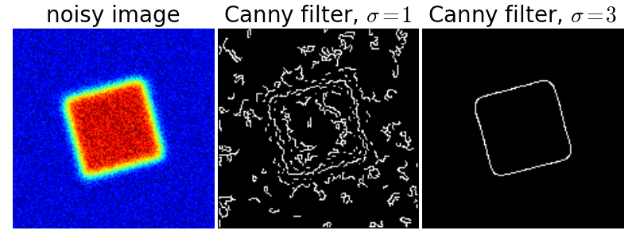
Gaussian filter
The Gaussian reduces the effect of noise present in the image.
The potential edges are thinned down to 1-pixel curves by removing non-maximum pixels of the gradient magnitude.
The edge pixels are kept or removed using hysteresis thresholding on the gradient magnitude.

Slide 14

Edge detector operator
(G_{x}) , (G_{y})
Intensity gradient
Canny algorithm uses four filters to detect horizontal, vertical and diagonal edges in the blurred image.
The edge detection operator (Robert,Prewitt,Sobel) return:
A value for the first derivative in the horizontal direction (G_{x}) and the vertical direction (G_{y}).
From this the edge gradient and direction can be determined.

Slide 15
The edge thinning
Non-maximum suppression is applied to find "the largest" edge, after applying gradient calculation.
Step 1:
Step 2:
Compare the edge strength of the current pixel with the edge strength of the pixel in the positive and negative gradient directions.
If the edge strength of the current pixel is the largest compared to the other pixels the value will be preserved. Otherwise, the value will be suppressed.
The pixel that is pointing in the y-direction, it will be compared to the pixel above and below it in the vertical axis

Slide 16
2
Approximation of contours

Slide 17
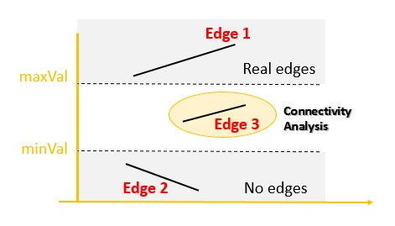
Potential edging
A double threshold filter to multibeam variables for the purpose of removing data (noise) within a specified range.
All samples with values below the Lower threshold are "thresholded out".
All samples with values above the Upper threshold are retained.
For samples with values between the thresholds:
Values that are between the two thresholds and within the specified Influence radius ("close") from a data point that has been unchanged.
Values that are between the two thresholds yet outside the specified Influence radius are set to a specified threshold value.

Slide 18
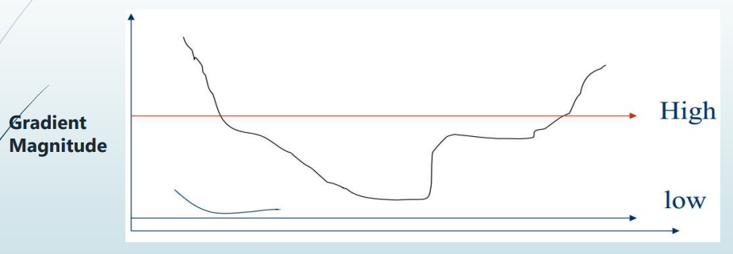
Edge map
Canny operator uses a method called "hysteresis"
This stage decides which are the edges and which are not. For this, we need two threshold values, minVal and maxVal.

Slide 19
2
Shape trace of contours

Slide 20
Ramer-Douglas-Peucker Algorithm
Python/NumPy implementation, serves to reduce the number of nodes and describe the contours by a set of segments.
Used for reducing the number of points in a curve that is approximated by a series of points for 2D and 3D data.
The split and merge algorithm for a better code and resource optimization.

Slide 21
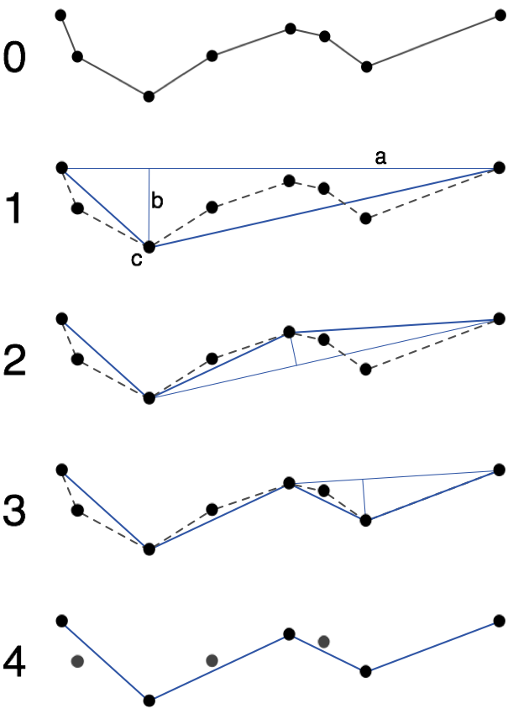
The algorithm works recursively by the "divide and conquer" method.
At each step, all the nodes are traversed between the terminals and the node furthest from the segment
if there is no node between the terminals the algorithm ends,
The algorithm is called recursively on two sub-parts of the polyline: from the first terminal to the remote node, and from the remote node to the final terminal.

Slide 22
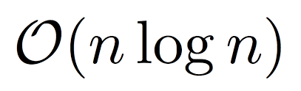

Ramer-Douglas-Peucker Algorithm complexity
Closing cause:
the algorithm ends necessarily because in the worst case the polyline (or the polygon) is not simplifiable and each branch formed by the recursion will end when the terminals will not be separated by a node
since at each iteration the number of recursion branches is multiplied by two and all nodes are visited.
the complexity is:
to the case where each segment is forced to be cutted:
.

Slide 23
2
Classification of edges’
algorithm

Slide 24
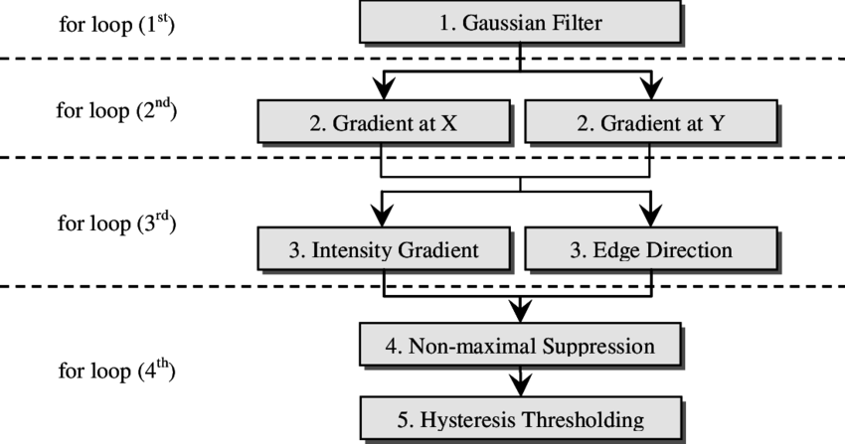
Canny edge algorithm
complexity
Using the FFT, it's possible to implement convolutions in time O(n log n).
If the image has dimensions m × n, the time complexity will be O((m*n) log (m*n)) .
By removing all the high and low values, then dropping all other pixels that aren't near other pixels that can be done in time O(m*n):
Overall time complexity is O((m*n) log(m*n))

Slide 25


Algorithms analysis
Canny edge detector
Price and performance
Sobel
Canny edge detector algorithm between all the other solutions is:
The most expensive,
Performs better than all these operators.
The least optimal filter for ressources
Prewitt
Robert

Slide 26
2
Conclusion

Slide 27
Why canny edge algorithm?
Number of responses
One real edge should not result in more than one detected edge.
Localisation
Minimum gap between real edge and detected Edge.
Detection
The probability of detecting real edge points is maximized while the probability of falsely detecting non-edge points is minimized.

Slide 28
Documentation
The split-and-merge algorithm: Ramer-Douglas-Peucker algorithm, RDP.
Edge detection algorithm: Canny edge detector algorithm

Slide 29
Thank You

Slide 30


Contact
Dhaouadi Zahra
zohra.dhaouadi@esprit.tn
+21626612978

Slide 31
We find a way or we make one..!

