Slide 1







PRESENTATION
Predictions
Trends
MOISTURE
MINDS
Presented by - 642947-UH8X7J63

Slide 2




TEAM
1.Vishal Gandluri
2.Nitin Vangipuram
3.Gagan Gandi
4.Ganesh Kumar
5.Nikhil Yarra

Slide 3





AGENDA
Analysing
Trends
Observing the trends for each parameter given i.e(sm,st,hum,etc…)
Pre-Processing
Prediction
Predicting The Soil Moisture for March 2023
Adding Given Two Datasets and replacing the null values with a suitable Value
i.e(mean,mode,median,etc….)

Slide 4

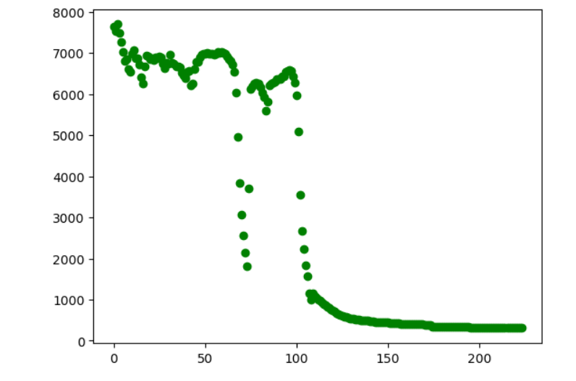
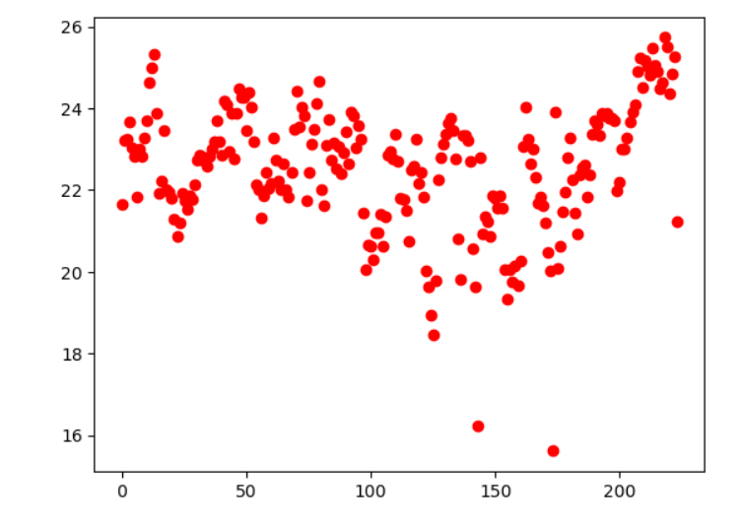

et
Soil Moisture vs day
Temperature vs day

Slide 5
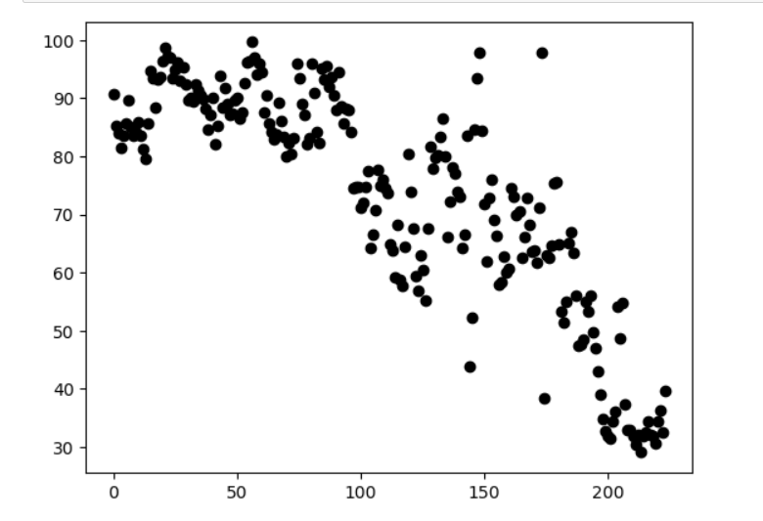
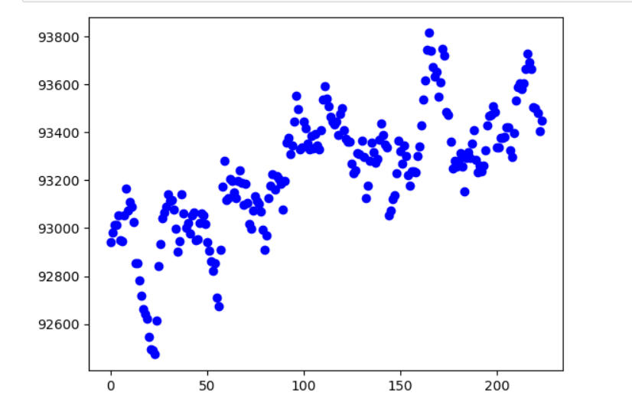
et
Humidity vs day
Pressure vs day

Slide 6
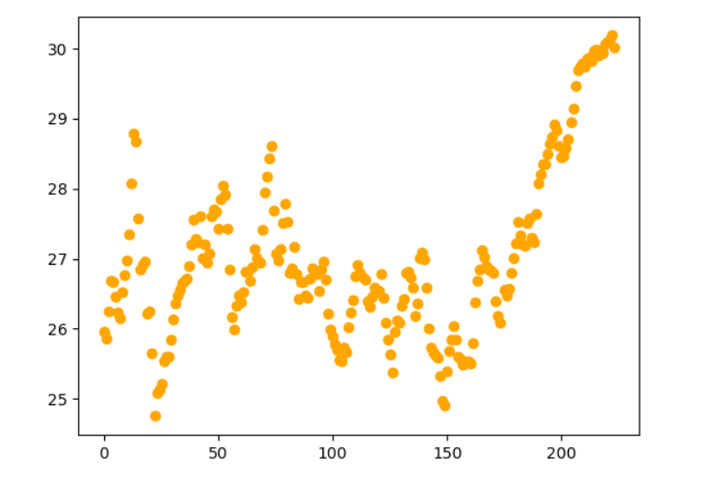
PRE-PROCESSING
We replaced the null values by average of values available in that month in all respective parameters. And ploted the parameter averaged over the day Vs day
et
Soil Temperature vs day

Slide 7
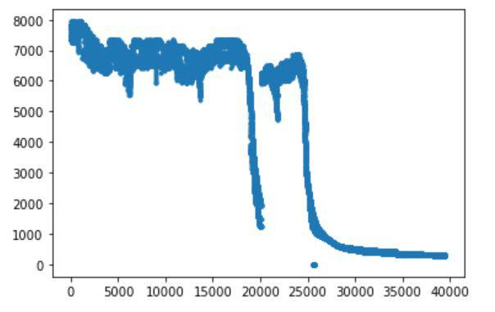
Now we are seeing the scattered plot of soil moisture values for all given data set points(around 40k points) after data pre-processing.
We can see that the soil moisture is high during July to around september as it is rainy season and the big drop is because of starting of summer season and it goes on decreasing in the march month.
From above we can conclude that soil moisture will be in order of 100’s, we can also compare and verify it from the predicted soil moisture values from our Decision Tree Regressor Model.
et

Slide 8



CONCLUSION
We can predict the soil moisture for
March 2023 by using this Decision tree regressor model.

Slide 9

THANK YOU
Presented by - 642947-UH8X7J63

