Slide 1
Decomposing Within & Between Person Effects in Longitudinal Data with SEM in R
Dustin Haraden, PhD
February 27, 2025

Slide 2
Also known as Random Intercept Cross Lagged Panel Model
Dustin Haraden, PhD
February 27, 2025

Slide 3
Or…RI-CLPM
Dustin Haraden, PhD
February 27, 2025

Slide 4
ABOUT ME
Assistant Professor at Rochester Institute of Technology in Rochester, NY, USA
Clinical/Community Psychology PhD
Research focuses on risk factors for internalizing disorders in youth
Examining circadian rhythms and sleep
Pubertal Development/Timing
Emphasis on Open Science Practices, Improving Measurement and “Giving Away” Psychological Science

Slide 5
STYLE
Mix of slides and live coding (I’ll try to only mess up a little)
I’ll switch back and forth often, let me know if I need to slow down
Follow Along!
Ask questions! Use the chat or raise your hand

Slide 6
OVERVIEW
Working in R
Longitudinal Data Analysis
Cross Lagged Panel Model
What is it
Why we shouldn’t be using it
Random Intercept Cross Lagged Panel Model
What it is doing
How we set it up in R
Interpretation
Potential: Helpful R Tools

Slide 7



Install R & R-Studio
LINK TO INSTALL GUIDE

Slide 8
File Structure & R Libraries
Folder for the Project (Not using .Rproj)
Sub folder for data
Libraries we will use for the workshop:
rio (http://gesistsa.github.io/rio/)
lavaan (https://lavaan.ugent.be/)
here (https://here.r-lib.org/)
dplyr (https://dplyr.tidyverse.org/)
ggplot2 (https://ggplot2.tidyverse.org/)
broom (https://broom.tidymodels.org/)
I hope I remember to put them all here! But in case I miss some, here are libraries that I like:
easystats (https://easystats.github.io/easystats/)
sjPlot (https://strengejacke.github.io/sjPlot/)
janitor (https://sfirke.github.io/janitor/index.html)
Workshop Folder
Script File
Data Folder
Data

Slide 9
Working with lavaan
formula type | operator | mnemonic
latent variable definition | =~ | is measured by
regression | ~ | is regressed on
(residual) (co)variance | ~~ | is correlated with
intercept | ~ 1 | intercept
Model creation within lavaan consists of a combination of the operators above encapsulated by single quotes
This is where you define all of your equations and variables

Slide 10
Working with lavaan
myModel <- ' # regressions
y1 + y2 ~ f1 + f2 + x1 + x2
f1 ~ f2 + f3
f2 ~ f3 + x1 + x2
# latent variable definitions
f1 =~ y1 + y2 + y3
f2 =~ y4 + y5 + y6
f3 =~ y7 + y8 + y9 + y10
# variances and covariances
y1 ~~ y1
y1 ~~ y2
f1 ~~ f2
# intercepts
y1 ~ 1
f1 ~ 1
'

Slide 11
Working with lavaan
Once the model is created, we can then “fit” the model using functions in lavaan
Depending on the level of control/constraint you want to be assumed, you can use different types of functions
The most commonly used are ‘sem()’ and ‘cfa’
Next, we get the statistics related to the model
fit <- cfa(model = myModel, data = myData)
summary(fit, fit.measures = TRUE)

Slide 12
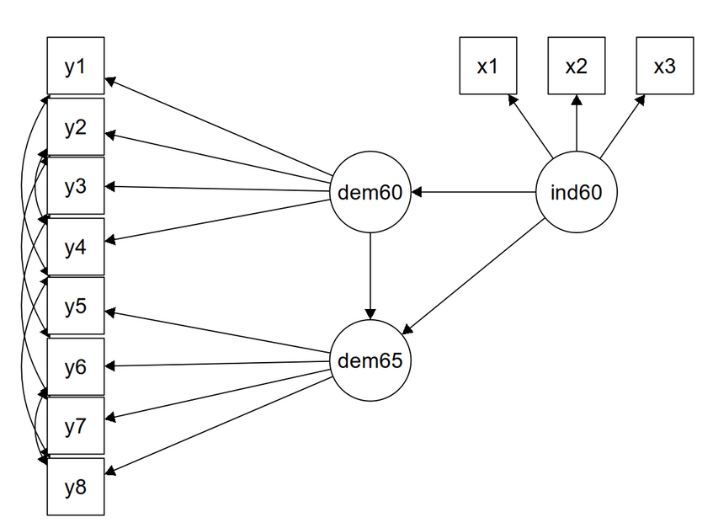
lavaan example
model <- '
# measurement model
ind60 =~ x1 + x2 + x3
dem60 =~ y1 + y2 + y3 + y4
dem65 =~ y5 + y6 + y7 + y8
# regressions
dem60 ~ ind60
dem65 ~ ind60 + dem60
# residual correlations
y1 ~~ y5
y2 ~~ y4 + y6
y3 ~~ y7
y4 ~~ y8
y6 ~~ y8
'
fit <- sem(model, data = PoliticalDemocracy)
summary(fit, standardized = TRUE)

Slide 13
GETTING STARTED
Create a new Rmarkdown file
Have the data saved in your folder
“You are your own worst collaborator”
Put lots of notes and organize things so future you will thank you
Future Proof your work

Slide 14
TRANSITION

Slide 15
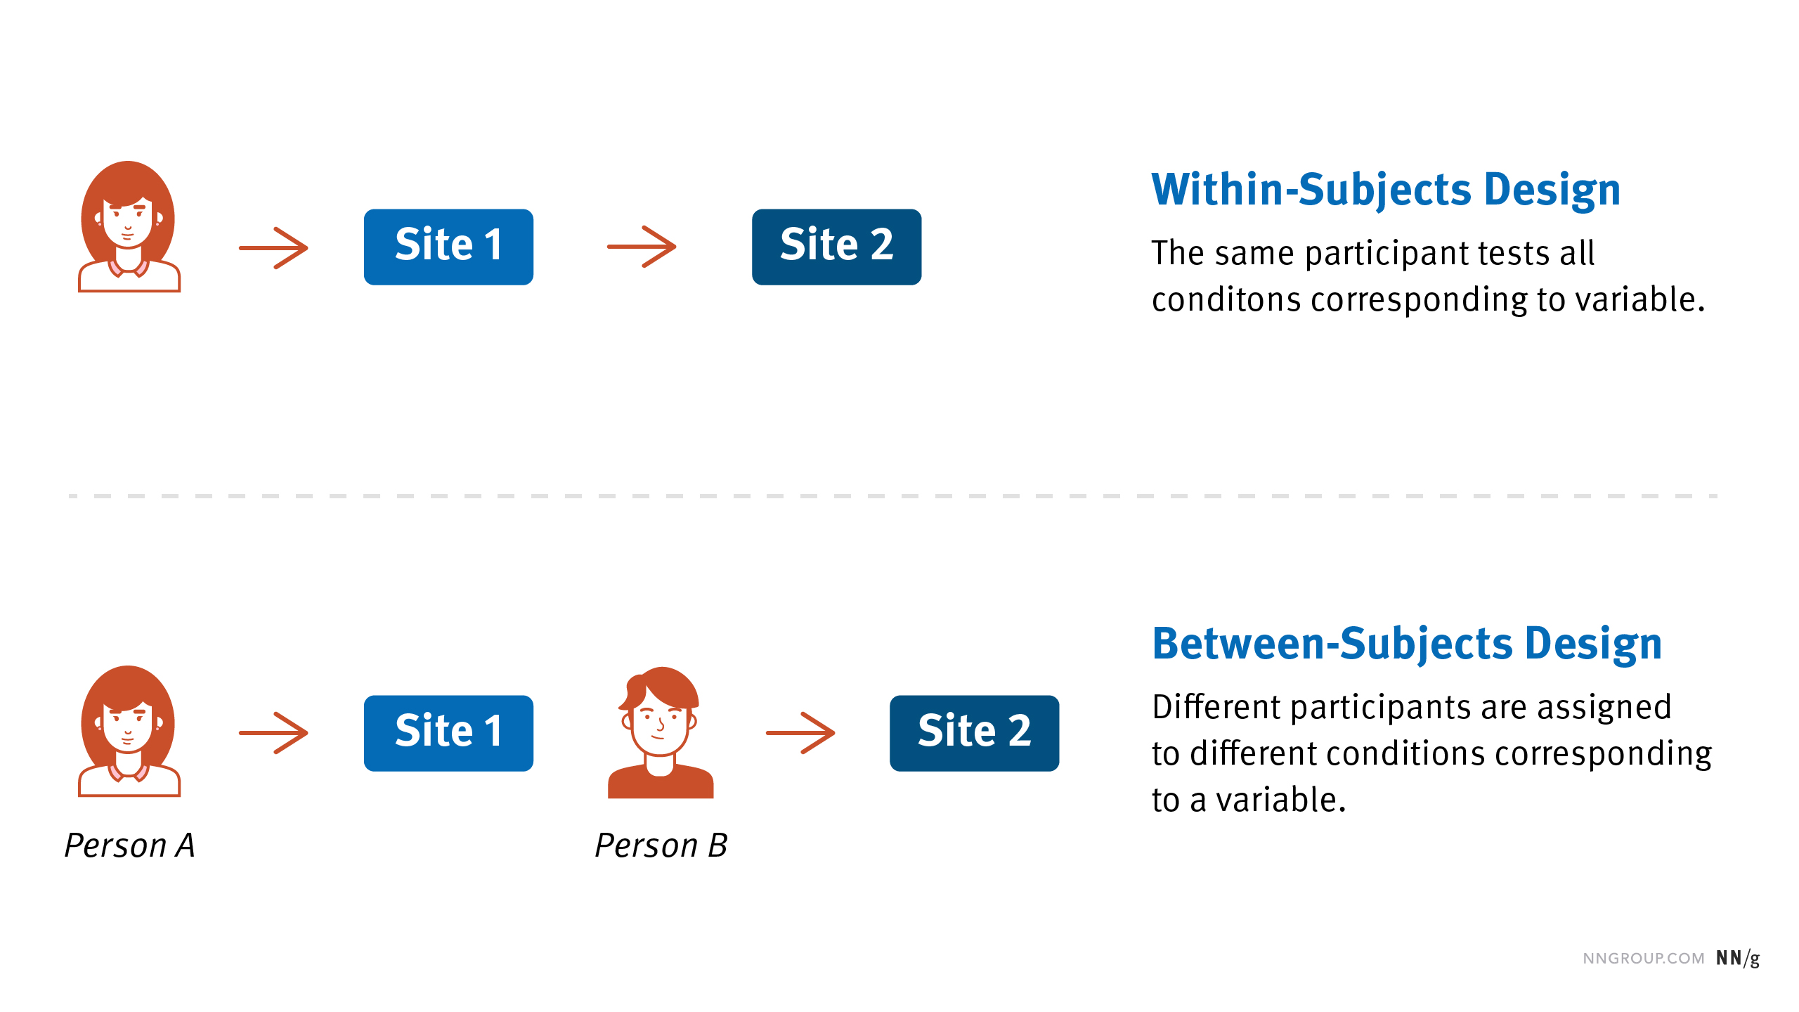
WITHIN VS BETWEEN-PERSON

Slide 16
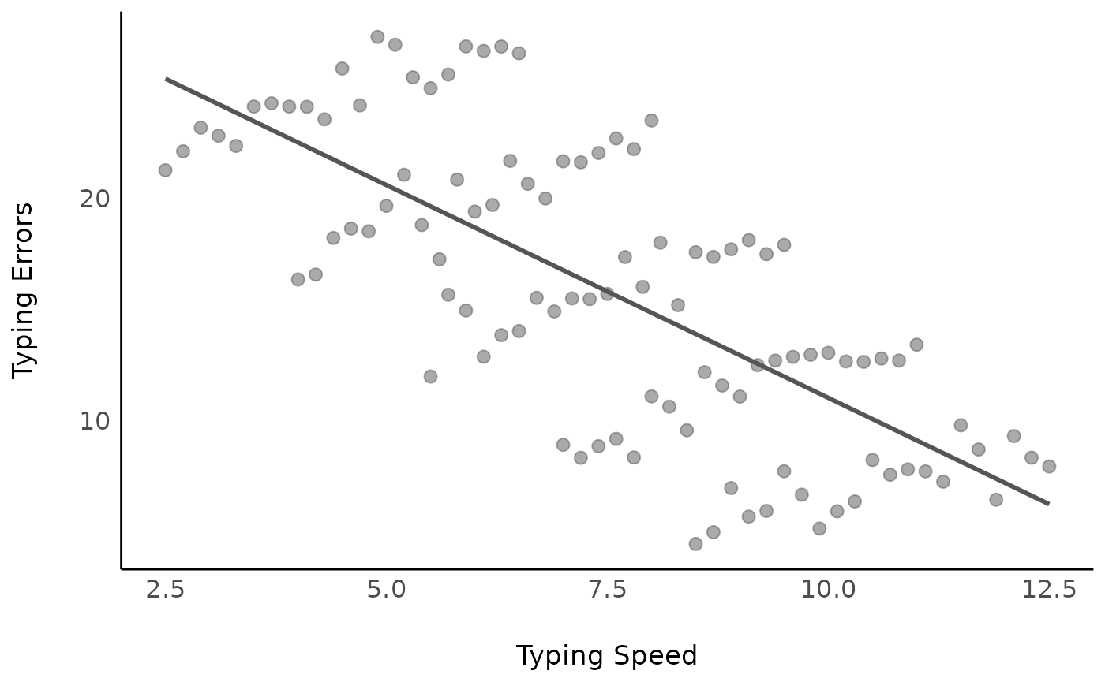
Typing Speed & Errors

Slide 17
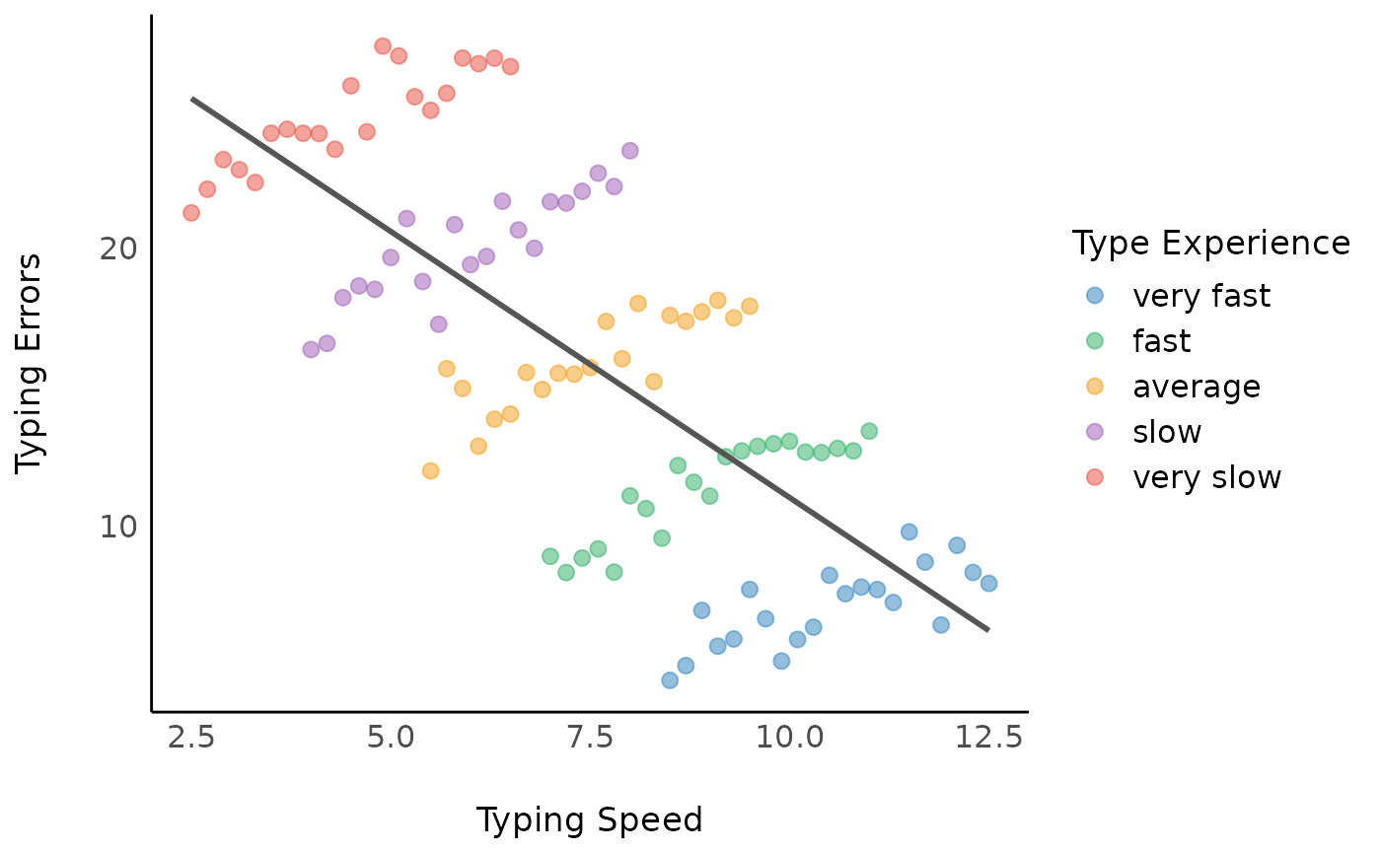
Typing Speed & Errors

Slide 18
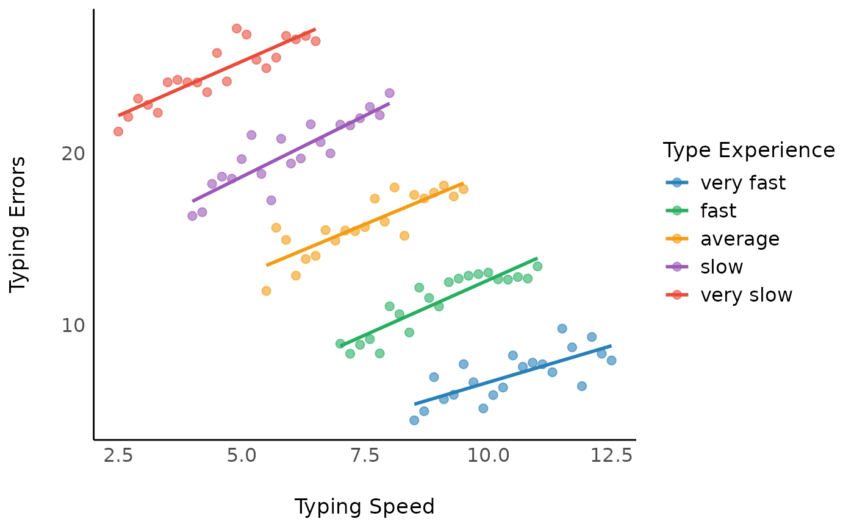
Typing Speed & Errors

Slide 19
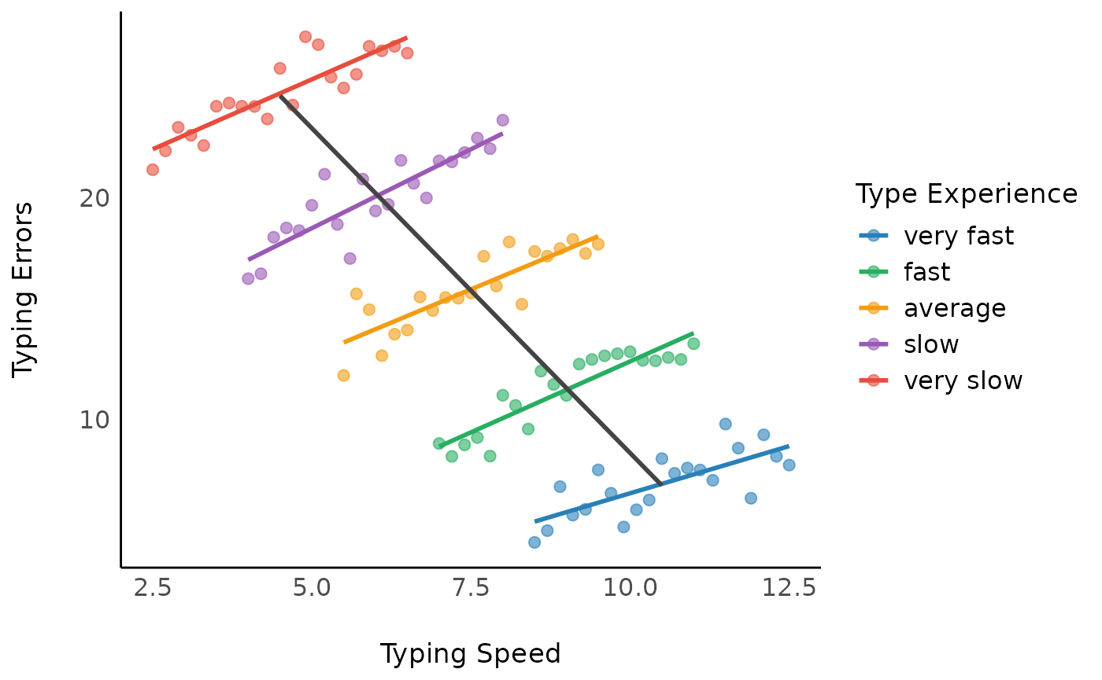
Typing Speed & Errors

Slide 20
Within & Between-Person
Important to consider both the within and between person amounts of variability within an analysis
When looking at longitudinal data, there are various methods for examining trajectories, change or profiles
These typically only look at a single variable over time
What happens when we want to look at the interplay between two variables?
“How do these variables cascade over time?”

Slide 21


Within & Between-Person
“How do these variables cascade over time?”

Slide 22
Cascading Sleep & Depression
Let’s say we are interested in the interplay between sleep challenges and symptoms of depression over time
Depression T1
Depression T2
Sleep T1
Sleep T2

Slide 23
Cascading Sleep & Depression
Let’s say we are interested in the interplay between sleep challenges and symptoms of depression over time
Depression T1
Depression T2
Sleep T1
Sleep T2

Slide 24
Cascading Sleep & Depression
Let’s say we are interested in the interplay between sleep challenges and symptoms of depression over time
With this model, we want to make claims like:
Earlier depression results in increased sleep problems
Sleep problems impact symptoms of depression the next day
How can we analyze this information?
Cross Lagged Panel Model?
Random Intercept Cross Lagged Panel Model?
Multilevel Models?

Slide 25
Cascading Sleep & Depression
Let’s say we are interested in the interplay between sleep challenges and symptoms of depression over time
With this model, we want to make claims like:
Earlier depression results in increased sleep problems
Sleep problems impact symptoms of depression the next day
How can we analyze this information?
Cross Lagged Panel Model?
Random Intercept Cross Lagged Panel Model!
Multilevel Models?

Slide 26
But First: Cross Lagged Panel Model
We need to see what is out there to appreciate what we are going to have

Slide 27
Depression
Sleep Problems

Slide 28
Time 1
Time 2
Time 3
Time 4
Depression
Sleep Problems

Slide 29
Time 1
Time 2
Time 3
Time 4
Depression
X1
X2
X3
X4
Y1
Y2
Y3
Y4
Sleep Problems

Slide 30

Time 1
Time 2
Time 3
Time 4
X1
X2
X3
X4
Y1
Y2
Y3
Y4

Slide 31
Time 1
Time 2
Time 3
Time 4
X1
X2
X3
X4
Auto-regressive Paths
Y1
Y2
Y3
Y4

Slide 32
X1
X2
X3
X4
Y1
Y2
Y3
Y4

Slide 33
X1
X2
X3
X4
Y1
Y2
Y3
Y4

Slide 34
Traditional Cross-Lagged Panel Model
X1
X2
X3
X4
Y1
Y2
Y3
Y4

Slide 35
Review R output
Note to Dustin if he doesn’t already bring it up: semPlot::semPaths(clpm_fit, layout = "tree2")

Slide 36
Seems like it makes sense, right?

Slide 37
WRONG

Slide 38
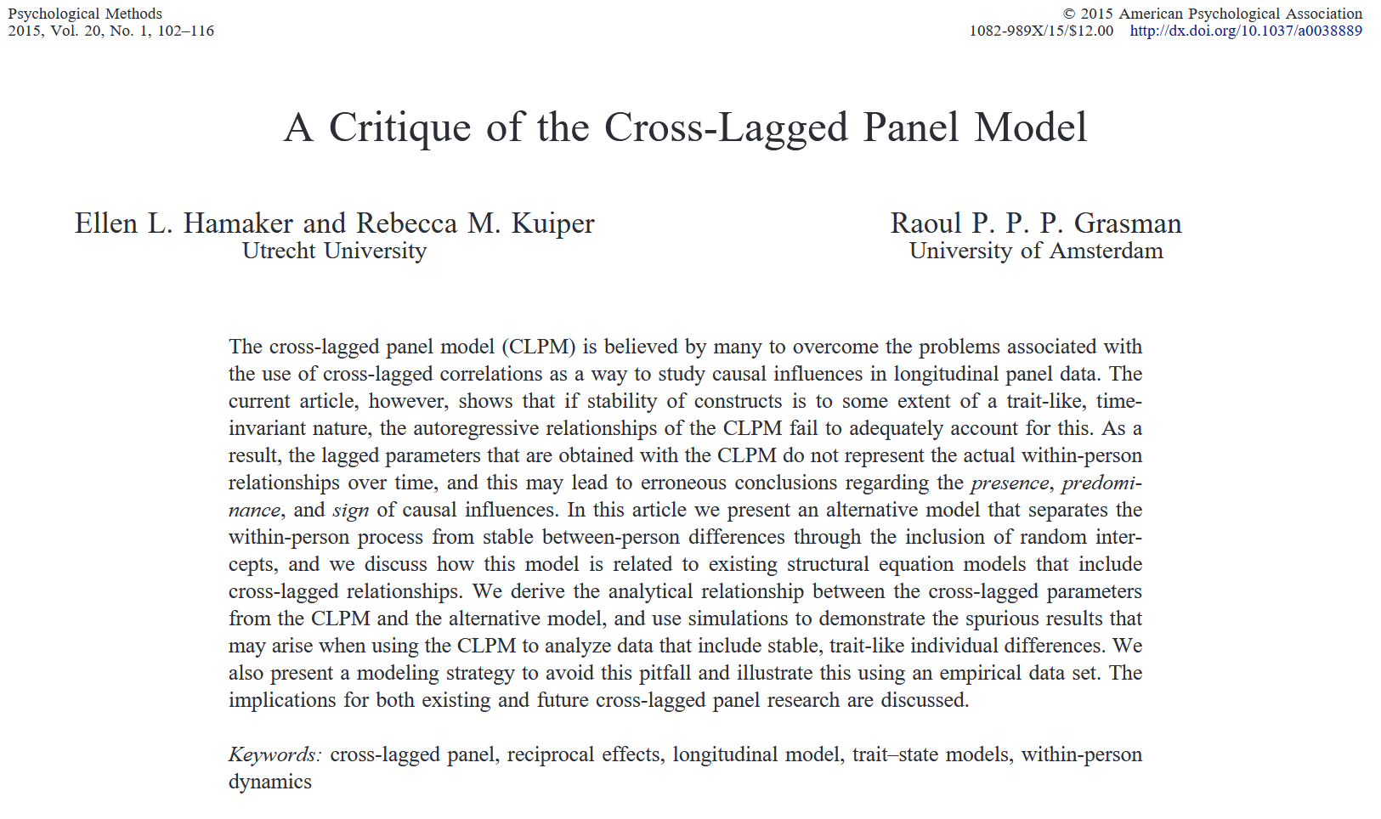

Slide 39
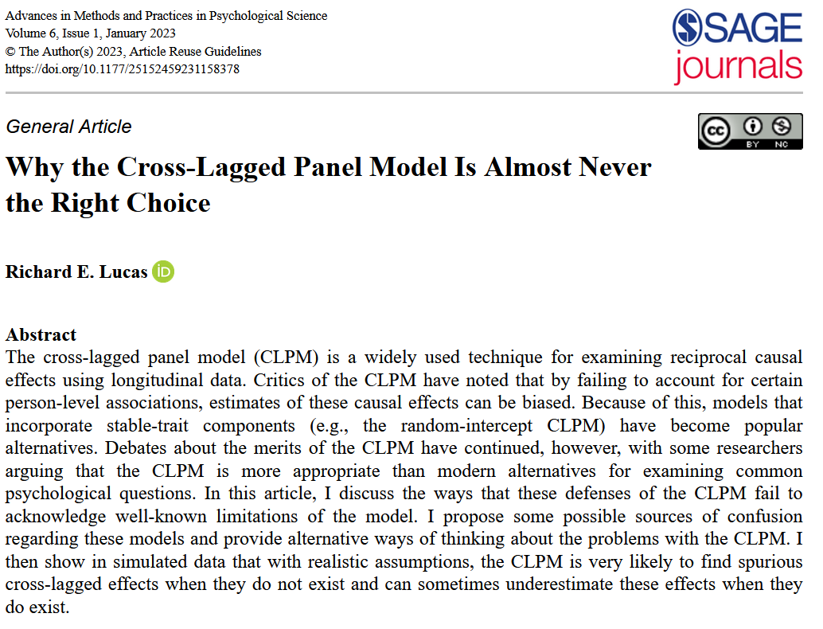

Slide 40
WITHIN VS BETWEEN-PERSON

Slide 41
WITHIN VS BETWEEN-PERSON
CLPM conflates within and between person variability and inflates estimates making them unreliable/biased

Slide 42

NOW WHAT?

Slide 44
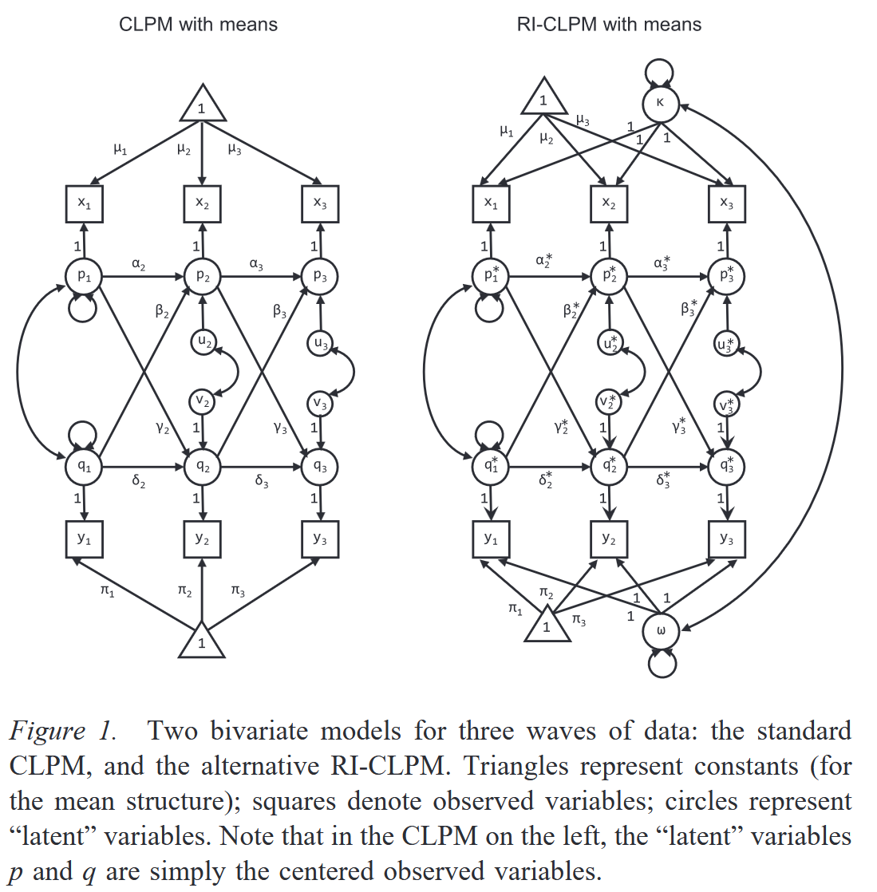
Other Models referenced:
The STARTS model by Kenny and Zautra (2001)
ALT Model by Curran and Bollen (2001, 2006)
LCS Model by McArdle and Hamagami (2001)
The LST Model by Steyer and Colleagues (1990, 1993, 1990)

Slide 45
Traditional Cross-Lagged Panel Model
X1
X2
X3
X4
Y1
Y2
Y3
Y4

Slide 46
X1
X2
X3
X4
Y1
Y2
Y3
Y4

Slide 47
Start with what we currently have
X1
X2
X3
X4
Y1
Y2
Y3
Y4

Slide 48
X1
X2
X3
X4
Between
X
Between
Y
Y1
Y2
Y3
Y4

Slide 49
X1
X2
X3
X4
Between
X
W
X1
W
X2
W
X3
W
X4
W
Y1
W
Y2
W
Y3
W
Y4
Between
Y
Y1
Y2
Y3
Y4

Slide 50
X1
X2
X3
X4
Between
X
W
X1
W
X2
W
X3
W
X4
W
Y1
W
Y2
W
Y3
W
Y4
Between
Y
Y1
Y2
Y3
Y4

Slide 51
X1
X2
X3
X4
1
1
1
1
Between
X
W
X1
W
X2
W
X3
W
X4
W
Y1
W
Y2
W
Y3
W
Y4
Between
Y
1
1
1
Y1
Y2
Y3
1
Y4

Slide 52
Within
X1
X2
X3
X4
Between
1
1
1
1
Between
X
W
X1
W
X2
W
X3
W
X4
W
Y1
W
Y2
W
Y3
W
Y4
Between
Y
1
1
1
Y1
Y2
Y3
1
Y4
Mulder, J. D., & Hamaker, E. L. (2021). Three extensions of the random intercept cross-lagged panel model. Structural Equation Modeling: A Multidisciplinary Journal, 28(4), 638-648.

Slide 53
X1
X2
X3
X4
1
1
1
1
Between
X
W
X1
W
X2
W
X3
W
X4
W
Y1
W
Y2
W
Y3
W
Y4
Between
Y
1
1
1
Y1
Y2
Y3
1
Y4

Slide 54
Within
X1
X2
X3
X4
Between
1
1
1
1
Between
X
W
X1
W
X2
W
X3
W
X4
W
Y1
W
Y2
W
Y3
W
Y4
Between
Y
1
1
1
Y1
Y2
Y3
1
Y4
Mulder, J. D., & Hamaker, E. L. (2021). Three extensions of the random intercept cross-lagged panel model. Structural Equation Modeling: A Multidisciplinary Journal, 28(4), 638-648.

Slide 55
Review R output Compare CLPM with RI-CLPM
Note to Dustin if he doesn’t already bring it up: visualize the inflation

Slide 56
RI-CLPM vs. Multilevel Models
Separating within and between person effects
RI-CLPM explicitly separates within-person and between-person variance
MLM models both within- and between-person effects but often assumes that predictors have the same effect at both levels, unless explicitly decomposed (e.g., via centering strategies)
More accurate within-person causal inferences
Better handling of reciprocal relationships

Slide 57
Reproducible Tables
Time Permitting

Slide 58
SUMMARY
When examining reciprocal relationships among variables, it is important to consider within- and between-person variation
Thoughtfully construct your models
Think about the alternatives that are out there:
Extensions of RI-CLPM
Consider # of participants and size of effects
Calculating power is complex

Slide 59
A COUPLE USEFUL MATERIALS
https://jeroendmulder.github.io/RI-CLPM/lavaan.html
https://johnflournoy.science/riclpm-lavaan-demo.html

Slide 60
THANK YOU!
Reach out with any questions!
dxhgsh@rit.edu
dustinharaden.com
Follow me on blue sky
@Dustinharaden.bsky.social

