Slide 1
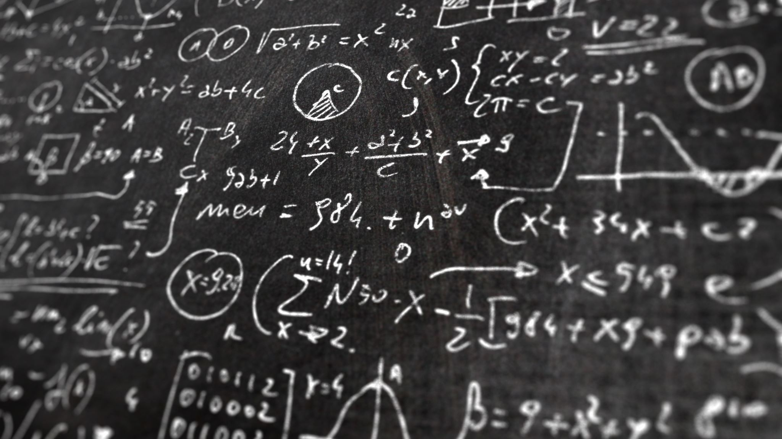
PSYC 640 Grad Stats
10/29/2024
Probability & Inference

Slide 2
Probability – Understanding Randomness
There are several possible interpretations of probability but they (almost) completely agree on the mathematical rules probability must follow.
P(A) = Probability of event A
0 ≤ P(A) ≤ 1
Bayesian interpretation:
A Bayesian interprets probability as a subjective degree of belief: For the same event, two separate people could have different viewpoints and so assign different probabilities.
Largely popularized by revolutionary advance in computational technology and methods during the last twenty years.
Frequentist interpretation:
The probability of an outcome is the proportion of times the outcome would occur if we observed the random process an infinite number of times.

Slide 3
Practice
In a survey, 52% of respondents said they are Democrats. What is the probability that a randomly selected respondent from this sample is a Republican?
(a) 0.48
(b) more than 0.48
(c) less than 0.48
(d) cannot calculate using only the information given

Slide 4
Practice
In a survey, 52% of respondents said they are Democrats. What is the probability that a randomly selected respondent from this sample is a Republican?
(a) 0.48
(b) more than 0.48
(c) less than 0.48
(d) cannot calculate using only the information given
If the only two political parties are Republican and Democrat, then (a) is possible. However it is also possible that some people do not affiliate with a political party or affiliate with a party other than these two. Then (c) is also possible. However (b) is definitely not possible since it would result in the total probability for the sample space being above 1.

Slide 5
Role of Probability Theory
Probability theory allows us to determine if survey results like “67% of respondents prefer Android" plausibly reflect the true population parameter
While intuitive reasoning can get us part way, probability theory provides powerful mathematical tools to assess sample representativeness
Though not statistics per se, probability theory forms the foundation for statistical inference

Slide 6
Probability & Statistics – How are they different?
Although closely related, they are not identical
Probability is the “doctrine of chances”
Tell you how often different kinds of events will happen
Questions for probability theory
What are the chances of a fair coin coming up heads 10 times in a row?
If I roll a six sided dice twice, how likely is it that I’ll roll two sixes?
How likely is it that five cards drawn from a perfectly shuffled deck will all be hearts?
What are the chances that I will win the lottery?

Slide 7
Probability & Statistics – How are they different?
Each of the questions have something in common
We know about a “truth of the world”
The questions relate to the type of events that may happen
What are the things that are “assumed” or known in the questions?
They start with a known “model of the world” and then we use that to do calculations
In probability theory, the model is known, but the data are not
Statistical questions work the other way
We do not know the truth, but we have the data

Slide 8
Probability & Statistics – How are they different?
Questions for statistics:
If my friend flips a coin 10 times and gets 10 heads, are they trying to trick me?
If 5 cards off the top of the deck are all hearts, how likely is it that the deck was shuffled?
If the lottery commissioner’s spouse wins the lottery, how likely is it that the lottery was rigged?
Again, we only have the data and we need to identify which “model of the world” we think is the most accurate
Data: H H H H H H H H H H
P(heads) = 0.5 or P(heads) ≠ 0.5
The statistical inference problem is to figure out which of the probability models is correct (or the most correct)

Slide 9

Estimating the unknown from a sample – Inferential Statistics
A little bit of methods in this section…

Slide 10
Parameter Estimation
We are often interested in population parameters.
Since complete populations are difficult (or impossible) to collect data on, we use sample statistics as point estimates for the unknown population parameters of interest.
Sample statistics vary from sample to sample.
Quantifying how sample statistics vary provides a way to estimate the margin of error associated with our point estimate.
Suppose we randomly sample 1,000 adults from each state in the US. Would you expect the sample means of their heights to be the same, somewhat different, or very different?
What if we took another random sample? Would they be identical?

Slide 11
Samples, populations and sampling
Sampling theory
Drawing inferences from the sample about the population
Defining a population
Creating an appropriate sample
LLN & CLT
Population Parameters and Sample Statistics
Outlining a simulation: https://onlinestatbook.com/stat_sim/sampling_dist/

Slide 12
Defining a population
More of an abstract idea about who you want to make statements
Example: Running a study with 100 undergraduate students as participants. Who is the population?
All of the undergraduate psychology students at RIT?
Undergraduate psychology students in general, anywhere in the world?
Americans currently living?
Americans of similar ages to my sample?
Anyone currently alive?
Any human being, past, present or future?
Any biological organism with a sufficient degree of intelligence operating in a terrestrial environment?
Any intelligent being?
Critical point is that the sample is a subset of the population with the goal of drawing inferences about the larger population
The relationship depends upon the procedure of selection for the sample

Slide 13
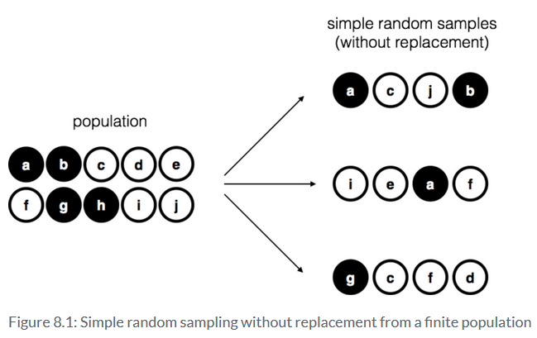
Sampling – Simple random samples
Let’s say I have a bag containing 10 chips
Note about with vs. without replacement
Most statistical theory is based on with replacement

Slide 14
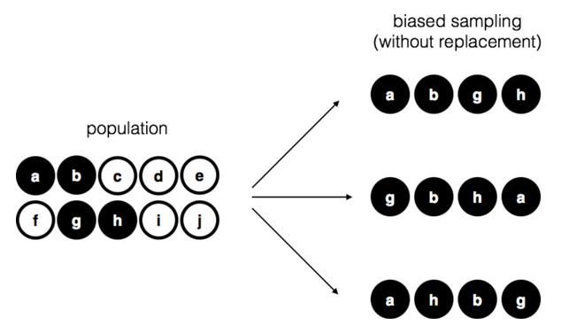
Sampling – Biased Sampling

Slide 15
Sampling – How much does it matter
Difficult to identify a simple random sample in the real world
Think about the differences between the two sampling techniques we just saw. Should it matter?
We can adjust for biases
Two Key Points
Designing studies – think about the population you want to make inferences about
Critiquing studies – Think about how their sample may impact the conclusions that are being made

Slide 16
Population Parameters & Sample Statistics
Let’s return to the simulation https://onlinestatbook.com/stat_sim/sampling_dist/
Parameters of the population
Mean = 16; Standard Deviation = 5
Sample is taken – can calculate the mean and standard deviation of the sample
These are the sample statistics
With this procedure, we will be able to estimate the population parameters and estimate confidence intervals
We need to do a little more with Sampling Theory first

Slide 17
Law of Large Numbers
We may need to increase our precision of our estimates
Increase our sample size; Why does this work?
Law of Large Numbers (a law about averages)
As the sample size increases, the sample mean tends to get closer to the population mean
As the sample size approaches infinity, the sample mean approaches the population mean

Slide 18
Sampling Distribution & Central Limit Theorem
LLN – a long run guarantee...not super useful IRL
Create the Sampling Distribution Simulation
Run a study with N = 5
Replicate the study 10 times
Collect 5 scores, calculate mean of sample
Repeat
Look at the simulated distribution
Create a sampling distribution of the means
Sampling distributions exist for other statistics

Slide 19
Sampling Distribution & Central Limit Theorem
What happens to sampling distribution when the sample size increases?
Standard Deviation of sampling distribution = Standard Error
What happens to sampling distribution when population is non-normal?
Central Limit Theorem
The mean of the sampling distribution is the same as the mean of the population
The standard deviation of the sampling distribution (i.e., the standard error) gets smaller as the sample size increases
The shape of the sampling distribution becomes normal as the sample size increases

Slide 20
Estimating Population Parameter
Calculated from the sample
Sample Statistic ≠ Estimate Population Parameter (conceptually)
Sample statistic – Description of your data
Estimate – best guess about the population
Most commonly used are Mean and Standard Deviation
We will get to when talking about descriptives

Slide 21
Confidence Intervals
Every dataset has some level of uncertainty
Need to quantify amount of uncertainty
We want to say - “There is a 95% chance that the true mean lies between 12 and 23”…but we can’t
Confidence Interval for the mean

Slide 22
Confidence Intervals
CLT – Sampling distribution of the mean is approximately normal
Normal Distribution – 95% chance that an observation will fall within 2 standard deviations of the mean
1.96 Standard Deviations (Standard Error of Sampling Distribution)
Can repeat the calculation of the confidence interval (frequentist approach)
Look to Simulation: https://rpsychologist.com/d3/ci/
What we can say “There is a 95% chance that the confidence interval captures the true mean”

Slide 23
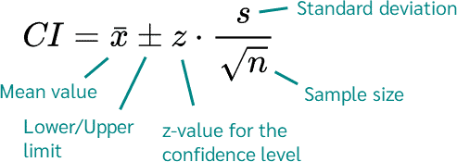
Practice
An idea from the professor if this can work
Get # of followers or # following of one of their social media accounts
This is the population
Plot this in a histogram
Plot the means from various random samples
This is the sampling distribution
Can calculate the confidence interval:
https://datatab.net/tutorial/confidence-interval

Slide 24
Summary
Probability Theory
Frequentist and Bayesian
Inferential Statistics
Taking data and applying probability theory to determine the likelihood of the data
Distributions
Normal & Binomial
Estimation
Making inferences about the population
Sampling, Law of Large Numbers, Central Limit Theorem & Sampling Distributions

