Slide 1
PSYC 640
Dr. Dustin Haraden
R Foundations
Assistant Professor
Department of Psychology
Primary: R & RStudio
Supplemental: Jamovi
Notes:
Welcome participants. Briefly introduce yourself and the workshop structure. Mention both sessions. Ask for a quick show of hands: who has used R before? Who has never done any statistics in software?

Slide 2
Overview
Revisit Replication/Reproducibility
The R Kitchen
Using Projects and Quarto Docs
Lab 2 Review
Data Wrangling/Tidying

Slide 3
Terminology
Effect Size
p-value
The magnitude or strength of a phenomenon/difference
The probability of getting that results or higher if the NULL hypothesis was true
Significant
Power
Statistical Significance (p < 0.05) vs.
Practical Significance (does it matter)
The probability of detecting an effect if an effect truly exists
Notes:
Ask the room: 'Has anyone heard of power posing?' Let them respond. Then: 'This is what happens when statistics are misused. By the end of today you'll know exactly what went wrong — and more importantly, how to avoid it in your own work.'

Slide 4
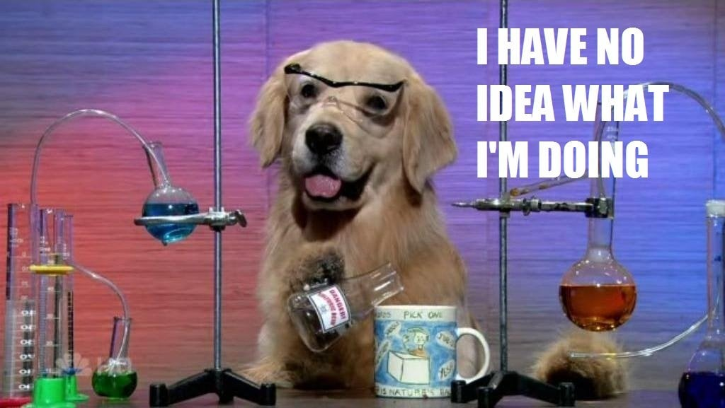
Do Science More Gooder
Notes:
This framing is the through-line for both sessions. Every method you learn today is a tool for making or breaking a scientific argument. You're not learning t-tests — you're learning how to prove or disprove a claim about your data.

Slide 5
The study everyone believed
Carney, D. R., Cuddy, A. J., & Yap, A. J. (2010). Power posing: Brief nonverbal displays affect neuroendocrine levels and risk tolerance. Psychological science, 21(10), 1363-1368. link
"Power posing increases testosterone and risk-taking."
Carney, Cuddy & Yap (2010) · Many studies cited this
Notes:
Ask the room: 'Has anyone heard of power posing?' Let them respond. Then: 'This is what happens when statistics are misused. By the end of today you'll know exactly what went wrong — and more importantly, how to avoid it in your own work.'

Slide 6
The study everyone believed, but shouldn’t have
"Power posing increases testosterone and risk-taking."
Carney, Cuddy & Yap (2010) · Many studies cited this
Sample size
Effect size
Outcome
N = 42
Not reported
p = .049
~80% underpowered
for the claimed effect
p < .05 treated as
full evidence
Ranehill et al. (2015)
N = 200: p = .52
Notes:
Ask the room: 'Has anyone heard of power posing?' Let them respond. Then: 'This is what happens when statistics are misused. By the end of today you'll know exactly what went wrong — and more importantly, how to avoid it in your own work.'

Slide 7
Replication & Reproducibility
Replication
The process of applying the same methodology with a different sample and research group
Reproduction
Taking all materials from a study and coming to the same conclusions
Notes:
Ask participants: 'Which type of t-test do we need to test the claim on the slide?' Answer: independent samples, because treatment vs. control are different people. Then also ask which type tests pre→post within one group. Answer: paired.

Slide 8

Example: “I Want to Bake a Cake”
Replication
The process of applying the same methodology with a different sample and research group
1. Find a recipe online
2. Get ingredients (@ Wegman’s if you’re fancy)
3. Follow the Recipe and Bake
4. Enjoy the delicious cake
https://thatsthecake.com/products/cartoon-cake-slice-3d
Notes:
Ask participants: 'Which type of t-test do we need to test the claim on the slide?' Answer: independent samples, because treatment vs. control are different people. Then also ask which type tests pre→post within one group. Answer: paired.

Slide 9
Example: “I Want to Bake a Cake”
Reproduction
Taking all materials from a study and coming to the same conclusions
1. Find a recipe online → Find their kitchen
2. Get ingredients → Use their ingredients
3. Follow the Recipe and Bake → Watch them and follow
4. Enjoy the delicious cake → Enjoy Cake (and jail for B&E)
https://thatsthecake.com/products/cartoon-cake-slice-3d
Notes:
Ask participants: 'Which type of t-test do we need to test the claim on the slide?' Answer: independent samples, because treatment vs. control are different people. Then also ask which type tests pre→post within one group. Answer: paired.

Slide 10
Replication & Reproducibility
Replication
Reproduction
Have a similar research question
Collect your own data
Follow their steps with your resources
Outcome: Similar results (depends on other factors)
Use the same research question
Use their data
Follow their steps with their resources
Outcome: Identical results
Notes:
Ask participants: 'Which type of t-test do we need to test the claim on the slide?' Answer: independent samples, because treatment vs. control are different people. Then also ask which type tests pre→post within one group. Answer: paired.

Slide 11
Replication & Reproducibility
Main goals of Science:
Important: We want to replicate the work of other researchers
MOST Important: Be able to reproduce all of our own results
You are your own worst collaborator!
Notes:
Ask the room: 'Has anyone heard of power posing?' Let them respond. Then: 'This is what happens when statistics are misused. By the end of today you'll know exactly what went wrong — and more importantly, how to avoid it in your own work.'

Slide 12
Has This Worked?? I’ve already asked you that…
Spoilers…not really

Slide 13
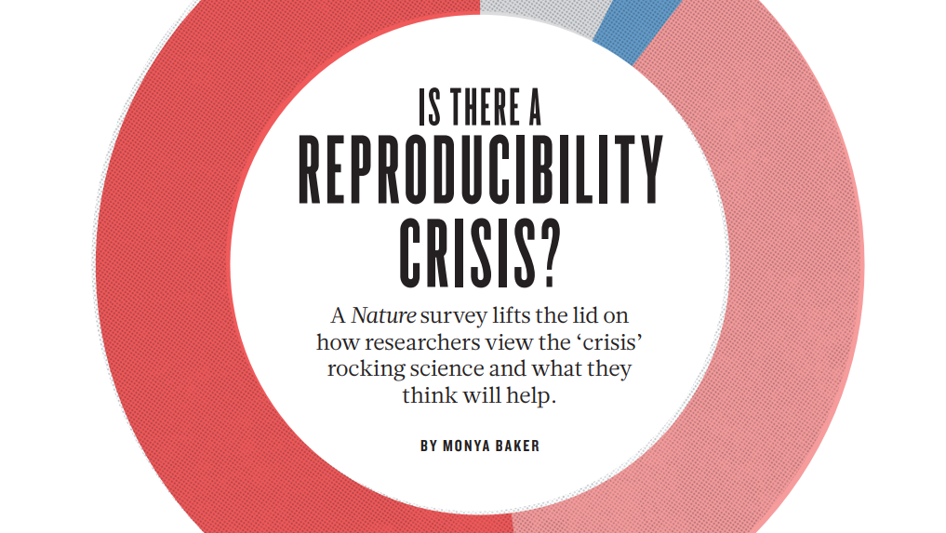

Slide 14
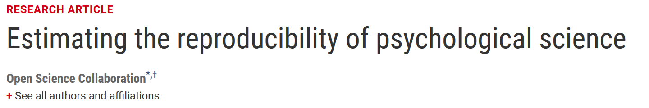
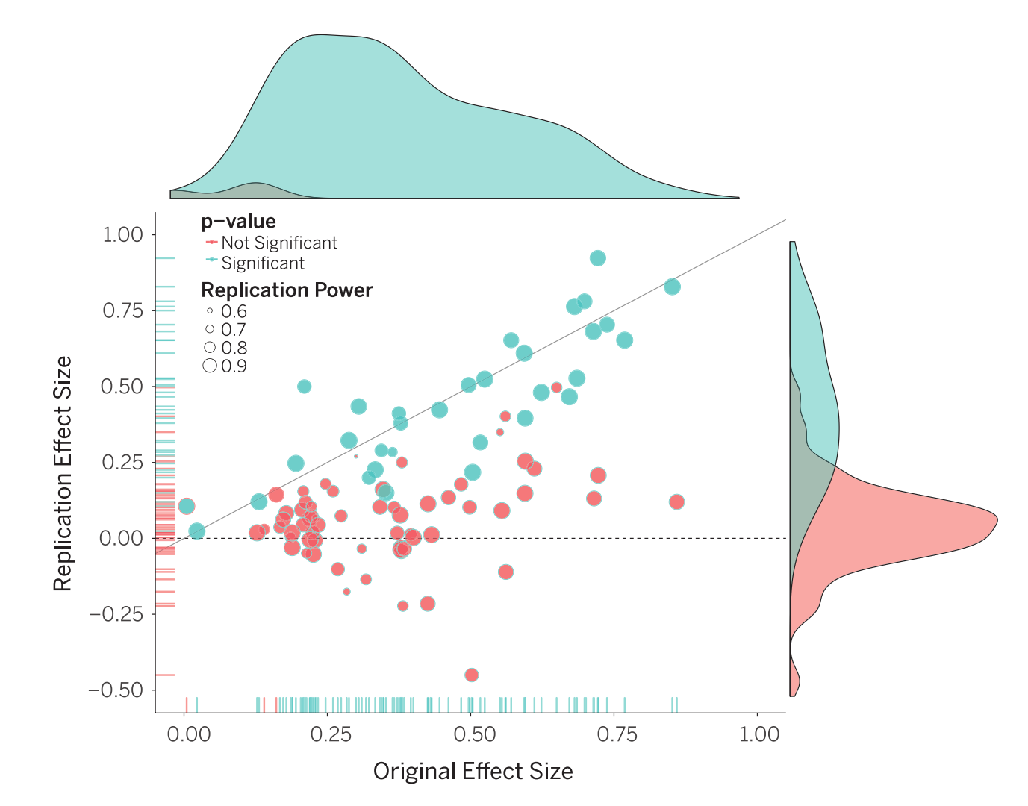
100 Replication Studies
Adequately Powered
Original Studies:
Mean Effect: 0.403
% with p<.05: 97%
Replication Studies:
Mean Effect: 0.197
% with p<.05: 47%
Notes:
Open Science Collaboration. (2015). Estimating the reproducibility of psychological science. Science, 349(6251), aac4716.
Something about the empire striking back?
Psychological accelerator
Many labs projects
https://www.nature.com/news/first-results-from-psychology-s-largest-reproducibility-test-1.17433
There is plenty of room for improvement, he adds, but earlier studies have suggested that reproducibility rates in cancer biology and drug discovery could be even lower^{1, 2}. “

Slide 15
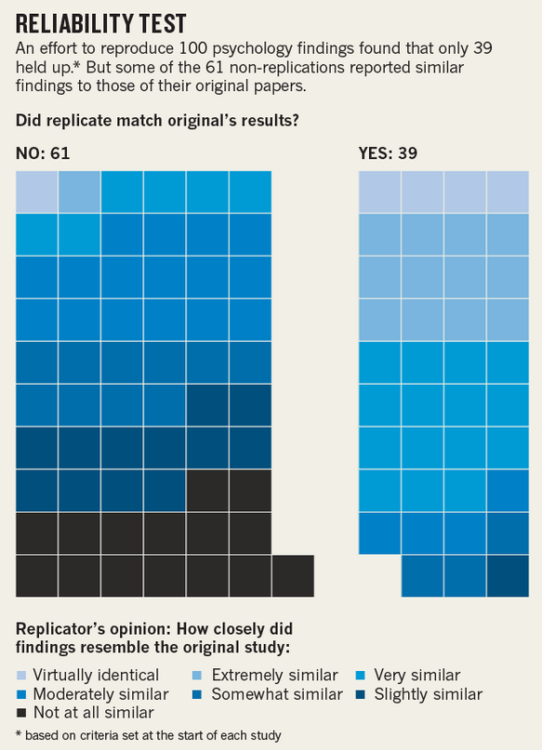
100 Replication Studies
Adequately Powered
Original Studies:
Mean Effect: 0.403
% with p<.05: 97%
Replication Studies:
Mean Effect: 0.197
% with p<.05: 47%
Notes:
Open Science Collaboration. (2015). Estimating the reproducibility of psychological science. Science, 349(6251), aac4716.
Something about the empire striking back?
Psychological accelerator
Many labs projects
https://www.nature.com/news/first-results-from-psychology-s-largest-reproducibility-test-1.17433
There is plenty of room for improvement, he adds, but earlier studies have suggested that reproducibility rates in cancer biology and drug discovery could be even lower^{1, 2}. “

Slide 16
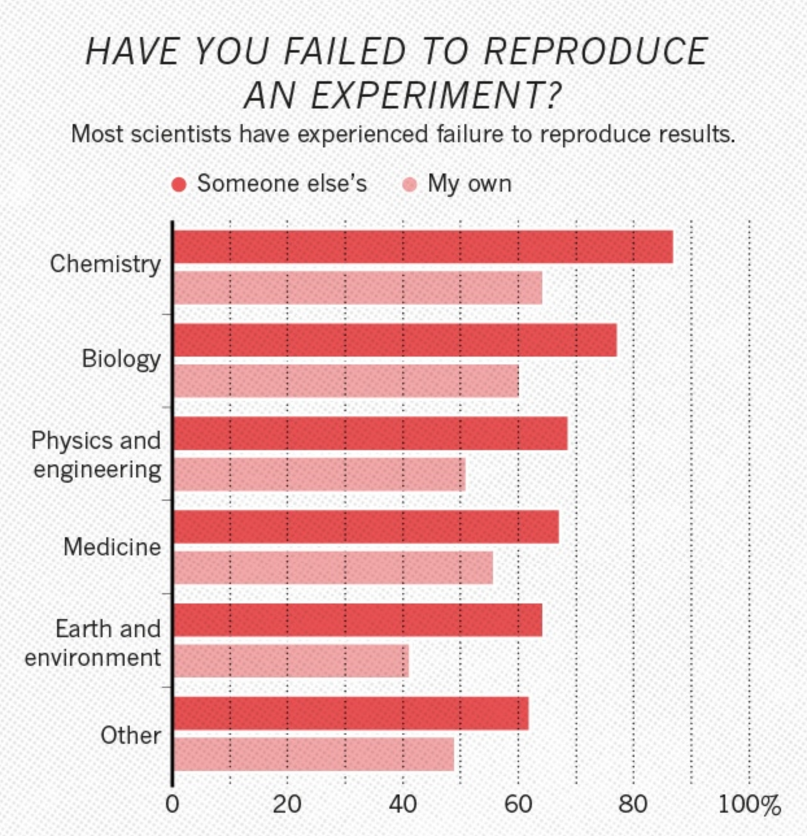
Notes:
Ask participants: 'Which type of t-test do we need to test the claim on the slide?' Answer: independent samples, because treatment vs. control are different people. Then also ask which type tests pre→post within one group. Answer: paired.

Slide 17
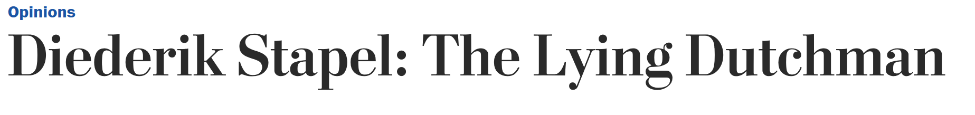
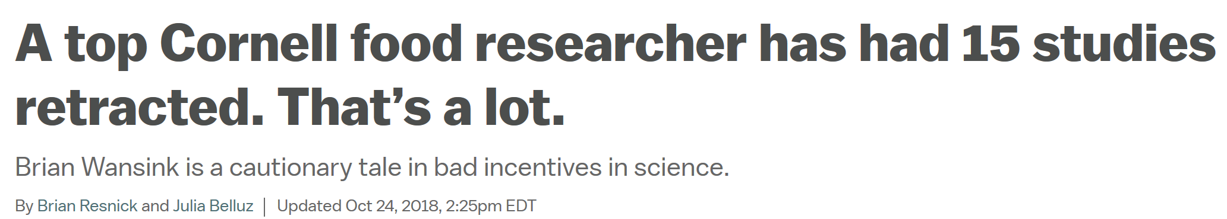
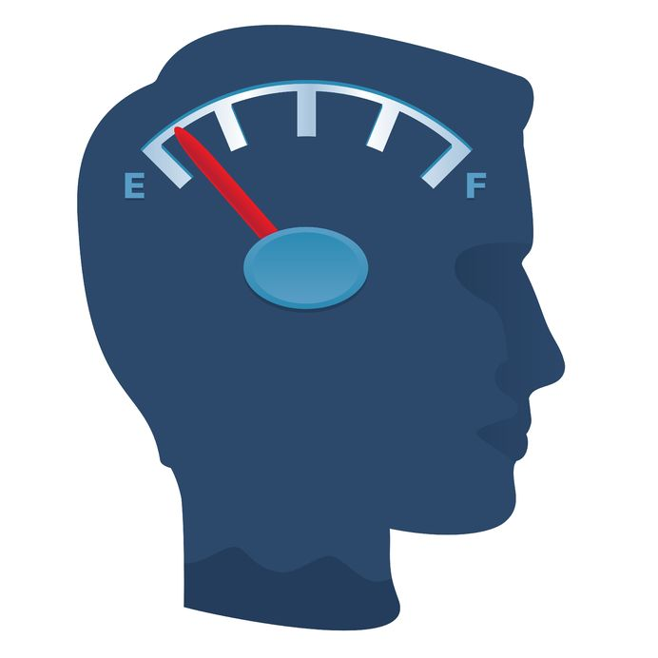
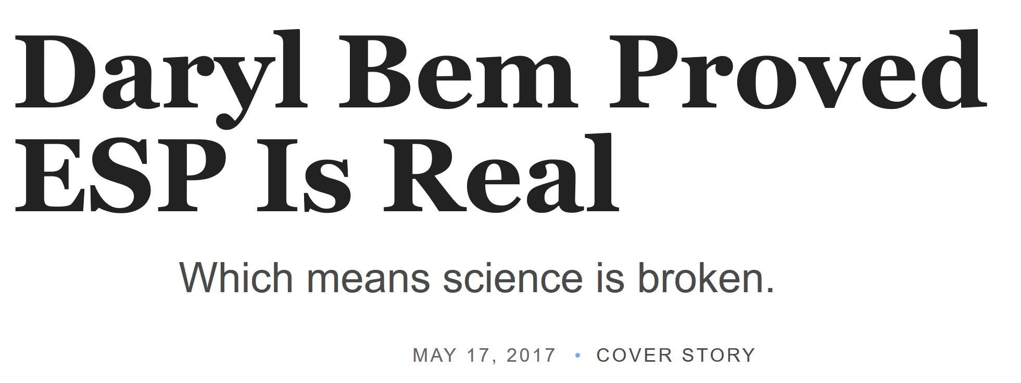

Notes:
2011 Daryl Bem
2011 Diederik Stapel: 58 publications (Falsifying Data)
January 2017 – Brian Wansink: 61 publications retracted (p-hacking)
Power Posing
Ego Depletion

Slide 18
Questionable Research Practices QRP’s
Selective reporting of dependent variables
Deciding whether to collect more data after looking to see whether the results will be significant
Failing to disclose experimental conditions
In a paper reporting selectively studies that worked
Reporting an unexpected finding as having been predicted from the start
Falsifying Data
Notes:
https://replicationindex.com/2015/01/24/questionable-research-practices-definition-detect-and-recommendations-for-better-practices/
HARKing
P-hacking

Slide 19
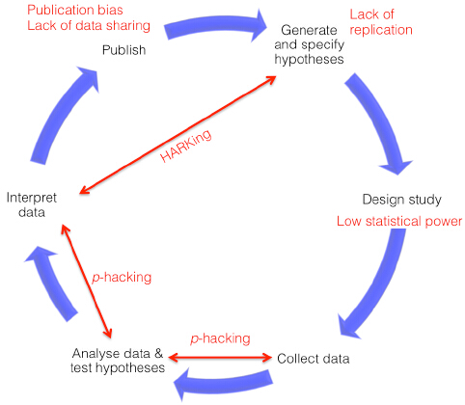
Scientific Process & QRP’s
Scientific Process & QRPs
Notes:
Chambers, C. D., Feredoes, E., Muthukumaraswamy, S. D., & Etchells, P. (2014). Instead of" playing the game" it is time to change the rules: Registered Reports at AIMS Neuroscience and beyond. AIMS Neuroscience, 1(1), 4-17.
https://projects.fivethirtyeight.com/p-hacking/

Slide 20
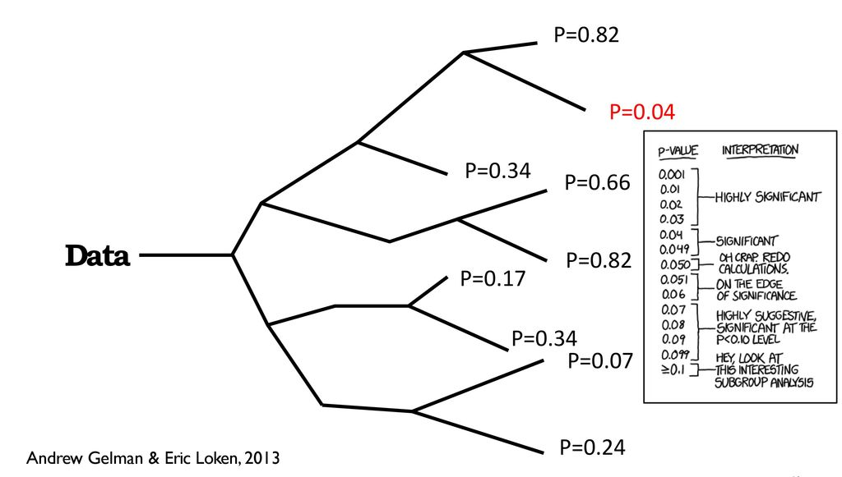
Garden of Forking Paths
Notes:
Bunch of different ways you could go about slicing your data

Slide 21
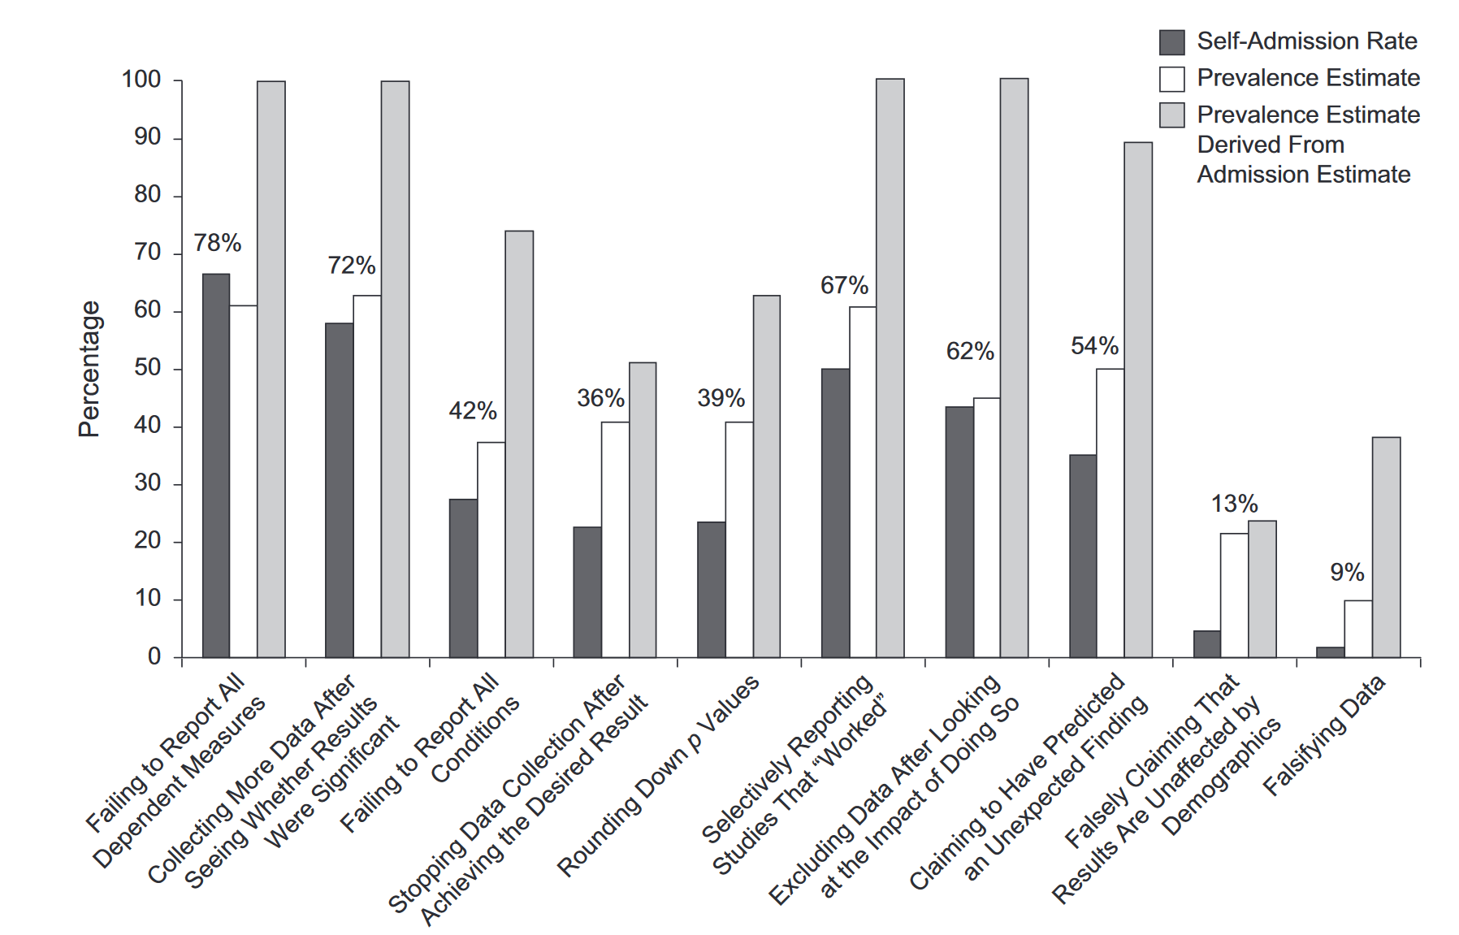
John, L. K., Loewenstein, G., & Prelec, D. (2012). Measuring the prevalence of questionable research practices with incentives for truth telling. Psychological science, 23(5), 524-532.
Notes:
John, L. K., Loewenstein, G., & Prelec, D. (2012). Measuring the prevalence of questionable research practices with incentives for truth telling. Psychological science, 23(5), 524-532.

Slide 22
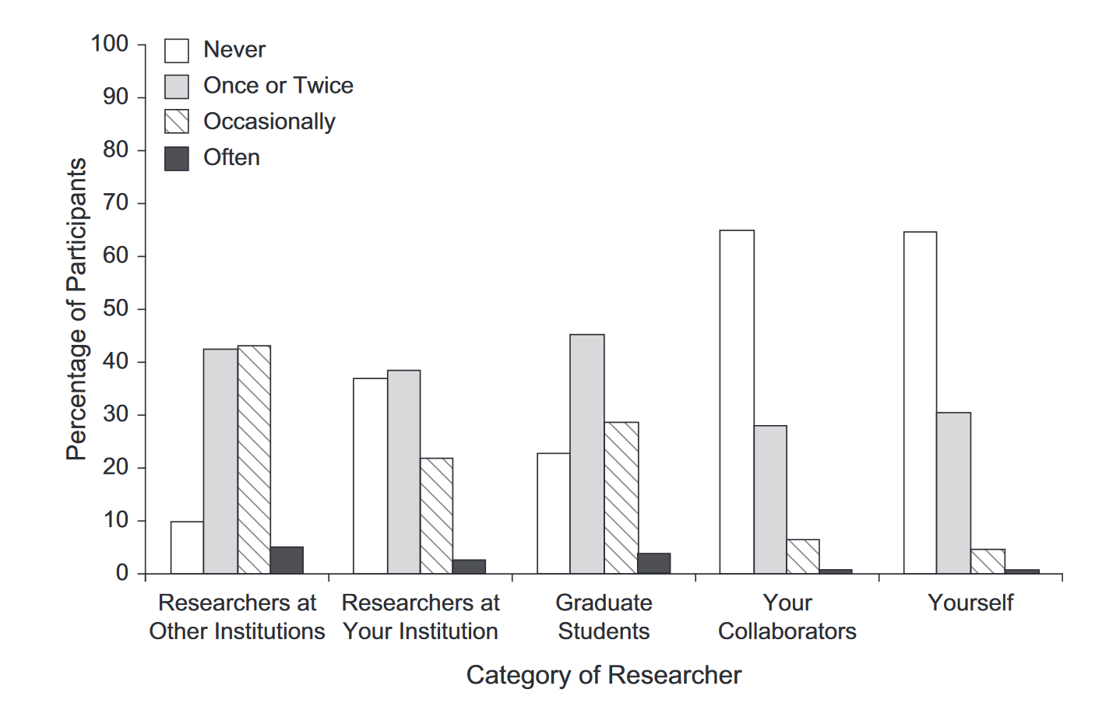
Notes:
John, L. K., Loewenstein, G., & Prelec, D. (2012). Measuring the prevalence of questionable research practices with incentives for truth telling. Psychological science, 23(5), 524-532.

Slide 23
Working with R-Studio
R-Studio is just like a kitchen 🧑‍🍳
The Environment pane is the pantry/fridge
The Console is like the oven/stove
The Markdown document is the recipe
The bottom right sometimes acts as the little window on the oven where you can see things baking
Creating a Project puts these things in their place

Slide 24

Welcome to the Kitchen
Your First Third(?) R Session
Nobody is born knowing how to cook. Every chef has burned something.
Notes:
Frame the session: today we tour the kitchen, make one simple dish, and set off the smoke alarm on purpose so it never scares us again. Set the tone that errors are normal and expected — you cannot break R by typing the wrong thing.

Slide 25

The Kitchen Map
Four panes, arranged just like your RStudio window:
The Recipe Card
The Fridge & Pantry
Script Editor · top-left
Environment · top-right
Write the steps down so anyone can make the dish again
Everything you've prepped and stored, ready to use
The Countertop
Cookbook Shelf & Serving Window
Console · bottom-left
Plots / Packages / Help · bottom-right
Cook right now, by hand — fast, but nothing is saved
Finished dishes appear here; cookbooks live here too
Notes:
Have students find each pane on their own screen. Quick check: call out a pane name, students point to it (or type the kitchen name in chat). The cards on this slide are arranged in the same 2x2 layout as the default RStudio window.

Slide 26


Choose Your Kitchen: Projects
One course/project = one dedicated kitchen. Every ingredient, recipe, and dish in one place.
Build it once:
The .Rproj file is the key
File → New Project → New Directory
Name it psych-stats, save in Documents (not Downloads)
Create Project — the Files pane now shows this kitchen's cabinets
Start every session by double-clicking it, not by opening RStudio directly
The working directory is where you stand
“File not found” usually means: wrong kitchen, not that the ingredient is missing
Walk into the right kitchen first. Then start cooking.
Notes:
Build the project live, together, before any code. Point out the project name in the top-right corner of RStudio — the sign on the kitchen door. Pre-empt setwd(): 'Advice online will tell you to use setwd(). That's teleporting between kitchens mid-recipe — it breaks on any other computer. We walk in the front door instead.' One course, one kitchen: a separate project for any other class using R.

Slide 27


Rule #1 of the Kitchen
The Countertop (Console)
The Recipe Card (Script)
Experiment freely
Taste as you go
Nothing is saved
Write the final version down
Repeatable & shareable
This is your real work
If it's not in a script, you can't make it again.
Notes:
This is the single biggest habit to build. Console for play, script for keeps. Foreshadows reproducibility without using the word yet.

Slide 28



Cooking on the Countertop
Type along in the console — press Enter after each line
A function is a technique
# arithmetic
2 + 2
100 / 4
3 * 12 # eggs in 3 dozen?
# functions = kitchen techniques
sqrt(144)
round(3.14159, 2)
round() is to numbers what “dice” is to onions → get it to the size you want
# = a note/comment
R ignores everything after it. Comments are for you!
Up arrow = recall
No need to re-chop the onion
Notes:
Live-code this with students typing along. Make at least one genuine typo and recover out loud. Point out the up-arrow trick early — it saves enormous frustration.

Slide 29


Stocking the Pantry: Objects
oven_temp <- 350 reads as “oven_temp gets 350”
# put it in a labeled container
oven_temp <- 350
# a whole tray of ingredients
cookie_ratings <- c(7, 9, 8,
10, 6, 9, 8)
# techniques for the whole tray
mean(cookie_ratings)
length(cookie_ratings)
<- fills a container
The label shows up in your Environment pane — watch the pantry stock itself
c() is the mixing bowl
It combines ingredients into one tray (a vector)
Notes:
After each assignment, direct attention to the Environment pane. 3-minute exercise: object named after their favorite food with a rating out of 10, then a vector of three foods, then the mean. Ask 1-2 volunteers to share.

Slide 30
You just computed your first statistic.
mean(cookie_ratings)
The same mean you’ve used before — the average rating.
That's it. That's the scary part.
Notes:
Pause here. The point: descriptive statistics are not a separate scary thing — students just did one. Demystify before the word 'statistics' gets weight.

Slide 31
Your First Full Recipe
File → New File → Quarto Document — a complete, repeatable recipe in a few
1
Gather ingredients/batter Pull in the data
import(), read.csv()
2
Check the batter Inspect the data
glimpse(), View(), summary()
3
Bake Make a bar plot
barplot(), ggplot()
4
Taste it Compute a statistic
mean()
5
Review the handout and get the data from the website
Notes:
The full script is on the student handout — students type or paste it. Walk through the five steps before anyone runs anything, so they see the structure of an analysis: data in, combine, inspect, visualize, summarize. That arc is every analysis they'll ever run.

Slide 32

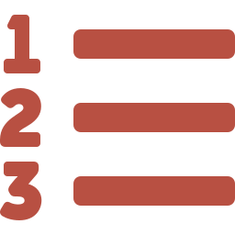

Three Ways to Cook a Recipe
Line by line
A chunk
The whole dish
Ctrl/Cmd + Enter
Highlight + Ctrl/Cmd + Enter
Source button
Tasting as you go — run the line your cursor is on
Cook a few steps together
Trust the recipe — run the entire script top to bottom
When the plot appears: screenshot it. That's your first dish.
Notes:
Demonstrate all three run methods live. Make the plot a moment: 'You just wrote a program that turned raw data into a research-quality figure. Day one.' Fast finishers: change a rating, add a sixth cookie, or change the bar color, then re-Source — plants the reproducibility seed.

Slide 33

Set Off the Smoke Alarm — On Purpose
cookie_ratngs
“I looked in the pantry. No container has that label.”
Error: object 'cookie_ratngs' not found
Mean(avg_rating)
“I don’t know a technique called ‘Mean’. (I know ‘mean’.)”
Error: could not find function "Mean"
mean(avg_rating
“Still listening — you haven’t finished the sentence.” (Escape = start over)
Error: console shows + and waits…
The error message is the smoke alarm, not the fire.
Notes:
Everyone triggers all three errors deliberately, together. Read each message aloud and translate. Key debrief: R is not judging you, not broken, not fragile. The error text tells you exactly which ingredient it couldn't find. Reading the message IS the skill. Mention that experienced R users got errors this morning too.

Slide 34

Before the Break
1
What's the difference between the console and a script? Kitchen terms welcome.
2
What does <- do?
3
What is an R-Project and how is it different from the Quarto Document?
4
What does %>% do?
Notes:
Collect on paper, LMS, or chat. Keep the 1-10 intimidation ratings — re-ask at midterm and analyze the before/after with the class in R. It's a paired-data example about themselves.

Slide 35
Review Lab 2
Notes:
This framing is the through-line for both sessions. Every method you learn today is a tool for making or breaking a scientific argument. You're not learning t-tests — you're learning how to prove or disprove a claim about your data.

Slide 36
Today you toured the kitchen, prepped ingredients,
baked your first dish, and set off the smoke alarm
without burning anything down.
Everything else this semester is just learning more recipes.
Notes:
End on confidence. Preview what's next session if you like (e.g., loading real data — 'shopping for groceries').

