Slide 1
PSYC 640 Grad Stats
Probability & Inference
10/24/2024

Slide 2
Descriptives vs. Inferences
Moving from simply describing our data
With means and standard deviations
To drawing conclusions about the world
Using inferential statistics

Slide 3
“When you make assumptions you make an…”
It is common to view assumptions in a negative way
Assumptions may introduce bias
Statistical inference relies on assumptions
Nearly impossible to use logical reasoning on it’s own

Slide 4
“When you make assumptions you make an…”
It is common to view assumptions in a negative way
Assumptions may introduce bias
Statistical inference relies on assumptions
Nearly impossible to use logical reasoning on it’s own

Slide 5
Limits of Logical Reasoning
Let’s test out the limits to logical reasoning using a coin flip game!
We will try to predict the coin flip prior and have us determine what the logical side would say vs. including assumptions

Slide 6
Assumptions
Reasonable to think that the unbeatable record is good evidence to predict the next win
No easy logical justification
Cannot truly justify betting on the win without an assumption
Relied on an implicit assumption that there was a skill/knowledge difference
Able to then learn from the assumption that was made
If a less sensible assumption was used to drive your understanding, it may have been less accurate
Logic will reject that assumption entirely
All outcomes remain to be equally as plausible
Trying to rule out what is impossible first did not allow for a prediction to be made

Slide 7
Assumptions & Inferences
You cannot avoid making assumptions with data
Since assumptions are necessary, it becomes important to make sure you make the right ones!
As we continue we will try to identify the underlying assumptions within a technique and how to check

Slide 8
Probability & Inferential Statistics

Slide 9
Random Process
A random process is a situation in which we know what outcomes could happen, but we don't know which particular outcome will happen.
Examples: coin tosses, die rolls, music shuffle, whether the stock market goes up or down tomorrow, etc.
It can be helpful to model a process as random even if it is not truly random.

Slide 10
Probability – Understanding Randomness
There are several possible interpretations of probability but they (almost) completely agree on the mathematical rules probability must follow.
P(A) = Probability of event A
0 ≤ P(A) ≤ 1
Bayesian interpretation:
A Bayesian interprets probability as a subjective degree of belief: For the same event, two separate people could have different viewpoints and so assign different probabilities.
Largely popularized by revolutionary advance in computational technology and methods during the last twenty years.
Frequentist interpretation:
The probability of an outcome is the proportion of times the outcome would occur if we observed the random process an infinite number of times.

Slide 11
Practice
Which of the following events would you be most surprised by?
(a) exactly 3 heads in 10 coin flips
(b) exactly 3 heads in 100 coin flips
(c) exactly 3 heads in 1000 coin flips

Slide 12
Practice
Which of the following events would you be most surprised by?
(a) exactly 3 heads in 10 coin flips
(b) exactly 3 heads in 100 coin flips
(c) exactly 3 heads in 1000 coin flips

Slide 13
Law of Large Numbers
Law of large numbers states that as more observations are collected, the proportion of occurrences with a particular outcome, p̂n, converges to the probability of that outcome, p.
For Example:
As the sample size increases, the sample mean tends to get closer to the population mean. And as the sample size approaches infinity, the sample mean approaches the population mean

Slide 14

Law of Large Numbers
When tossing a fair coin, if heads comes up on each of the first 10 tosses, what do you think the chance is that another head will come up on the next toss? 0.5, less than 0.5, or more than 0.5?
The probability is still 0.5, or there is still a 50% chance that another head will come up on the next toss.
P(H on 11th toss) = P(T on 11th toss) = 0.5
The coin is not “due” for a tail
The common misunderstanding of the LLN is that random processes are supposed to compensate for whatever happened in the past; this is just not true and is also called gambler’s fallacy (or law of averages).

Slide 15
Disjoint and non-disjoint outcomes
Disjoint (mutually exclusive) outcomes: Cannot happen at the same time.
The outcome of a single coin toss cannot be a head and a tail.
A student both cannot fail and pass a class.
A single card drawn from a deck cannot be an ace and a queen.

Slide 16
Disjoint and non-disjoint outcomes
Disjoint (mutually exclusive) outcomes: Cannot happen at the same time.
The outcome of a single coin toss cannot be a head and a tail.
A student both cannot fail and pass a class.
A single card drawn from a deck cannot be an ace and a queen.
Non-disjoint outcomes: Can happen at the same time.
A student can get an A in Stats and A in Econ in the same semester.

Slide 17
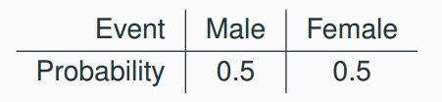
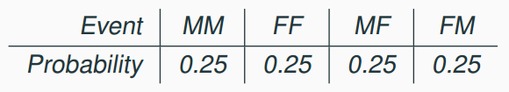
Probability distributions
A probability distribution lists all possible events and the probabilities with which they occur.
The probability distribution for the sex assigned at birth of one kid:
Rules for probability distributions:
1. The events listed must be disjoint
2. Each probability must be between 0 and 1
3. The probabilities must total 1
The probability distribution for the sex assigned at birth of two kids:

Slide 18
Practice
In a survey, 52% of respondents said they are Democrats. What is the probability that a randomly selected respondent from this sample is a Republican?
(a) 0.48
(b) more than 0.48
(c) less than 0.48
(d) cannot calculate using only the information given

Slide 19
Practice
In a survey, 52% of respondents said they are Democrats. What is the probability that a randomly selected respondent from this sample is a Republican?
(a) 0.48
(b) more than 0.48
(c) less than 0.48
(d) cannot calculate using only the information given
If the only two political parties are Republican and Democrat, then (a) is possible. However it is also possible that some people do not affiliate with a political party or affiliate with a party other than these two. Then (c) is also possible. However (b) is definitely not possible since it would result in the total probability for the sample space being above 1.

Slide 20
Statistics, Inference and Probability
Think about seeing statistics posted on the news
Often times polling companies survey a large sample to then make a statement about the population
We assume the sample is representative of the larger population, but how representative?
This is where probability theory comes in
Probability theory provides tools to assess how likely sample results are if they differ from the true population parameter

Slide 21
Role of Probability Theory
Probability theory allows us to determine if survey results like “67% of respondents prefer Android" plausibly reflect the true population parameter
While intuitive reasoning can get us part way, probability theory provides powerful mathematical tools to assess sample representativeness
Though not statistics per se, probability theory forms the foundation for statistical inference

Slide 22
Probability & Statistics – How are they different?
Although closely related, they are not identical
Probability is the “doctrine of chances”
Tell you how often different kinds of events will happen
Questions for probability theory
What are the chances of a fair coin coming up heads 10 times in a row?
If I roll a six sided dice twice, how likely is it that I’ll roll two sixes?
How likely is it that five cards drawn from a perfectly shuffled deck will all be hearts?
What are the chances that I will win the lottery?

Slide 23
Probability & Statistics – How are they different?
Each of the questions have something in common
We know about a “truth of the world”
The questions relate to the type of events that may happen
What are the things that are “assumed” or known in the questions?
They start with a known “model of the world” and then we use that to do calculations
In probability theory, the model is known, but the data are not
Statistical questions work the other way
We do not know the truth, but we have the data

Slide 24
Probability & Statistics – How are they different?
Questions for statistics:
If my friend flips a coin 10 times and gets 10 heads, are they trying to trick me?
If 5 cards off the top of the deck are all hearts, how likely is it that the deck was shuffled?
If the lottery commissioner’s spouse wins the lottery, how likely is it that the lottery was rigged?
Again, we only have the data and we need to identify which “model of the world” we think is the most accurate
Data: H H H H H H H H H H
P(heads) = 0.5 or P(heads) ≠ 0.5
The statistical inference problem is to figure out which of the probability models is correct (or the most correct)

Slide 25
Probability
Frequentist approach
Probability is a long-run frequency of an event
Bayesian approach
Probability of an event as the degree of belief

Slide 26
Probability – Frequentist Approach
The more dominant one in our field
Flipping a coin over and over again
P(heads) = 0.5
First 20 flips: T,H,H,H,H,T,T,H,H,H,H,T,H,H,T,T,T,T,T,H
11/20 were Heads (55%)
Calculate the proportion of heads at each flip (Number of Heads / Total Flips)

Slide 27
Probability – Frequentist Approach
Flip Number | Coin Result | Number of Heads | Proportion Heads
1 | T | 0 | 0.00
2 | H | 1 | 0.50
3 | H | 2 | 0.67
4 | H | 3 | 0.75
5 | H | 4 | 0.80
6 | T | 4 | 0.67
7 | T | 4 | 0.57
8 | H | 5 | 0.63
9 | H | 6 | 0.67
10 | H | 7 | 0.70
11 | H | 8 | 0.73
12 | T | 8 | 0.67
13 | H | 9 | 0.69
14 | H | 10 | 0.71
15 | T | 10 | 0.67
16 | T | 10 | 0.63
17 | T | 10 | 0.59
18 | T | 10 | 0.56
19 | T | 10 | 0.53
20 | H | 11 | 0.55

Slide 28
Probability – Frequentist Approach
Flip Number | Coin Result | Number of Heads | Proportion Heads
1 | T | 0 | 0.00
2 | H | 1 | 0.50
3 | H | 2 | 0.67
4 | H | 3 | 0.75
5 | H | 4 | 0.80
6 | T | 4 | 0.67
7 | T | 4 | 0.57
8 | H | 5 | 0.63
9 | H | 6 | 0.67
10 | H | 7 | 0.70
11 | H | 8 | 0.73
12 | T | 8 | 0.67
13 | H | 9 | 0.69
14 | H | 10 | 0.71
15 | T | 10 | 0.67
16 | T | 10 | 0.63
17 | T | 10 | 0.59
18 | T | 10 | 0.56
19 | T | 10 | 0.53
20 | H | 11 | 0.55

Slide 29
Probability – Frequentist Approach
Flip Number | Coin Result | Number of Heads | Proportion Heads
1 | T | 0 | 0.00
2 | H | 1 | 0.50
3 | H | 2 | 0.67
4 | H | 3 | 0.75
5 | H | 4 | 0.80
6 | T | 4 | 0.67
7 | T | 4 | 0.57
8 | H | 5 | 0.63
9 | H | 6 | 0.67
10 | H | 7 | 0.70
11 | H | 8 | 0.73
12 | T | 8 | 0.67
13 | H | 9 | 0.69
14 | H | 10 | 0.71
15 | T | 10 | 0.67
16 | T | 10 | 0.63
17 | T | 10 | 0.59
18 | T | 10 | 0.56
19 | T | 10 | 0.53
20 | H | 11 | 0.55

Slide 30

Probability – Frequentist Approach
Flip Number | Coin Result | Number of Heads | Proportion Heads
1 | T | 0 | 0.00
2 | H | 1 | 0.50
3 | H | 2 | 0.67
4 | H | 3 | 0.75
5 | H | 4 | 0.80
6 | T | 4 | 0.67
7 | T | 4 | 0.57
8 | H | 5 | 0.63
9 | H | 6 | 0.67
10 | H | 7 | 0.70
11 | H | 8 | 0.73
12 | T | 8 | 0.67
13 | H | 9 | 0.69
14 | H | 10 | 0.71
15 | T | 10 | 0.67
16 | T | 10 | 0.63
17 | T | 10 | 0.59
18 | T | 10 | 0.56
19 | T | 10 | 0.53
20 | H | 11 | 0.55
$As N→∞$

Slide 31

Look to R for simulation

Slide 32
Probability – Frequentist Approach
Pros
Objective: the probability of an event is grounded in the world & exist in the physical universe
Unambiguous: two people can watch the same sequence of events and will come up with the same answer
Cons
Infinity: not possible in the physical world
What would happen if we flipped a coin an infinite amount of times?
Narrow in scope: although we want to make statements about a single event, we typically are forbidden (see above point about infinity)
Example: There is a 60% chance that it will rain on Wednesday in Rochester.
“There is a category of days for which I predict a 60% chance of rain, and if we look only across those days for which I make this prediction, then on 60% of those days it will actually rain”

Slide 33
Probability – Bayesian Approach
Probability of an event as the degree of belief
Probabilities don’t exist in the world, but in the thoughts and assumptions of the people
What do we mean by “degree of belief?”
“Rational Gambling”

Slide 34
Probability – Bayesian Approach
Would you bet $5 on this? You will lose it all if you are incorrect.
I have a 75% chance of making the shot.
I have a 45% chance of making the shot.
“Subjective probability” in terms of the bets you are willing to take
This allows researchers to bring previous knowledge to assign probabilities to a single event
They do not only need to be repeatable
However, this means that this approach cannot be purely objective

Slide 35
Frequentist vs. Bayesian Approach
Which is right?
Nothing mathematically incorrect for either
Have actually informed one another
Some people get upset
Relying on frequentist methods could turn you into “a potent but sterile intellectual rake who leaves in his merry path a long train of ravished maidens but no scientific offspring” (Meehl, P. H. (1967). Theory testing in psychology and physics: A methodological paradox. Philosophy of Science, 34, 103–115.)
Most commonly used in Psychology (and what we will focus on) is the frequentist method

Slide 36
Probability Distributions

Slide 37
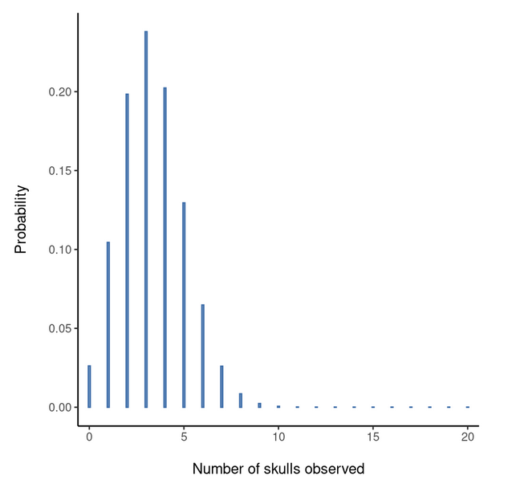
Distributions - Binomial
Discrete Variables
Experiment: 20 six-sided dice; all blank with 1 side that has a Yoshi
If we roll all 20, what is the probability that we’ll get exactly 4 Yoshi?
Chance of one dice rolling Yoshi -> 1 in 6
Number of Yoshi Observed

Slide 38
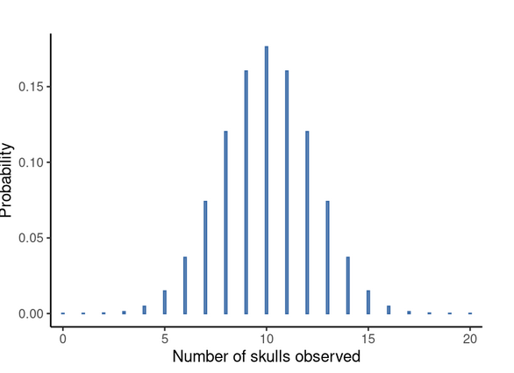
Distributions - Binomial
Experiment: Coin flip; 1 side Yoshi
Flip the coin 20 times
Chance of getting Yoshi -> 1 in 2
Number of Yoshi Observed

Slide 39
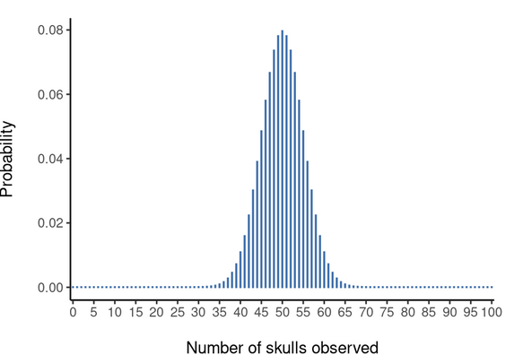
Distributions - Binomial
Experiment: Coin flip; 1 side Yoshi
Flip the coin 100 times
Chance of getting Yoshi -> 1 in 2
Approaches a bell curve
https://www.statcrunch.com/applets/type2&binomial
Number of Yoshi Observed

Slide 40
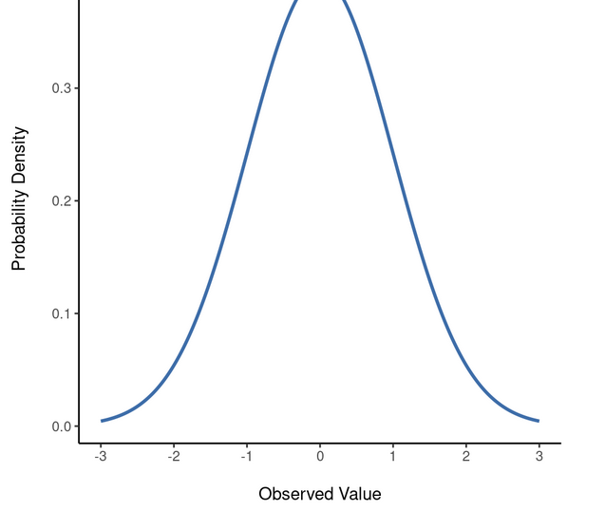
Distributions - Normal
Continuous Variables
Described by 2 parameters, the mean and the standard deviation
Mean = 0, SD = 1
https://www.statcrunch.com/applets/type2&normal

Slide 41
How does this relate to probability?
Each statistic we calculate is considered a random variable
Remember the probability distributions?
Event | 1 | 2 | 3 | 4 | 5 | 6
Probability | 1/6 | 1/6 | 1/6 | 1/6 | 1/6 | 1/6
This is the sampling distribution
What happens when things aren’t equal across groups?

Slide 42
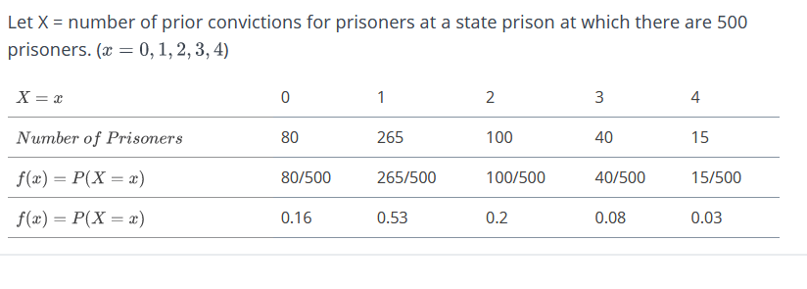
Discrete Variables

Slide 43
Discrete Variables
Won’t usually be able to sample the whole population
But this type of distribution can help inform us moving forward!

Slide 44
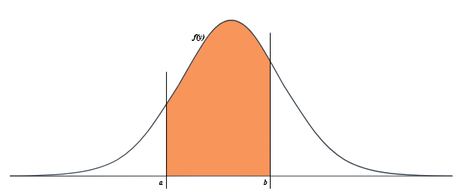
Continuous Variables – Probability Density Function
What is the probability of getting the value exactly right?
P(Y=y) = 0
Turtles all the way down…
Look at probability of an interval by
examine the area under the curve
Can calculate z-scores for normal random
variables and identify the probability
Event | 1 | 2 | 3 | 4 | 5 | 6
Probability | 1/6 | 1/6 | 1/6 | 1/6 | 1/6 | 1/6

Slide 45
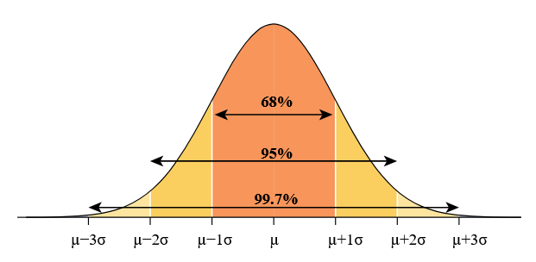
Empirical Rule
In any normal or bell-shaped distribution, roughly...
68% of the observations lie within one standard deviation to either side of the mean.
95% of the observations lie within two standard deviations to either side of the mean.
99.7% of the observations lie within three standard deviations to either side of the mean.

Slide 46

Estimating the unknown from a sample – Inferential Statistics
A little bit of methods in this section…

Slide 47
Parameter Estimation
We are often interested in population parameters.
Since complete populations are difficult (or impossible) to collect data on, we use sample statistics as point estimates for the unknown population parameters of interest.
Sample statistics vary from sample to sample.
Quantifying how sample statistics vary provides a way to estimate the margin of error associated with our point estimate.
Suppose we randomly sample 1,000 adults from each state in the US. Would you expect the sample means of their heights to be the same, somewhat different, or very different?
What if we took another random sample? Would they be identical?

Slide 48
Samples, populations and sampling
Sampling theory
Drawing inferences from the sample about the population
Defining a population
Creating an appropriate sample
LLN & CLT
Population Parameters and Sample Statistics
Outlining a simulation: https://onlinestatbook.com/stat_sim/sampling_dist/

Slide 49
Defining a population
More of an abstract idea about who you want to make statements
Example: Running a study with 100 undergraduate students as participants. Who is the population?
All of the undergraduate psychology students at RIT?
Undergraduate psychology students in general, anywhere in the world?
Americans currently living?
Americans of similar ages to my sample?
Anyone currently alive?
Any human being, past, present or future?
Any biological organism with a sufficient degree of intelligence operating in a terrestrial environment?
Any intelligent being?
Critical point is that the sample is a subset of the population with the goal of drawing inferences about the larger population
The relationship depends upon the procedure of selection for the sample

Slide 50
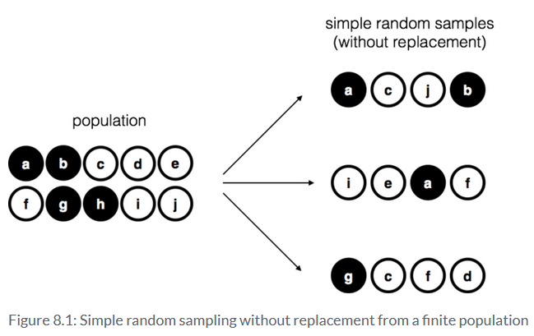
Sampling – Simple random samples
Let’s say I have a bag containing 10 chips
Note about with vs. without replacement
Most statistical theory is based on with replacement

Slide 51
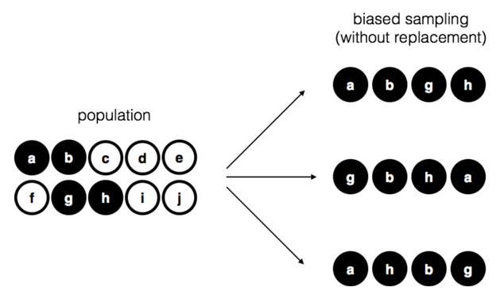
Sampling – Biased Sampling

Slide 52
Sampling – How much does it matter
Difficult to identify a simple random sample in the real world
Think about the differences between the two sampling techniques we just saw. Should it matter?
We can adjust for biases
Two Key Points
Designing studies – think about the population you want to make inferences about
Critiquing studies – Think about how their sample may impact the conclusions that are being made

Slide 53
Population Parameters & Sample Statistics
Let’s return to the simulation https://onlinestatbook.com/stat_sim/sampling_dist/
Parameters of the population
Mean = 16; Standard Deviation = 5
Sample is taken – can calculate the mean and standard deviation of the sample
These are the sample statistics
With this procedure, we will be able to estimate the population parameters and estimate confidence intervals
We need to do a little more with Sampling Theory first

Slide 54
Law of Large Numbers
We may need to increase our precision of our estimates
Increase our sample size; Why does this work?
Law of Large Numbers (a law about averages)
As the sample size increases, the sample mean tends to get closer to the population mean
As the sample size approaches infinity, the sample mean approaches the population mean

Slide 55
Sampling Distribution & Central Limit Theorem
LLN – a long run guarantee...not super useful IRL
Create the Sampling Distribution Simulation
Run a study with N = 5
Replicate the study 10 times
Collect 5 scores, calculate mean of sample
Repeat
Look at the simulated distribution
Create a sampling distribution of the means
Sampling distributions exist for other statistics

Slide 56
Sampling Distribution & Central Limit Theorem
What happens to sampling distribution when the sample size increases?
Standard Deviation of sampling distribution = Standard Error
What happens to sampling distribution when population is non-normal?
Central Limit Theorem
The mean of the sampling distribution is the same as the mean of the population
The standard deviation of the sampling distribution (i.e., the standard error) gets smaller as the sample size increases
The shape of the sampling distribution becomes normal as the sample size increases

Slide 57
Estimating Population Parameter
Calculated from the sample
Sample Statistic ≠ Estimate Population Parameter (conceptually
Sample statistic – Description of your data
Estimate – best guess about the population
Most commonly used are Mean and Standard Deviation
We will get to when talking about descriptives

Slide 58
Confidence Intervals
Every dataset has some level of uncertainty
Need to quantify amount of uncertainty
We want to say - “There is a 95% chance that the true mean lies between 12 and 23”…but we can’t
Confidence Interval for the mean

Slide 59
Confidence Intervals
CLT – Sampling distribution of the man is approximately normal
Normal Distribution – 95% chance that an observation will fall within 2 standard deviations of the mean
1.96 Standard Deviations (Standard Error of Sampling Distribution)
Can repeat the calculation of the confidence interval (frequentist approach)
Look to Simulation: https://rpsychologist.com/d3/ci/
What we can say “There is a 95% chance that the confidence interval captures the true mean”

Slide 60
Summary
Probability Theory
Frequentist and Bayesian
Inferential Statistics
Taking data and applying probability theory to determine the likelihood of the data
Distributions
Normal & Binomial
Estimation
Making inferences about the population
Sampling, Law of Large Numbers, Central Limit Theorem & Sampling Distributions

