Slide 1
AI-Sahayak: A Smart WhatsApp-First Compliance Assistant for Indian SMEs 19CSE495 Project Phase 1 Team ID: 22UG049 Panel No. :15
S.No | Reg.No | Name of the Student | Branch
1 | BL.EN.U4CSE22033 | Karthik Katuri | CSE
2 | BL.EN.U4CSE22035 | Mudumala Varnika Narayani | CSE
3 | BL.EN.U4CSE22040 | Nunnaguppala Rohit | CSE
4 | BL.EN.U4CSE22218 | Dhara Lakshmi Kusumanchi | CSE
Project Guide: Dr Thangam S.
Associate Professor (CSE)

Slide 2
Contents
Mentor Approval
Problem Definition
Objectives
Justification for the Proposed Problem
Significance of the Solution
Motivation
Literature survey
Data Set
Architecture Diagram
Methodology
Tools and Technologies
Implementation Roadmap
Results and Analysis
Conclusion
Future Work
References

Slide 3
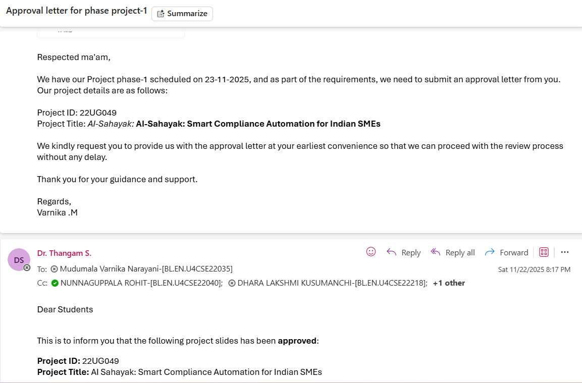
Mentor Approval

Slide 4
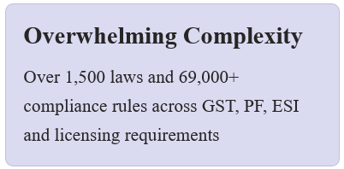
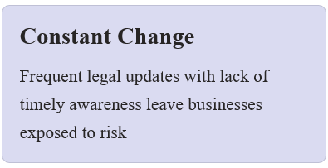
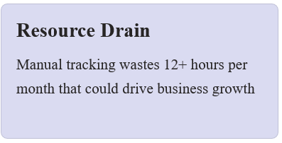
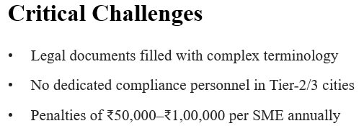
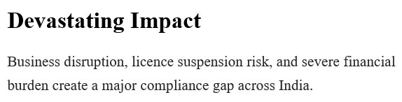
Millions of Indian small and medium enterprises face a daunting compliance landscape that threatens their survival and growth. The regulatory burden is immense and unforgiving.

Slide 5
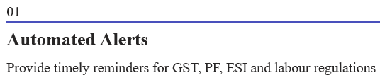
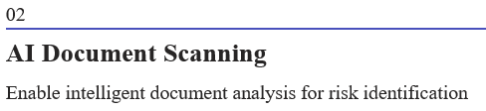
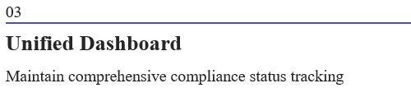
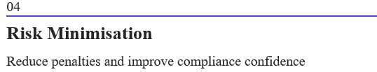
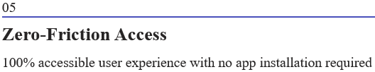
Project Objectives
Primary Objective
Develop AI-Sahayak, an intelligent compliance assistant that operates entirely through WhatsApp, enabling SMEs to maintain compliance effortlessly without additional infrastructure or training.

Slide 6
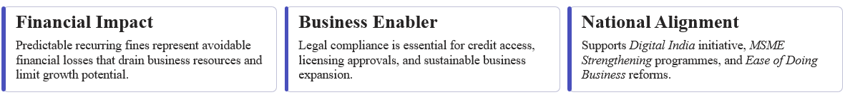
Why This Solution Matters
The Market Reality
80% of SMEs lack any compliance automation tool. Current solutions are expensive, app-based, and English-only — creating insurmountable barriers for most Indian businesses.
WhatsApp is used by 95% of Indian SMEs for business communication, making it the perfect delivery channel.
This solution addresses a critical gap with strong business and societal justification, empowering India's economic backbone.

Slide 7
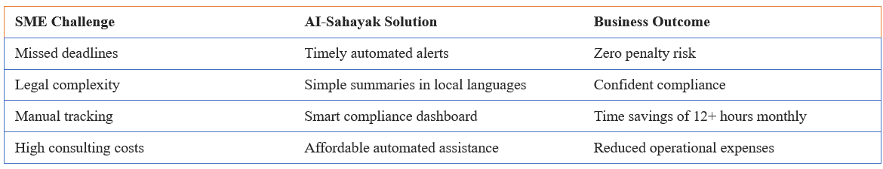
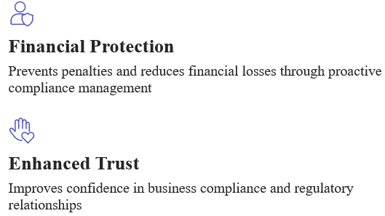
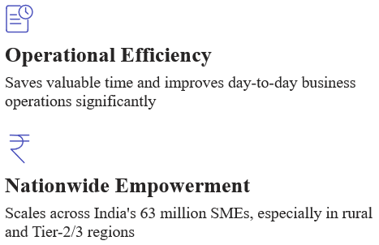
Solution Impact & Advantages
AI-Sahayak delivers measurable value by transforming how SMEs manage compliance, turning a burden into a competitive advantage.

Slide 8
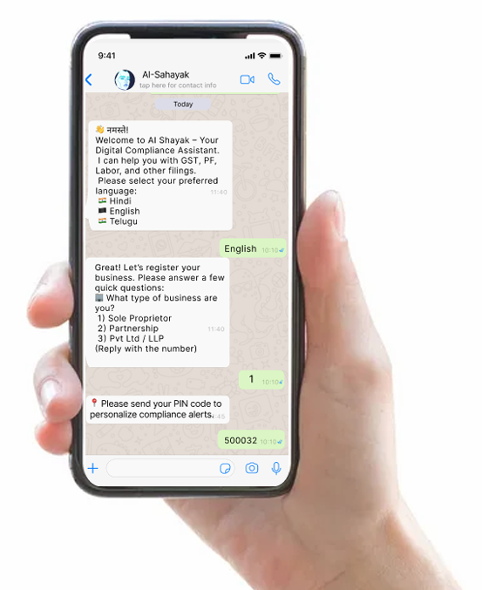
Core Features
AI-Sahayak Features
📅 Compliance Calendar
🔔 Smart Alerts (Email, SMS, WhatsApp)
📄 Document Scanner (risk/missing info detection)
📝 Auto-filing Assist
📁 Document Repository
📲 Mobile-first (no app install needed)

Slide 9
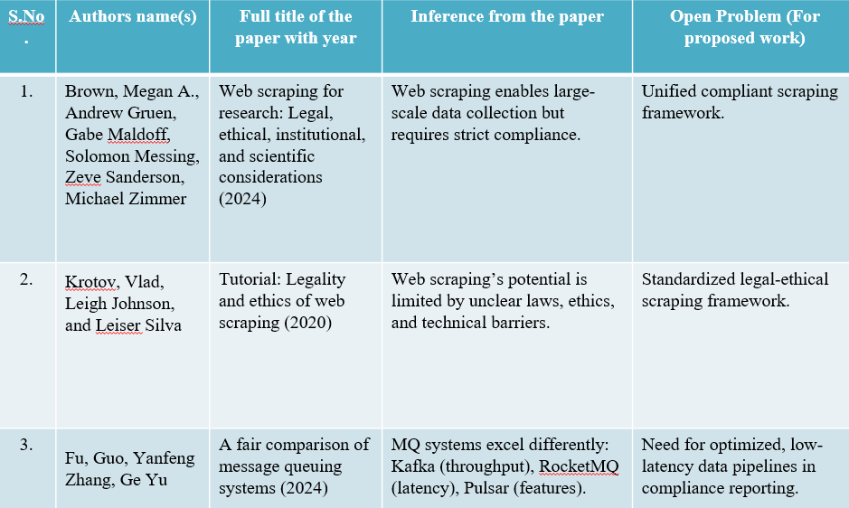
Literature survey

Slide 10
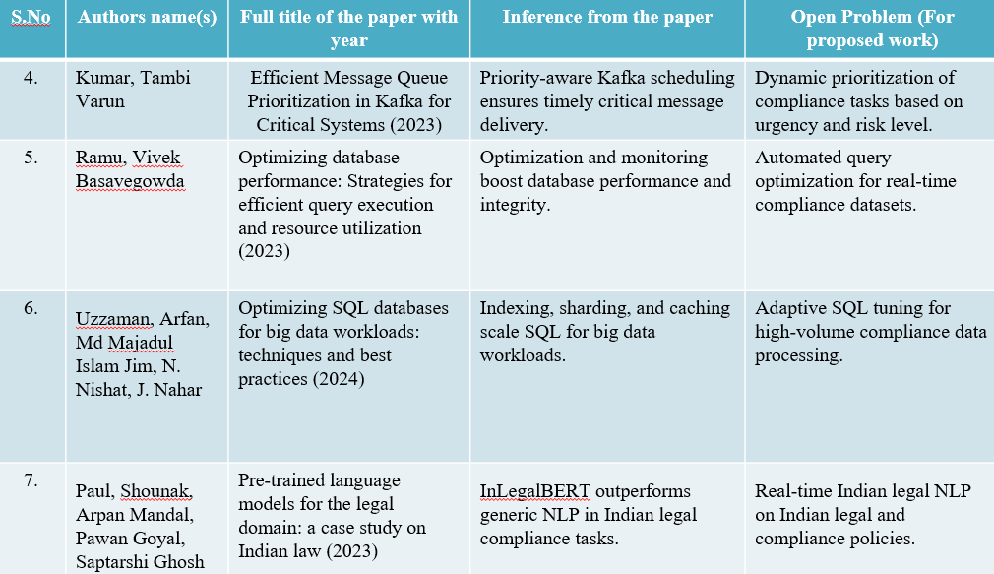
Literature survey

Slide 11
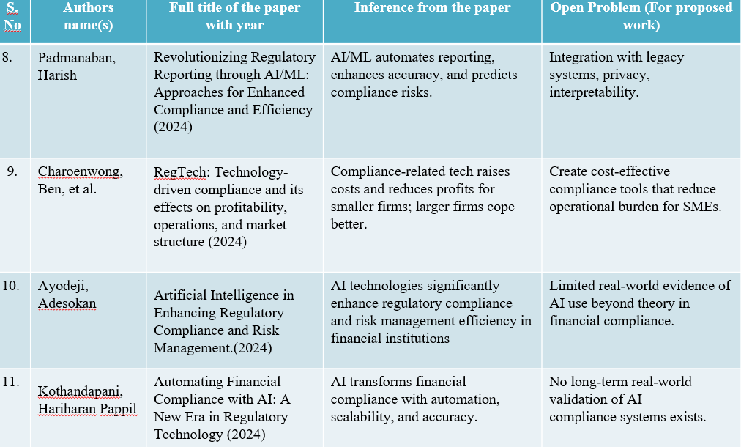
Literature survey

Slide 12
Research gaps
Lack of a unified and compliant web scraping framework balancing scalability with legal and ethical rules.
Legal uncertainties and technical barriers in web scraping, especially for Indian compliance contexts.
Absence of adaptive, low-latency, automated pipelines for real-time compliance reporting.
AI compliance tools face challenges in legacy system integration, privacy, and interpretability.
High operational costs limit adoption of compliance solutions for SMEs.
No long-term real-world validation of AI compliance systems.
Missing frameworks for SME-specific compliance needs, dynamic regulation tracking, and compliance-linked financing eligibility.

Slide 13
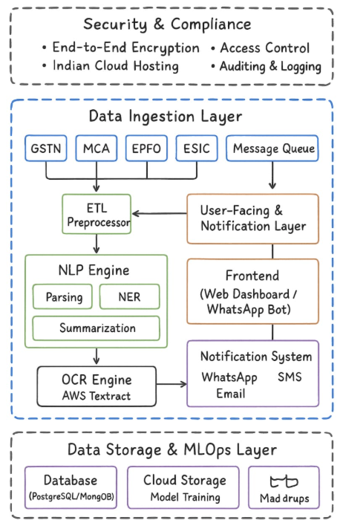
Data-Architecture Diagram
Notes:
Its explains the overall data architecture of AI-Sahayak and how information flows through the system in a secure and efficient way. 1. At the top, we have the Security & Compliance layer, which ensures the entire system operates safely. for all data transfers, for authorized users, keeping personal data within the country, to track system activity - This layer protects sensitive business data and makes the system trustworthy. 2. This layer is responsible for collecting and preprocessing data from multiple sources. This ensures that only high-quality, machine-readable data enters the system. All incoming data first goes through an ETL Preprocessor, which performs: Cleaning, Structuring, Metadata tagging, Preparing the content for AI processing
3. Once the data is preprocessed, it is handled by two key engines: legal/financial text, for extracting important fields, to convert complex laws into simple explanations - This layer enables the AI to understand regulatory language and respond accurately. The OCR engine (AWS Textract) processes scanned documents uploaded by the user such as: GST certificates, Notices, Compliance forms, Invoices -It extracts text and converts it to structured data for further analysis.
4. After the NLP/OCR processing, the system interacts with the user through:
Frontend Web Dashboard where users can upload documents, view alerts, track compliance, and get summaries.
Notification System sends reminders and updates through Email or SMS.
5. At the bottom is the Data Storage & MLOps layer, which maintains the system’s memory and supports model training:
Databases (PostgreSQL/MongoDB) store: , user profiles, compliance history, extracted data, metadata
Cloud Storage is used for: storing documents, model artifacts, training datasets
MLOps pipelines manage: model updates, retraining, deployment
This layer keeps the system scalable, reliable, and easy to upgrade.

Slide 14
Data Set
Source of data set:
Government Portals – Official sources for latest notifications, rules, and deadlines.
GST: Tax updates, return dates – gst.gov.in
MCA: Company & LLP compliance – mca.gov.in
Labour Laws: National labour policies – labour.gov.in
EPFO: PF regulations – epfindia.gov.in
RBI: Banking & financial circulars – rbi.org.in
FSSAI: Food safety compliance – fssai.gov.in
Legal Databases (Free) – Case laws, judgements, and bare acts.
indiankanoon.org
bareactslive.com
Open Data Initiatives – Public datasets on laws, taxes, and corporate affairs.
data.gov.in
Notes:
It explains the sources of data used to build AI-Sahayak. Since our system depends on accurate legal and financial information, we pull data only from trusted and official sources. 1. We collect structured and unstructured data from: For GST return dates, rule changes, and tax notifications.,
2. To support deeper legal understanding like ….. - These repositories help the NLP engine and extract relevant rules accurately. 3. We also use government-supported open data portals like: These sources help enrich our dataset and enable better analysis and model training.

Slide 15
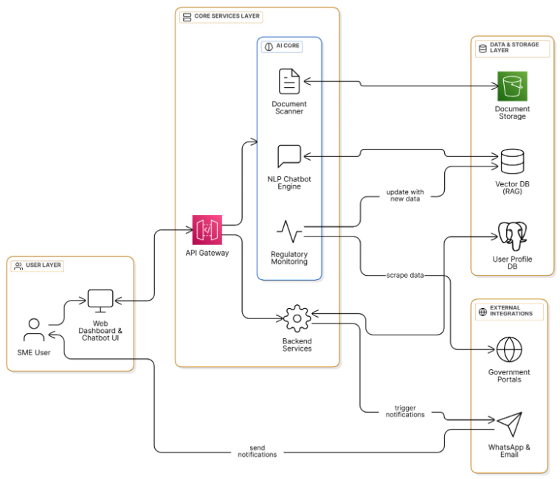
Architecture Diagram

Slide 16
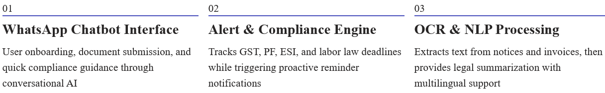
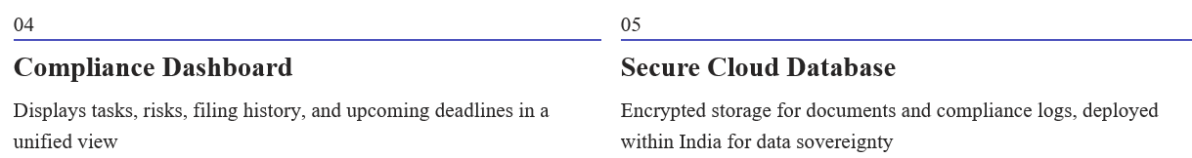
System Architecture Overview
AI-Sahayak integrates multiple AI-powered components to deliver end-to-end compliance automation through a familiar WhatsApp interface.

Slide 17
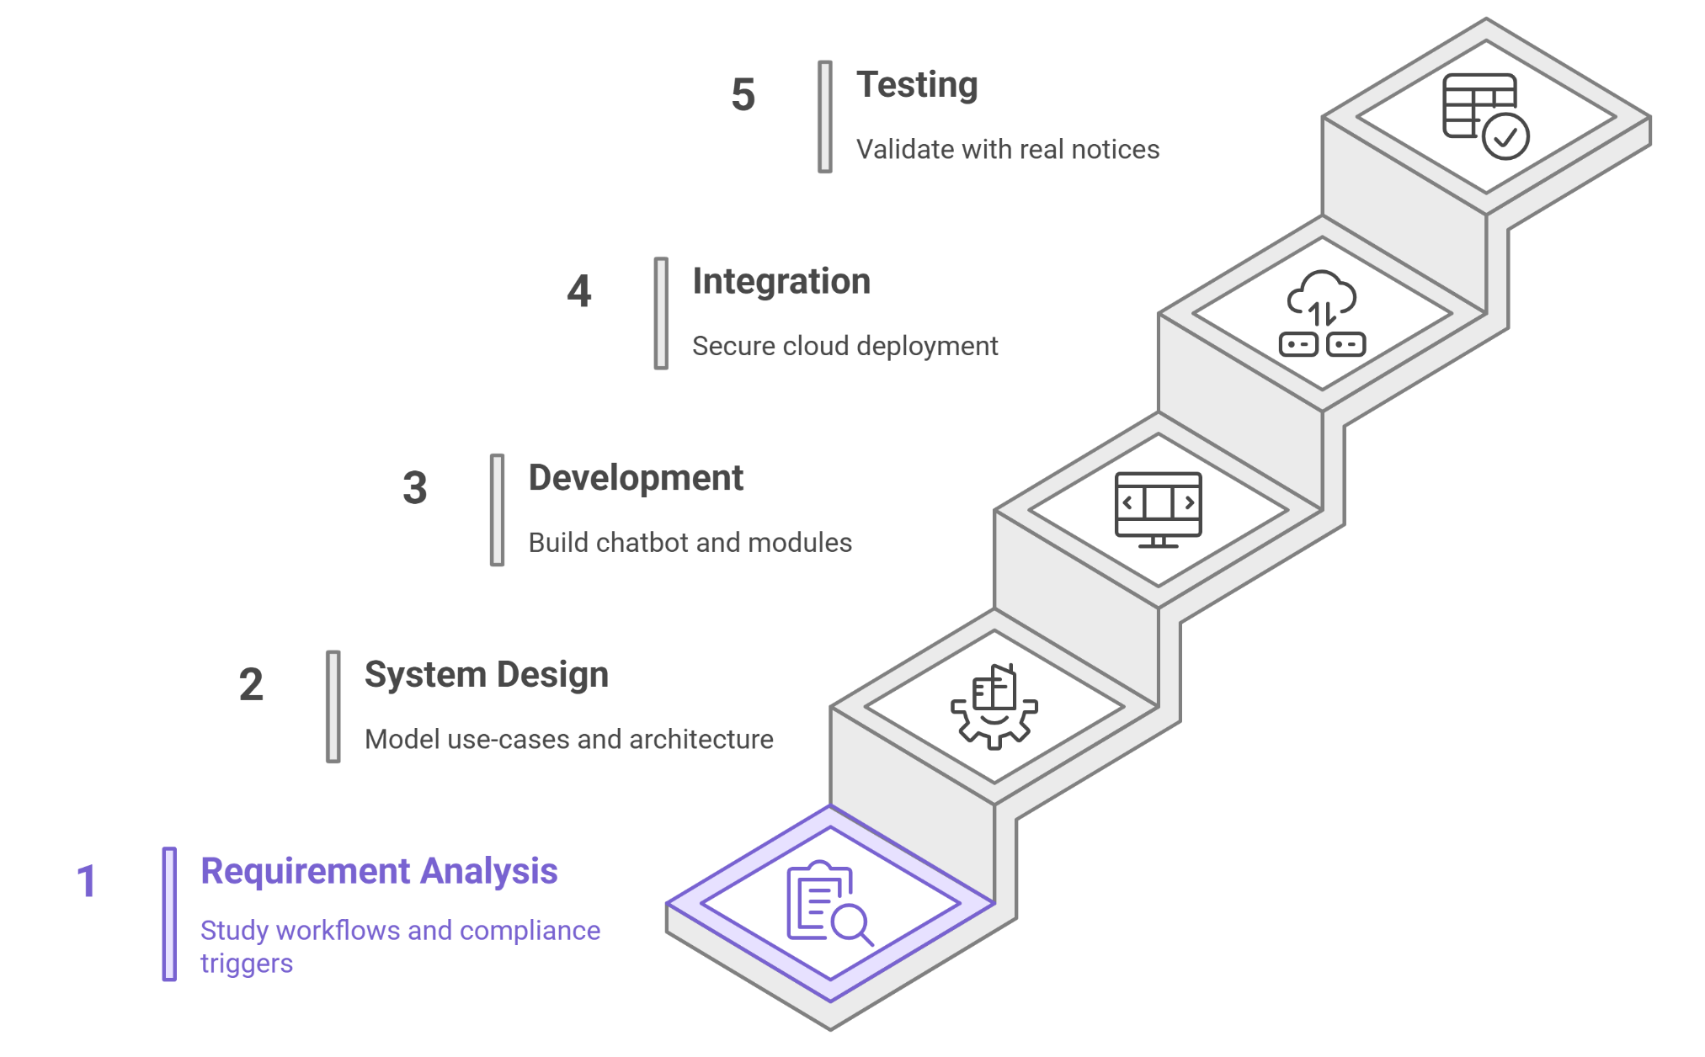
Methodology

Slide 18
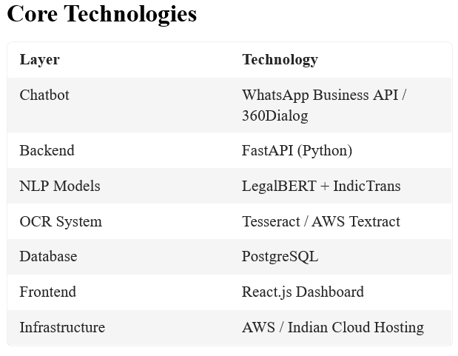
Technology Stack

Slide 19
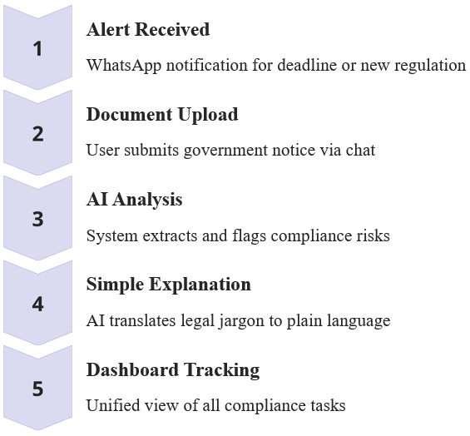
User Interaction Flow

Slide 20
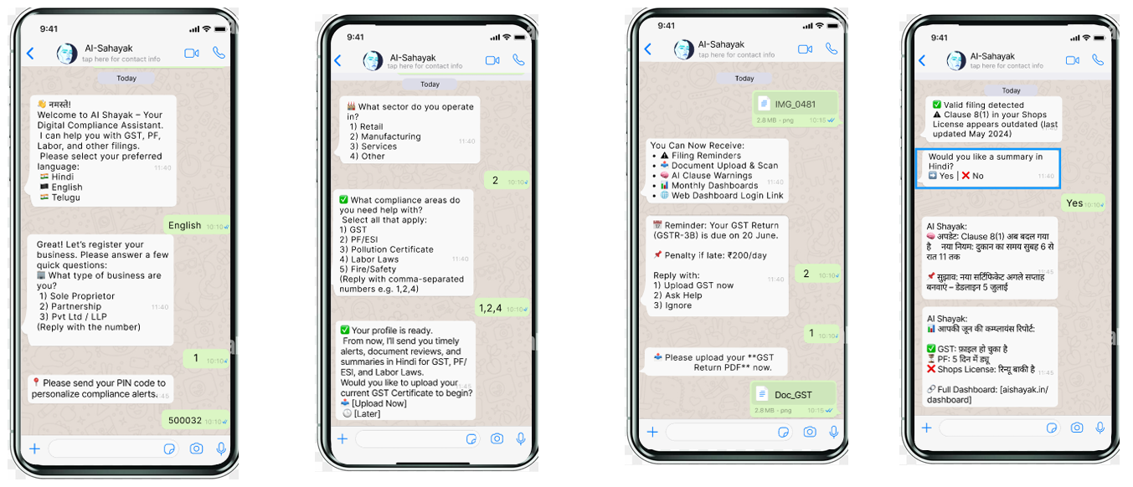
Ui-Mockup’s

Slide 21
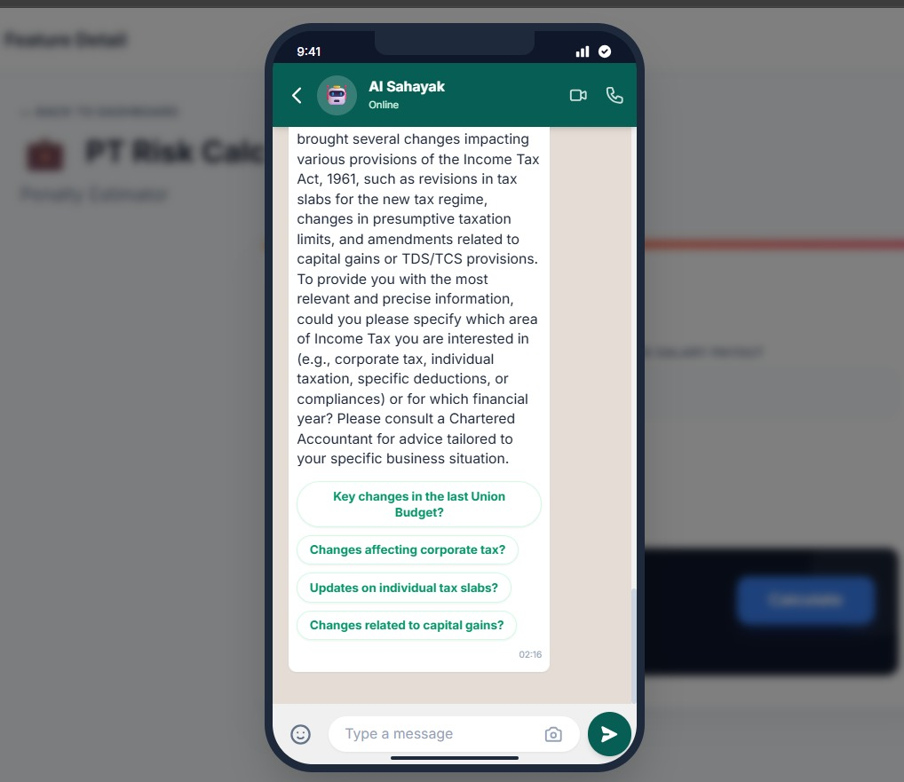
Results

Slide 22
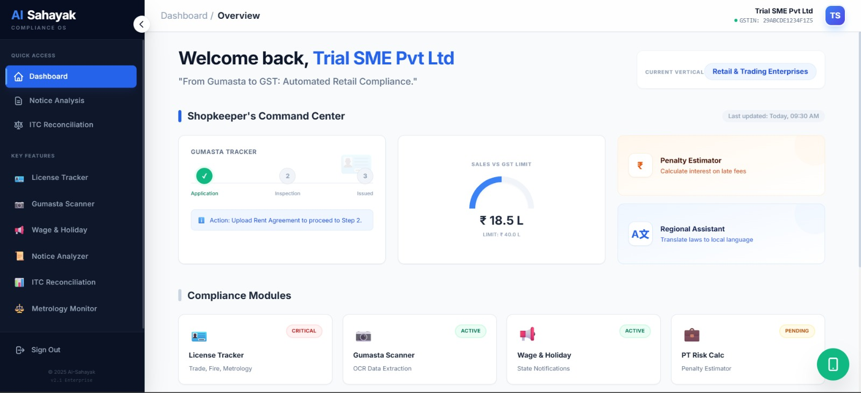

Slide 23
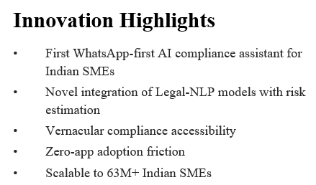
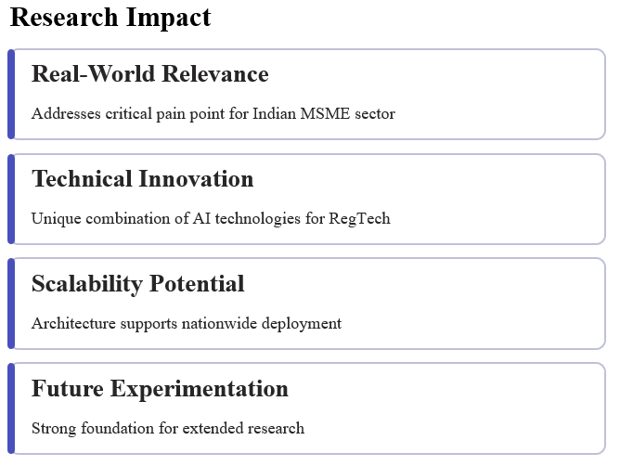
Research Contribution & Publication Potential
Notes:
Our project introduces one of the first AI-based compliance assistants designed specifically for Indian SMEs. Instead of using complicated applications, businesses can access compliance help directly through a simple web interface.
We use advanced Legal-NLP models that understand Indian laws and regulations. These models can interpret legal text, extract important details, and even estimate compliance risks.
The system supports vernacular languages, which means users can get help in simple, easy-to-understand regional languages. This improves access for small business owners who may not be comfortable with English.
There is zero adoption friction because the system is web-based. Users do not need to download any app or learn difficult tools. They can start using it immediately.
The solution is scalable to more than 63 million SMEs in India, which means it has the potential to create a very large real-world impact.
Real-World Relevance This project directly solves a major problem faced by Indian SMEs: difficulty in understanding and managing compliance. It has strong practical use.
Technical Innovation The project combines several AI technologies like NLP, RAG, OCR, and automation in a unique way. This makes it a strong technical contribution in the RegTech (Regulatory Technology) space.
Scalability Potential The architecture is designed to support large-scale deployment across different states and industries. It can be expanded nationwide without major changes.
Future Experimentation This system provides a strong base for future work, including advanced risk prediction, multilingual voice support, document autofiling, and deeper legal automation.

Slide 24
Conclusion
AI-Sahayak delivers a real compliance transformation for SMEs:
🧩 Simplifies complex regulations into actionable guidance
🛡 Reduces penalties and compliance risks significantly
🌍 Enhances accessibility with multilingual & WhatsApp-first design
💼 Empowers small business owners to focus on growth, not paperwork
🇮🇳 Strengthens India’s MSME sector — the economic backbone of the country
Notes:
To conclude, AI-Sahayak brings a real change in how SMEs handle compliance. 1. Our system makes complicated rules easy to understand and converts them into simple, actionable steps for businesses.
2. It helps reduce penalties and compliance risks by giving timely reminders, clear explanations, and smart guidance. 3. The platform is accessible to everyone because it supports simple language and works smoothly through a web interface.
4. Most importantly, AI-Sahayak allows small business owners to focus on growing their business instead of spending time on paperwork and legal confusion. By making compliance easier, faster, and more affordable, our project strengthens the Indian MSME sector — which is the backbone of our economy.

Slide 25
Future Work
Technology Enhancements
Advanced Risk Prediction Engine using ML models
Support for ALL major Indian regional languages
Voice-enabled WhatsApp commands using ASR models
Auto-filing integration with GSTN, EPFO & MCA portals
Secure e-signing & compliance history for audits
Business Upgrades
Partner network with CA/CS associations & FinTech companies
Micro-credit scoring based on compliance performance
Affordable subscription tiers for startups, retail, & factories
Research Extensions
Compliance knowledge graph of Indian laws
Real-time law change monitoring using AI
Collaborative dataset building for Legal-NLP benchmark research
Notes:
Our project has strong potential for expansion, and we have planned several future enhancements.
1. Technology Enhancements
In the next phase, we aim to add:
An advanced risk prediction engine using machine learning to warn SMEs about possible compliance risks before they occur.
Support for all major Indian native languages, so every business owner can use the platform comfortably.
Voice-enabled commands using speech recognition, allowing users to interact hands-free.
Auto-filing integration with GSTN, EPFO, and MCA portals for faster submissions.
Secure e-signing features and complete compliance history for audit-readiness.
2. Business Upgrades
We plan to expand the platform with:
A partner network of CA/CS professionals and FinTech companies for expert support.
Micro-credit scoring, where SME compliance behavior can help them qualify for loans.
Affordable subscription plans for startups, shops, factories, and small businesses.
3. Research Extensions
Academically, we aim to explore:
Building a compliance knowledge graph of Indian laws for deeper legal intelligence.
An AI-based real-time monitoring system for detecting law and policy changes instantly.
Collaborative datasets to create new Legal-NLP benchmarks, contributing to research and innovation.

Slide 26
References
[1] Ayodeji, Adesokan. "Artificial Intelligence in Enhancing Regulatory Compliance and Risk Management." ResearchGate, June (2024).
[2] Kothandapani, Hariharan Pappil. "Automating financial compliance with AI: A New Era in regulatory technology (RegTech)." Int. J. Sci. Res. Arch 11 (2024): 2646-2659.
[3] Padmanaban, Harish. "Revolutionizing regulatory reporting through AI/ML: Approaches for enhanced compliance and efficiency." Journal of Artificial Intelligence General science (JAIGS) ISSN: 3006-4023 2, no. 1 (2024): 71-90.
[4] Brown, Megan A., Andrew Gruen, Gabe Maldoff, Solomon Messing, Zeve Sanderson, and Michael Zimmer. "Web scraping for research: Legal, ethical, institutional, and scientific considerations." arXiv preprint arXiv:2410.23432 (2024).
[5] Krotov, Vlad, Leigh Johnson, and Leiser Silva. "Tutorial: Legality and ethics of web scraping." (2020).
[6] Fu, Guo, Yanfeng Zhang, and Ge Yu. "A fair comparison of message queuing systems." IEEE access 9 (2020): 421-432.
[7] Kumar, Tambi Varun. "Efficient Message Queue Prioritization in Kafka for Critical Systems." (2023).
[8] Ramu, Vivek Basavegowda. "Optimizing database performance: Strategies for efficient query execution and resource utilization." International Journal of Computer Trends and Technology 71, no. 7 (2023): 15-21.

Slide 27
References
[9] Uzzaman, Arfan, Md Majadul Islam Jim, N. Nishat, and J. Nahar. "Optimizing SQL databases for big data workloads: techniques and best practices." Academic Journal on Business Administration, Innovation & Sustainability 4, no. 3 (2024): 15-29.
[10] S. Paul, A. Mandal, P. Goyal, and S. Ghosh, “Pre-trained language models for the legal domain: a case study on Indian law,” in Proc. Int. Conf. on Artificial Intelligence and Law (ICAIL), 2023, pp. 313–322.
[11] B. Charoenwong, et al., “RegTech: Technology-driven compliance and its effects on profitability, operations, and market structure,” Journal of Financial Economics, vol. 154, p. 103792, 2024.
[12] A. U. Akang, “Regulatory compliance and access to finance: implications for business growth in developing economies,” Journal of Business Venturing Insights, vol. 19, e00365, 2023.
[13] S. Hassani, “Enhancing legal compliance and regulation analysis with large language models,” AI and Ethics, 2024.
[14] D. Mendis, K. Barker, and K. McCullagh, “Tracing technological boundaries: law, technology, and compliance?,” International Review of Law, Computers & Technology, vol. 36, no. 3, pp. 261–280, 2022.
[15] K. Li and Y. Zhang, “Automated compliance monitoring with natural language processing,” Information Systems Frontiers, vol. 25, pp. 345–360, 2023.

Slide 28
THANK YOU

