Slide 1
Predicting ICD9 Codes from Unstructured Clinical Notes Through the Use of NLP Techniques
Dimitri Haralampopoulos & Izabel Miminoshvili

Slide 2
Table of Contents
Introduction
Data Preparation
Methods
Results
Reflection
Future Applications
Q&A

Slide 3
Introduction
By creating a tool that can identify ICD9 codes accurately and consistently from medical texts directly, we hope to reduce the burden on clinical coders and mitigate erroneous assignment of ICD9 codes.
Previous studies either focused on identifying ICD9 codes for a specific patient or visit based on clinical notes [1,3] or implementing search-based methods [2].
Citations
[1] Coffman, Abe, and Nat Wharton. Clinical Natural Language Processing Auto-Assigning ICD-9 Codes. https://courses.ischool.berkeley.edu/i256/f09/Final%20Projects%20write-ups/coffman_wharton_project_final.pdf
[2] Falter, Maarten, et al. “Using Natural Language Processing for Automated Classification of Disease and to Identify Misclassified ICD Codes in Cardiac Disease.” European Heart Journal. Digital Health, 9 Feb. 2024, https://doi.org/10.1093/ehjdh/ztae008. Accessed 20 Apr. 2024. https://academic.oup.com/ehjdh/article/5/3/229/7604129
[3] Gangavarapu, Tushaar, et al. “Predicting ICD-9 Code Groups with Fuzzy Similarity Based Supervised Multi-Label Classification of Unstructured Clinical Nursing Notes.” Knowledge-Based Systems, vol. 190, Feb. 2020, p. 105321, https://doi.org/10.1016/j.knosys.2019.105321. Accessed 6 Oct. 2021.https://www.sciencedirect.com/science/article/abs/pii/S0950705119305982?via%3Dihub

Slide 4
Data Preparation
Dataset was built from NOTEEVENTS, DIAGNOSES_ICD, and PROCEDURES_ICD tables
NOTEEVENTS restricted to only notes labeled “Report”
Notes tokenized using clinitokenizer before joining on code tables
Grouped by subject_id, aggregated by text and ICD9 code, and averaged embedding vectors to create a single embedding for all the texts for any given patient, truncated to 512 in length
Vocabularies built for ICD9 codes and were tokenized as well
These decisions were made with time and space efficiency in mind

Slide 5
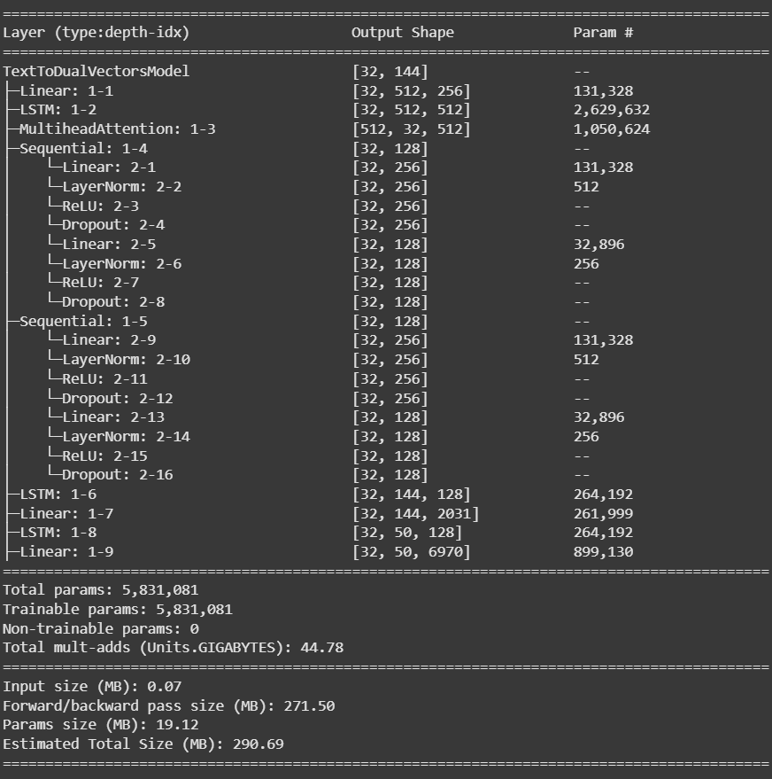
Methods
Powerful BiLSTM w/ Multi-head Attention
Regularization (dropout) and linear projection layers to get logits
Two models were trained (one ignoring padding tokens and one not) for 10 & 20 epochs each

Slide 6
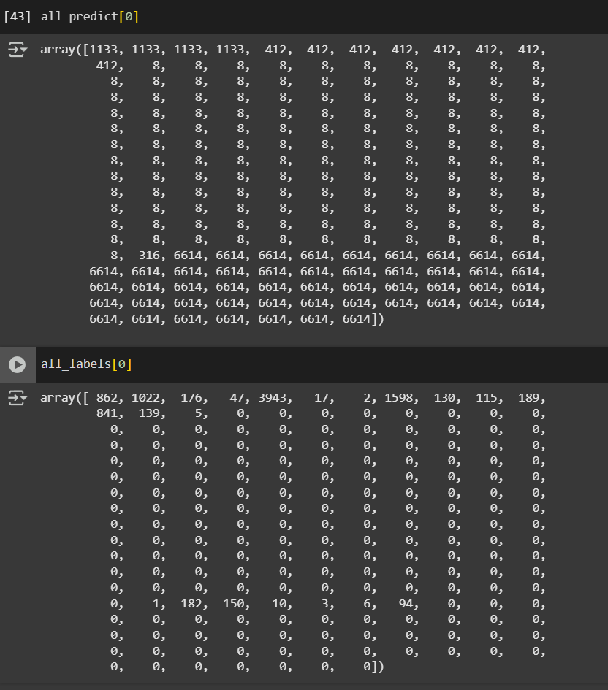
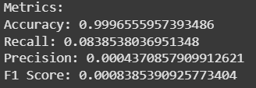
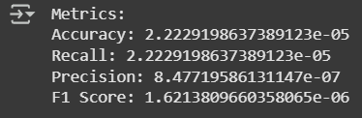

Results
Output from ignore pad model
Accuracy is likely misleading
Tokens in output duplicated many times
Very few to no output tokens actually match the ground truth
Precision, Recall, and F1 Score all very low
Very high misclassification rate
Averaging Metrics per class
Averaging over each prediction
Correct & Misclassifications per non-pad token over total number of predicted tokens

Slide 7
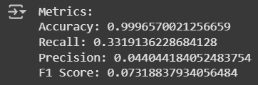
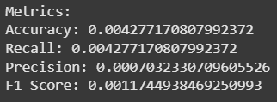

Results (contd.)
Averaging Metrics per class
Averaging over each prediction
Output from ignore pad model (20 epochs)
Accuracy still misleading
Tokens in output duplicated many times
Precision, Recall, and F1 Score still all very low
High rate of misclassifications but also higher rate of correct classifications compared to 10 epoch
Correct & Misclassifications per non-pad token

Slide 8
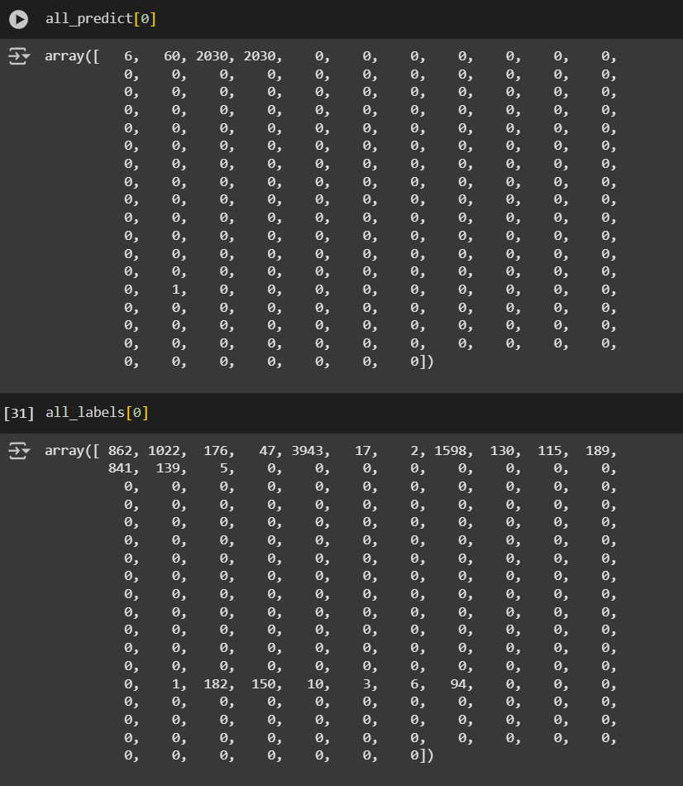
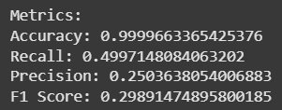
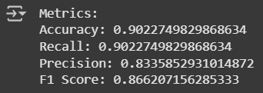

Results (contd.)
Output from not ignoring pad token model
More tame than the other one
Enforces a stricter order to tokens than previous model
Accuracy also deceptively high
Precision, Recall, and F1 Score much higher than the first model
Averaging Metrics per class
Averaging over each prediction
Correct & Misclassifications per non-pad token over total number of predicted tokens

Slide 9
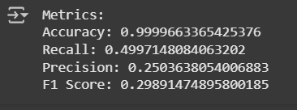
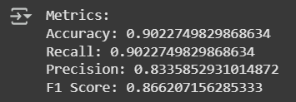
Results (contd.)
Averaging Metrics per class
Averaging over each prediction
Output from not ignoring pad model (20 epochs)
Accuracy still misleading
Compared to 10 epoch model there were no significant differences in any of the metrics
Brings into question the structure of the model and how it can be improved to accommodate the data better
Correct & Misclassifications per non-pad token

Slide 10
Limitations
Google Colab GPU time
Low number of epochs
Slow training
Even with paid time, training takes long
Tokenizers
Clinitokenizer one of the few public tokenizers for clinical text available
May not be 100% tailored to our use case
ICD9 Vocabularies built might not capture the true structure of the codes well
Sheer Data Volume
Affects what we can do in terms of processing
Without powerful machines, processing can take hours, allowing for mistakes

Slide 11
Reflection
In our project proposal, we wrote that we would work with NLP systems such Encoder-Decoder models or Transformers, but we ended up using only an Encoder-Decoder model
We also did not include BLEU score as one of our metrics
We also chose to include precision and recall, as is standard for classification problems

Slide 12
Reflection (contd.)
No single, straightforward solution to this problem
Data very finicky
Model construction bears a lot of weight on results
Iterating to create a better model time-consuming and research intensive
We really should have started earlier

Slide 13
Future Applications
Results reliable for researchers to understand whether or not NLP systems are reliable when it comes to identifying ICD9 codes based on unstructured note data
Researchers better understand the advantages and limitations of using NLP systems with unstructured data
Model can be extended to ICD10 and/or ICD11 code systems to see how well the model can perform with more current systems
Methodology used can be tested on clinical notes in other languages or multilingual datasets

Slide 14
Thank you! Q&A

