Slide 1
Variant Control Demo Outputs
Name: Dharal Naik
Reg No.: RA2311003010893

Slide 2
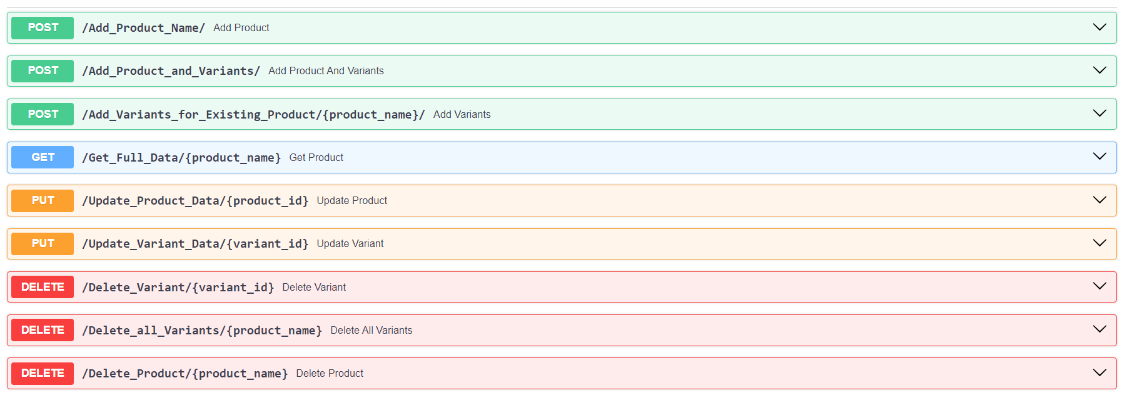
Different FastAPI Endpoints
Total 9 Endpoints, 3 to Create data, 1 to Read data, 2 to Update data,
3 to Delete Data.

Slide 3
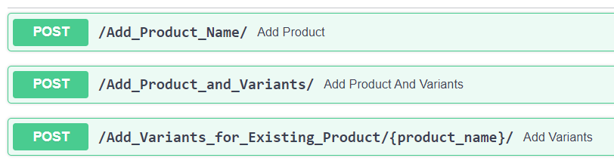
Create Endpoints
There are three different endpoints to post and store data in a database using FastAPI.
They are :-
First to just add a product name to the database.
Second to add both product name and its variants to the database.
Third to add only variants of the pre-existing products in the database.

Slide 4
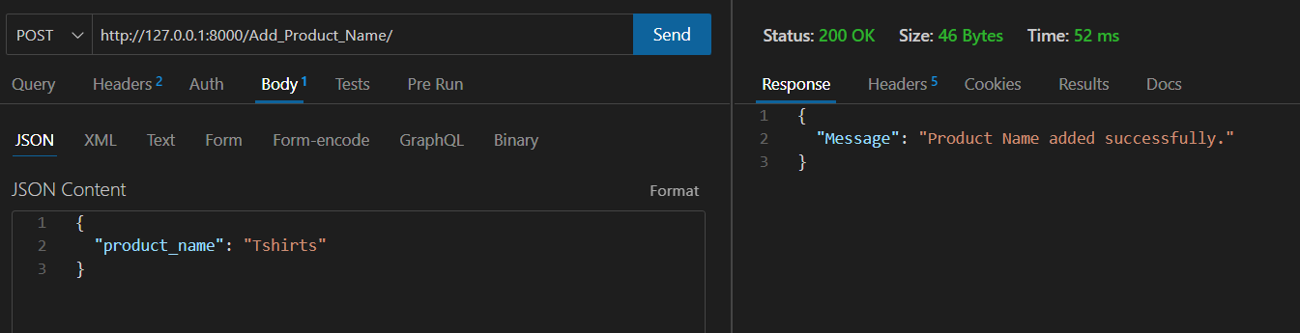
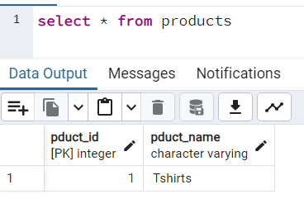
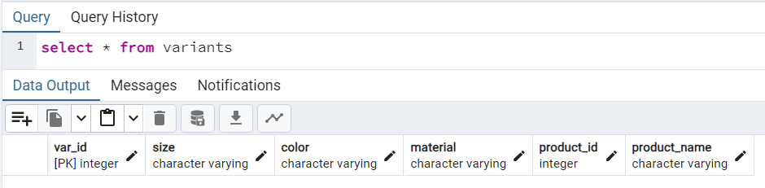
The above picture is the thunder client output for POST request. The below two pictures are the changes made to database after this query.
1. Add Product Name

Slide 5
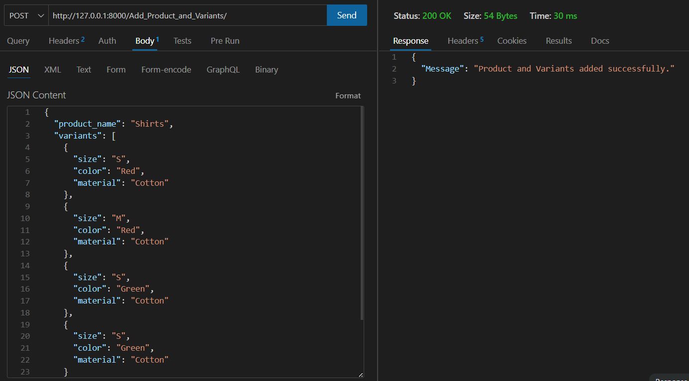
The above picture is the thunder client output for POST request.
2. Add Product and Variants

Slide 6
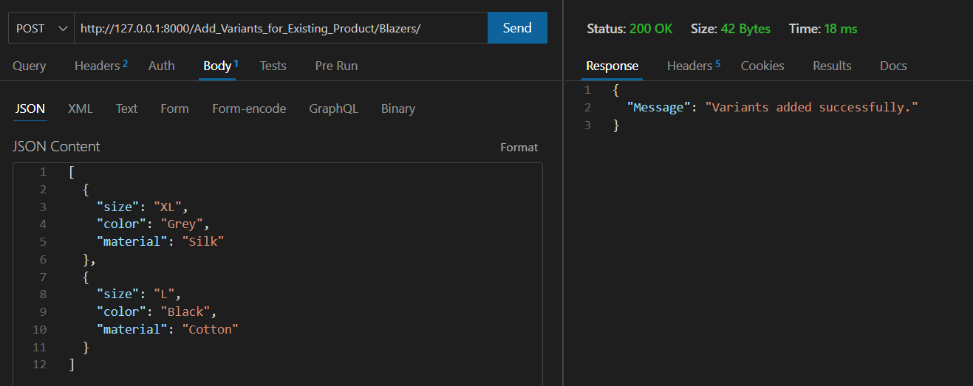
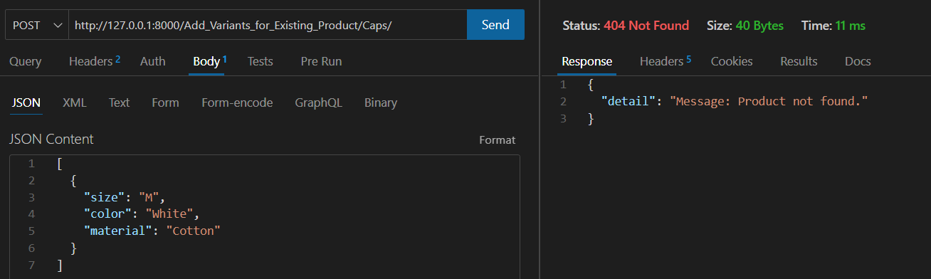
The first picture is the thunder client output for POST request, where variants are added to the product name – Blazers. The second picture is to show the output when product is not found in the database, giving error 404 Not Found.
3. Add Variants for Existing Product

Slide 7
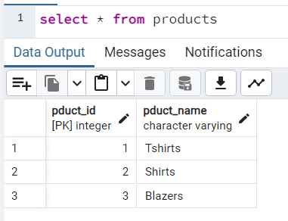
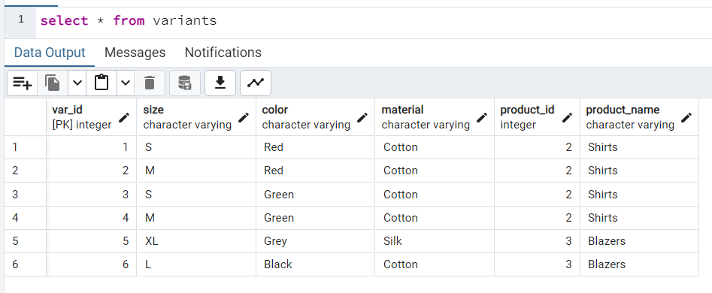
Database SS after all three POST requests

Slide 8
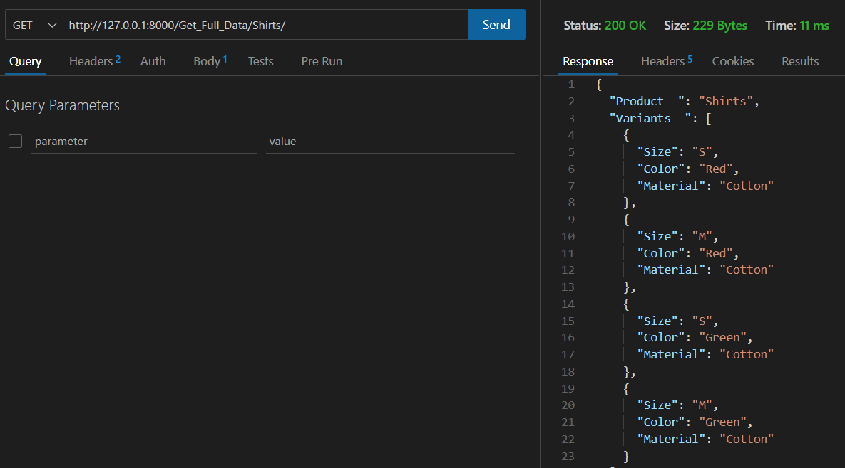
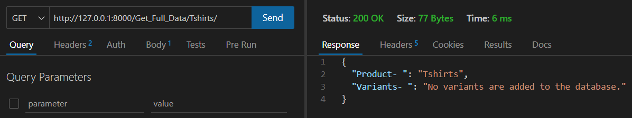

Read Endpoints
There is one endpoint to read the data from the database using FastAPI.
Here, user gives input as the product name and gets the output of all of its variants.
First picture shows output for product – Shirts, which has 4 variants in the database.
Second picture shows output for product – Tshirts, which has no variants in the database.

Slide 9
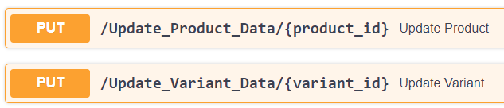
Update Endpoints
There are two endpoints to update the data from the database using FastAPI, one to update Product Data and other to update Variants Data.
Here, user gives input as the product id and variant id, which allows it to update the respective data.

Slide 10
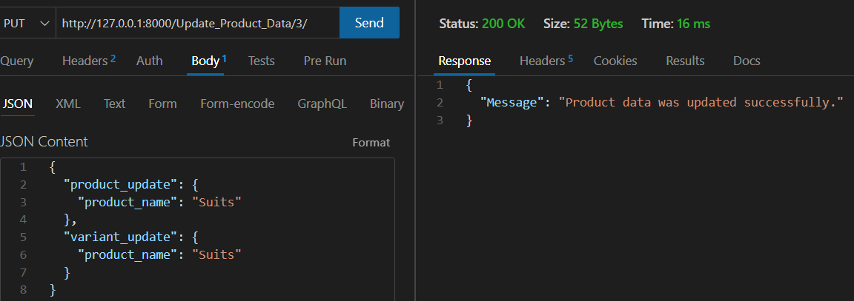
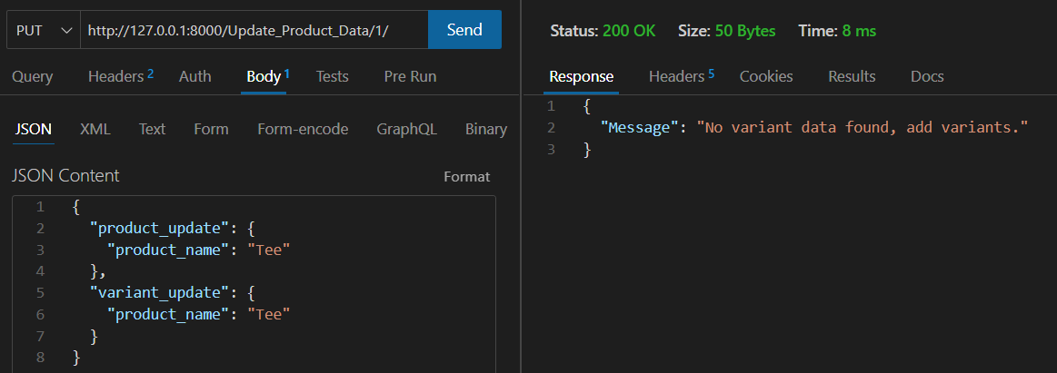
The first picture is the thunder client output for PUT request, where product – Blazers is updated to Suits. The second picture is to show the output when product – Tshirts is not found in the database for variants.
1. Update Product Data

Slide 11
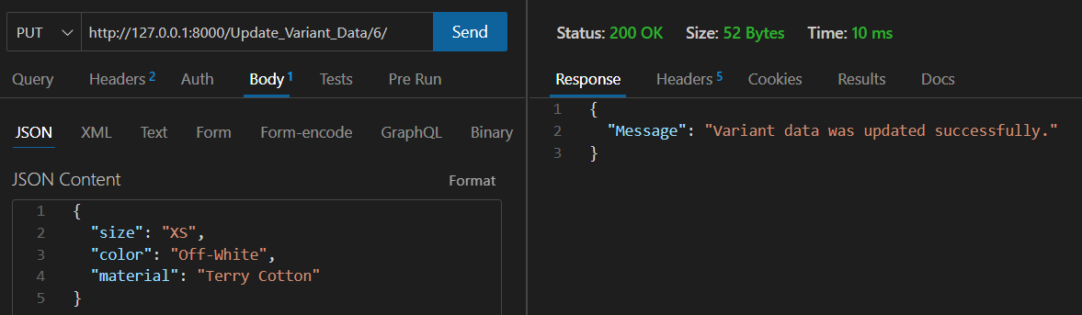
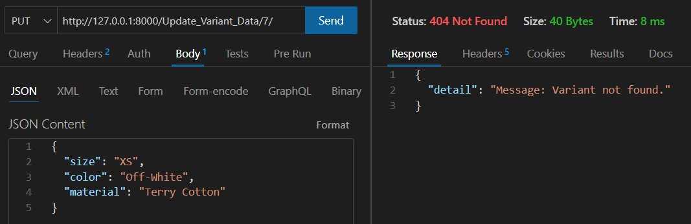
The first picture is the thunder client output for PUT request, where variant data is updated. The second picture is to show the output when variant is not found in the database, and its same for product data.
2. Update Variant Data

Slide 12
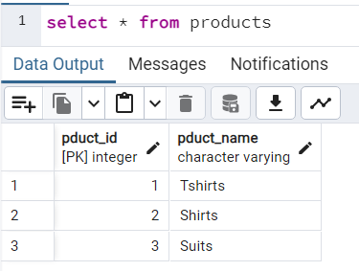
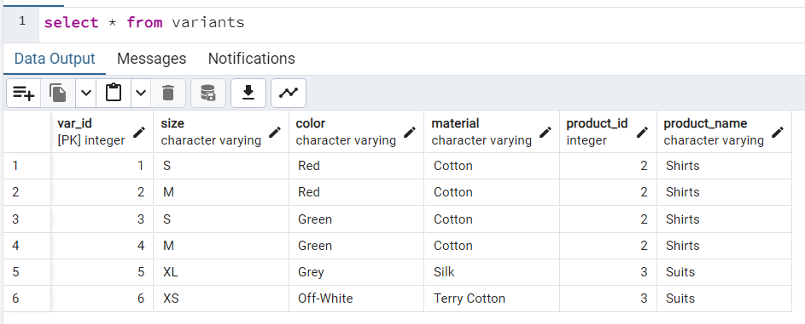
Database SS after both PUT requests

Slide 13
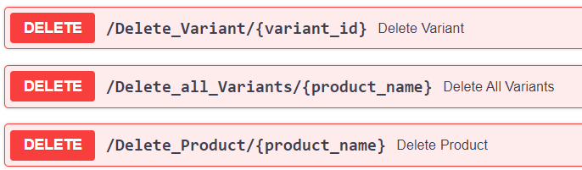
Delete Endpoints
There are three endpoints to delete the data from the database using FastAPI.
They are :-
First to just delete one variant from the database.
Second to delete all the variants from the database, to allow to delete product without foreign key issues.
Third to delete the product from the database.

Slide 14
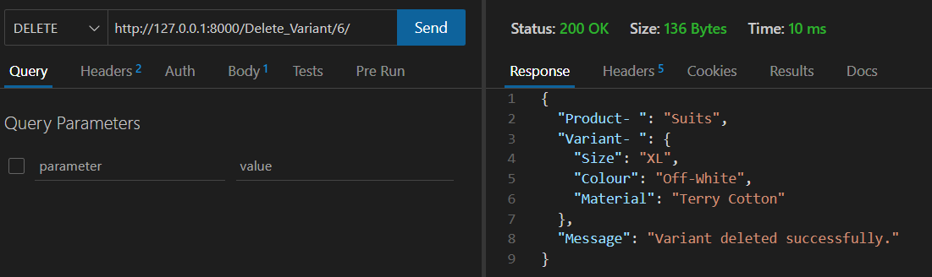
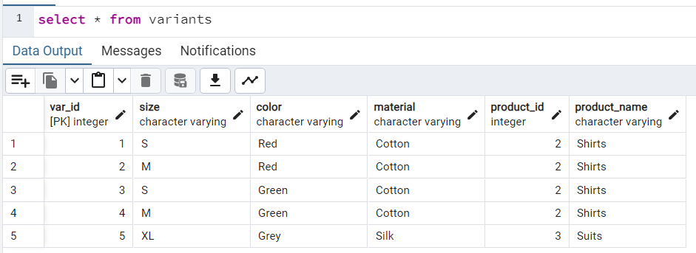
The above picture is the thunder client output for DELETE request. The below picture is the changes made to database after deleting one variants of Suits.
1. Delete one Variant

Slide 15
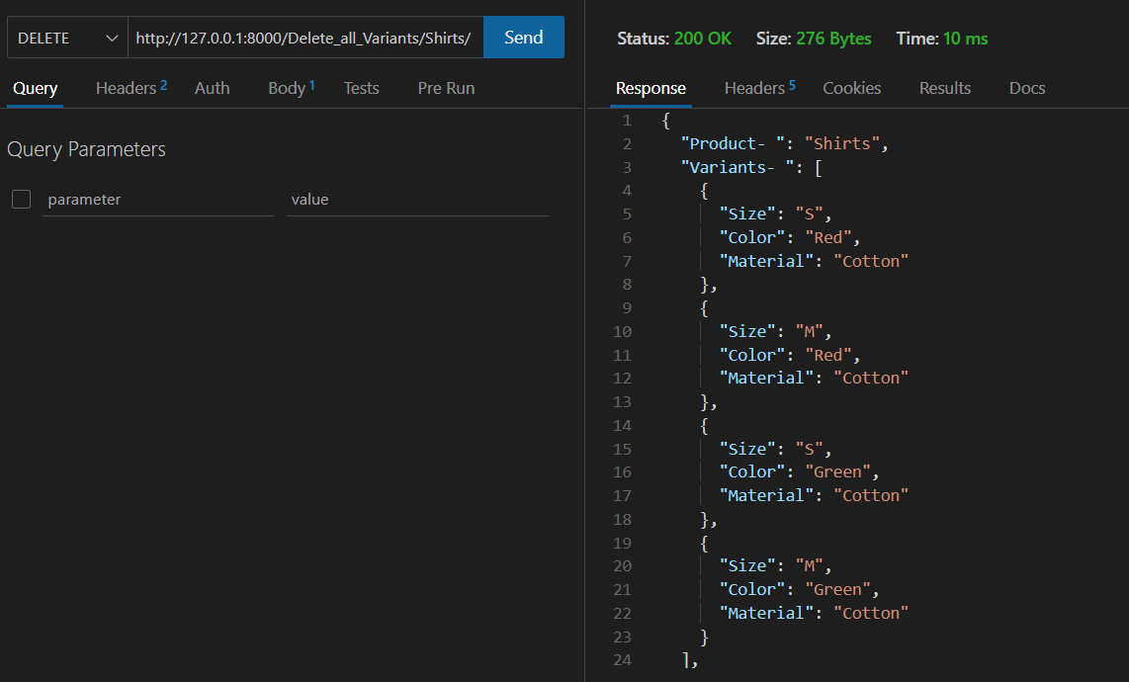
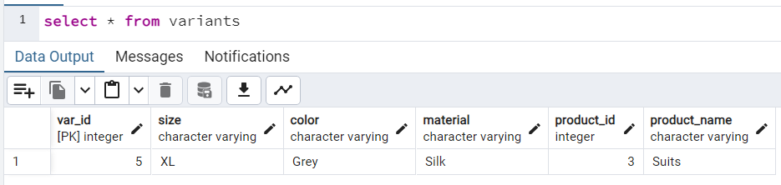
The above picture is the thunder client output for DELETE request. The below picture is the changes made to database after deleting all variants for Shirts.
2. Delete all Variants

Slide 16
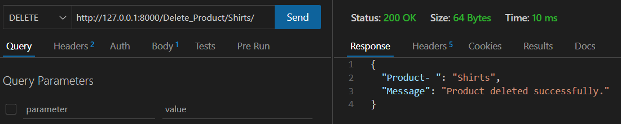
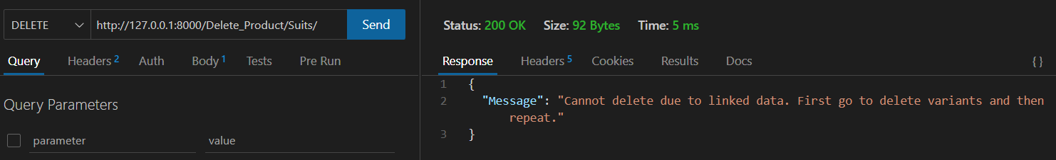
The above two pictures are the thunder client output for DELETE request. The first picture is to show deletion of product – Shirts, and second is to show the reason behind no deletion of product – Suits.
3. Delete Product

Slide 17
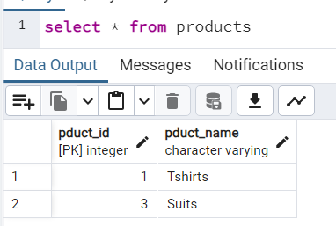
The above two pictures are the thunder client output for DELETE request. The below picture shows the changes made to database, after deletion of product – Shirts.
3. Delete Product (Continued)

Slide 18
Thank you!

