Slide 1
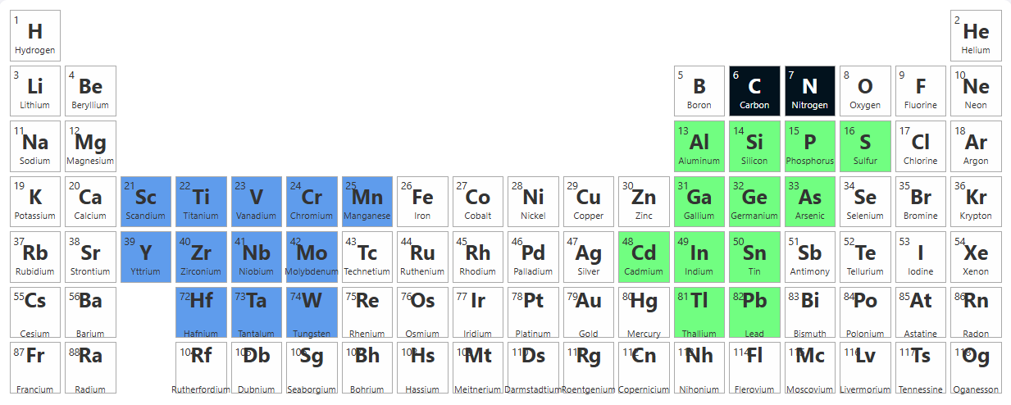
MXene
Under the supervision of
Dr. Rohit Ranjan Shahi
DHARAMANANDA SAHA
CUSB2404112015
M_{n+1}
A_{n}
X_{n}
PHASE
Where n = 0,1,2,3…
https://youtu.be/UUhlRWbomyA?si=57b2YRZ9HiyTxHdj

Slide 2
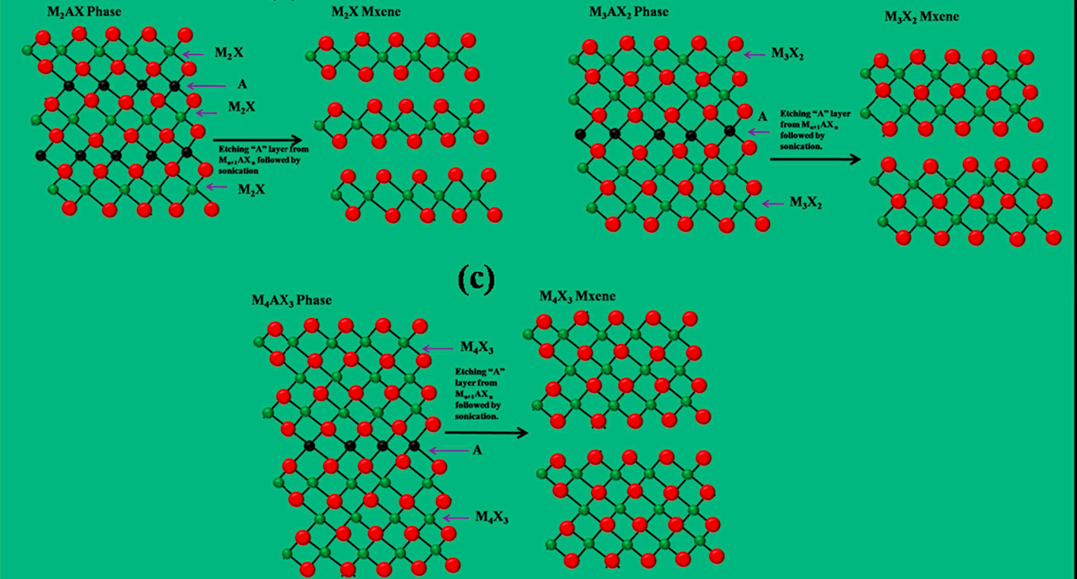
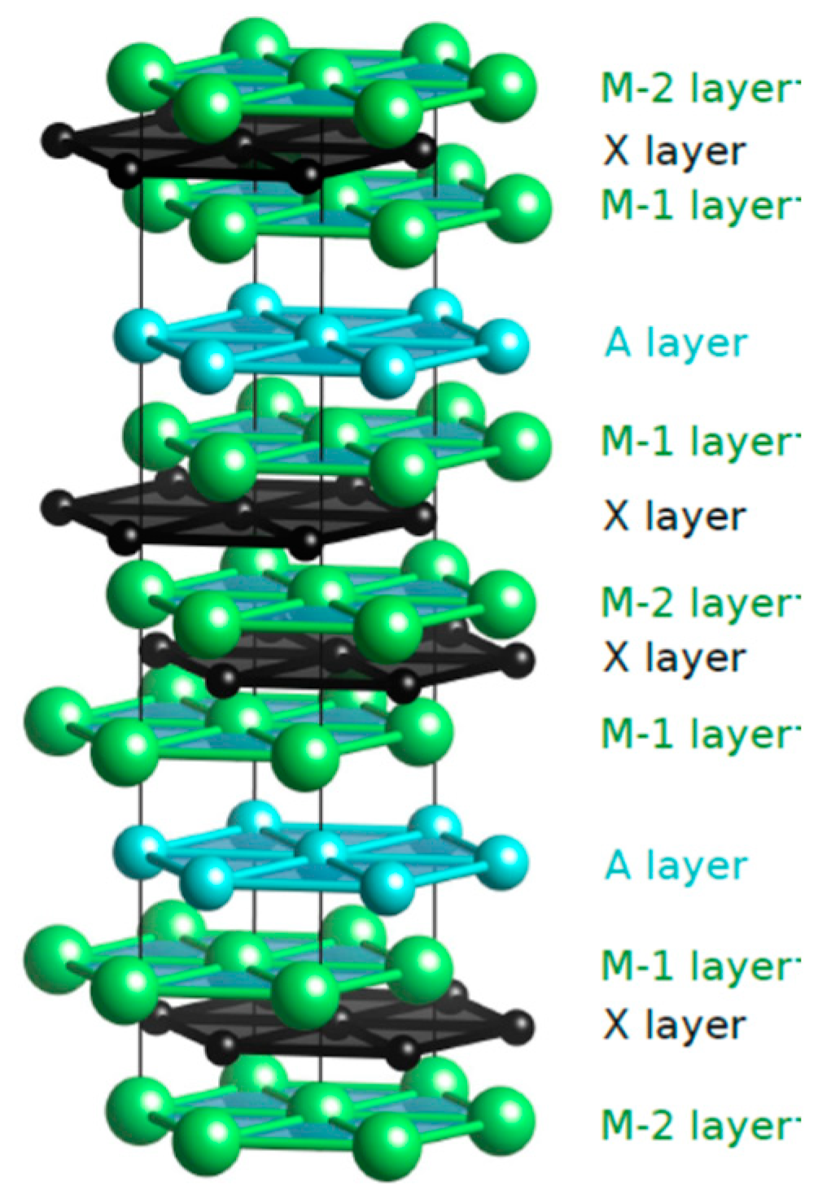
MXene
MXenes are a class of two-dimensional (2D) nanomaterials composed of transition metal carbides, nitrides, or carbonitrides. These materials are derived from a parent layered compound known as the MAX phase.
The term “MXene” is derived as follows:
M is Early transition metal (Ti, V, Cr, Nb, etc.)
X isCarbon and/or Nitrogen
https://doi.org/10.1016/j.susmat.2022.e00439

Slide 3
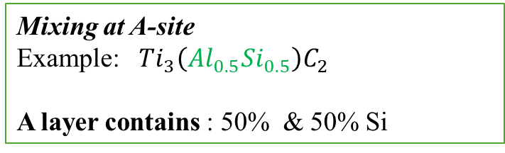
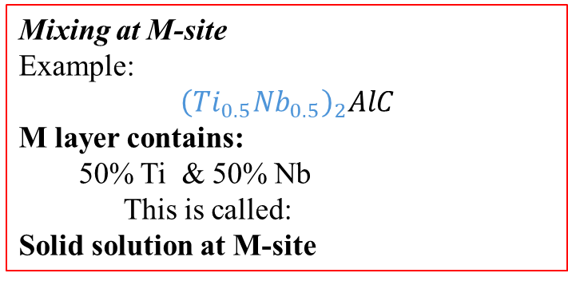
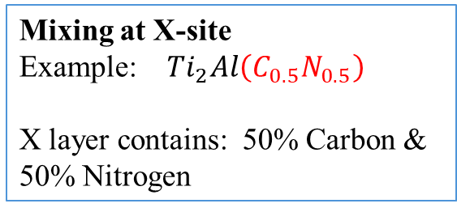
MXene
Type | MAX Phase | M | A | X
211 | Ti₂AlC | Ti | Al | C
211 | V₂GaC | V | Ga | C
211 | Nb₂SnC | Nb | Sn | C
211 | Cr₂AlN | Cr | Al | N
312 | Ti₃SiC₂ | Ti | Si | C
312 | V₃AlC₂ | V | Al | C
312 | Nb₃GeC₂ | Nb | Ge | C
312 | Cr₃AlN₂ | Cr | Al | N
413 | Ti₄AlC₃ | Ti | Al | C
413 | Nb₄SiC₃ | Nb | Si | C
413 | V₄GaC₃ | V | Ga | C
413 | Ti₄AlN₃ | Ti | Al | N
514 | Mo₅AlC₄ | Mo | Al | C
514 | Ti₅SiC₄ | Ti | Si | C
514 | Nb₅GaC₄ | Nb | Ga | C
514 | V₅AlN₄ | V | Al | N
Mixing at M-site
Example:
$${\left(Ti_{0.5}Nb_{0.5}\right)}_{2}AlC$$
M layer contains:
50% Ti & 50% Nb
This is called: Solid solution at M-site
Mixing at A-site
Example: $Ti_{3}\left(Al_{0.5}Si_{0.5}\right)C_{2}$
A layer contains : 50% & 50% Si
Mixing at X-site
Example: $Ti_{2}Al\left(C_{0.5}N_{0.5}\right)$
X layer contains: 50% Carbon & 50% Nitrogen

Slide 4
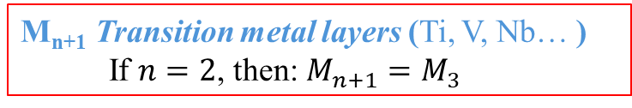

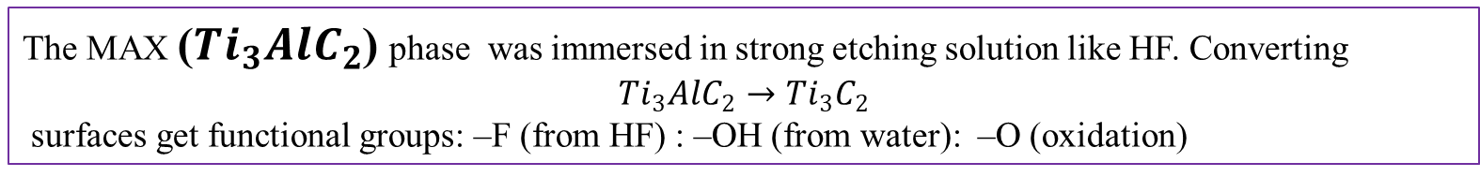
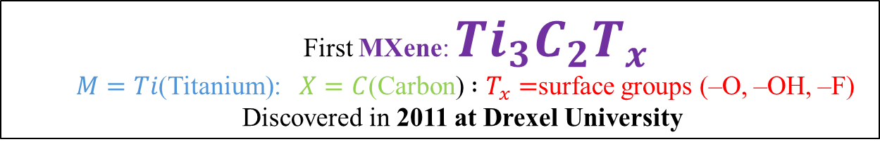
MXene
$$M_{n+1}X_{n}T_{x}$$
T_{x} surface terminations
After synthesis, the surface gets functional groups like:
–O (oxygen) –OH (hydroxyl) –F (fluorine)
–Cl (chlorine)
M_{n+1}​ Transition metal layers (Ti, V, Nb… )
If $n=2$, then: $M_{n+1}=M_{3}$
X_{n​} is Carbon/Nitrogen layers
n=1,2,3…… determines the thickness and structure
Examples: $n=1then$ $M_{2}X : n=2 then M_{3}X_{2}: n=3 then$ $M_{4}X_{3}$
The MAX ($Ti_{3}AlC_{2}$) phase was immersed in strong etching solution like HF. Converting
$$Ti_{3}AlC_{2}→Ti_{3}C_{2}$$
surfaces get functional groups: –F (from HF) : –OH (from water): –O (oxidation)
First MXene: $Ti_{3}C_{2}T_{x}$
$M=Ti$(Titanium): $X=C$(Carbon) $:T_{x}=$surface groups (–O, –OH, –F)
Discovered in 2011 at Drexel University
https://youtu.be/UUhlRWbomyA?si=57b2YRZ9HiyTxHdj

Slide 5
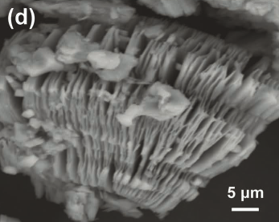

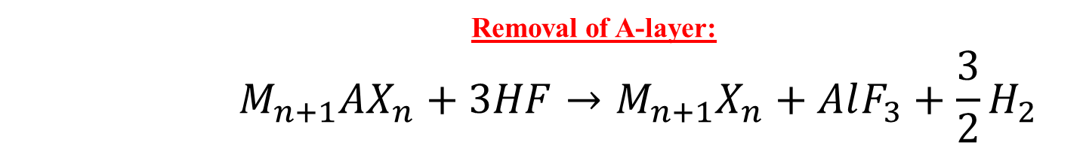
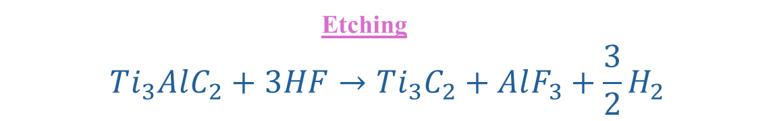
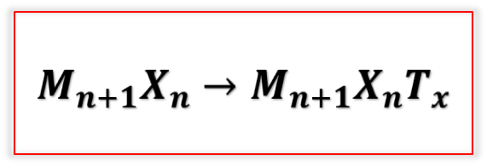
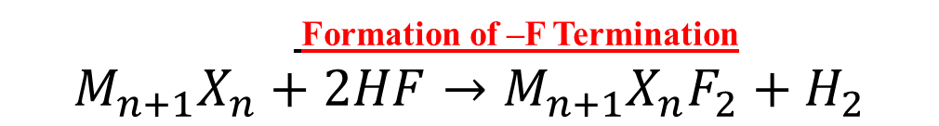
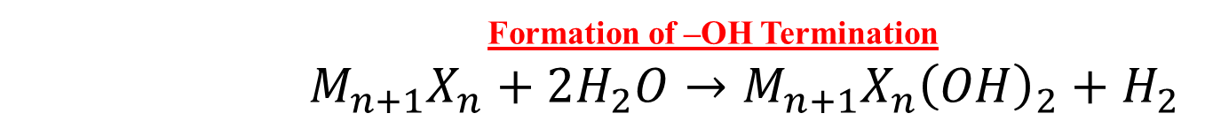

Synthesis of MXene
Removal of A-layer:
$$M_{n+1}AX_{n}+3HF→M_{n+1}X_{n}+AlF_{3}+\frac{3}{2}H_{2}$$
Formation of –OH Termination
$${ M}_{n+1}X_{n}+2H_{2}O→M_{n+1}X_{n}{\left(OH\right)}_{2}+H_{2}$$
$$M_{n+1}X_{n}→M_{n+1}X_{n}T_{x}$$
Formation of –F Termination
$$M_{n+1}X_{n}+2HF→M_{n+1}X_{n}F_{2}+H_{2}$$
Etching
$$Ti_{3}AlC_{2}+3HF→Ti_{3}C_{2}+AlF_{3}+\frac{3}{2}H_{2}$$
Hydroxyl Termination
$$Ti_{3}C_{2}+2H_{2}O→Ti_{3}C_{2}{\left(OH\right)}_{2}+H_{2}$$
Fluorine Termination
$$Ti_{3}C_{2}+2HF→Ti_{3}C_{2}F_{2}+H_{2}$$
https://doi.org/10.1002/adma.201102306

Slide 6
MXene
Properties | Advantages | Disadvantages
Electrical & Electronic Properties | MXenes exhibit high electrical conductivity (up to ~10,000 S/cm) due to partially filled d-orbitals of transition metals, enabling efficient electron transport and metallic behavior. | Conductivity degrades upon oxidation as surface Ti (or other metals) forms insulating oxides (e.g., TiO₂), disrupting electron pathways.
Surface Area & Ion Transport | The 2D layered structure provides a high surface-to-volume ratio and hydrophilic surface terminations (–OH, –O), facilitating rapid ion diffusion and high electrochemical capacitance. | Strong van der Waals interactions cause restacking of layers, reducing accessible surface area and hindering ion transport.
Chemical Tunability | Surface terminations (Tₓ = –O, –OH, –F) can be tuned to modify electronic structure, catalytic activity, due to reactive surface sites. | Synthesis typically involves hydrofluoric acid (HF), which is highly toxic and corrosive, posing safety and scalability challenges.

Slide 7
MXene
Application | how mxene is used ? | Property of mxene | Reference
Supercapacitors | MXenes store charge via pseudocapacitive behavior and electric double-layer formation. Their layered structure allows rapid ion intercalation/de-intercalation. | High conductivity (~10⁴ S/cm) & hydrophilic surface (–OH, –O groups) enables fast ion transport and high capacitance. | Naguib et al., Advanced Materials, 2014 DOI: 10.1002/adma.201304138
Lithium-ion Batteries | MXenes act as anode materials where Li⁺ ions intercalate between layers with minimal diffusion resistance. | Large interlayer spacing & metallic conductivity improves charge transfer and cycling stability. | Lukatskaya et al., Science, 2013 DOI: 10.1126/science.1241488
Electrocatalysis (HER/OER) | Surface terminations and exposed metal sites act as active catalytic centers for hydrogen and oxygen evolution reactions. | Tunable surface chemistry (–O, –OH, –F) & high surface area enhances catalytic activity and lowers overpotential. | Seh et al., Chemical Society Reviews, 2017 DOI: 10.1039/C6CS00631E
Sensors (Gas/Biosensors) | Changes in electrical resistance occur upon adsorption of gas molecules or biomolecules on MXene surface. | High surface reactivity & large surface area provides high sensitivity and fast response time. | Kim et al., ACS Nano, 2018 DOI: 10.1021/acsnano.8b05054
Water Purification | MXenes adsorb heavy metal ions and dyes through electrostatic interaction and surface functional groups. | Hydrophilicity & negatively charged surface enhances adsorption efficiency. | Rasool et al., Nature Communications, 2016 DOI: 10.1038/ncomms12461

Slide 8
Thank you.

Slide 14
