Slide 1
Coursera – Capstone project
Restaurant Analysis based on cuisine
- Dharan Sendamaraikannan (10/28/2020)

Slide 2
Introduction
Let's assume in this one of the world's most diverse region we want to open an Indian restaurant, so what are all the factors we must take into account such as follows,
Market Places
Competition in particular location
Aiding places that make people come to restaurants like Gym, Entertaining Public places
Population
Menu from competitors
Our solution needs to be data driven for avoiding or considering low risk criteria and high success rate and thus apply our overall knowledge in the techniques and the tools gained so far in this course.

Slide 3
DaTA SOurces
DATA 1 : https://cocl.us/new_york_dataset
DATA 2 : https://data.cityofnewyork.us/City-Government/Borough-Boundaries/tqmj-j8zm
DATA 3 : FOURSQUARE API

Slide 4
ANALYSIS:
Number of Neighborhoods in New York city

Slide 5
ANALYSIS (contd…)
Boroughs vs. Indian cuisine restaurants – New York

Slide 6
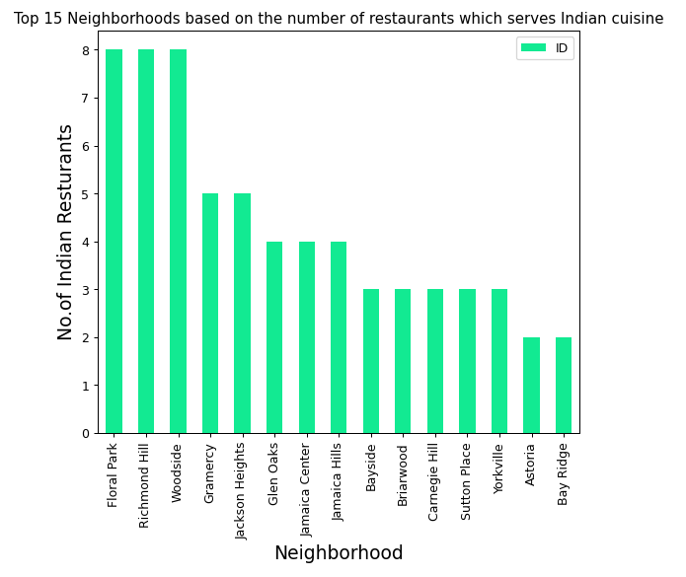
ANALYSIS (contd…)
Top Neighborhoods based on number of Indian restaurants

Slide 7
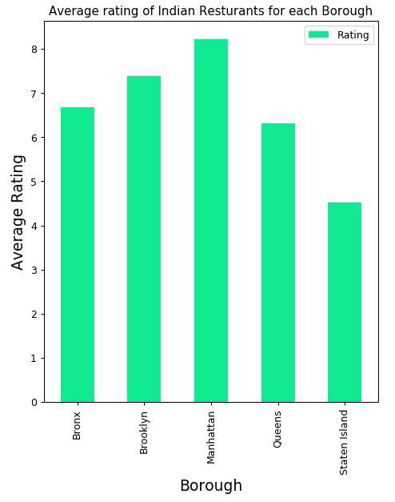
ANALYSIS (contd…)
Boroughs based on Average rating of Indian restaurants

Slide 8
results
Best Neighborhood for opening Restaurant (Indian Cuisine) in New York.
o Astoria (Queens), Blissville (Queens), Civic Center (Manhattan) are some of the best neighborhoods for Indian cuisine.
Area which lack Indian Restaurants.
o Staten Island ranks last in average rating of Indian Restaurants.
Places with best Indian Cuisine.
o Manhattan is the best place to stay if you prefer Indian Cuisine.
Areas with Potential Indian Restaurants.
o Manhattan have potential Indian Restaurant Market

