Slide 1

[Samsung PRISM] Mid Review Report
MULTI KWS USING RNN BASED ARCHITECTIRE
Team
College Professor(s): Dr. Anusuya
Students:
Anand Naryanan
Dharneesh
Fathima Saliha
Pretivarshini
Department: Information Technology
Date: 5 Aug 2019

Slide 2
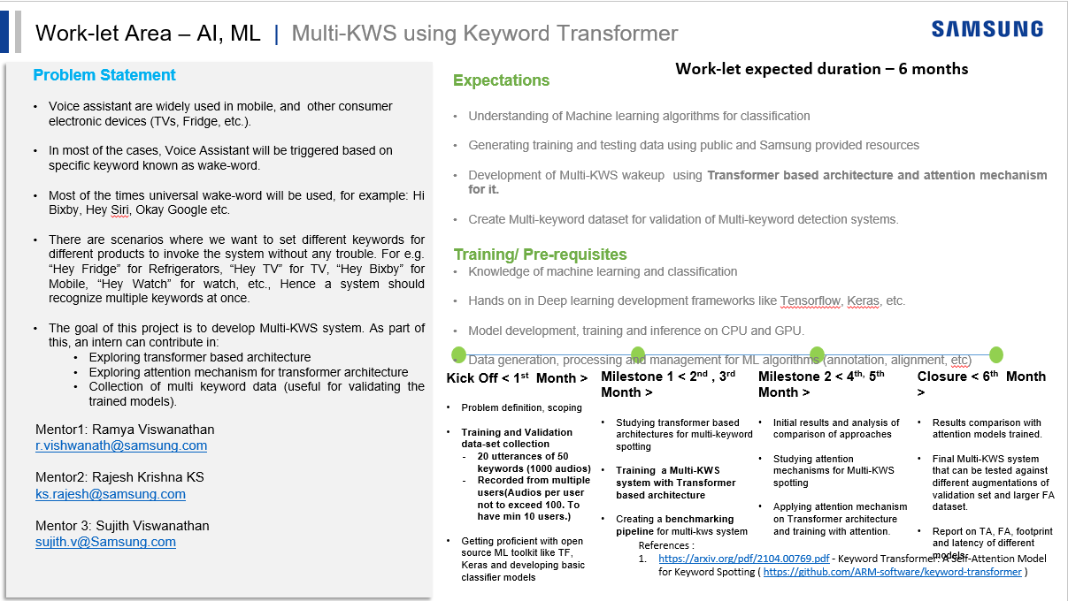

Slide 3
Proposed Approach / Solution
Concept Diagram :
( Clear detailed schematic / block diagram / flow chart depicting the proposed concept / solution )
Input Audio signal
Feature Extraction block
RNN Block
Posterior handling block
Output

Slide 4
Dataset(s) Analysis / Description
Dataset Capture / Preparation / Generation :
(Discuss the dataset generation process or if downloaded data provide details of what data & from where it was obtained etc… - 2 to 3 bullets only)
Each individual collected 250 audio recordings, each associated with 50 keywords
Dataset Understanding / Analysis :
(Provide 2 to 3 bullets about what is your understanding of the data / opinion about the data)
The dataset should be in WAV format for improved machine learning model comprehension
Dataset Pre-Processing / Related Challenges (if any) :
(List out the challenges you fore see in data handling wrt problem definition – 2 to 3 bullets only)
To convert audio files from mp3 to WAV format

Slide 5
Experimental Results / Simulations / Observations
Results :
(provide numerical data / bar charts / plots / images / videos / tabulated results etc. Use full slide or multiple slides up to max 3 slides to demonstrate the results)
Major Observations / Conclusions & Challenges :
(provide details about your findings, experimental opinion – Use separate slide if necessary)
The RNN model achieved a 75% accuracy rate, indicating its performance in making correct predictions for the given task. However, further improvements may be necessary for more accurate results.
The presence of mixed mono and stereo audio files poses a challenge for consistent processing and analysis, requiring adaptability in the model design and feature extraction methods.

Slide 6
Further Plan to Complete Project
Final Probable Deliverables :
(Discuss in the form of bullets, what are the next steps to complete the solution, any road blocks / bottlenecks, any support needed from SRIB)
Our next step in completing the project involves utilizing both mono and stereo audio to enhance the RNN model's performance and efficiency.
IP Target / Plan :
(Any possibility of papers / patentable ideas / innovative aspects that can lead to patentable ideas)

Slide 7
Further Plan to Complete Project
Completion Plan:
(High level plan to complete the project in next 8 weeks after review, in format below)
Week 1 to 2
Building classification models using tensorflow
Week 2 to 4
Audio classification models
Week 5 to 6
CNN Model
Week 7 to 8
Building RNN Model
Challenges Anticipated:
Git Upload details:

Slide 8
Thank you

