Slide 1

Multi-KWS using RNN based architectures
Worklet Details
Worklet ID:23VI21PSG
College Name: PSG College of Technology
KPIs achieved till now
Any Challenges/ Issues faced
Developed RNN Models with LSTM, GRU, Bi-RNN and CRNN
Created a Pipeline that works on live audio.
Perform Data Augmentation to increase dataset size
2) Calculate latency of models
Multi-KWS using RNN based architectures
Multi-KWS using RNN based architectures
Next Steps
1)Reduce overfitting of the models
Key Achievements/ Outcome till now
1)Developed RNN models with LSTM, GRU, Bi-RNN and CRNN Layers
Date: 24/1/2024

Slide 2
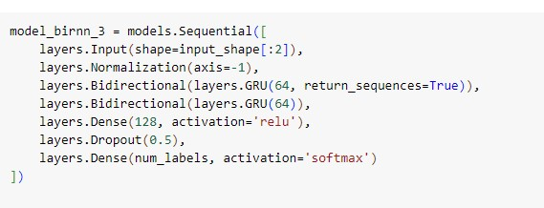
Bi-RNN Model with Accuracy : 78.96%

Slide 3
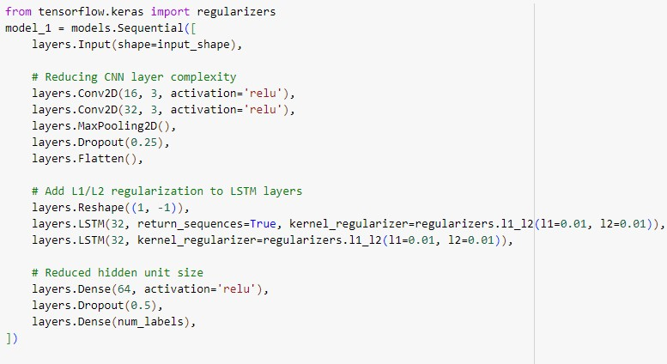
CRNN Model with Accuracy : 78.79%

Slide 4
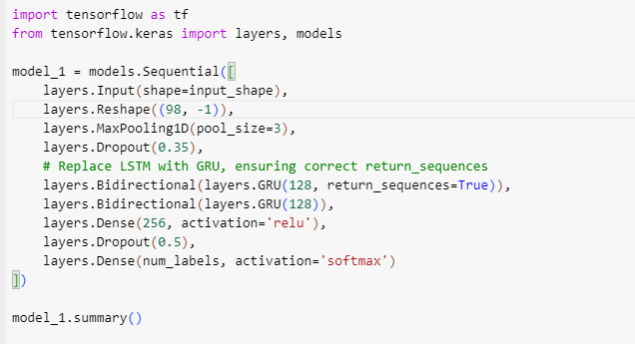
Bi-RNN Model with GRU - Accuracy : 90.28%

Slide 5
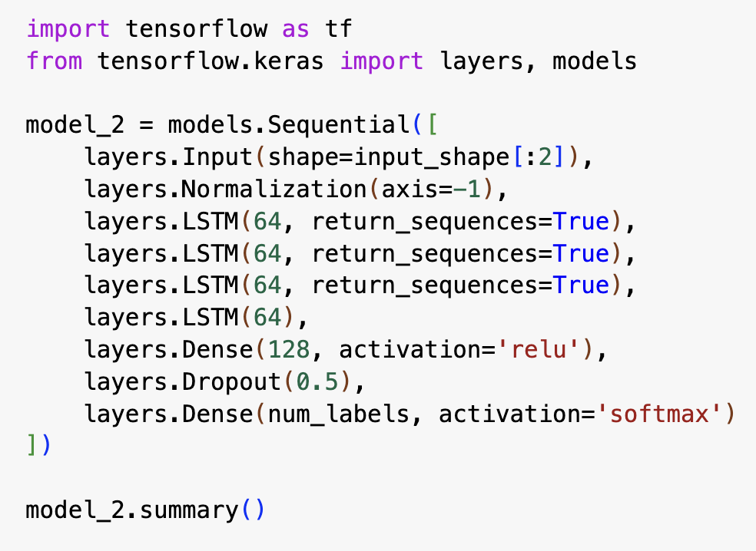
RNN Model with LSTM Accuracy : 31.81%

