Slide 1

[Samsung PRISM] End Review Report
Multi-KWS using RNN based architectures
Working Team Details [Name & Email ID] :
Professor : Dr. Anusuya R
Students:
Anand Narayanan N - 21i205@psgtech.ac.in
Dharaneesh CKV - 21i212@psgtech.ac.in
Fathima Saliha M - 21i214@psgtech.ac.in
Preti Varshni G- 21i237@psgtech.ac.in
Department: BTech Information Technology
Date: 15 Feb 2024

Slide 2

Work-let Area – AI, ML | Multi-KWS using RNN based architectures
Problem Statement
Voice assistant are widely used in mobile, and other consumer electronic devices (TVs, Fridge, etc.).
In most of the cases, Voice Assistant will be triggered based on specific keyword known as wake-word.
Most of the times universal wake-word will be used, for example: Hi Bixby, Hey Siri, Okay Google etc.
There are scenarios where we want to set different keywords for different products to invoke the system without any trouble. For e.g. “Hey Fridge” for Refrigerators, “Hey TV” for TV, “Hey Bixby” for Mobile, “Hey Watch” for watch, etc., Hence a system should recognize multiple keywords at once.
The goal of this project is to develop Multi-KWS system. As part of this, an intern can contribute in:
exploring RNN based architectures like LSTM, GRU, Bi-RNN, CRNN, etc.,
collection of multi keyword data (useful for validating the trained models).
Work-let expected duration – 6 months
Expectations
Understanding of Machine learning algorithms for classification
Generating training and testing data using public and Samsung provided resources
Development of Multi-KWS wakeup using RNN based architectures (at least 2)
Create Multi-keyword dataset for validation of Multi-keyword detection systems.
Training/ Pre-requisites
Knowledge of machine learning and classification
Hands on in Deep learning development frameworks like Tensorflow, Keras, etc.
Model development, training and inference on CPU and GPU.
Data generation, processing and management for ML algorithms (annotation, alignment, etc)
Kick Off < 1st Month >
Problem definition, scoping
Training and Validation data-set collection
20 utterances of 50 keywords (1000 audios)
Recorded from multiple users(Audios per user not to exceed 100. To have min 10 users.)
Getting proficient with open source ML toolkit like TF, Keras and developing basic classifier models
Milestone 1 < 2nd , 3rd Month >
Studying RNN based architectures for multi-keyword spotting
Training a Multi-KWS system with RNN based architectures like LSTM, GRU, BI-RNN, CRNN, etc.,
Creating a benchmarking pipeline for multi-kws system
Milestone 2 < 4th , 5th Month >
Initial results and analysis of comparison of approaches
Measuring latency across different architectures
Training a smaller version of RNN-based architectures for latency comparison
Closure < 6th Month >
Results comparison with smaller models trained.
Final Multi-KWS system that can be tested against different augmentations of validation set and larger FA dataset.
Report on TA, FA, footprint and latency of different models.
Mentor1: Ramya Viswanathan r.vishwanath@samsung.com
Mentor2: Ravi Solanki
ravi.siso@samsung.com
Mentor 3: Sujith Viswanathan
sujith.v@Samsung.com
References :
https://github.com/google-research/google-research/tree/master/kws_streaming

Slide 3
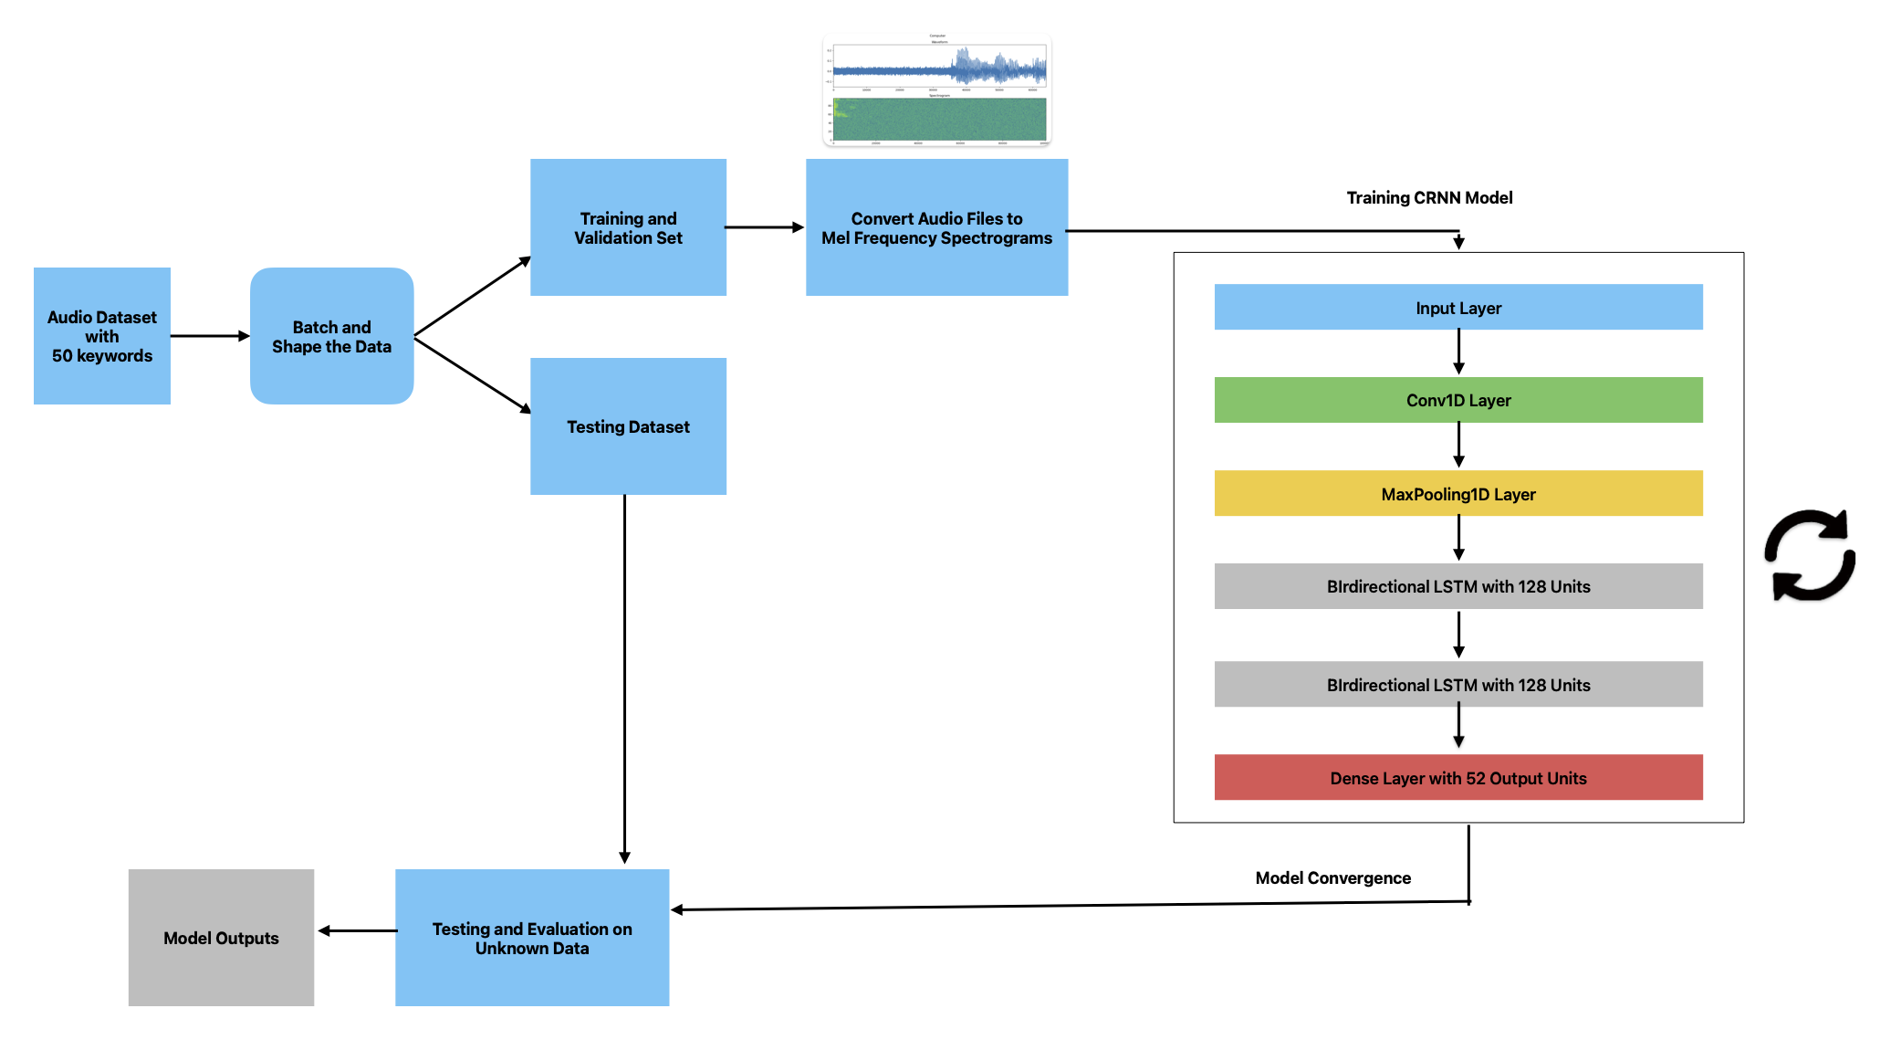
Approach / Solution
Concept Diagram :
( Clear detailed schematic / block diagram / flow chart depicting the proposed concept / solution )

Slide 4
Dataset(s) Analysis / Description
Dataset Capture / Preparation / Generation :
(Discuss the dataset generation process or if downloaded data provide details of what data & from where it was obtained etc… - 2 to 3 bullets only)
Dataset comprises of 50 keywords with 20 audios each.
There are 50 audios per speaker
Keywords List :
1. Aeroplane | 14. Computer | 27. Moon | 40. Spoon
2. Amazon | 15. Dog | 28. Netflix | 41. Sun
3. Apple | 16. Donut | 29. Pants | 42. Table
4. Backpack | 17. Door | 30. Paper | 43. Television
5. Bamboo | 18. Electricity | 31. Pen | 44. Toothbrush
6. Banana | 19. Flower | 32. Phone | 45. Toothpaste
7. Bike | 20. Fork | 33. Radio | 46. Towel
8. Book | 21. Hat | 34. Sandals | 47. Tree
9. Car | 22. Hockey | 35. Shark | 48. Umbrella
10. Cat | 23. Internet | 36. Shirt | 49. Wallet
11. Chair | 24. Keys | 37. Shoes | 50. Window
12. Clock | 25. Knife | 38. Shower | a) Noise
13. Coffee | 26. Lamp | 39. Soap | b) Unknown

Slide 5
Dataset(s) Analysis / Description
Dataset Understanding / Analysis :
(Provide 2 to 3 bullets about what is your understanding of the data / opinion about the data)
Audio Dataset includes 1000 original audios recorded from speakers in .wav format.
Sampling Rate of the audio is 64000.
Every audio runs for about 1 second.
Dataset Pre-Processing / Related Challenges (if any) :
(List out the challenges you fore see in data handling wrt problem definition – 2 to 3 bullets only)
Conversion of Audio recorded in multiple formats (.mp3, .aac) to .wav for compatibility during training.
Organisation of the Audio in their respective folders to ensure error-free training.

Slide 6

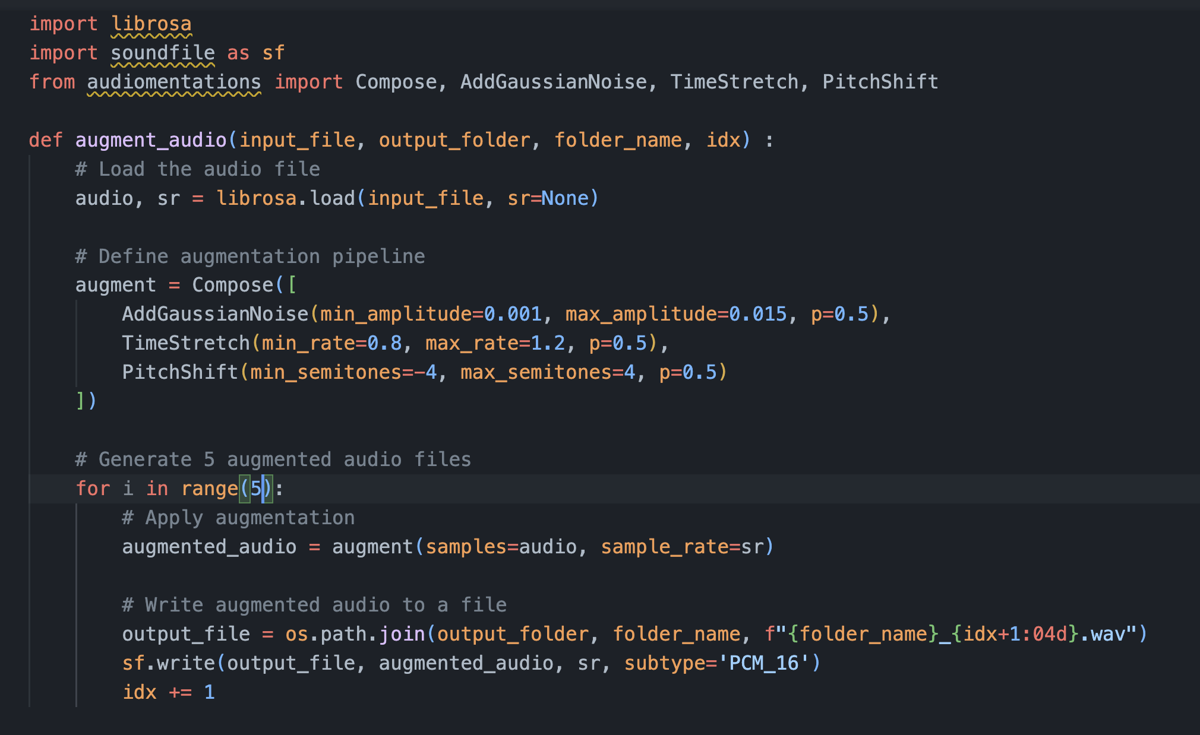
Dataset Augmentation
Augmentation of Audios
Augmented Dataset contains 100 audios per keyword.
audiomentations library was utilised for augmentation of the audios.
Augmentation Pipeline :

Slide 7
Model Training
RNN Models
Eight RNN models were trained using various architectures:
Two each for LSTM, GRU, BiRNN, and CRNN.
All models were trained for 30 epochs with a batch size of 128.
RNN Model | Number of Hidden Units | Number of Layers | Model Size
LSTM 1 | 64 | 2 | 14.973MB
LSTM 2 | 128 | 2 | 34.133MB
GRU 1 | 64 | 2 | 11.419MB
GRU 2 | 64 | 3 | 12.562MB
BiRNN 1 | 128(GRU Layer) | 2 | 23.651MB
BiRNN 2 | 128(LSTM Layer) | 2 | 31.133MB
CRNN 1 | 64(GRU Layer) | 4 | 7.412MB
CRNN 2 | 128(LSTM Layer) | 4 | 36.717MB

Slide 8
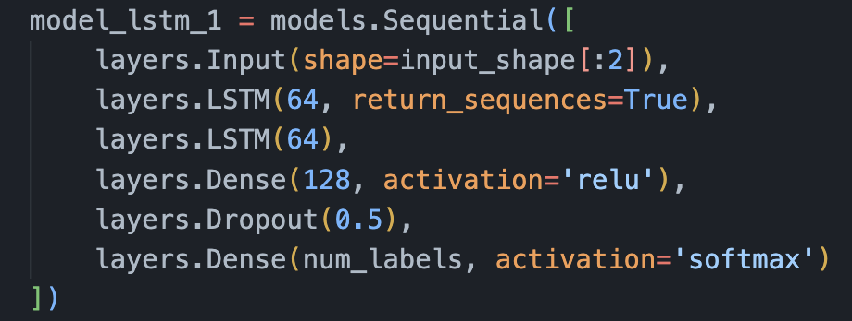
Model Architecture
LSTM 1

Slide 9
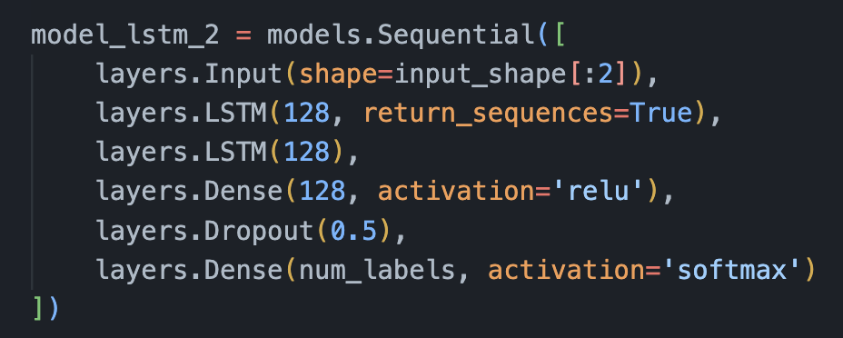
Model Architecture
LSTM 2

Slide 10
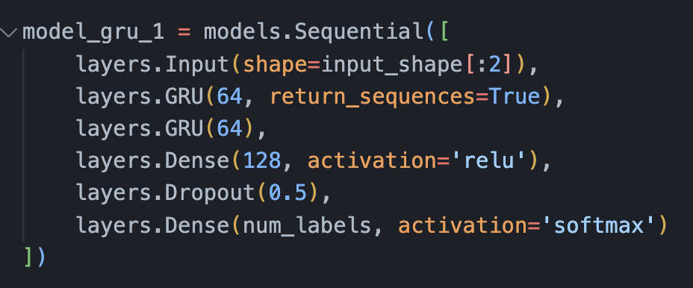
Model Architecture
GRU 1

Slide 11
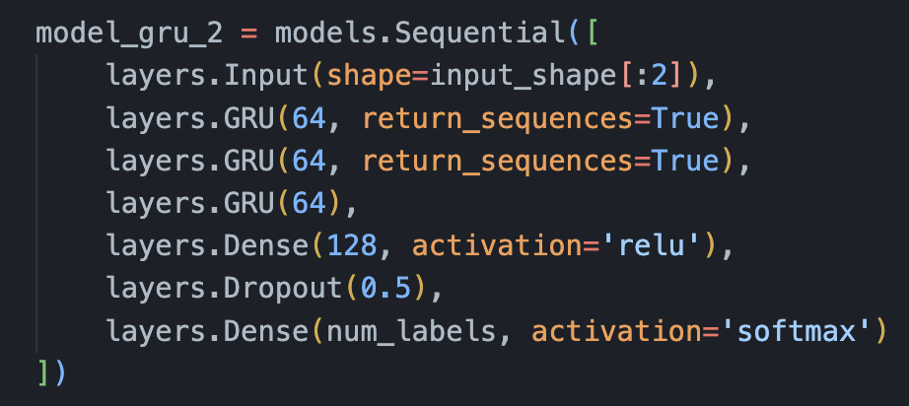
Model Architecture
GRU 2

Slide 12
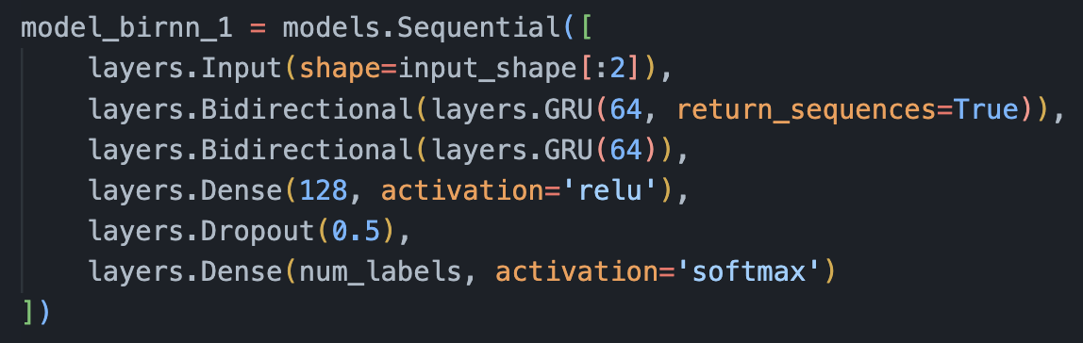
Model Architecture
BiRNN 1

Slide 13
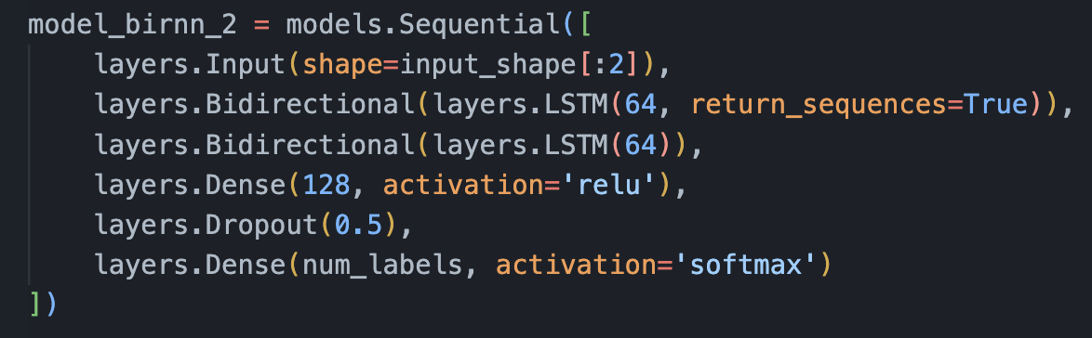
Model Architecture
BiRNN 2

Slide 14
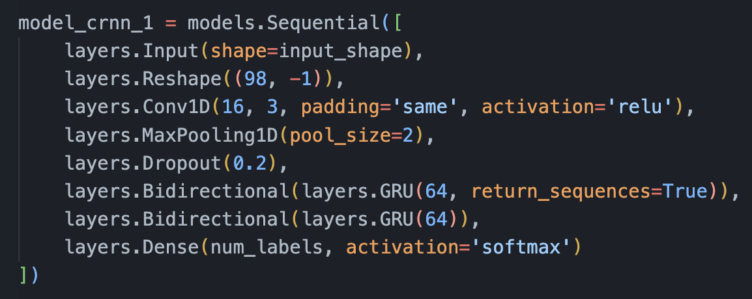
Model Architecture
CRNN 1

Slide 15
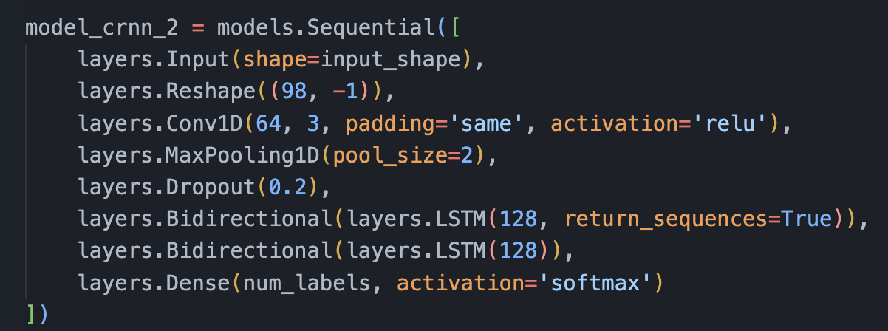
Model Architecture
CRNN 2

Slide 16
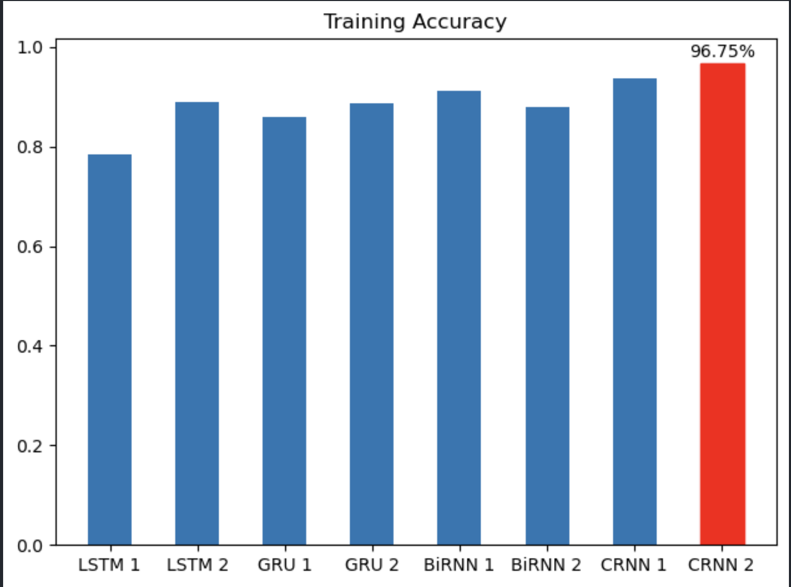
Experimental Results / Simulations / Observations
Results for Augmented Dataset:
(provide numerical data / bar charts / plots / images / videos / tabulated results etc. Use full slide or multiple slides up to max 3 slides to demonstrate the results)
Training Accuracy Comparison

Slide 17
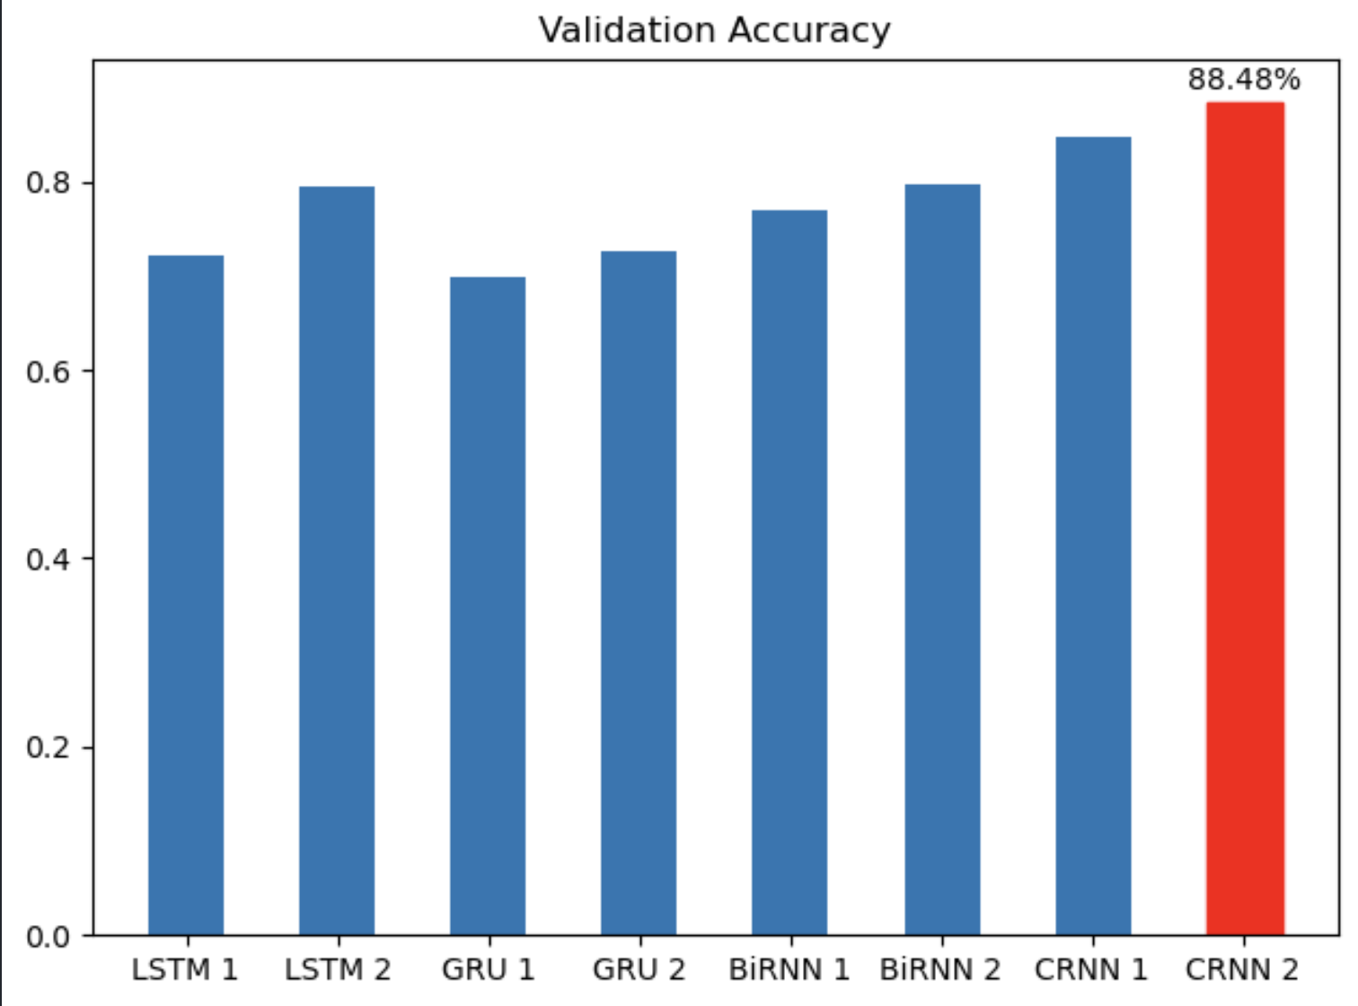
Experimental Results / Simulations / Observations
Results for Augmented Dataset :
(provide numerical data / bar charts / plots / images / videos / tabulated results etc. Use full slide or multiple slides up to max 3 slides to demonstrate the results)
Validation Accuracy Comparison

Slide 18
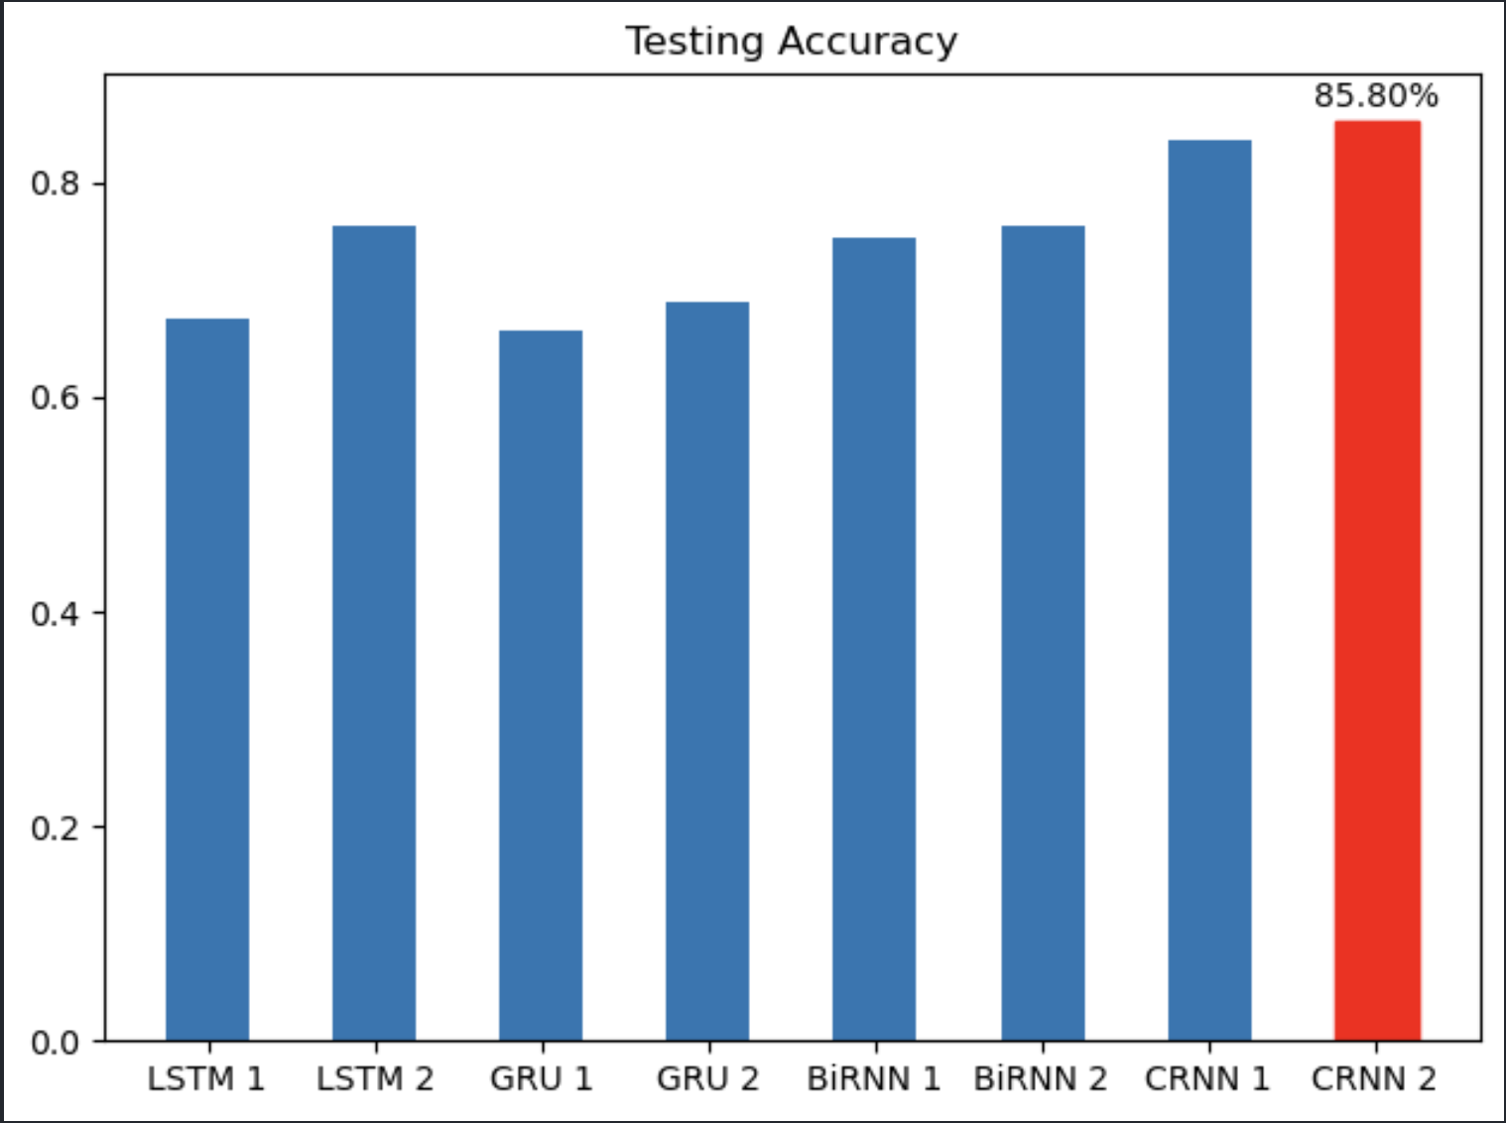
Experimental Results / Simulations / Observations
Results For Augmented Dataset:
(provide numerical data / bar charts / plots / images / videos / tabulated results etc. Use full slide or multiple slides up to max 3 slides to demonstrate the results)
Testing Accuracy Comparison

Slide 19
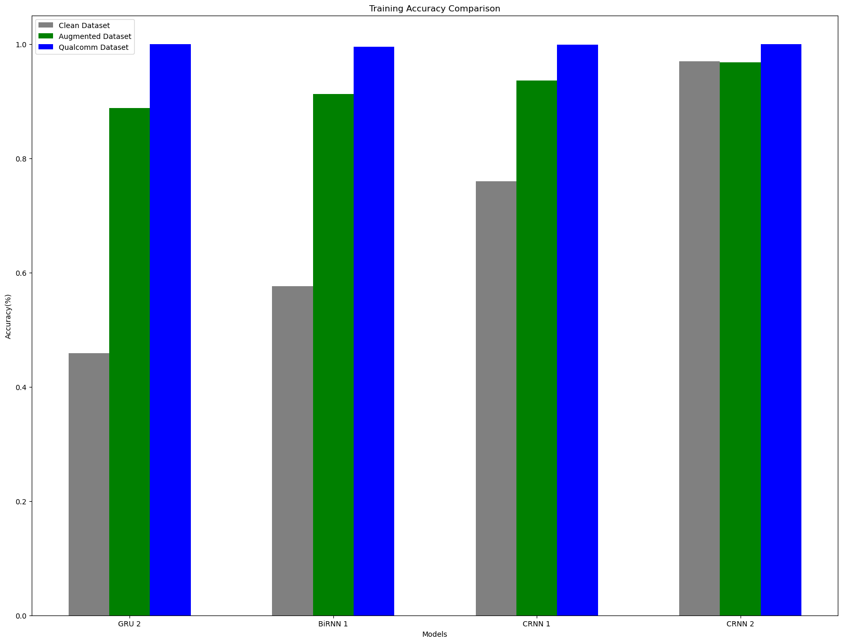
Experimental Results / Simulations / Observations
Results Comparison:
(provide numerical data / bar charts / plots / images / videos / tabulated results etc. Use full slide or multiple slides up to max 3 slides to demonstrate the results)
Training Accuracy Comparison

Slide 20
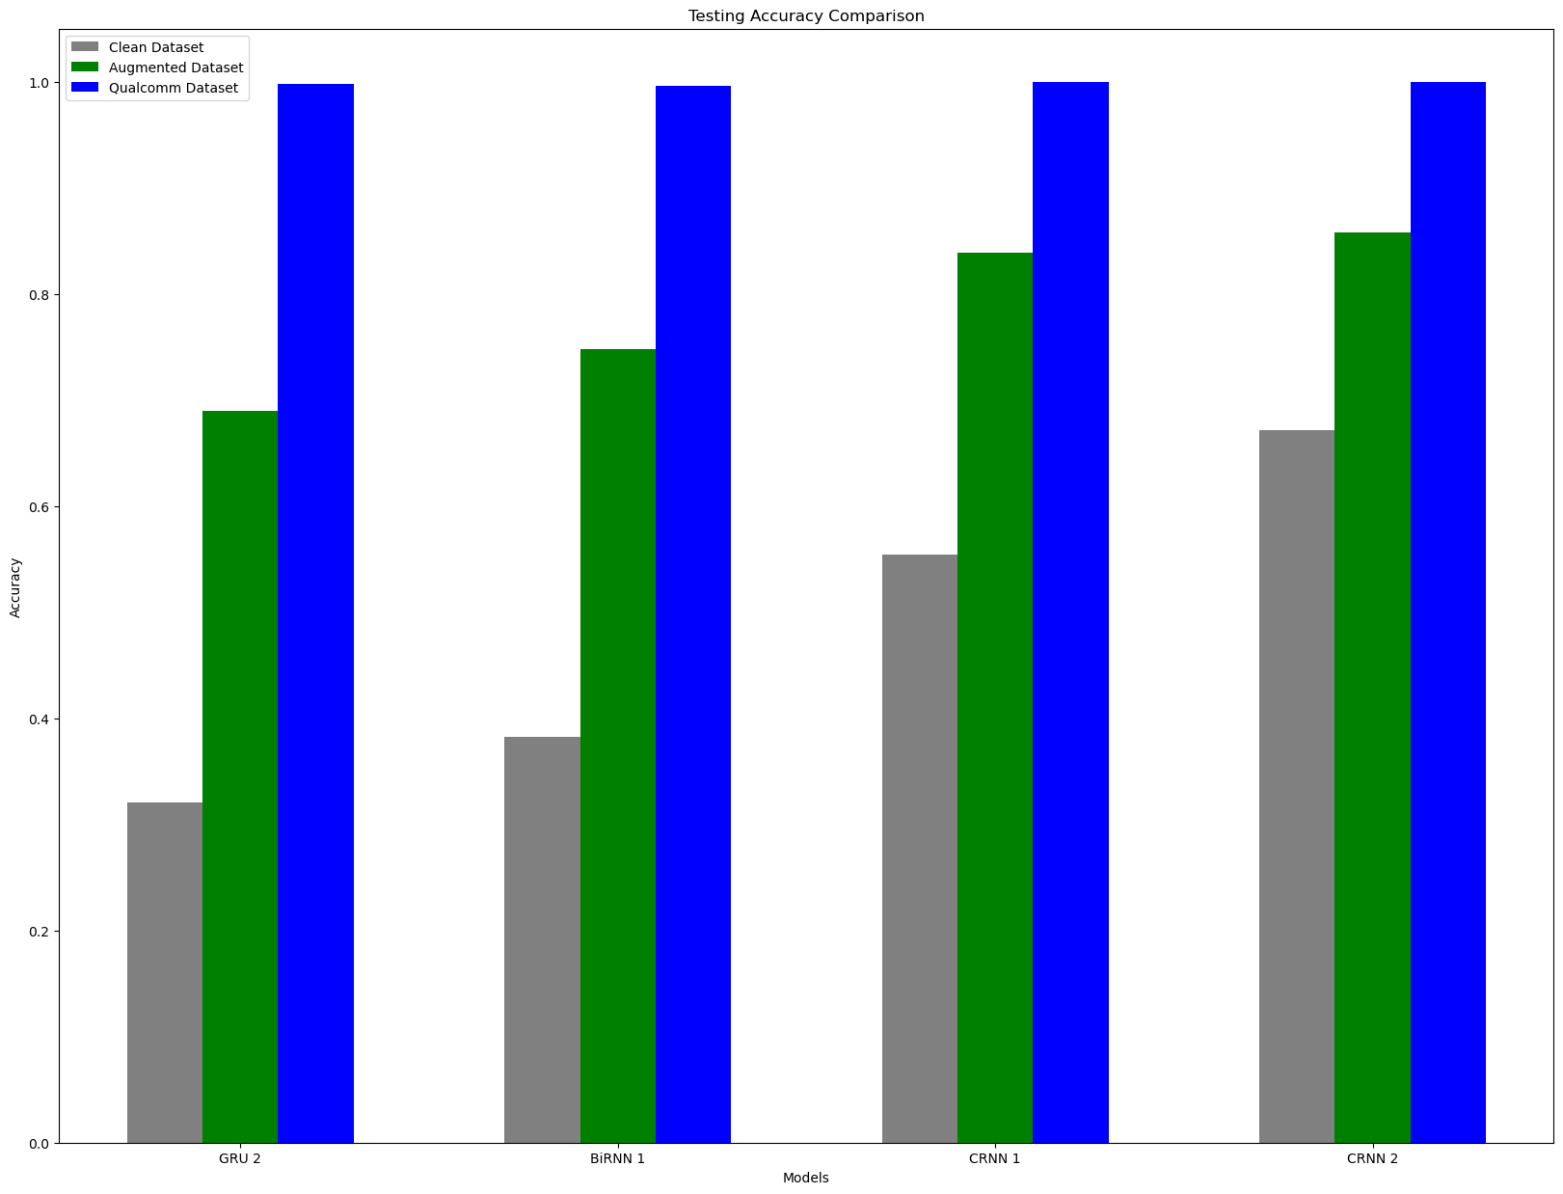
Experimental Results / Simulations / Observations
Results Comparison:
(provide numerical data / bar charts / plots / images / videos / tabulated results etc. Use full slide or multiple slides up to max 3 slides to demonstrate the results)
Testing Accuracy Comparison

Slide 21
Experimental Results / Simulations / Observations
Results For Augmented Dataset:
(provide numerical data / bar charts / plots / images / videos / tabulated results etc. Use full slide or multiple slides up to max 3 slides to demonstrate the results)
Evaluation Metrics of Models
RNN Model | Training Accuracy | Validation Accuracy | Testing Accuracy | Prediction Accuracy | Training Loss | Validation Loss | Testing Loss
LSTM 1 | 78.44 | 72.27 | 67.23 | 85.00 | 0.72 | 1.08 | 1.24
LSTM 2 | 88.92 | 79.49 | 75.94 | 88.00 | 0.42 | 0.88 | 1.00
GRU 1 | 85.84 | 69.92 | 66.10 | 86.00 | 0.52 | 1.15 | 1.32
GRU 2 | 88.75 | 72.66 | 68.94 | 88.00 | 0.42 | 1.27 | 1.33
BiRNN 1 | 91.22 | 76.95 | 74.81 | 90.00 | 0.31 | 0.97 | 1.01
BiRNN 2 | 87.86 | 79.69 | 75.95 | 88.00 | 0.44 | 0.76 | 0.89
CRNN 1 | 93.65 | 84.77 | 83.90 | 93.00 | 0.29 | 0.63 | 0.64
CRNN 2 | 96.75 | 88.48 | 85.8 | 96.00 | 0.12 | 0.44 | 0.52

Slide 22
Experimental Results / Simulations / Observations
Results For Qualcomm Dataset:
(provide numerical data / bar charts / plots / images / videos / tabulated results etc. Use full slide or multiple slides up to max 3 slides to demonstrate the results)
Evaluation Metrics of Models
RNN Model | Training Accuracy | Validation Accuracy | Testing Accuracy | Prediction Accuracy | Training Loss | Validation Loss | Testing Loss
LSTM 1 | 99.30 | 99.74 | 98.94 | 100.00 | 0.025 | 0.008 | 0.045
LSTM 2 | 99.71 | 100.00 | 99.15 | 99.00 | 0.015 | 0.002 | 0.029
GRU 1 | 99.65 | 100.00 | 99.57 | 99.00 | 0.016 | 0.005 | 0.012
GRU 2 | 99.94 | 100.00 | 99.79 | 99.00 | 0.005 | 0.002 | 0.004
BiRNN 1 | 99.56 | 98.96 | 99.58 | 99.00 | 0.015 | 0.018 | 0.011
BiRNN 2 | 98.36 | 99.74 | 99.14 | 99.00 | 0.053 | 0.013 | 0.035
CRNN 1 | 99.91 | 100.00 | 100.00 | 100.00 | 0.005 | 0.004 | 0.004
CRNN 2 | 100.00 | 99.74 | 100 | 100.00 | 0.0002 | 0.002 | 0.002

Slide 23
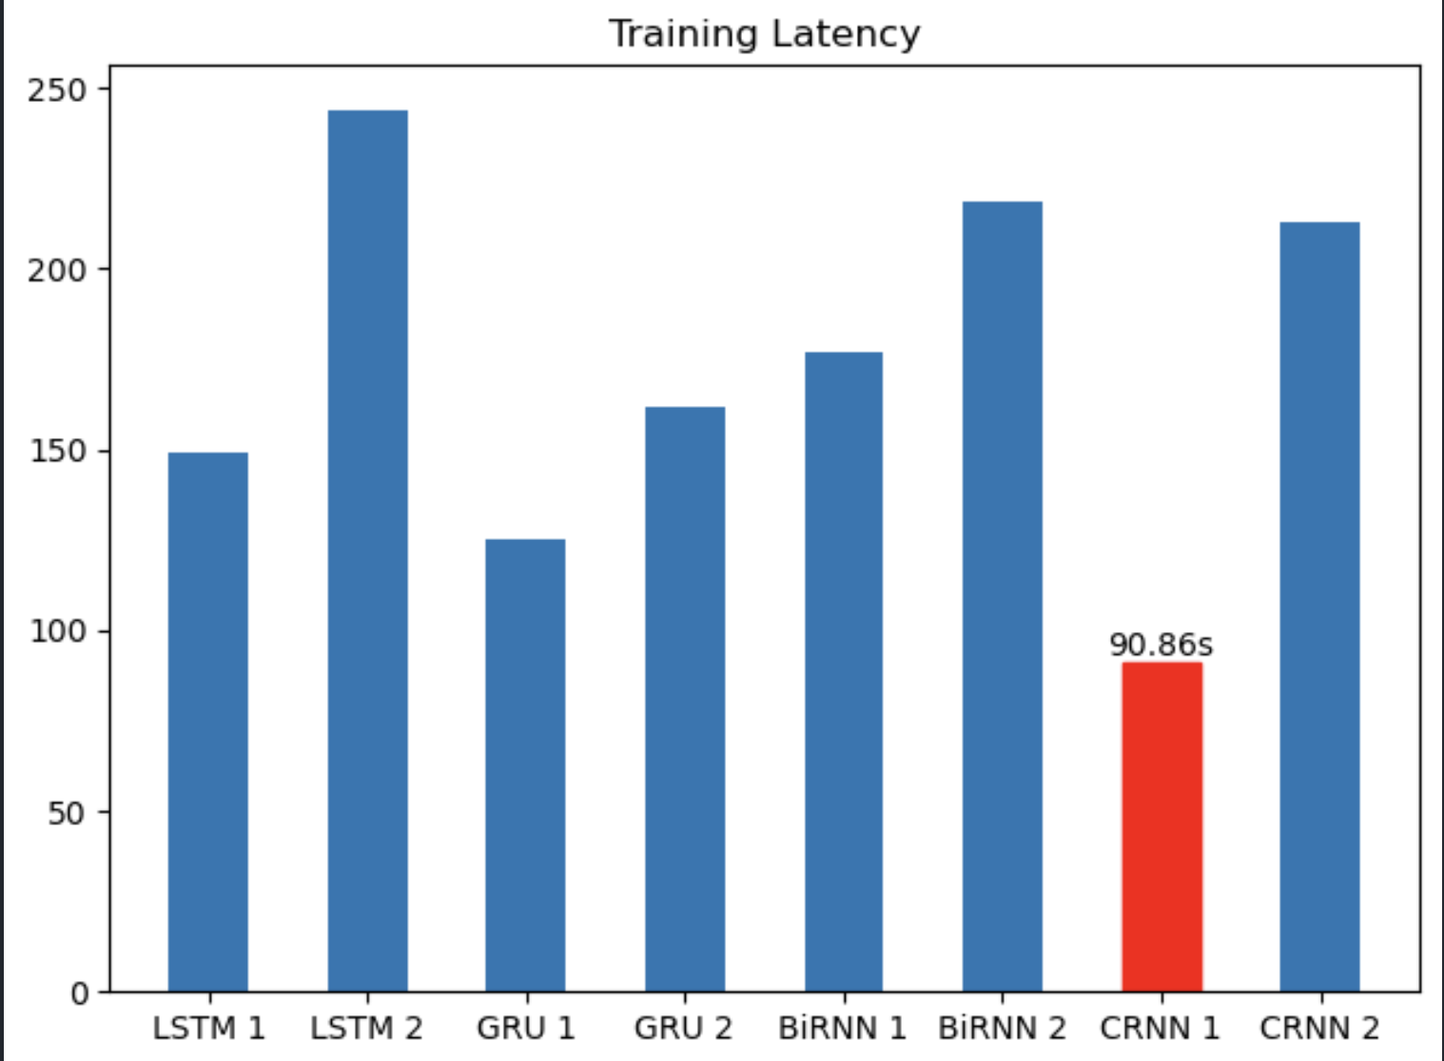
Experimental Results / Simulations / Observations
Results For Training Dataset:
(provide numerical data / bar charts / plots / images / videos / tabulated results etc. Use full slide or multiple slides up to max 3 slides to demonstrate the results)
Training Latency Comparison

Slide 24
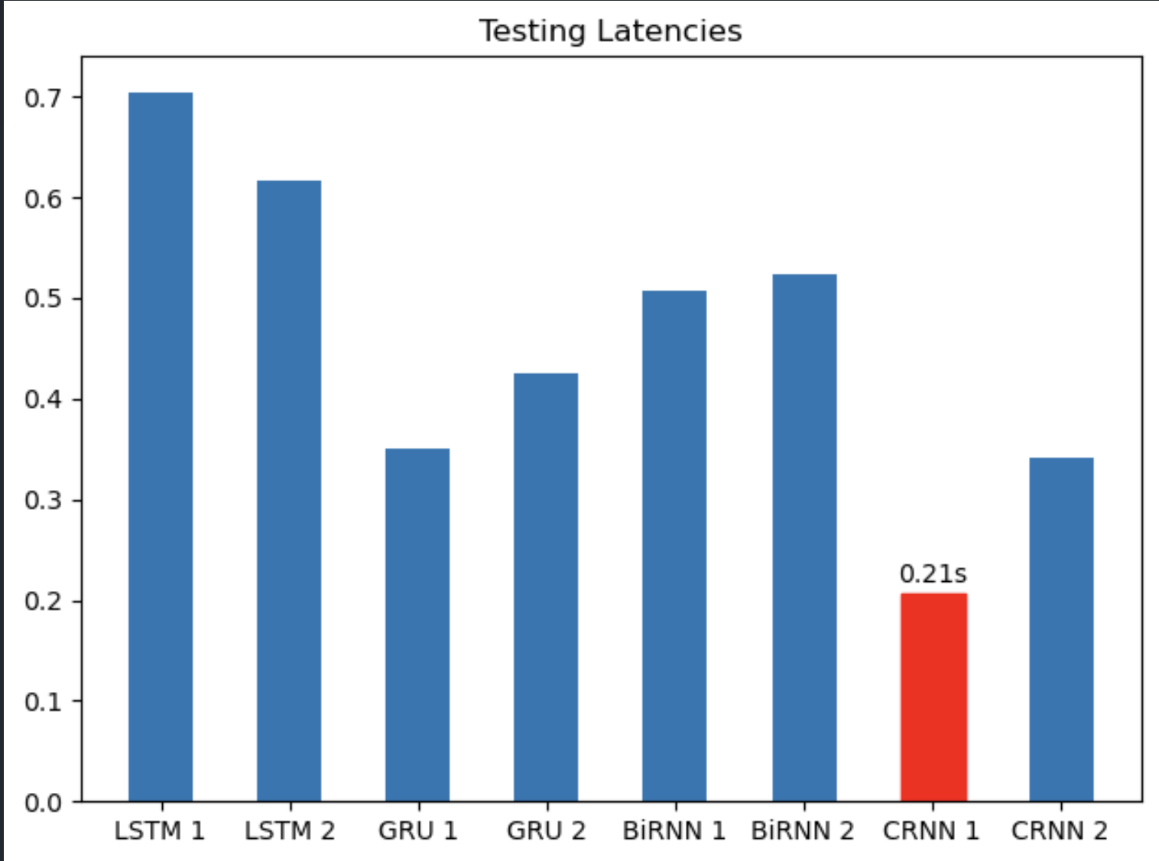
Experimental Results / Simulations / Observations
Results For Testing Dataset :
(provide numerical data / bar charts / plots / images / videos / tabulated results etc. Use full slide or multiple slides up to max 3 slides to demonstrate the results)
Testing Latency Comparison

Slide 25
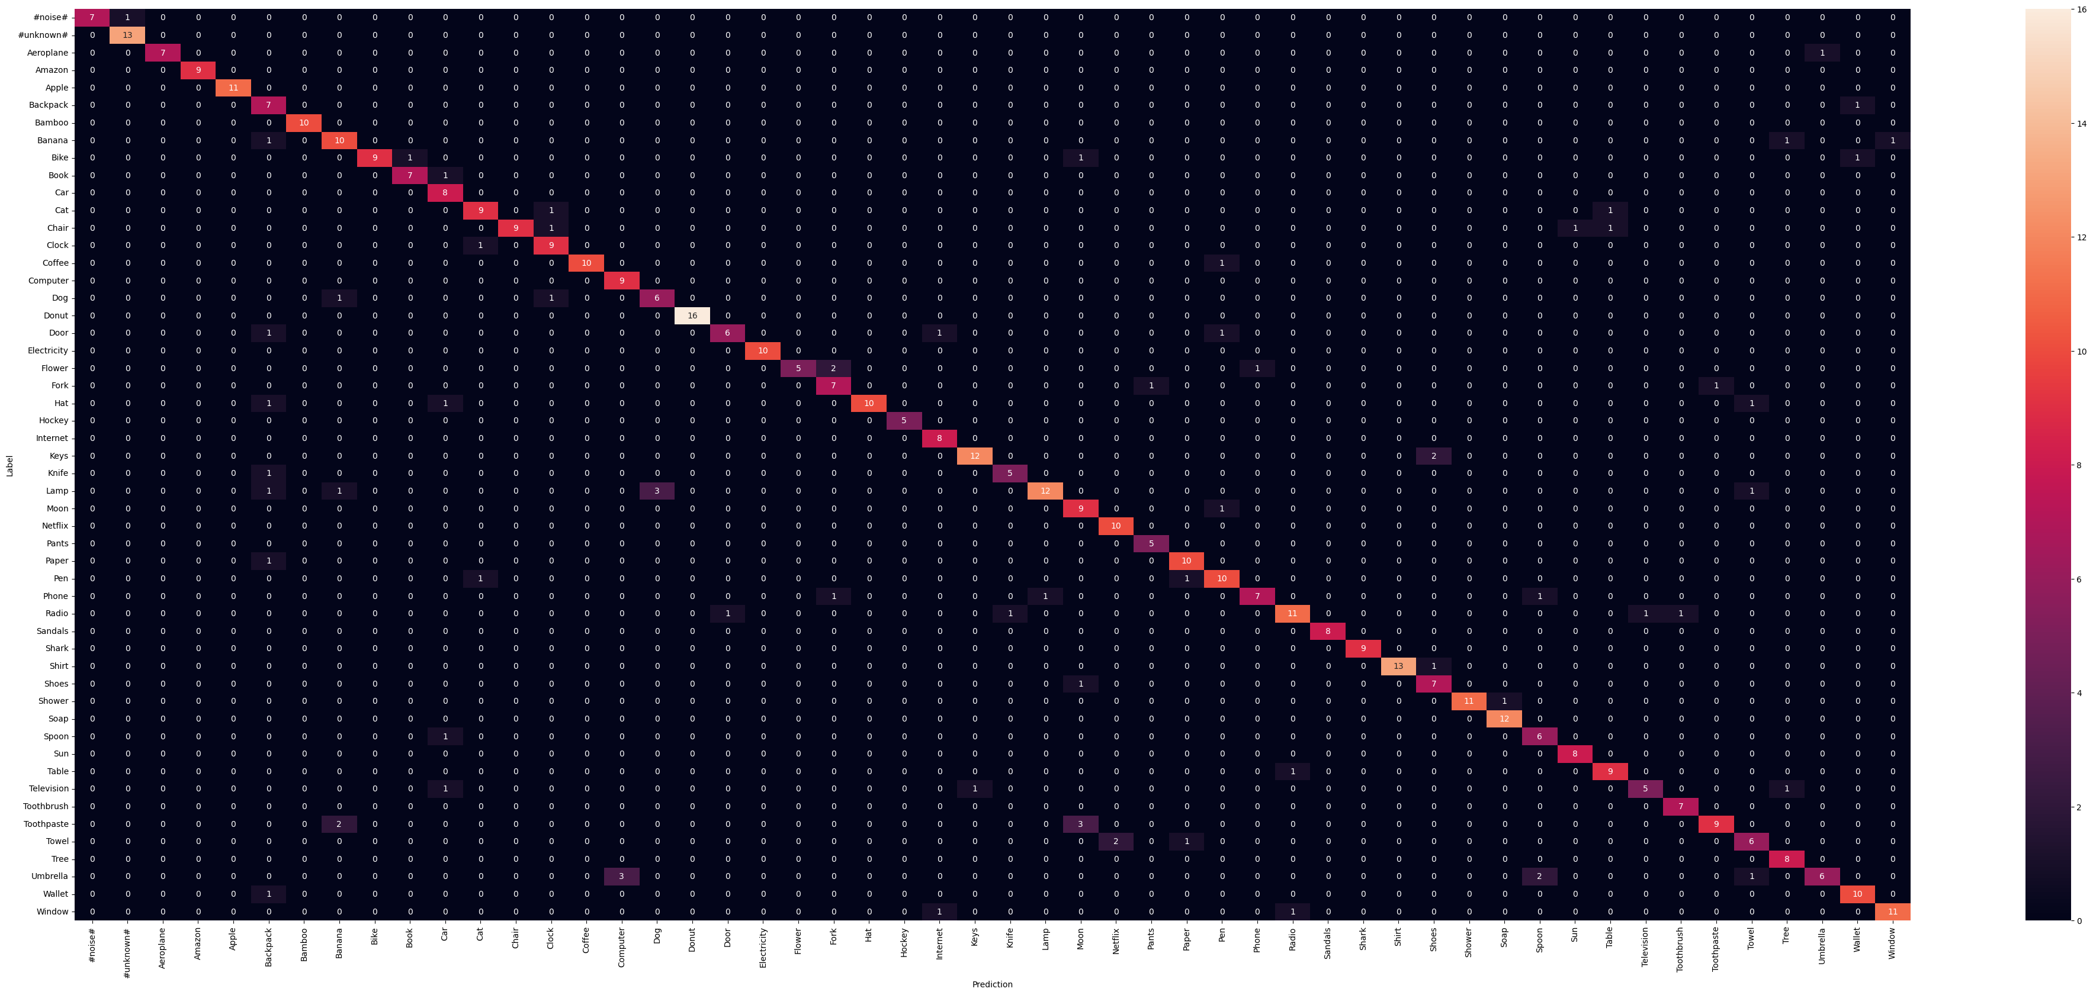
Experimental Results / Simulations / Observations
Results For Augmented Dataset:
(provide numerical data / bar charts / plots / images / videos / tabulated results etc. Use full slide or multiple slides up to max 3 slides to demonstrate the results)
Confusion Matrix for CRNN 2

Slide 26
Experimental Results / Simulations / Observations
Results For Qualcomm Dataset:
(provide numerical data / bar charts / plots / images / videos / tabulated results etc. Use full slide or multiple slides up to max 3 slides to demonstrate the results)
TA, FA, Latency and Footprint of Models
RNN Model | True Acceptance | False Acceptance | Latency |  | Footprint
 |  |  | Training Latency | Testing Latency | Model Size | Memory Usage
GRU 2 | 0.915 | 0.002 | 161.879s | 0.425s | 12.562MB | 12.078MB
BiRNN 1 | 0.937 | 0.0015 | 177.006s | 0.508s | 23.651MB | 89.93MB
CRNN 1 | 0.953 | 0.0011 | 90.861s | 0.207s | 7.412MB | 196.312MB
CRNN 2 | 0.954 | 0.0011 | 213.113s | 0.342s | 36.717MB | 23.688MB

Slide 27
Deliverable
Final Deliverables :
(Discuss in the form of bullets, what are the next steps to complete the solution, any road blocks / bottlenecks, any support needed from SRIB)
Experiment and Improve on the CRNN 2 model, the current best performing model.
Test the model on standard datasets (For Example, Google Speech Commands Dataset).
IP / Paper Publication Plan :
(Details of papers / patentable ideas / innovative aspects that can lead to patentable ideas)
Build a Continual Learning Model on top of CRNN 2 to adapt for practical situations.
Handle Catastrophic Forgetting during CL using Regularisation methods.
Collect datasets in local languages and dialects to enhance the performance in languages other than English.

Slide 28
Deliverable
KPIs delivered/Expectations Met:
(Planned Expectations shared in Work-let vs Delivered Results)
Collected Audio Dataset with 50 keywords
Tested on different RNN models with LSTM, GRU, BiRNN and CRNN models
Augmented the Dataset using audiomentations
Calculated Training and Testing Evaluation Metrics
Calculated True Acceptance, False Acceptance, Latency and Footprint(Model Size and Memory Usage) for the best performing models on the dataset.

Slide 29
Work-let Closure Details
Code Upload details:
Items | Details
KLOC (Number OF Lines of codes in 000’s) | 2KLoC
Model and Algorithm details | Convolutional RNN Model with Conv1D and LSTM Layers
Is Mid review, end review report uploaded on Git ? | Yes
Link for Git | Github Repo
Data details (if applicable):
Items | Data folder 1 | Data folder 2
Name & Type of Data (Audio/Image/Video) | Audio_Dataset_9 | Audio_Dataset_10
Number of data points | 5200 Audio Samples | 52000 Audio Samples
Source of Data (self collected, Scrapped, available on open source) | Self collected | Self Collected
Google drive link/ git link to access data | Audio_Dataset_9 Link | Audio_Dataset_10 Link
Note: If data uploaded on google drive, access to be shared to prism.srib@gmail.com

Slide 30
Thank you

