Slide 1
DUAL MODE HIDDEN SURVEILLANCE DETECTION SYSTEM USING ESP32 AND AD8318
Under the guidance of
Mrs.M.Swetha
Assistant Professor
Submitted by
TEAM-14A
S.V.MADHAVI A22126552196 SHABANA PARVEEN A22126552049
U.DHARANESH A22126552054 P.YASWANTH VARASAI A22126552192

Slide 2
Contents
Problem Statement
Abstract
Existing System
Proposed System
Methodology
Advantages
Applications
Conclusion

Slide 3
Problem Statement
The growing use of hidden surveillance devices such as spy cameras and wireless bugs has become a major threat to personal privacy in places like hotels, rental rooms, and offices. These devices are often concealed in everyday objects and can transmit data using technologies like Wi-Fi, Bluetooth, GSM, or infrared (IR).
Most existing detection systems rely on a single method, such as RF signal detection or IR detection. This creates limitations:
RF-based systems cannot detect non-transmitting or wired cameras
IR-based systems fail to detect cameras that do not use infrared illumination
Many solutions are costly, complex, and prone to false alarms
Because of these challenges, there is a need for a compact, affordable, and reliable solution that can:
Detect both RF signals (1 GHz–2.4 GHz) and IR emissions
Provide real-time alerts
Reduce false detections
Be easy to use for non-technical users

Slide 4
ABSTRACT
Dual-Mode Hidden Surveillance Detection System
This project presents a compact embedded system to detect hidden surveillance cameras using two complementary sensing methods — infrared (IR) and radio-frequency (RF).
An ESP32 microcontroller interfaces with an AD8318 RF detector (1–2.4 GHz) to identify wireless cameras (GSM, Wi-Fi, Bluetooth) and a 38 kHz IR receiver to detect night-vision IR-illuminated cameras. Detected signals trigger visual alerts on an OLED and 16×2 LCD, plus an audible buzzer alarm.
RF hysteresis and IR debounce filtering minimise false triggers, ensuring reliable detection. The dual-mode approach provides broader coverage than any single-mode system.

Slide 5
EXESTING SYSTEM
Hidden surveillance detection systems available today are primarily based on single detection techniques, such as Radio Frequency (RF), Infrared (IR), or optical methods.
1. RF-Based Detection Systems
Detect wireless signals emitted by devices
Identify cameras using Wi-Fi, Bluetooth, or GSM
Do not require line-of-sight
2. Optical Detection Systems
Use light reflection to identify camera lenses
Require manual scanning of the environment
3. IR-Based Detection Systems
Detect infrared radiation from night-vision cameras
Effective only for IR-enabled cameras
Works mainly in low-light conditions

Slide 6
Proposed System
The proposed system is a Dual-Mode Hidden Surveillance Detection System that identifies hidden cameras using both Radio Frequency (RF) and Infrared (IR) detection techniques.
It is built around the ESP32 microcontroller, which controls the entire system. RF signals in the 1 GHz–2.4 GHz range are detected using the AD8318 detector, while IR emissions from night-vision cameras are captured using the TSOP1838 sensor.
Both detection methods work simultaneously, allowing the system to identify a wide range of surveillance devices. The ESP32 processes the signals, compares them with set thresholds, and detects suspicious activity.
When a device is detected, the system gives real-time alerts using:
LCD display
OLED display (for RF signal strength)
Buzzer (audio alert)
This dual-mode system improves accuracy, reduces false alarms, and provides a compact, low-cost, and efficient solution for hidden camera detection.

Slide 7
Methodology
The system is developed by integrating both RF and IR detection techniques using an ESP32 microcontroller. The AD8318 RF detector captures wireless signals in the environment and converts them into an analog voltage, while the IR sensor detects infrared emissions from night-vision cameras.
The ESP32 continuously reads and processes the signals from both modules. The RF signal is converted into digital values using the ADC, and the IR sensor provides digital input. Signal processing techniques such as averaging, threshold comparison, and noise filtering are applied to ensure accurate detection.
Based on the processed data, the system determines the presence of hidden surveillance devices. When a signal exceeds the predefined threshold, the system generates real-time alerts through the LCD display, OLED visualization, and buzzer, providing reliable and efficient detection.

Slide 8
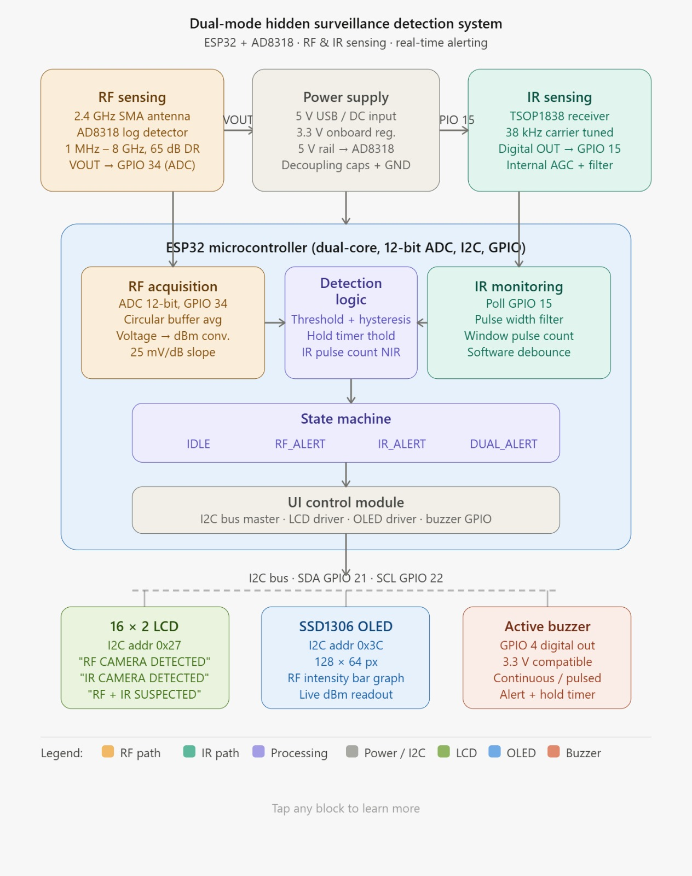
SYSTEM ARCHITECTURE

Slide 9
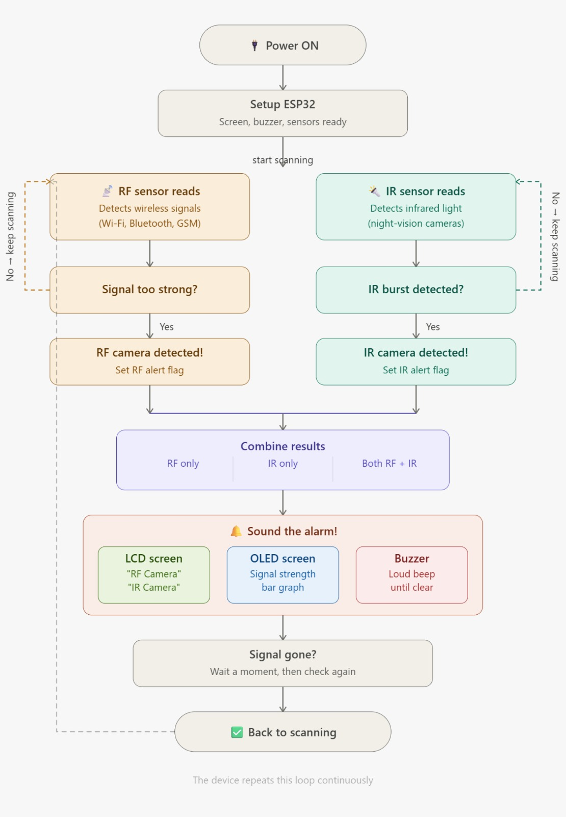
SYSTEM WORKFLOW

Slide 10
RF Detection (Radio Frequency)
Detects wireless signals from hidden devices (Wi-Fi, Bluetooth, GSM)
Works in the frequency range of 1 GHz – 2.4 GHz
Uses AD8318 RF detector to measure signal strength
Identifies active transmitting cameras or spy devices
Triggers alert when signal exceeds a threshold
Effective for detecting wireless hidden cameras
IR Detection (Infrared)
Detects infrared light emitted by night-vision cameras
Works even in dark or low-light conditions
Uses IR sensor to capture invisible IR radiation
Identifies cameras with IR LEDs (night surveillance)
Triggers alert when IR burst is detected

Slide 11
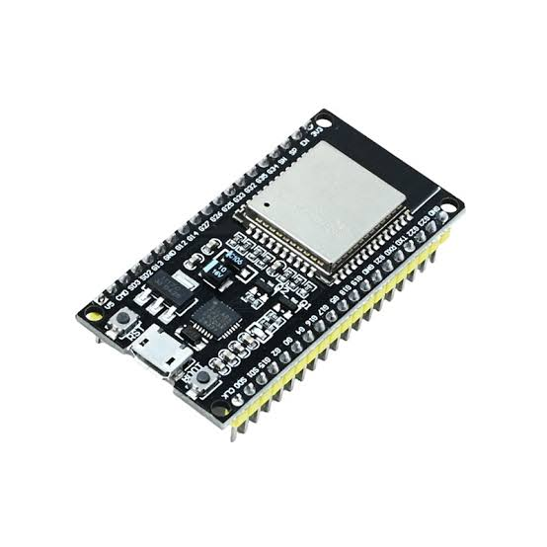
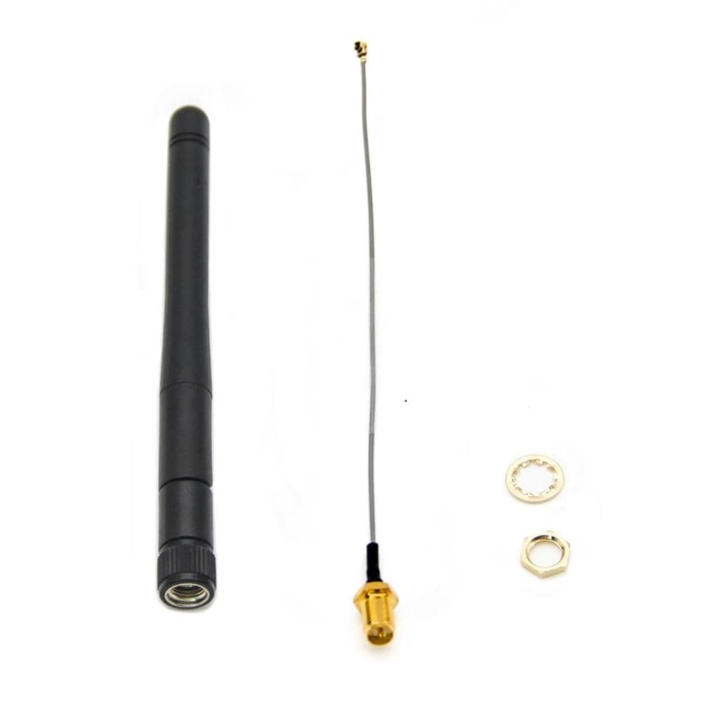
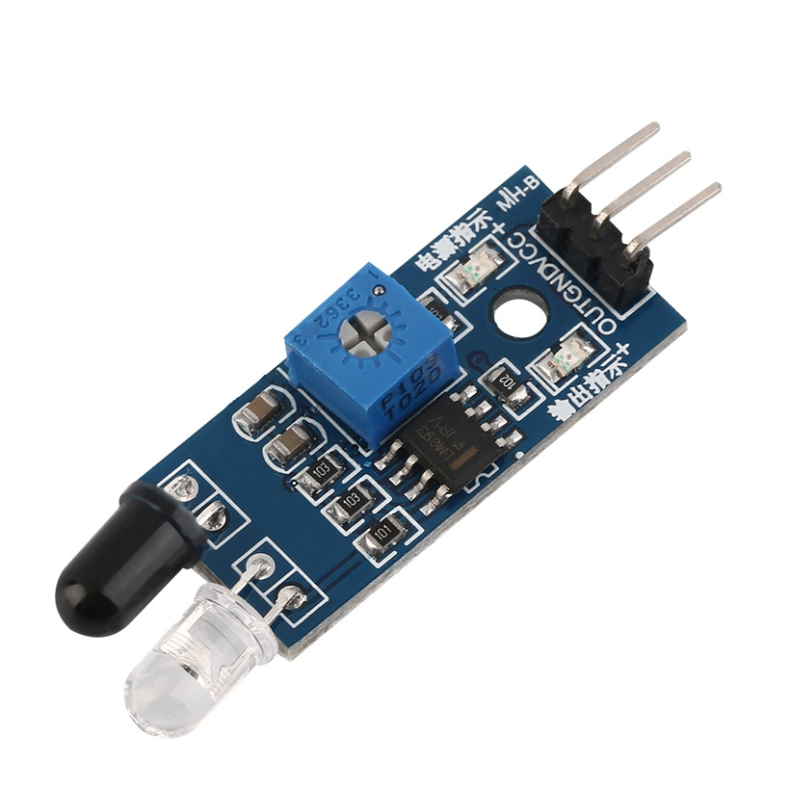
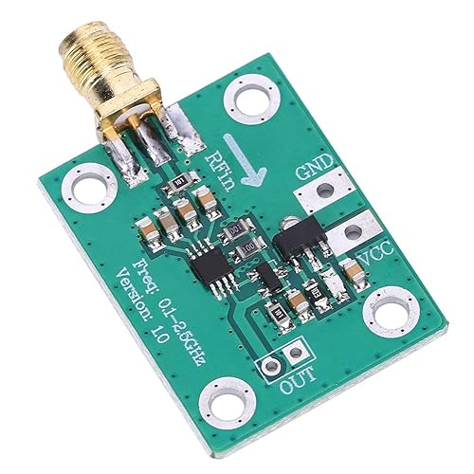
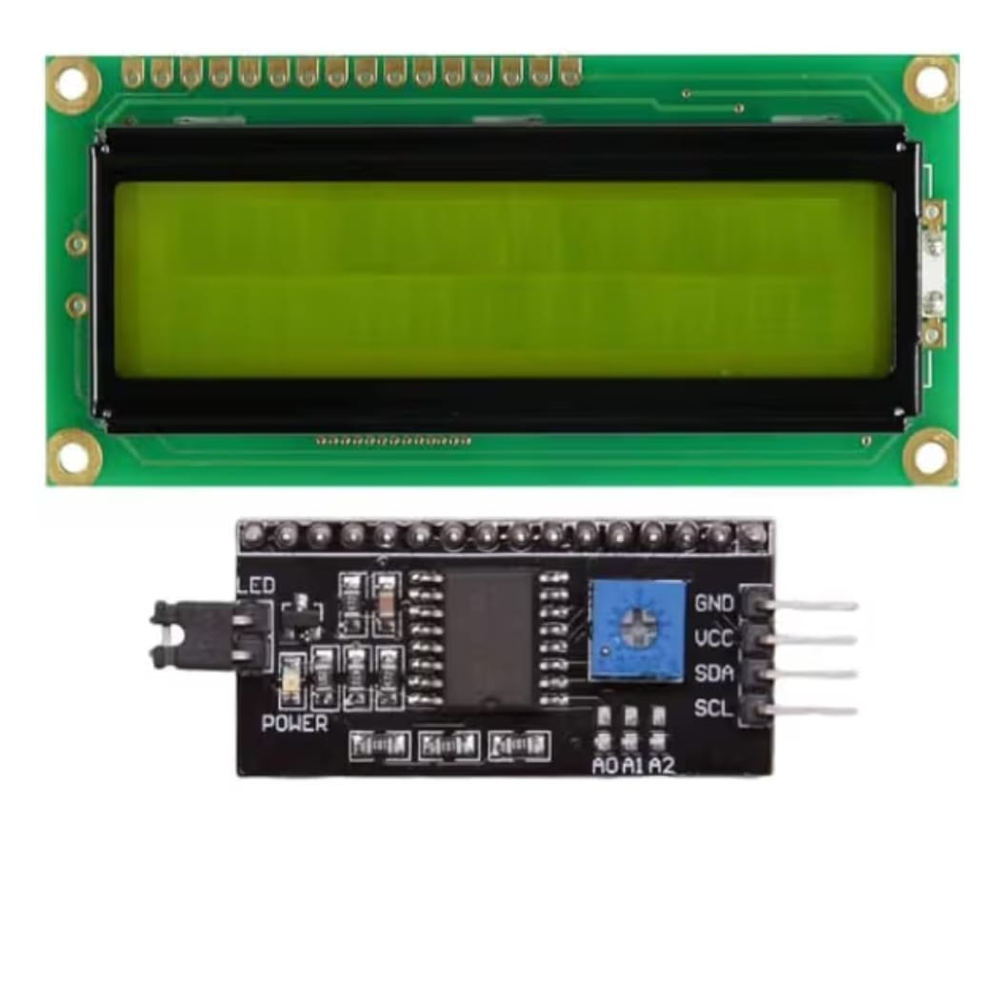
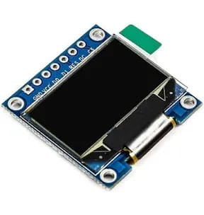
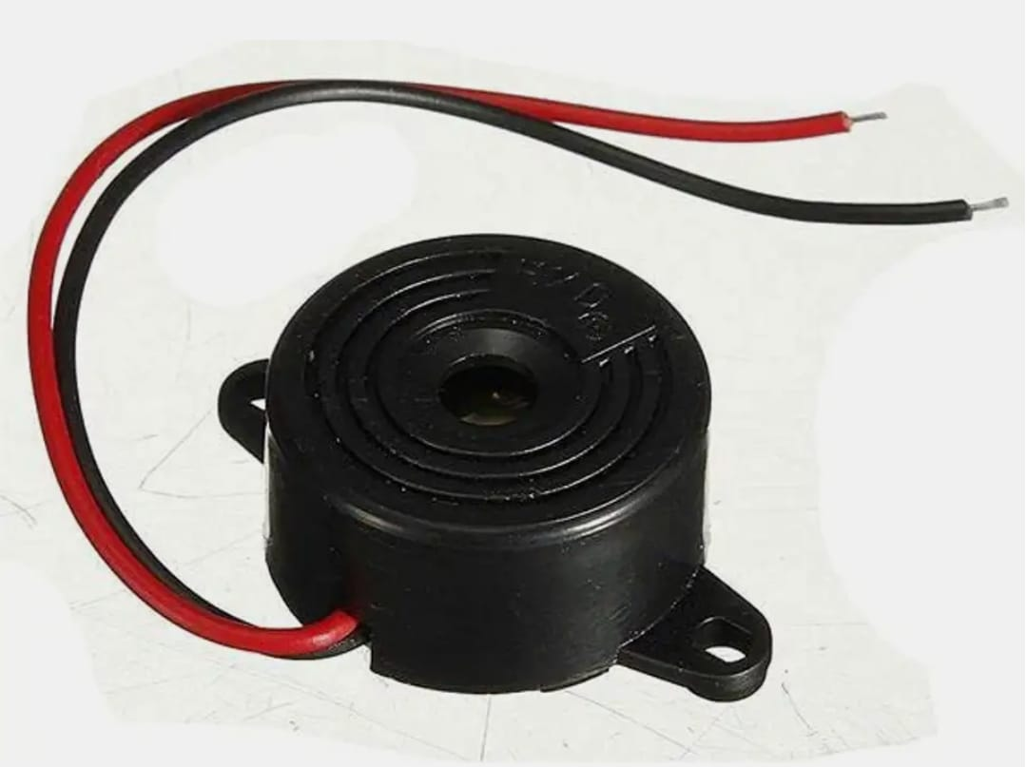
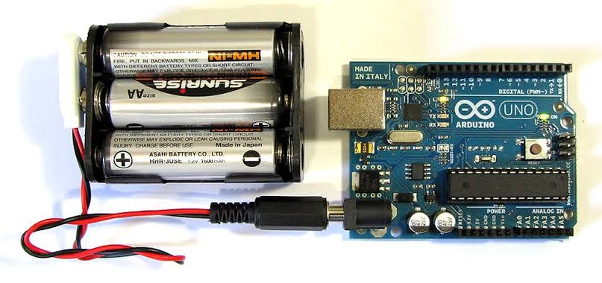
HARDWARE REQUIREMENTS
ESP 32 MICRO CONTROLLER
RF DETECTOR
EXTERNAL ANTENNA
IR SENSOR
LCD DISPLAY
OLED DISPLAY
PIEZO BUZZER
POWER SUPPLY

Slide 12
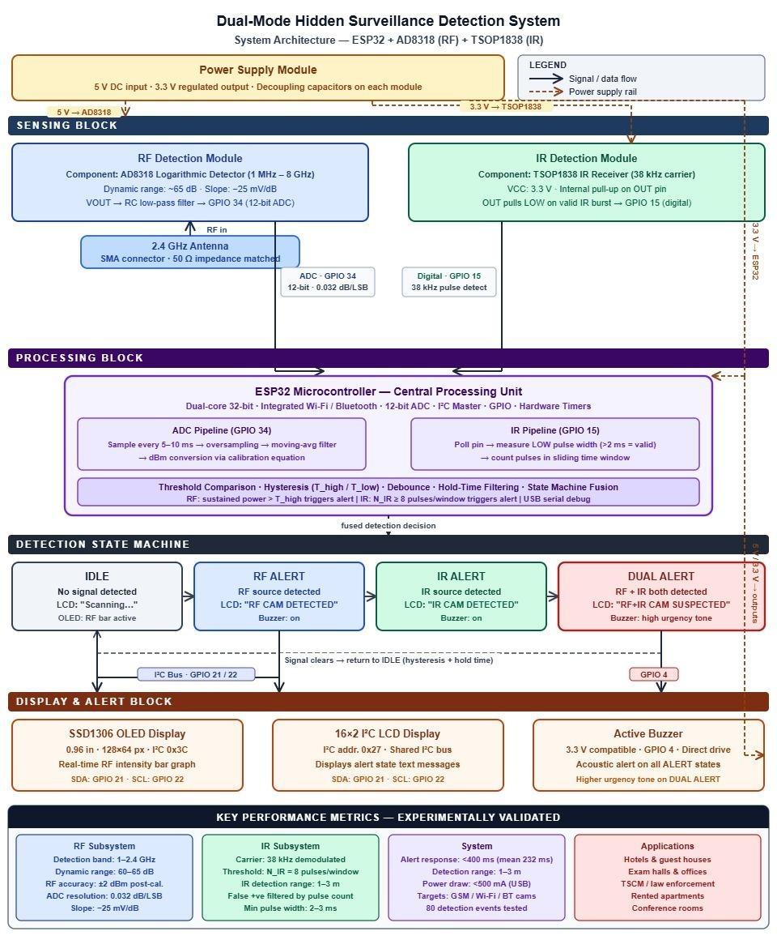
Hardware Circuit Design

Slide 13
Advantages
Dual Detection Capability: Unlike existing systems that use only RF or IR, the proposed system combines both, enabling detection of a wider range of hidden cameras.
Improved Accuracy: By integrating two sensing methods, the system reduces missed detections and increases reliability.
Reduced False Alarms: Filtering techniques and threshold logic minimize false positives compared to conventional detectors.
Real-Time Detection: Provides instant alerts through LCD, OLED, and buzzer, whereas many existing systems lack proper real-time feedback.
User-Friendly Operation: Simple interface with clear alerts, unlike systems requiring manual interpretation.

Slide 14
Applications
Surveillance Awareness: The system helps in detecting hidden IR cameras in sensitive areas such as hotels, changing rooms, offices, and rental spaces, ensuring user privacy and safety.
Educational Demonstration: It can be used as an academic tool to demonstrate concepts like RF sensing, IR detection, signal processing, and embedded system design using ESP32.
Security Research: Useful for studying RF signals and analyzing wireless surveillance devices, helping researchers understand hidden camera technologies and detection methods.
IR Communication Understanding: Demonstrates practical implementation of IR communication (around 38 kHz), similar to remote control systems, enhancing learning in electronics and communication.

Slide 15
FUTURE SCOPE
Improve detection range and accuracy using directional antennas or antenna arrays
Use frequency filters to distinguish Wi-Fi, Bluetooth, and cellular signals
Extend frequency range beyond 1–2.4 GHz to detect advanced devices
Develop a mobile app for remote monitoring and real-time alerts
Make the system battery-powered with low-power optimization for portability
Apply AI/ML techniques for better signal classification and reduced false alarms

Slide 16


Slide 17
Conclusion
This project develops a Dual-Mode Hidden Surveillance Detection System using RF and IR sensing with an ESP32. It detects wireless cameras in the 1–2.4 GHz range and identifies night-vision cameras through infrared signals.
By combining both methods, the system improves accuracy and reduces false alarms compared to single-mode systems. The integration of components like the AD8318, IR sensor, OLED display, and buzzer enables real-time detection and alerts.
Overall, the system is low-cost, efficient, and reliable, providing a practical solution for enhancing privacy and security, with scope for future improvements.

Slide 18
