Slide 1

Azure Resources and Architecture for ACSFlix
Step-by-Step approach to building a video streaming platform
System component document v1.0
By: Kori

Slide 2
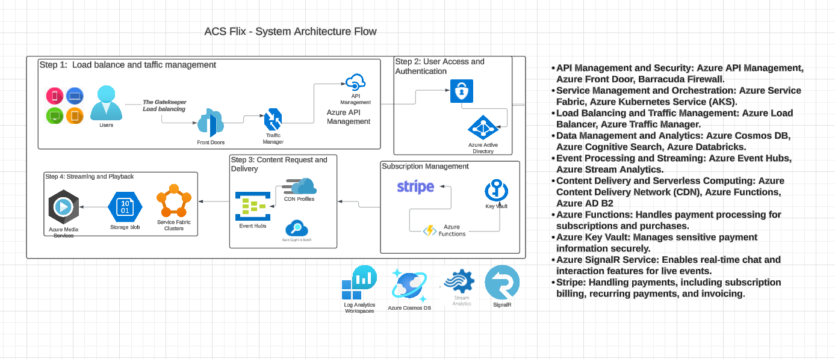

Slide 3
ReactJS is suitable for building user interfaces (UIs) for client devices accessing video content via web browsers, mobile apps, smart TVs, and other platforms.
Client Devices: End users accessing video content via web browsers, mobile apps, smart TVs, etc.
Azure Front Door: Global load balancing and acceleration.
Azure API Management: API gateway for routing requests.
Data Layer: Azure Cosmos DB: Distributed database for user data and metadata.
Azure SQL Database: Relational database for transactional data.
Azure Application Gateway with Barracuda WAF: Web Application Firewall for security.
Microservices Layer: Azure Kubernetes Service (AKS): Container orchestration for microservices.
Azure Functions: Scalable serverless compute for event-driven processing.
Content Delivery: Azure Content Delivery Network (CDN): Efficient content delivery globally.
Analytics and Monitoring: Azure Event Hubs: Event ingestion service.
Azure Stream Analytics: Real-time analytics.
Azure Databricks: Big data processing.
Azure Monitor and Application Insights: Monitoring and diagnostics.
Identity Management: Azure AD B2C: Identity and access management for user authentication.
Created this visio architectural component diagram using Lucid app:
https://lucid.app/documents/view/87dfe049-af0c-4080-ae97-a090f7e33610

