Slide 1

V.O.I.C.E. AI
Voice-Optimized Ingestion & Citizen Engagement AI
Next-Generation Civic Grievance Processing Powered by Multimodal Generative AI for Madurai Corporation

Slide 2
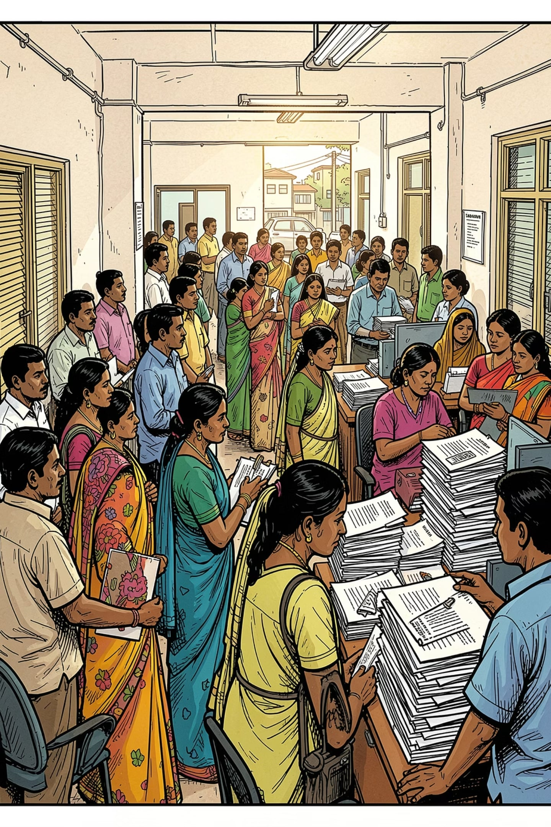
THE CHALLENGE
The Civic Engagement Gap
Madurai's citizens file grievances in unstructured Tanglish and colloquial Tamil — voice and text formats that standard database schemas cannot parse. Municipal departments manually categorize and translate each query, creating processing delays of up to 4 days and leaving critical infrastructure issues unresolved.
Language Barrier
Manual Bottleneck
Code-switched Tanglish and regional Tamil dialects bypass structured intake systems entirely
Human translation and categorization introduce 96-hour average processing delays
Privacy Risk
Citizen PII enters unsecured workflows without automated redaction or audit trails

Slide 3

ARCHITECTURE
The Multimodal Pipeline
V.O.I.C.E. AI transforms chaotic citizen inputs into structured, actionable records — fully automated, in under two minutes.
Unstructured Input
Ingestion Layer
Semantic Translation
PII Masking
Every stage is fully automated — from raw regional speech to a clean, queryable BigQuery record — with zero manual touchpoints required.

Slide 4
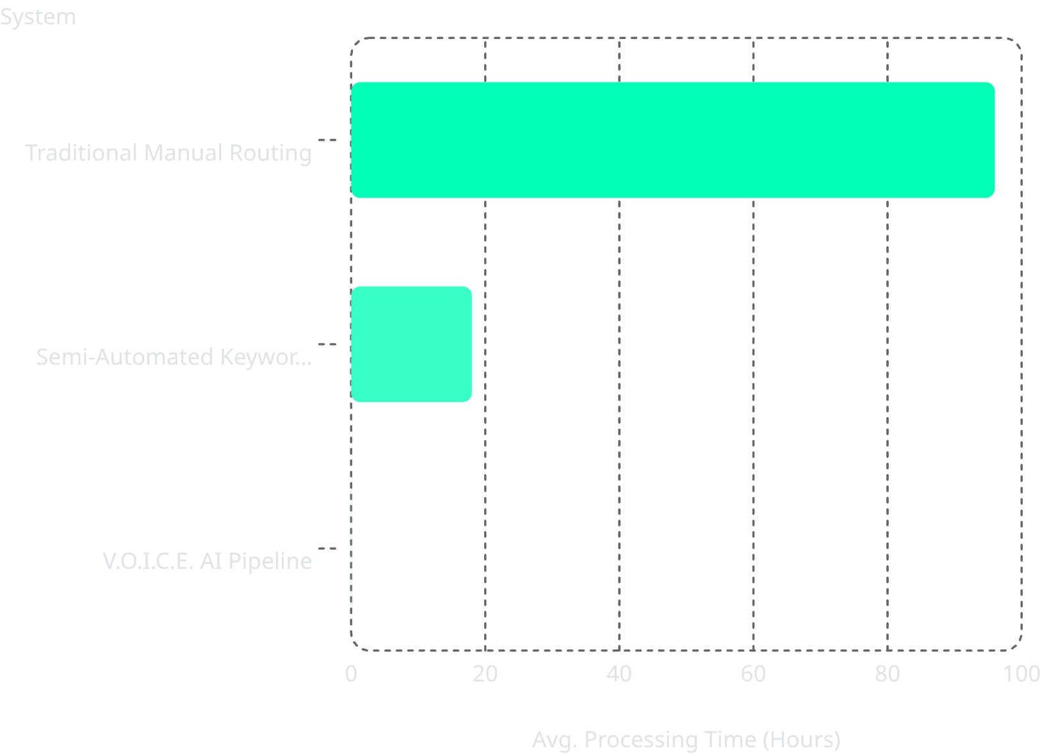



PERFORMANCE
Latency Reduction Performance
A 99.9% Reduction in Processing Time
Where legacy workflows took 4 days, V.O.I.C.E. AI completes ingestion, translation, classification, and routing in under 2 minutes.
96 hrs → Manual
18 hrs → Keywords
2 min → V.O.I.C.E.
Human translation, routing, and data entry
Partial automation, still requires review
Fully autonomous end-to-end pipeline

Slide 5




TECHNOLOGY
Core Engine Capabilities
Multimodal Parsing
Automated Anonymization
Directly ingests audio speech and raw code-switched Tanglish text — no pre-processing or manual transcription required
Strips phone numbers, names, and personal identifiers automatically before any database ingestion — zero PII leakage
Dynamic Priority Routing
Assigns algorithmic severity scores (1–5) to fast-track emergency infrastructure failures like electrical hazards and water main breaks

Slide 6
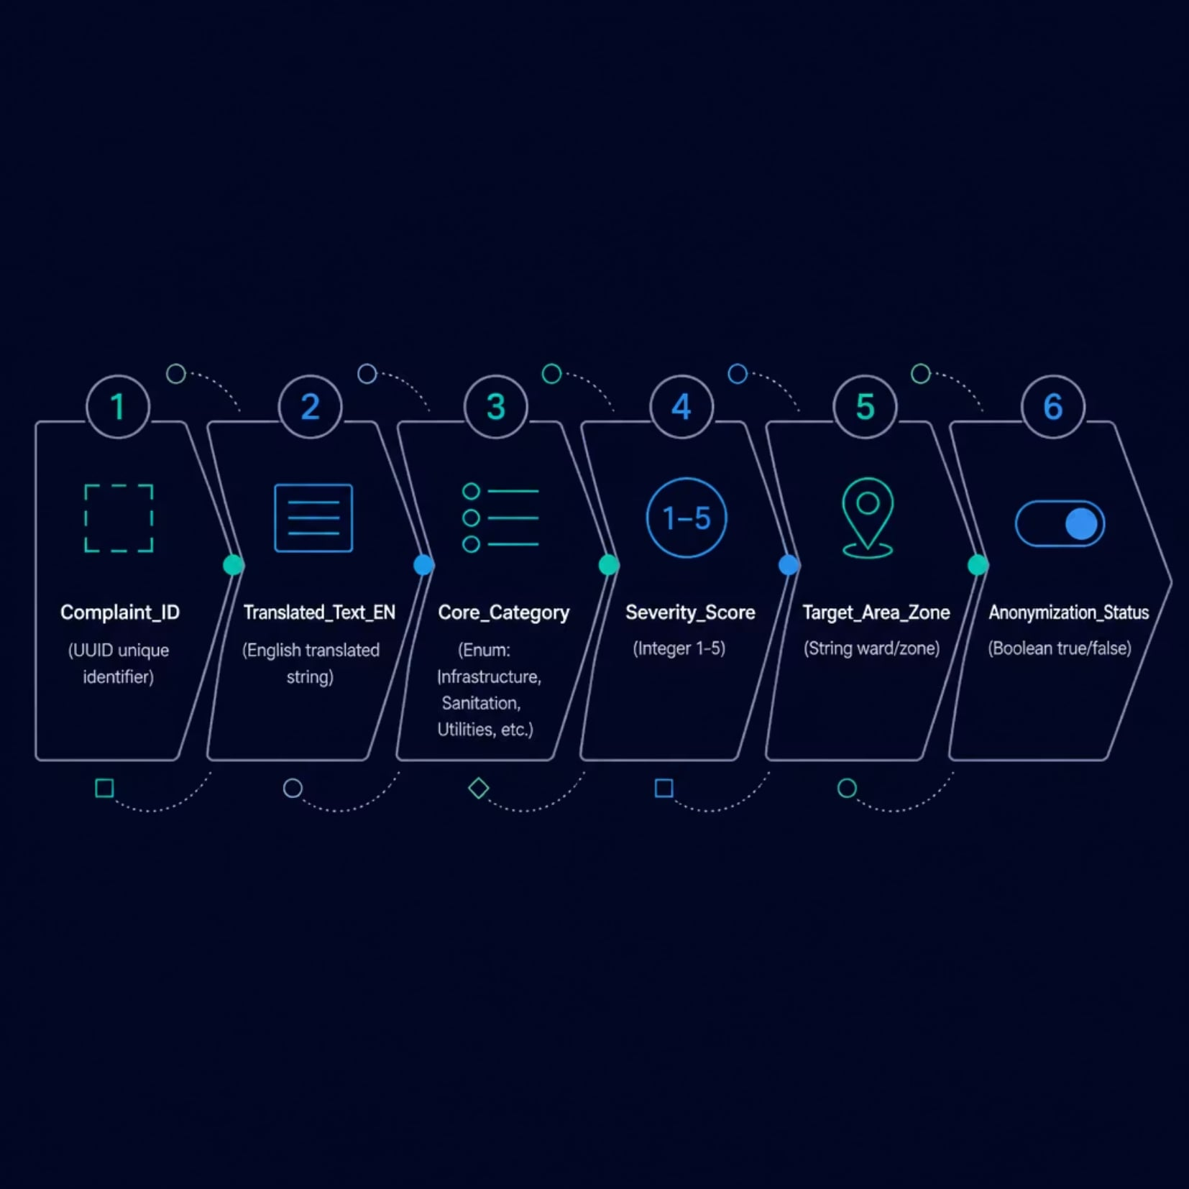

DATA ARCHITECTURE
Standardized Schema Target
Chaotic regional inputs are mapped into a clean, queryable BigQuery relational schema — enabling instant cross-departmental analytics.
From Chaos to Clarity
Every grievance — regardless of language or format — lands in BigQuery with a consistent, analyzable structure. Departments query by zone, severity, or category instantly.
All fields are typed and validated at ingestion. No null-category or unclassified records enter the system.

Slide 7
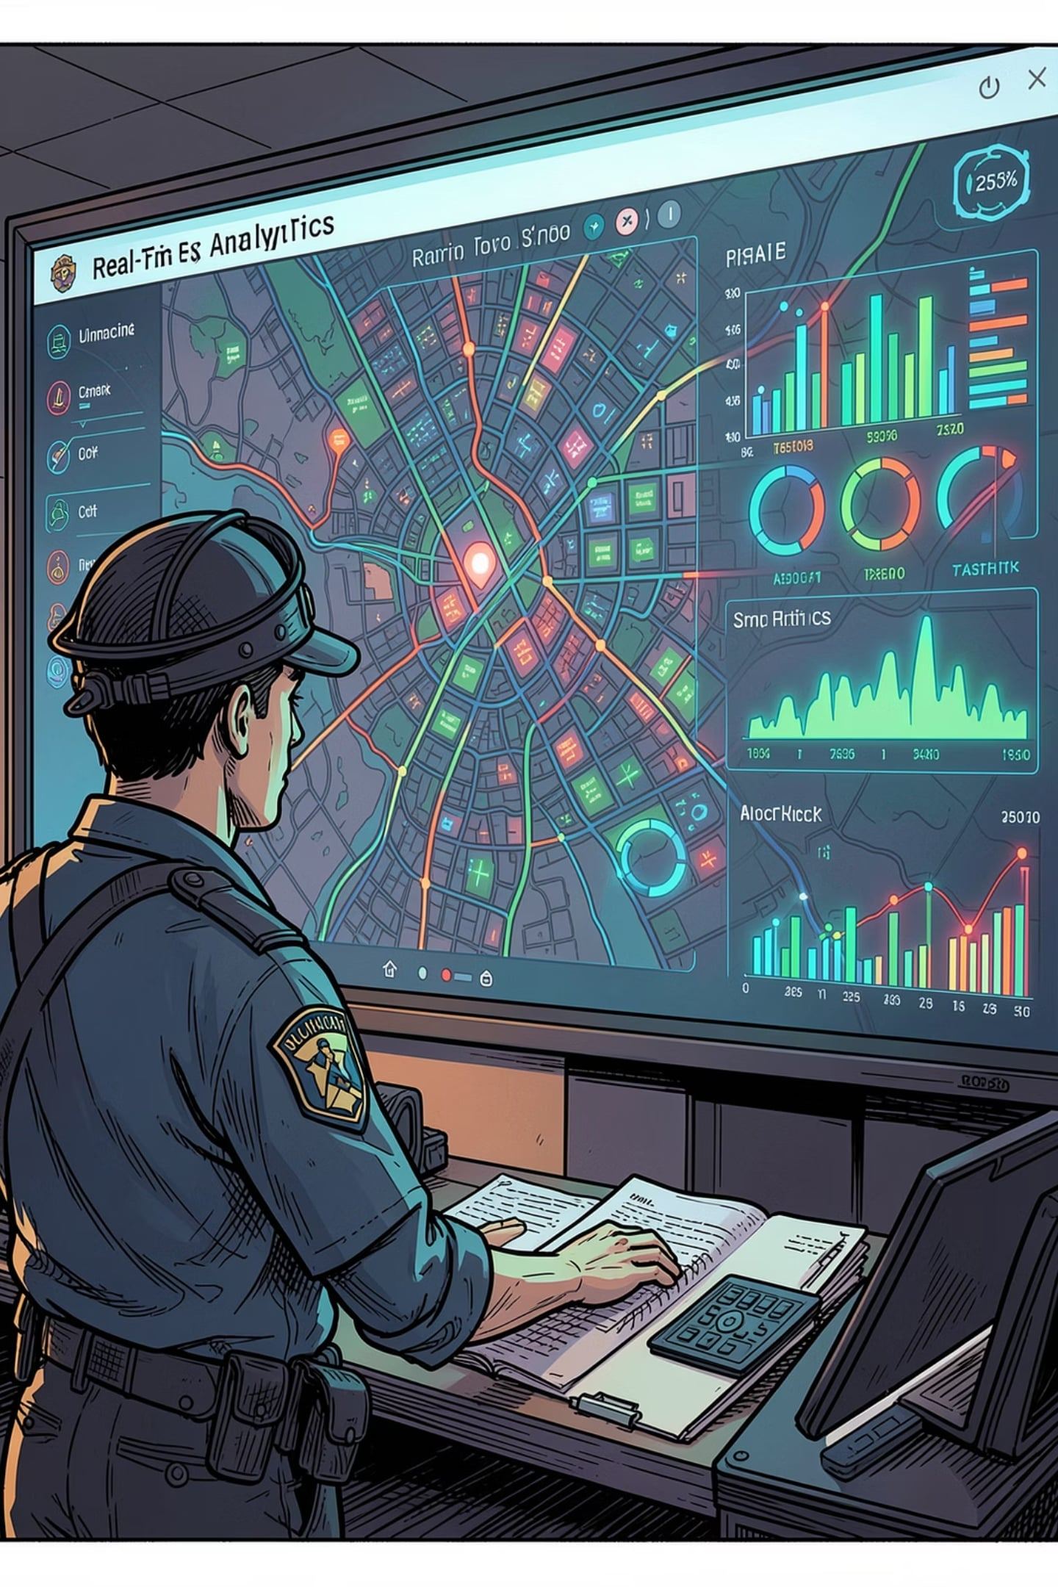
IMPACT
Transforming Local Governance
98%
0%
Translation Accuracy
PII Leak Rate
Semantic regional translation precision across Tamil dialects and Tanglish inputs
Zero personal data exposed in logs or database records post-anonymization
2min
End-to-End Routing
From voice input to department assignment and BigQuery landing
Regional officers access real-time visual dashboards mapping critical civic concerns — potholes, water leaks, electrical hazards — by zone and severity, enabling proactive, data-driven response.

Slide 8

NEXT STEPS
Deployment Roadmap
Phase 1 — Pilot Launch
1
Deploy in 3 high-volume wards. Integrate Gemini 1.5 Flash translation and BigQuery schema. Validate PII masking pipeline.
2
Phase 2 — Citywide Rollout
Expand to all Madurai Corporation zones. Enable officer dashboards and real-time severity mapping.
Phase 3 — Optimization
3
Refine classification models on live data. Introduce predictive issue clustering and automated SLA tracking.
4
Phase 4 — Scale & Govern
Establish governance framework, audit logs, and model retraining cadence. Prepare for state-level replication.
V.O.I.C.E. AI is production-ready. Madurai Corporation can begin Phase 1 within 6 weeks of procurement approval.

