Slide 1
Microprocessor System
SESSION OF Intel 8085
By
Engr.Shafiullah Soomro
safiullah123@gmail.com

Slide 2
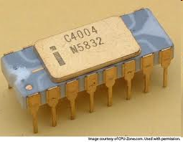
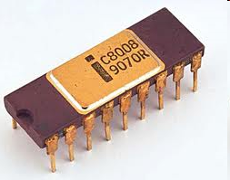
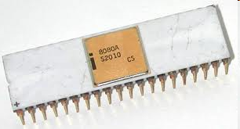
History of Intel Microprocessors Before 8085
INTEL 4004
1969
16 Pins DIP Package
Clock speed : 108 KHz
* Number of transistors:
2300
4-bit register and 4-bit data bus.
The world first microprocessor
INTEL 8008
1972
18 Pins DIP Package
Clock speed : 800 KHz
* Number of transistor:
3500
* 8-bit register and 8-bit data bus.
INTEL 8080
1974
40 Pin DIP Package
Clock speed : 2 MHz
* Number of transistor:
4500
8-bit registers
16-bit address bus and an 8-bit data bus

Slide 3
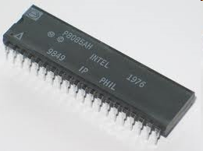
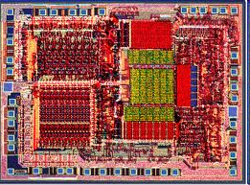
INTEL 8085 Microprocessor
Year 1977
Enhancement of 8080
40 Pins DIP Package
The 8085 uses approximately 6,500 transistors
Clock Speed: Max 6 MHz
8-bit Data Bus & 16 Bit Address Bus

Slide 4
8085 INTRODUCTION
The features of INTEL 8085 are :
It is an 8 bit processor.
It is a single chip N-MOS(N Type Metal Oxide Semiconductor) device with 40 pins DIP Package.
It uses all instructions of 808 therefore it is program compatible with 8080
It has multiplexed address and data bus.(AD0-AD7)
It works on single 5 Volt dc power supply.
The maximum clock frequency is 6 MHz while minimum frequency is 500kHz.
It provides 74 instructions with 5 different addressing modes, Two new instruction has been added in 8085, for taking advantage of added hardware

Slide 5
8085 INTRODUCTION
It provides 16 address lines so it can access 2^16 =64K bytes of memory.
It generates 8 bit I/O address so it can access 2^8=256 input ports.
It provides 5 hardware interrupts:TRAP, RST 5.5, RST 6.5, RST 7.5,INTR.
It provides Acc ,one flag register ,6 general purpose registers and two special purpose registers(SP,PC).
It provides serial lines SID ,SOD.So serial peripherals can be interfaced with 8085 directly.

Slide 6
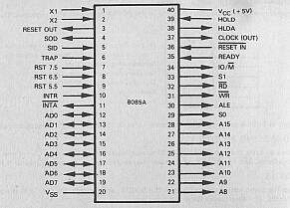
8085 Pin Diagram
Note: you may refer to Fig 8-2 (a) on page 209 of Microprocessor Fundamentals by Roger

Slide 7
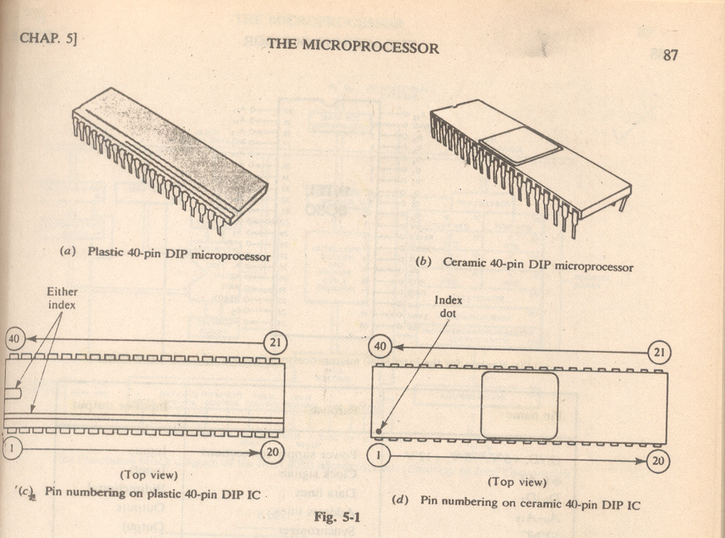
How Would you identify Pin Numbers of DIP IC Package?

Slide 8
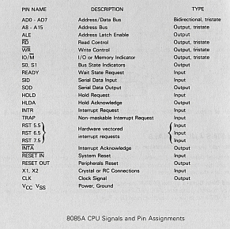
Short Description of Pin Diagram
Note: you may refer to Fig 8-2 (b) on page 210 of Microprocessor Fundamentals by Roger

Slide 9
8085 Pin Diagram Description(1/7)
ADDRESS BUS, DATA BUS & ALE
More functions then 8080 are added therefore less number of pins remain, therefore It has multiplexed address and data bus.(AD0-AD7) from Pin 12 through 19.
Least Significant 8 Lines of Address Bus shared with 8-bit Data Bus.
Multiplexed means selecting one at a time, First pins 12-19 work as Address Bus to send address then works as Data Bus to carry Data.
When these Pins worked as Data Bus and When as Address Bus is Decided by ALE (Address Latch Enable) Output Pin Number 30 Signal.
When ALE = 1 its Adress, when ALE = 0 its Data.

Slide 10
8085 Pin Diagram Description (2/7)
Power & Clock Signals
8085 MPU works on Single +5V Power Supply
Pin 40 & 20: Vcc is Power and Vss is Ground
Pin 1 & 2 : X1 & X2 are Input pins that are connected from a crystal to the internal clock circuitry of 8085 MP
Pin 37: CLK is a Output Pin and it is used for timing & synchronization of other peripherals by MP
X1
8085 MPU
Crystal
Frequency A
X2
Internal Clock Circuitry
Frequency ½ A

Slide 11
8085 Pin Diagram Description (3/7)
RESTART SIGNALS
Pin 36: RESET IN is Input Pin if it is 0 then it will reset MPU and set Program counter to address 000H
Data Bus Address Bus and Control lines are TRI-STATED during a Reset. Tri-state means MP will release their control & they are isolated from MP, and any other peripheral can take control of them.
Pin 3: RESET OUT is a Output pin, if it is 1 then it will inform all peripherals that System is restart

Slide 12
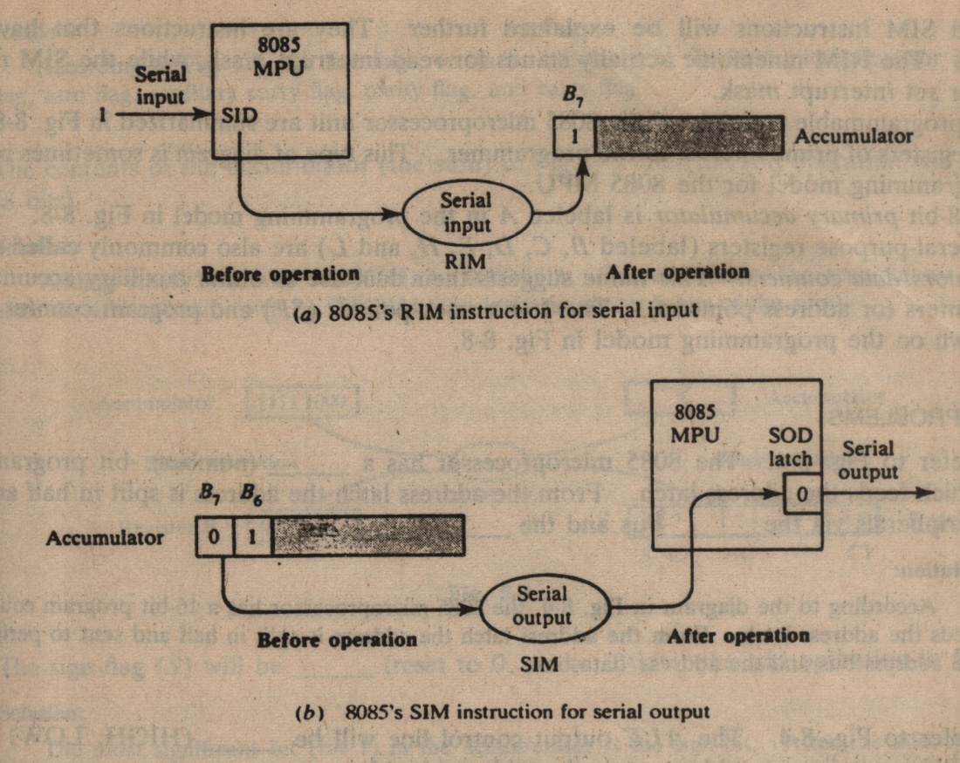
8085 Pin Diagram Description (4/7)
SERIAL INPUT & OUTPUT SIGNALS
8085 has two pins for serial data input and output so, serial devices can be directly interfaced with 8085
Pin 5: SID is a Serial Input Pin, it is used to input serial data (i.e. one bit at a time) to MSB of Accumulator. This Pin is control by RIM instruction
Pin 4: SOD is Serial Output Pin, it is used to send serial data, by SIM instruction
Figure: 8-7 From Book Page 217

Slide 13
8085 Pin Diagram Description (5/7)
READY & HOLD SIGNALS
Pin 35: is READY input port, it is used by other peripherals to inform MP that they are ready to send or receive data
If READY pin is low means 0 then MP will be in wait state until again the REDY signal is high 1, this mostly occur frequently because of low speed of other peripherals
Pin39: is HOLD input signal, used by other peripherals to request MP that they want to use the Data & Address Bus (may occur in DMA operations)
Upon receiving HOLD signal, MP will first finish its own data transfer on busses then
Address Bus, Data Bus, RD, WR, IO/M pins are Tri-stated (means isolated from MP)
Pin 38: HOLDA, is a Output signal, it is an Acknowledgement to peripheral requesting HOLD, and it inform the requesting peripheral that MP is going to release the control of Buses in next clock cycle

Slide 14
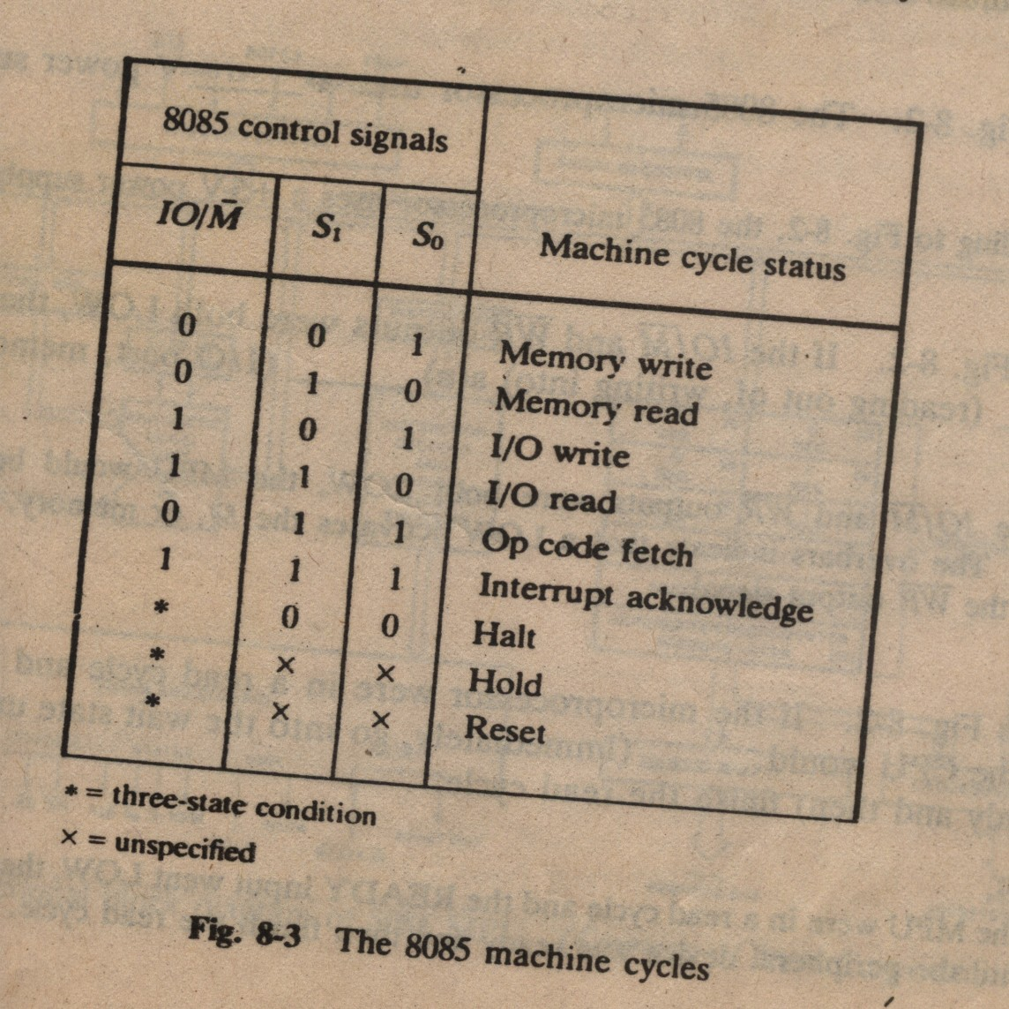
8085 Pin Diagram Description (6/7)
MACHINE CYCLE
Pins 33: S1, 29: S0, 34: IO/M are Output signals that are used to inform other peripherals that what type of machine cycle MP is running
Figure 8-3 Page 211

Slide 15
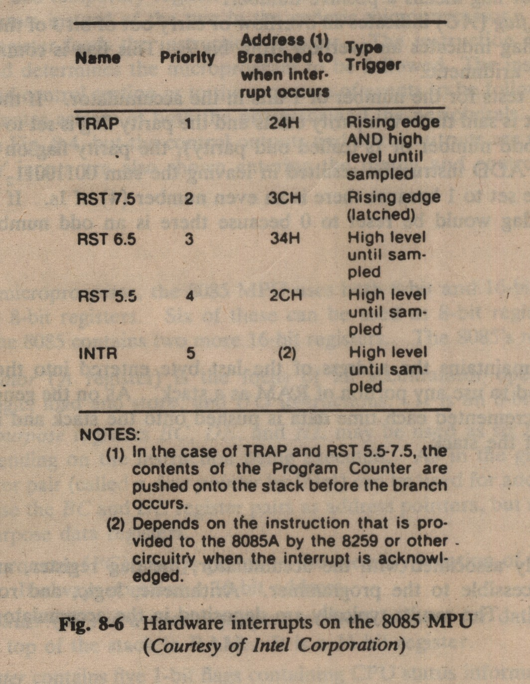
8085 Pin Diagram Description (7/7)
Interrupts SIGNALS
An interrupt is a signal that alter the normal execution of Microprocessor
In 8085 there are 5 interrupts Inputs TRAP, RST 7.5, RST 6.5, RST 5.5, INTR, through these interrupt signals can be sent to MP
When MP receive interrupt it Acknowledged the interrupting device through INTRA output signal
Those interrupts that can be enabled or disabled by software are called Maskable interrupts e.g.: RST 7.5, RST 6.5, RST 5.5, INTR
Those interrupts that can not be disabled are called Non-Maskable interrupts e.g. TRAP
Fig 8-6 page 216

Slide 16
End of PIN Diagram Description

Slide 17
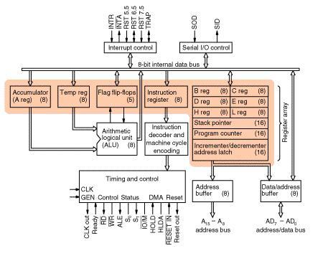
8085 ARCHITECTURE

Slide 18
Functional Blocks of 8085 ARCHITECTURE
The various functional blocks of 8085 are as follows:
1. Registers
2. Arithmetic logic unit
3. Data/Address buffer
4. Incrementer/decrementer address latch
5. Interrupt control
6. Serial I/O control
7. Timing and control circuitry
8. Instructions decoder and machine cycle encoder.

Slide 19
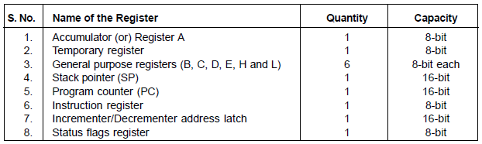
Description of 8085 ARCHITECTURE (1/8)
REGISTERS OF 8085:
1. ACCUMULATOR
This 8-bit register is the most important one amongst all the registers of 8085. Any data input/output to/from the microprocessor takes place via the accumulator (register). It is generally used for temporary storage of data and for the placement of final result of arithmetic/logical operations. Accumulator (ACC or A) register is extensively used for arithmetic, logical, store and rotate operations
2. TEMPORARY REGISTERS
The temporary data register of 8085 is an 8-bit register, which is not available to the programmer, but is used internally for execution of most of the arithmetic and logical operations.

Slide 20
Description of 8085 ARCHITECTURE (2/8)
3. GENERAL PURPOSE REGISTERS
The general purpose registers of 8085 are: B, C, D, E, H and L. They are all 8-bit registers but can also be used as 16-bit register pairs—BC, DE and HL. These registers are also known as scratch pad registers.
HL register pair can be used as a data pointer or memory pointer.
General purpose registers store temporary data during program execution, which can also be stored in different accessible memory locations. But storing temporary data in memory requires bus access—hence more time is needed to store. Thus it is always advisable to store data in general purpose registers.

Slide 21
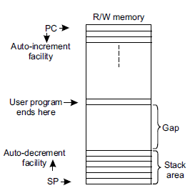
Description of 8085 ARCHITECTURE (3/8)
4. PROGRAM COUNTER
Program counter (PC) is a sixteen bit register which contains the address of the instruction to be executed just next. PC acts as a address pointer (also known as memory pointer) to the next instruction. As the processor executes instructions one after another, the PC is incremented—the number by which the PC increments depends on the nature of R/W memory the instruction. For example, for a 1-byte instruction, PC is incremented by one, while for a 3-byte instruction, the processor increments PC by three address locations.
5. STACK POINTER
Stack pointer (SP) is a sixteen bit register which points to the ‘stack’. The stack is an area in the R/W memory where temporary data or return addresses (in cases of subroutine CALL) are stored. Stack is a auto-decrement facility provided in the system. The stack top is initialized by the SP by using the instruction LXI SP, memory address.
In the memory map, the program should be written at one end and stack should be initialized at the other end of the map—this is done to avoid crashing of program.

Slide 22
Description of 8085 ARCHITECTURE (4/8)
6. INSTRUCTION REGISTER
Program written by the programmer resides in the R/W memory. When an instruction is being executed by the system, the opcode of the instruction is fetched from the memory and stored in the 8-bit instruction register. The opcode is loaded into the instruction register during opcode fetch cycle. It is then sent to the instruction decoder.
7. INCREMENT/DECREMENT ADDRESS LATCH
This 16-bit register increments/decrements the contents of PC or SP when instructions related to them are executed.

Slide 23

Description of 8085 ARCHITECTURE (5/8)
8. STATUS FLAGS REGISTER
It is an 8-bit register in which five bit positions contain the status of five condition flags which are Zero (Z), Sign (S), Carry (CY), Parity (P) and Auxiliary carry (AC). Each of these five flags is a 1 bit F/F. The flag register can’t be written into. The flag register format is shown in Fig
Sign (S) flag: – If the MSB of the result of an operation is 1, this flag is set, otherwise it is reset.
Zero (Z) flag:– If the result of an instruction is zero, this flag is set, otherwise reset.
Auxiliary Carry (AC ) flag:– If there is a carry out of bit 3 and into bit 4 resulting from the execution of an arithmetic operation, it is set otherwise reset. This flag is used for BCD operation and is not available to the programmer to change the sequence of an instruction.
Carry (CY) flag:– If an instruction results in a carry (for addition operation) or borrow (for subtraction or comparison) out of bit D7, then this flag is set, otherwise reset.
Parity (P) flag:– This flag is set when the result of an operation contains an even number of 1’s and is reset otherwise.

Slide 24
Description of 8085 ARCHITECTURE (6/8)
ALU
ALU is responsible for all arithmetic and logic operations of MP.
The ALU functions as a part which includes arithmetic logic group of circuits. This includes accumulator, flags F/Fs and temporary register blocks.
8085 does not have the above two instructions. It can neither multiply nor divide two 8-bit numbers. The same are executed by the processor following the process of repetitive addition or subtraction respectively.

Slide 25
Description of 8085 ARCHITECTURE (7/8)
SERIAL I/O CONTROL
It is used to accept the serial 1 bit data by using SID and SOD signals and it can be performed by using SIM & RIM instructions
INTERRUPT CONTROL
It accepts different interrupts like TRAP INT5.5,6.5,7.5and INTR.
ADDRESS / DATA BUFFERS
8-bit Temperory Storage for Data/Address before transmitting to or after receiving from Data/Address Bus
INSTRUCTION DECODER & MACHINE CYLE ENCODING
This section is responsible for decoding the opcode and provide this information to timing & control section

Slide 26
Description of 8085 ARCHITECTURE (8/8)
TIMMING AND CONTROL SECTION
The T&C section is a part of CPU and generates timing and control signals for execution of instructions. This section includes Clock signals, Control signals, Status signals, DMA signals as also the Reset section. This section controls fetching and decoding operations. It also generates appropriate control signals for instruction execution as also the signals required to interface external devices.

Slide 27
End of Internal Architecture of 8085

Slide 28
What are the different instruction word sizes in 8085?
The instruction word sizes are of the following types:
1-byte instruction
2-byte instruction
3-byte instruction
The examples are given below:
1-byte instruction : ADD B
2-byte instruction : MVIC, 07
3-byte instruction : LDA 4400

Slide 29
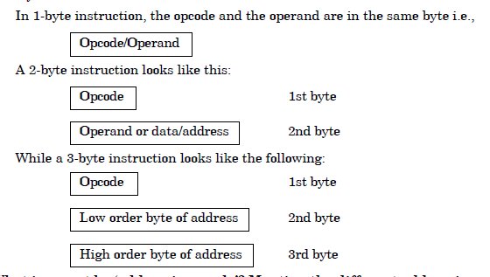
Explanation of word size of instructions

Slide 30
ADDRESSING MODES OF 8085
Each instruction indicates an operation to be performed on certain data. There are various methods to specify the data for the instructions, known as ‘addressing modes’.
Or An Addressing mode is the technique used to fetch the desired operand during execution of an instruction
For 8085 microprocessor, there are five addressing modes.
These are:
Direct addressing
Register addressing
Register indirect addressing
Immediate addressing
Implicit addressing.

Slide 31
ADDRESSING MODES OF 8085
Direct Addressing:
In this mode, the operand is specified within the instruction itself.
Examples of this type are:
LDA 4000H, STA 5513H, etc.
IN/OUT instructions (like IN PORT C, OUT PORT B, etc.) also falls under this
category.
(b) Register Addressing:
In this mode of addressing, the operand are in the general purpose registers.
Examples are: MOV A, B ; ADD D, etc.

Slide 32
ADDRESSING MODES OF 8085
(c) Register Indirect Addressing:
MOV A, M; ADD M are examples of this mode of addressing. These instructions utilise 1-byte. In this mode, instead of specifying a register, a register pair is specified to accommodate the 16-bit address of the operand.
(d) Immediate Addressing:
MVI A, 07; ADI 0F are examples of Immediate Addressing mode.
The operand is specified in the instruction in this mode. Here, the operand address is not specified.
(e) Implicit Addressing:
In this mode of addressing, the operand is fully absent. Examples
are RAR, RAL, CMA, etc.

