Slide 1

Home Credit Default Risk
Team 25
Dharani Doppalapudi
Manognya Katapally
Krishna Sannidhi
Godha Priyanka Gummula

Slide 2

Outline for Presentation
Team Information
Project Description
Summary of Tasks
Summary of Visual EDA
Overview of Modeling Pipelines
Results and discussions
Conclusion

Slide 3




Dharani Doppalapudi ddoppala@iu.edu | Manognya Katapally makata@iu.edu | Krishna Sannidhi ssannidh@iu.edu | Godha Priyanka Gummula ggummula@iu.edu

Slide 4
Project Description
Data Description:
We are working on Home Credit Default Risk dataset which is hosted on Kaggle. Our project will calculate every factor which can help a person repay the loan they took. Analysis of monthly income from all the sources, existing loans, and history of repayment will be considered before approving a loan.

Slide 5
Project Abstract
As part of phase 3, we implemented Multi Layer Perceptron using PyTorch and calculated the Loss and Accuracy.
We have used Tensorboard to visualize our results by plotting graphs for our Loss, Accuracy and ROC metrics for each epoch.
Additionally, We have implemented XGBoost model in this phase.
Our Multi Layer Perceptron achieved an ROC accuracy of 0.72
The XGBoost model achieved an AUC accuracy of 0.75

Slide 6
Summary of Tasks
Completed Tasks :
Previous phases:
Visual EDA, Feature Engineering
Feature Importance, Feature selection
Ensemble methods
Constructing optimal joins in the dataset.
Implemented Support Vector Machine, Random Forest, K-Nearest Neighbors and Logistic Regression models.
Phase 3:
Built multi-layer perception (MLP) and XGBoost Models
Visualized results of multi-layer perception using Tensorboard.

Slide 7
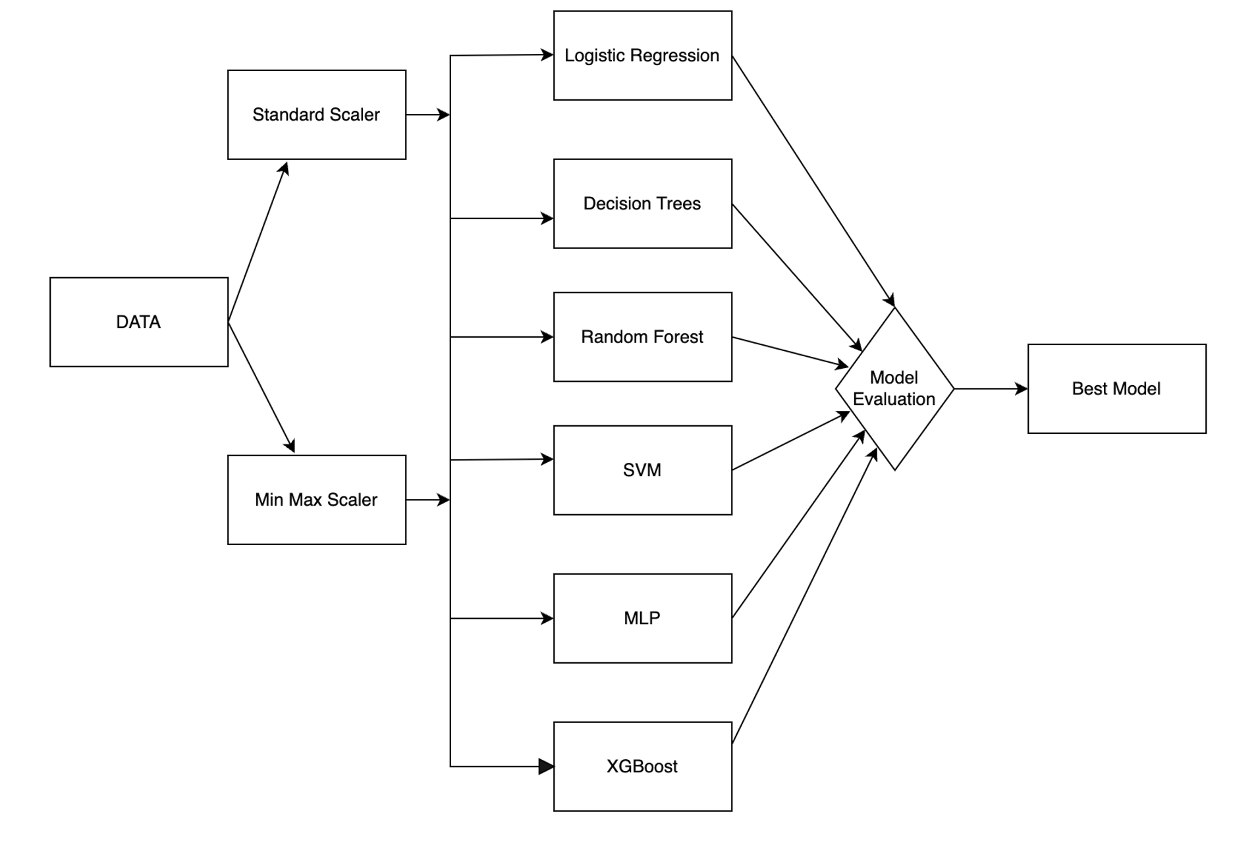
WORKFLOW

Slide 8
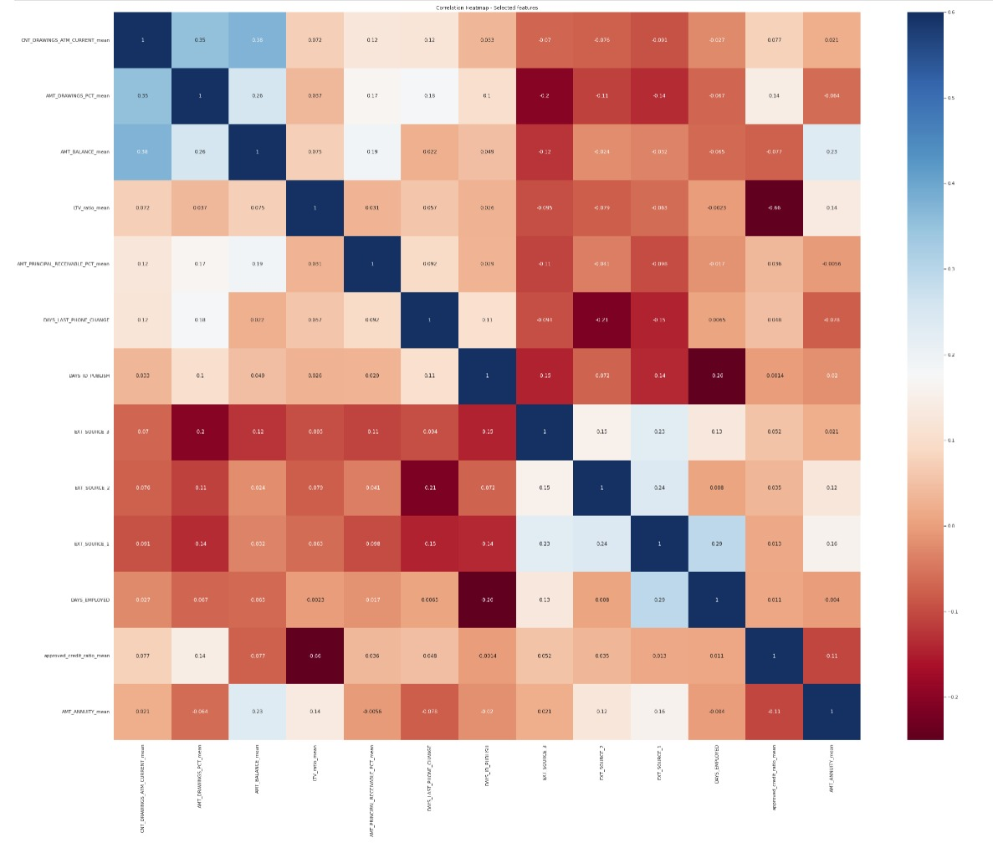
SUMMARY VISUAL EDA

Slide 9
OVERVIEW OF MODELING PIPELINES
Multi Layer Perceptron Model:
Multi layer perceptron (MLP) is a supplement feed forward neural network.
In an MLP, data flows from input to output layer in the forward direction, similar to a feed forward network. The back propagation learning algorithm is used to train the neurons in the MLP. MLPs can solve problems that aren't linearly separable and are designed to approximate any continuous function.
XGBoost Model:
XGBoost is a tree based ensemble machine learning algorithm which is a scalable machine learning system for tree boosting. XGBoost stands for Extreme Gradient Boosting. It uses more accurate approximations to find the best tree mode

Slide 10
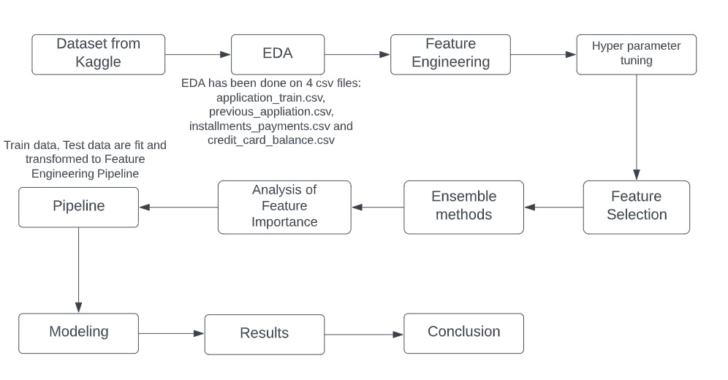
Block diagram of Modeling Pipelines

Slide 11
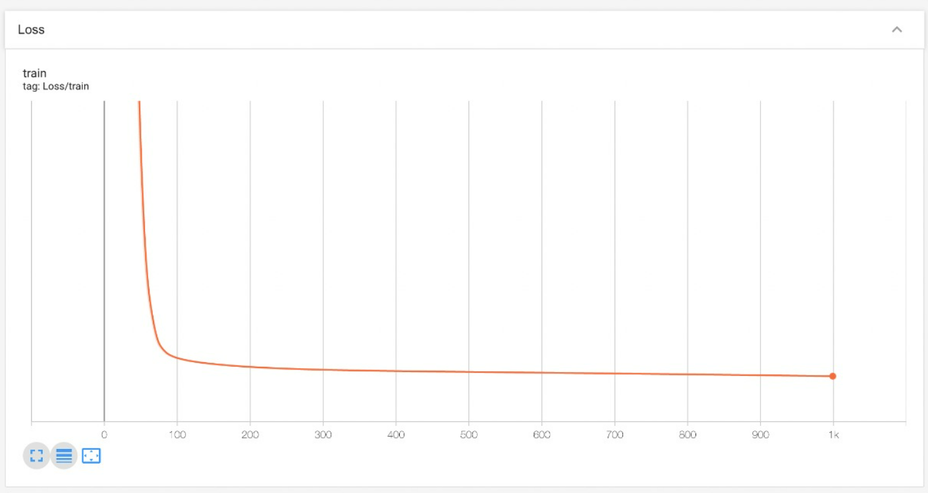
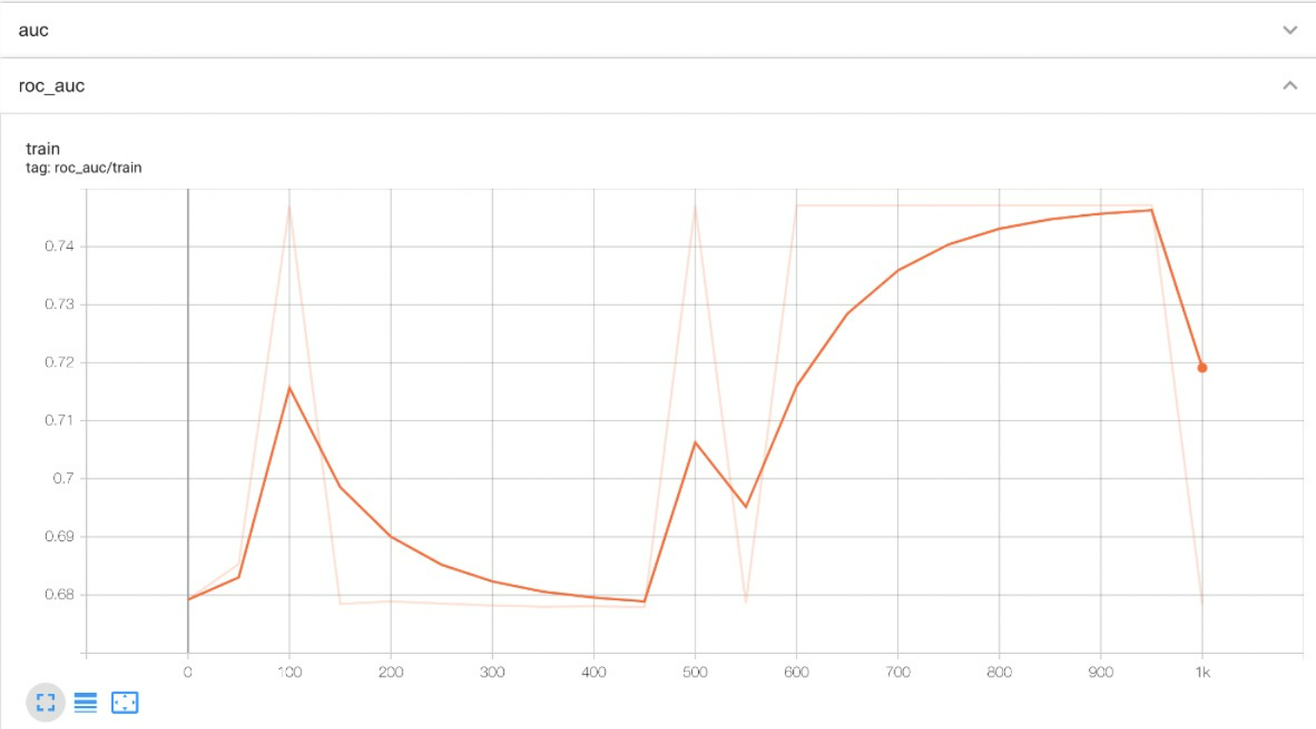
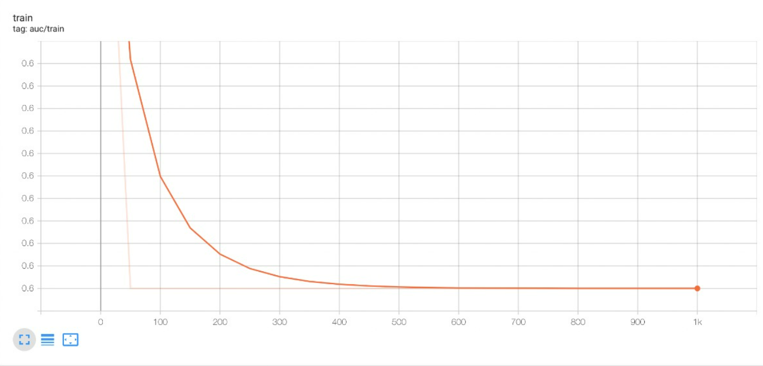
RESULTS AND DISCUSSIONS

Slide 12

For Multi Layer Perceptron, We have achieved an ROC score of 72%.
Kaggle score: 0.73629
Screenshot:

Slide 13

For XGBoost model, We have achieved an AUC score of 75%
Kaggle score: 0.73629
Screenshot:

Slide 14
CONCLUSION
In phase 3, when we used PyTorch with a single layer to create Multi Layer Perceptron, we got roughly 0.74 test accuracy.
Later, when we tested with a larger number of neurons in the hidden layers, we saw that the test accuracy trend had dropped to 0.72, indicating that the model was over-fitting.
As we were not so satisfied with MLP results, with the curiosity in exploring best model we landed on XGBoost.
This XGBoost model received a Kaggle score of 0.7363 and an AUC accuracy of 75%.
After analyzing the accuracies, error rates, F1 scores, and all other metrics of all models, we concluded that XGBoost performed better overall than MLP and all other previous models we evaluated in phase-2.

Slide 15
THANK YOU

