Slide 1
TidalTwin
Interactive 4D Ocean Model Validation & Decision Intelligence Platform
“Not another ocean viewer — we tell you where the model disagrees with reality,
why it matters, and what to do about it. The 3D globe is just the interface.”
Smart India Hackathon 2026 · Problem Statement SIH-26067 · Ocean Data Utilization for Coastal Community Services
Team TidalTwin · Mumbai

Slide 2
From “what the ocean looks like” to “is the model right?”
The gap: coastal India makes life-and-safety decisions on instinct and scattered data.
THE PROBLEM
OUR ANSWER — THE SCIENTIFIC INTELLIGENCE PIPELINE
7,500 km of coastline — data-poor, decisions made on instinct
DATA
QC
MATCHING
DEVIATION
UNCERTAINTY
EVENT
IMPACT
DECISION
Ocean tools show WHAT the sea looks like, never IF the model is right
Live data → quality check → model-observation matching → field-by-field deviation
→ explained uncertainty → classified ocean events → impact on coastal people
→ a concrete operational decision.
Models drift from reality quietly — heatwaves, rough seas, flood risk
Warnings reach the coast late, in no language the community speaks
Platforms are archival: they show yesterday, they don’t validate today
The 3D globe is only the interface — the intelligence is the pipeline.
We validate · we measure · we explain · we name the event · we end in a decision

Slide 3
Live today — data in, decisions out
DATA LAYER
Open-Meteo Marine (ERA5-driven) · PostgreSQL 16 + PostGIS · 8 Indian coastal regions · 384+ live observations · injected heatwave scenarios
BACKEND — FASTAPI AI ENGINES
Difference Engine · Explainable Confidence · Model Skill Score · Event Classification · Anomaly Detection (Isolation Forest + z-score) · Forecasting · Safety Advisory · Risk Index · What-If Simulator · NLP Assistant · Live WebSocket push
FRONTEND — REACT 19 · TYPESCRIPT · CESIUM 3D · PWA
Dashboard · 4D Digital Twin Globe & Event Replay · Model Validation Workspace · Monitoring · Safety Center · National Risk Map · Ocean AI · Story Mode · Reports
DECISION OUTPUTS
SAFE / CAUTION / DANGER advisory · safe sailing window (IST) · SMS / WhatsApp + 6-language voice · national risk map · executive report + CSV
LIVE PROOF (from the running system)
Marine heatwave at Goa CAUGHT
+1.8°C vs model baseline — explained
91% event confidence
DANGER advisory + 6-language voice
Confidence 92–100% component-by-component
Observations streamed live every 12s

Slide 4
From validation to action at the coast
🐟 LIVELIHOODS
🏥 SAFETY
🏛️ GOVERNANCE
🌍 SCALE
Tells fisherfolk which grounds are safe today — and when the next safe sailing window opens.
Anomaly → event → advisory in seconds: detection, confidence, interpretation, alert on one screen.
Authorities get a validated, auditable ocean brief — risk ranking, executive summary, CSV.
The pipeline is coastline-agnostic — point it at any coast and the same engines run.
With SIH support: scale to 100+ Indian coastal regions and connect official marine advisories —
a decision-intelligence dashboard in the hands of every coast.

Slide 5
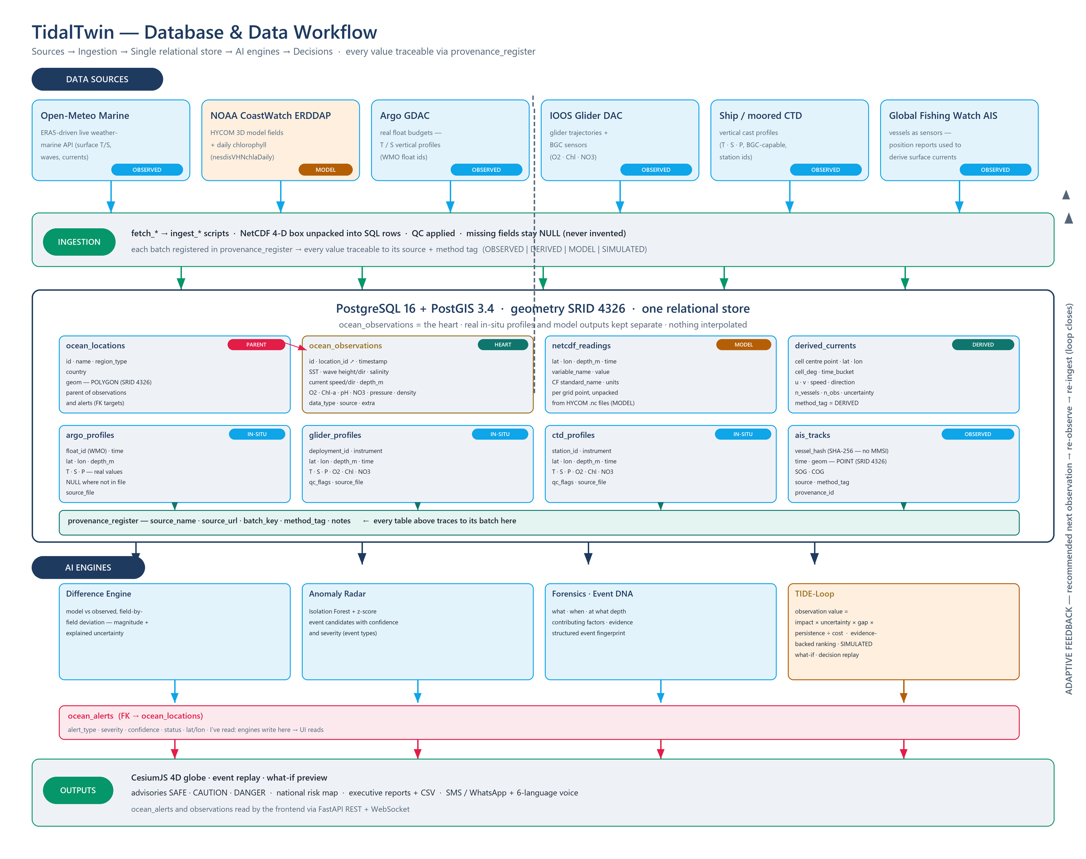
Database & data flow
Sources → ingestion → PostgreSQL 16 + PostGIS 3.4 → engines → outputs · every row traceable via provenance_register

Slide 6
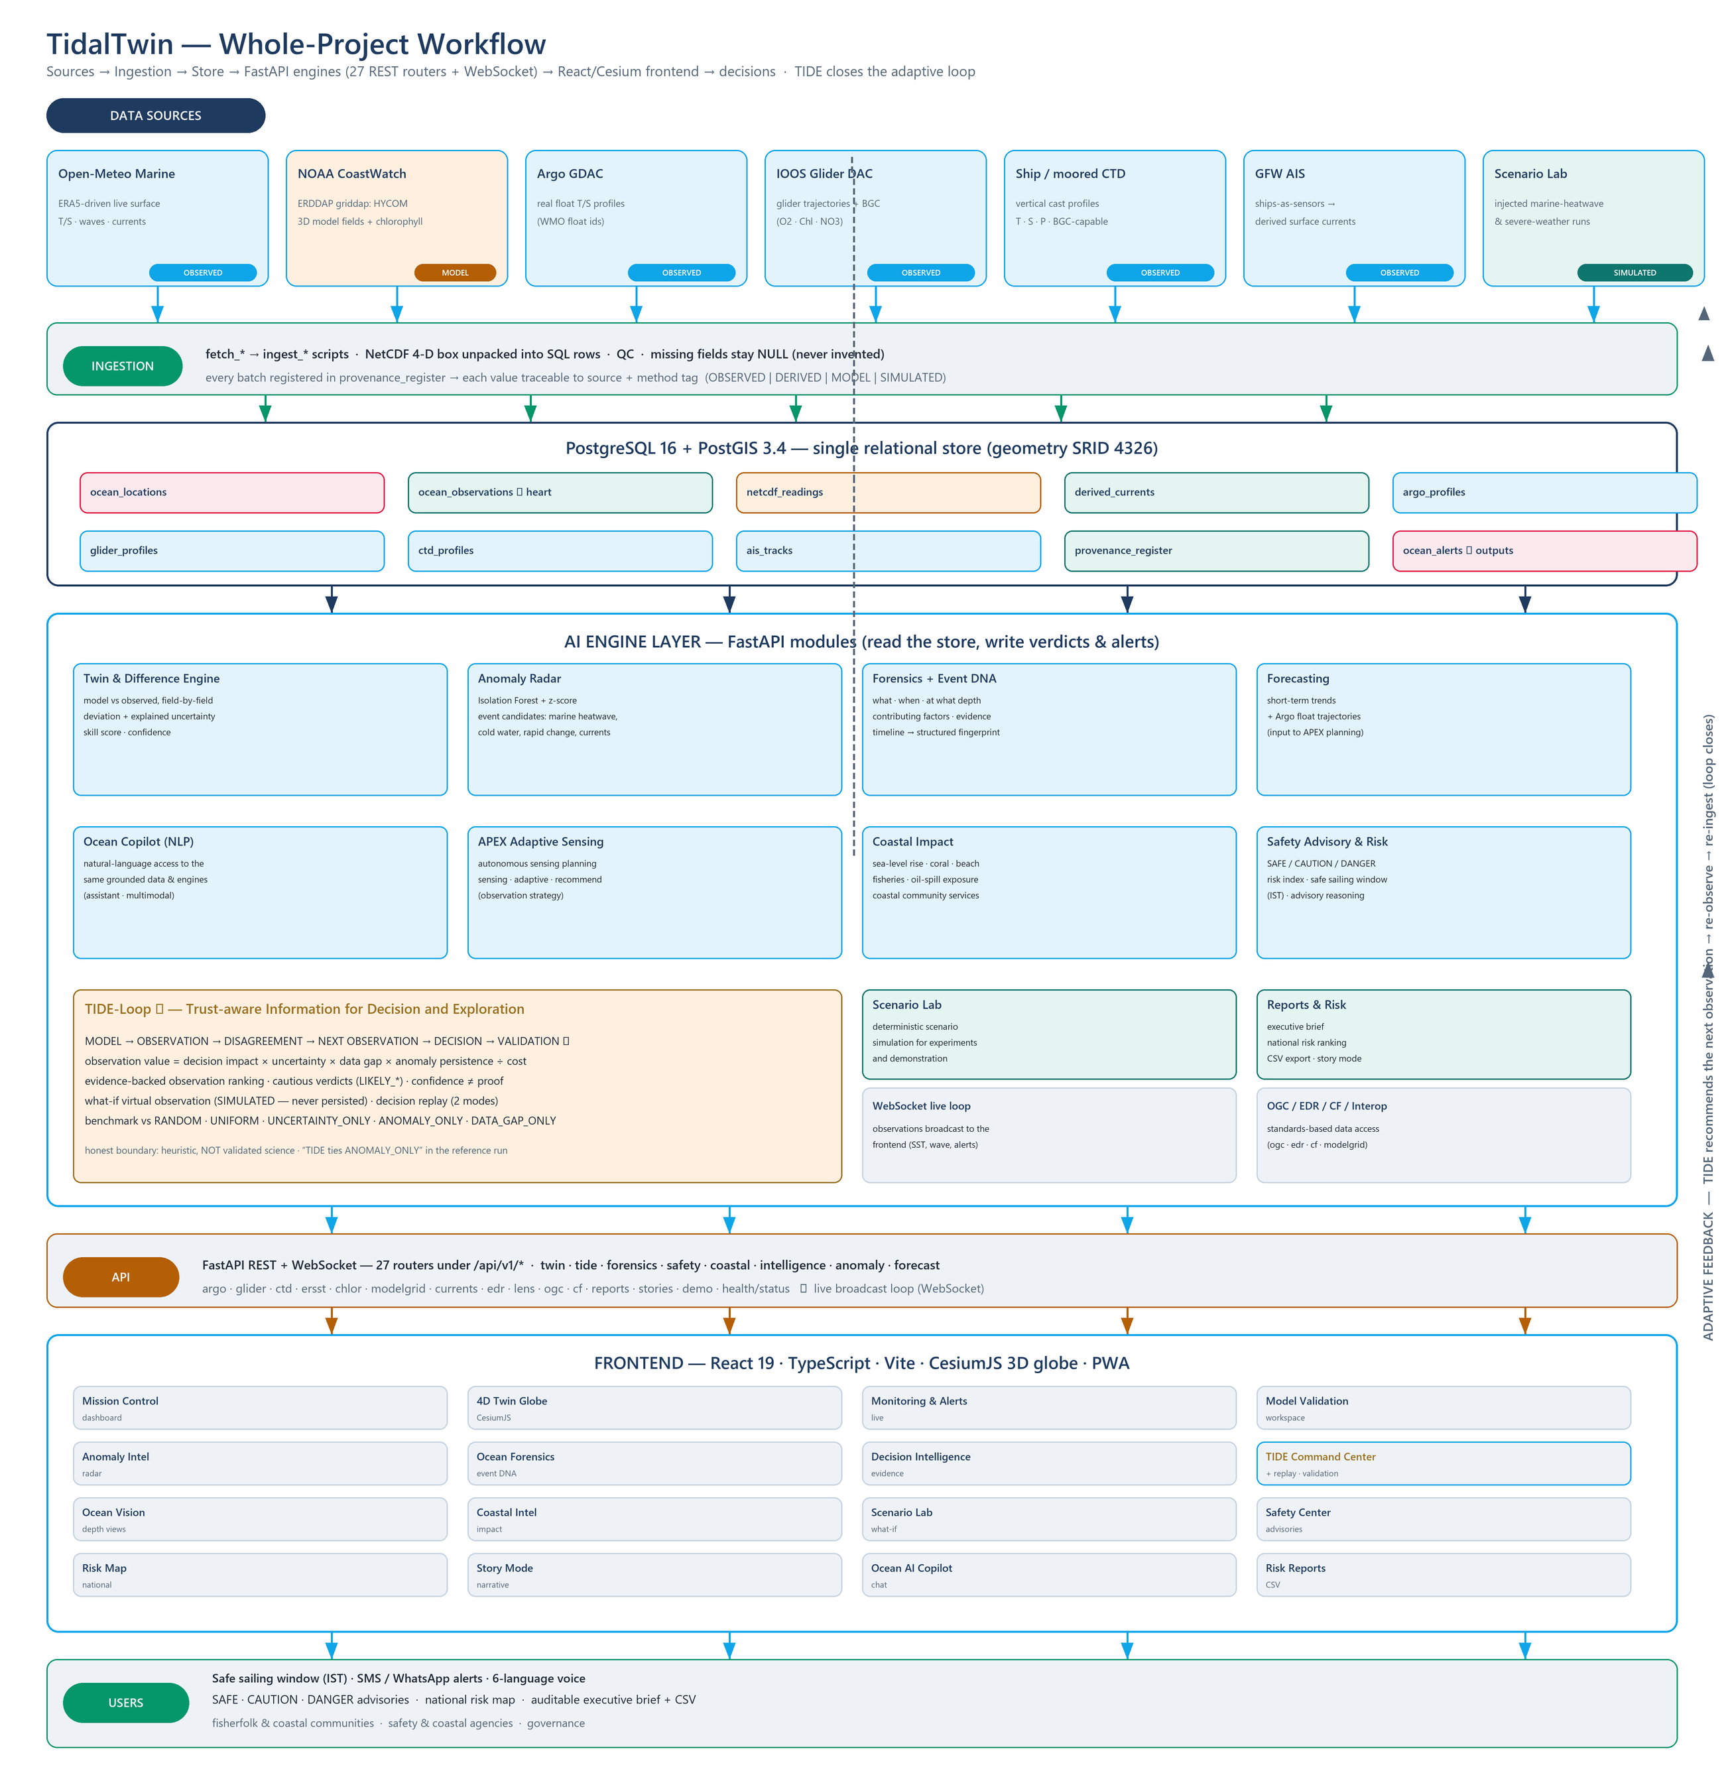
Whole-project workflow
TIDE closes the adaptive loop: recommended next observation → re-observe → re-ingest

Slide 7
Research & References
OPEN DATA SOURCES (in production)
ACADEMIC INSPIRATION (framing, not validation)
STACK
Open-Meteo Marine API (ERA5-driven) — live observations
Howard, Information Value Theory — IEEE TSSC (1966)
FastAPI · SQLAlchemy · Pydantic
NOAA CoastWatch ERDDAP — HYCOM 3D model + chlorophyll
Lindley, On a Measure of the Information Provided by an Experiment — Ann. Math. Stat. (1956)
PostgreSQL 16 · PostGIS 3.4
IOOS National Glider DAC — glider profiles + BGC
MacKay, Information-Based Objective Functions for Active Data Selection — Neural Computation (1992)
React 19 · TypeScript · Vite · PWA
Argo Program GDAC — real float T/S profiles
Liu, Ting & Zhou, Isolation-Based Anomaly Detection — ACM TKDD (2012)
CesiumJS 3D globe
Global Fishing Watch AIS — derived surface currents
scikit-learn · NetCDF/CF · Docker
Honesty: TIDE is inspired by decision / value-of-information theory as a decision-support heuristic; empirical scientific validation is future work.

