Slide 1
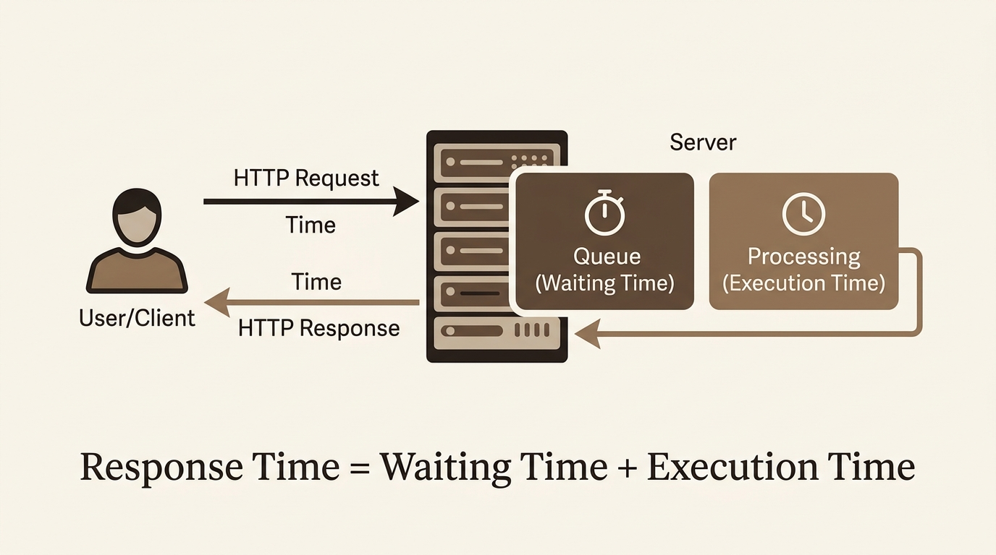
MICRO PROJECT 13
Server Response Time
Prediction Using
Regression Models
Competency: Probability and Statistics for Data Science and Cyber Security
Course Outcomes: CO2 (Modeling), CO3 (Prediction), CO4 (Justification), CO5 (Validation)
Project at a Glance:
• Data: 5,000 cloud task records
• Model: OLS regression in Python
• Tests: t-test, F-test, 95% CI
• Finding: predicted duration drives response time
Dharani Dharan M (URK25AI1043) | Lithish Kumar P (URK25AI1027
Rowan Matthew R (URK25AI1012) ) | Danush A T (URK25AI1013)
Notes:
Introduce the team and the question: can workload parameters predict server response time, and can we prove it statistically instead of just reporting accuracy?

Slide 2
Introduction
Cloud Telemetry, Quality of Service & Proactive Capacity Planning
The Engineering Challenge
• Web services must meet strict latency SLAs
• Response time is random, so it needs statistical modelling
• Reactive scaling acts after performance has already dropped
What We Developed
• Defined response time for 5,000 cloud task records
• Fitted simple and multiple regression (random forest as benchmark)
• Tested with t-tests, F-test and 95% CIs in two scenarios
Fundamental Queueing Latency Model
• Total latency: T_response = T_waiting + T_execution
• T_waiting: queue delay before a worker is free
• T_execution: compute, database and I/O time
02
Notes:
Response time is the most visible quality measure of a web service. It varies request to request, so it is a probability and statistics problem. We define it the standard queueing way: waiting time plus execution time.

Slide 3
Aims & Objectives
Project Purpose, Objectives & Course Outcomes
Project Aim
• Aim: predict server response time from workload parameters using regression
• Test statistically which parameters truly influence it
Project Objectives
Course Outcomes (CO) Alignment
1. Data Preparation:
Define response time; clean and explore 5,000 records.
2. Regression Modeling:
Fit simple and multiple OLS models in Python.
3. Statistical Testing:
Evaluate with R², MAE, RMSE, CV, t-tests, F-test and CIs.
• CO2 & CO3 (Modeling & Prediction):
• Model uncertain workload data; predict response time.
• CO4 (Justification):
• Justify linear regression with OLS mathematics and tests.
• CO5 (Validation):
• Validate with F-test, t-tests, CIs and cross-validation.
03
Notes:
Read the aim, then the three objectives. Objective three matters most: we do not only report accuracy, we test whether each input is statistically significant. Map CO2 to CO5 as shown.

Slide 4
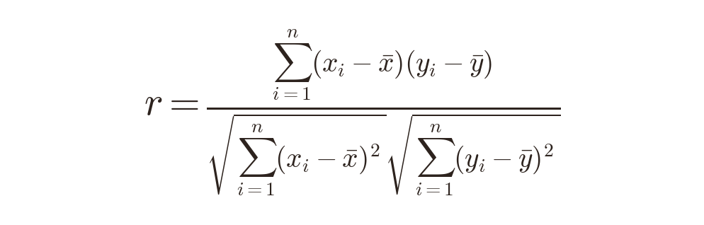
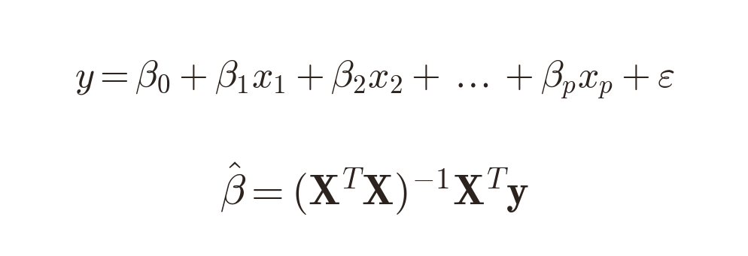
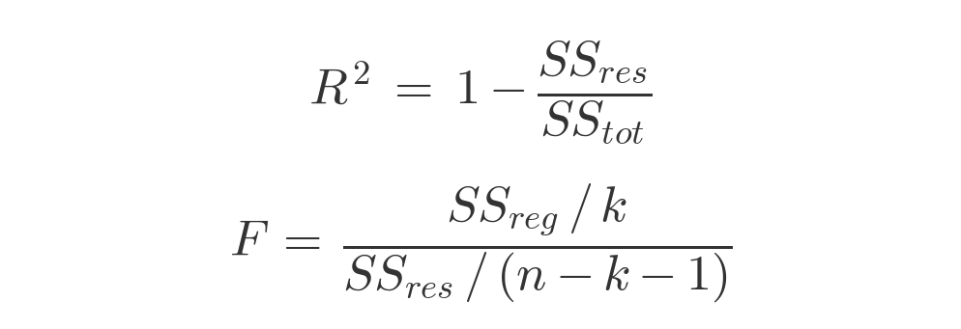
Mathematical Concepts
Core Statistical Formulations Applied to Server Response Time Prediction
1. Pearson Correlation
Coefficient
2. Multiple Linear
Regression
3. Goodness-of-Fit &
ANOVA F-Test
• Linear association with response time, from −1 to +1
• Predicted duration r = 0.97; CPU, memory, users |r| < 0.03
• Response time as a weighted sum of workload features
• Least squares fit on 80% of data, tested on 20%
• R² = variance explained: 0.002 (workload) vs 0.944 (+ duration)
• F-test p = 0.57 vs < 0.001
04
Notes:
Units II and IV: correlation. Unit IV: regression by least squares, beta hat = (X transpose X) inverse X transpose y. Unit V: F-test and t-tests. Response time is treated as a continuous random variable.

Slide 5
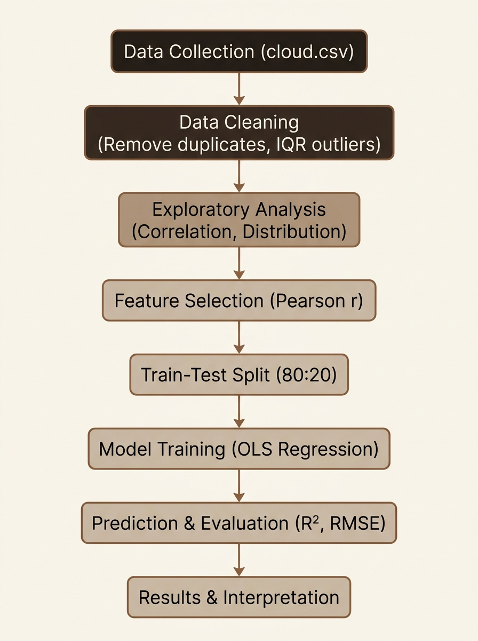
Methodology & Algorithms
System Workflow, Engineering Pipeline & Algorithmic Steps
Algorithm : Predicting Response Time by Regression
Input: cloud workload data (5,000 records)
Output: predicted response time, accuracy, significant parameters
1. Compute response time = waiting time + execution time
2. Clean the data: remove duplicates and outliers
3. Select features; split the data 80% train, 20% test
4. Fit the model by least squares: β̂ = (XᵀX)⁻¹ Xᵀ y
5. Predict response time for the test data: ŷ = X β̂
6. Measure accuracy: R², MAE, RMSE, 5-fold CV
7. Test each parameter (t-test) and the model (F-test)
8. If p < 0.05 then significant, else not significant
05
Notes:
This is Algorithm 1, the full procedure from input to output. Read the Input and Output lines, then steps 1 to 8: define response time, clean, split, fit by least squares, predict, measure accuracy, then test significance with the t-tests and F-test. It matches the flowchart on the left and the Python script. Walk the flowchart top to bottom. Waiting and execution time are excluded as features because they make up the response time; including them would be data leakage. IQR bounds were -1,946 to 7,975 ms. Skewness was 0.055.

Slide 6
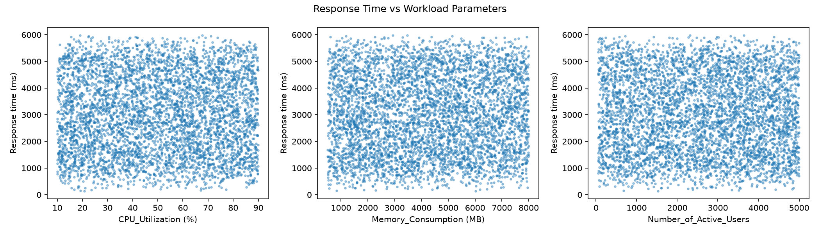
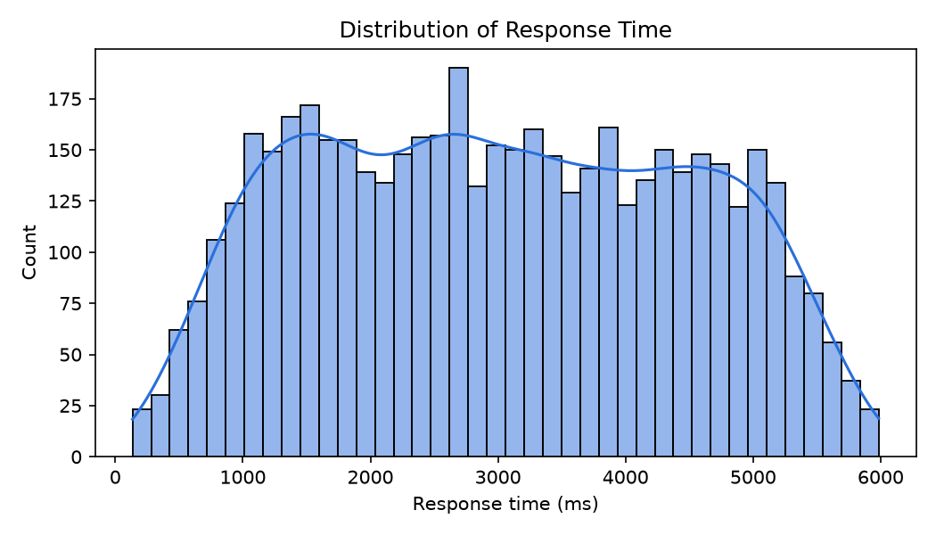
Implementation Using Python
Scientific Computing Stack, Data Pipeline & Visualizations
Python Scientific Software Stack
• pandas: loading, cleaning, IQR bounds
• numpy: matrix operations for OLS
• scikit-learn: scaling, regression, cross-validation
• statsmodels: OLS, t-tests, F-test, CIs
• scipy: skewness and normality test
• matplotlib and seaborn: plots and heatmaps
Execution Pipeline Stages
1. Load cloud.csv and define response time
2. Clean: remove duplicates, IQR outlier check
3. Model: scale features; fit simple, multiple, forest
4. Evaluate: R², RMSE, MAE, t-tests, F-test
5. Report: save plots and print all metrics
06
Notes:
Everything is Python. The script prints every metric and test result and saves the plots. The scatter plots on the right show why workload alone fails: there is no visible pattern between CPU, memory or users and response time.

Slide 7
Python Code
Core Script Snippets: Data Preprocessing, OLS Modeling & Statistical Testing
Data Loading & Cleaning
Model Training & Pipeline
Statistical Inference (OLS)
import statsmodels.api as sm
# Fit OLS with intercept column
X_ols = sm.add_constant(X_train)
ols_model = sm.OLS(y_train, X_ols).fit()
# Hypothesis testing results
print(f'F-stat: {ols_model.fvalue:.2f}')
print(f'p-value: {ols_model.f_pvalue:.4g}')
print(f'R-squared: {ols_model.rsquared:.4f}')
# Goodness of fit metrics
r2 = r2_score(y_test, y_pred)
rmse = np.sqrt(mean_squared_error(
y_test, y_pred))
# Load cloud telemetry dataset
df = pd.read_csv('cloud.csv')
# Queueing model latency target
df['Response_Time_ms'] = (
df['Task_Waiting_Time (ms)'] +
df['Task_Execution_Time (ms)']
)
# Remove duplicates & IQR outliers
df = df.drop_duplicates()
q1, q3 = df[TARGET].quantile([.25,.75])
iqr = q3 - q1
df = df[(df[TARGET] >= q1 - 1.5*iqr) &
(df[TARGET] <= q3 + 1.5*iqr)]
from sklearn.linear_model import \
LinearRegression
from sklearn.preprocessing import \
StandardScaler
from sklearn.pipeline import make_pipeline
# 80:20 Train-Test split
X_train, X_test, y_train, y_test = \
train_test_split(X, y, test_size=0.2)
# OLS Regression Pipeline
model = make_pipeline(
StandardScaler(),
LinearRegression()
)
model.fit(X_train, y_train)
y_pred = model.predict(X_test)
07
Notes:
Three snippets: loading and cleaning, the model pipeline, and the statsmodels OLS call that gives the F-test, t-tests and confidence intervals. The full script is server_response_time_regression.py.

Slide 8
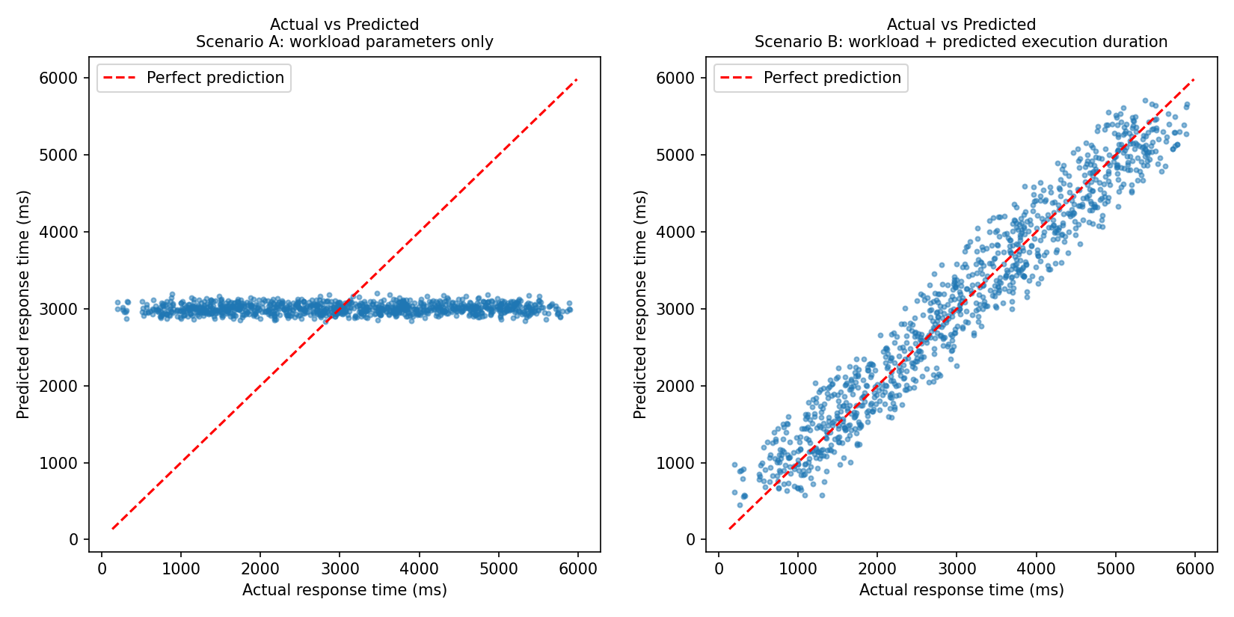
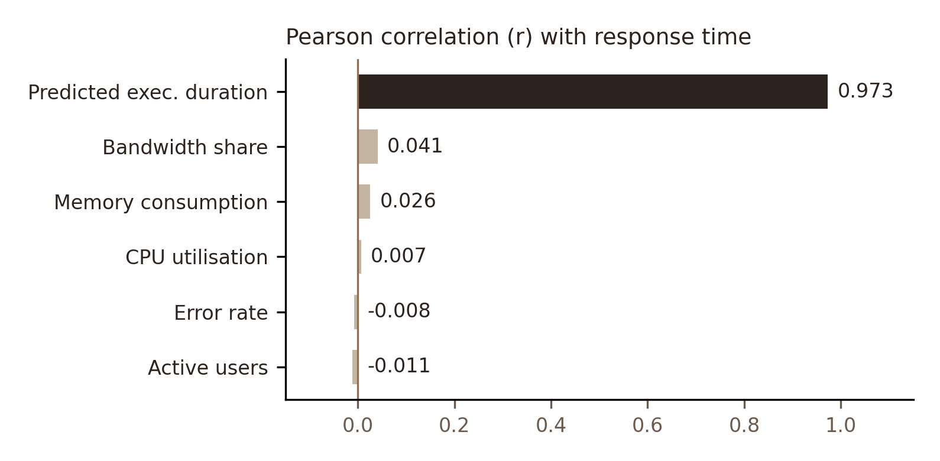
Results & Interpretation
Model Benchmark Comparison, Goodness-of-Fit & Statistical Findings
Comparative Model Evaluation
• Scenario A: workload only
→ R² = 0.002 | RMSE 1453.9 ms | MAE 1248.4 ms
→ 5-fold CV R² = −0.002 ± 0.004
• Scenario B: + predicted duration
→ R² = 0.944 | RMSE 344.6 ms | MAE 287.5 ms
→ 5-fold CV R² = 0.946 ± 0.003
• Random forest benchmark
→ A: R² = −0.037 | B: R² = 0.942
Key Inferential Findings
• Workload alone: F-test p = 0.57, no significant effect
• Predicted duration is the only significant predictor
• High R² is not cause: duration is almost the response time (r = 0.97)
08
Notes:
Left plot: Scenario A predictions sit in a flat band, so the model learned nothing. Right plot: Scenario B follows the red line. If asked: simple regression on the best single feature also gave R2 0.002 (A) and 0.945 (B). A second dataset of 732 website records gave R2 = 0.006.

Slide 9
Conclusion & Future Scope
Summary of Achievements, Academic Takeaways & Industrial Extensions
Conclusions
Future Scope & Industrial Roadmap
• Real load tests with JMeter or Locust and psutil
• SLA risk: P(response time > SLA)
• More models: ridge, Gaussian process, ARIMA
• Anomaly alerts from prediction error (DDoS)
• Validate on more QoS datasets such as WS-DREAM
• Workload alone failed: R² = 0.002, p = 0.57
• With predicted duration: R² = 0.944
• Duration is the only significant predictor
• Second dataset (732 sites): R² = 0.006
Core Takeaway
• Regression plus hypothesis testing shows whether inputs truly matter, not just how accurate a model is.
• Here workload carried no signal; predicted duration carried almost all of it.
• Validate statistically before trusting any prediction model.
09
Notes:
Details: MAE about 287 ms in Scenario B; predicted duration coefficient 0.983 with 95% CI 0.975 to 0.990. Three findings. If asked about bandwidth share: it had p = 0.041, but with ten separate tests one false positive is expected by chance and the model explains only 0.2 percent of variance. Why did CPU and memory not matter? The dataset appears synthetic, with columns generated independently, and the tests correctly found no signal.

Slide 10
Thank You
Server Response Time Prediction Using Regression Models
Micro Project 13
Dharani Dharan M | Lithish Kumar P | Danush A T | Rowan Matthew R
Notes:
Thank the audience and invite questions.

