Slide 1

Regular Expressions for Real-World Text Processing
GUIDED BY:
Dr .T. Devi
NAME :T. Dharani Devi
REG.NO:192425036

Slide 2


Introduction
Regular Expressions (Regex) are patterns used to search and match text.
They help process and analyze text efficiently.
Regex is used to validate user input such as email addresses and phone numbers.
It can extract specific information from large text files.
Regex is useful for searching, replacing, and cleaning text data.
It is widely used in programming, web development, and data analysis.
It improves the accuracy and efficiency of text handling.

Slide 3
Regular Expression
What is a Regular Expression?
A Regular Expression (Regex) is a sequence of characters that defines a search pattern.
It is used to find, replace, or validate text.
Supported in many programming languages such as Python, Java and JavaScript.
Example : Email: abc@gmail.com
Why Use Regex?
Fast and efficient text searching.
Validates user input.
Extracts useful information from text.
Cleans and formats data.

Slide 4
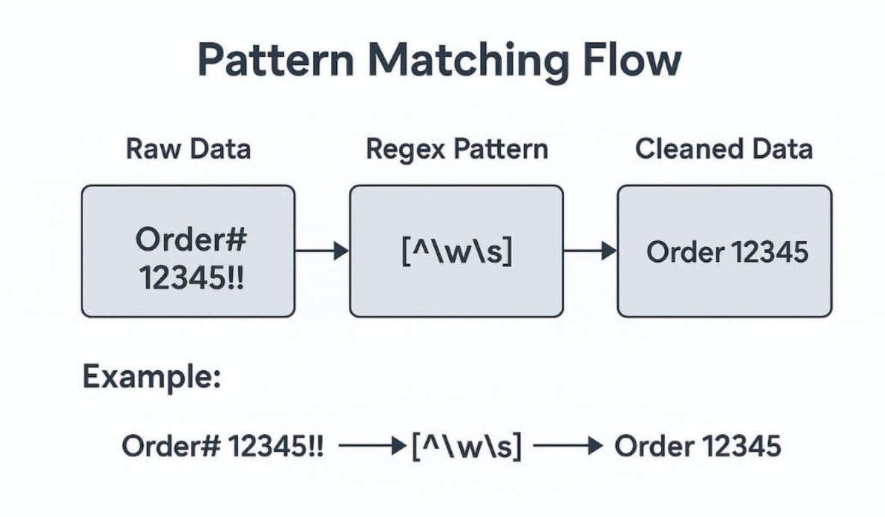
REGEX PATTERN

Slide 5
Real-World Applications
Email validation - Ensures emails are valid before creating an account.
Phone number validation - Ensures only valid phone numbers receive OTPs.
Password validation - Protects user information from unauthorized access.
Data extraction - Saves time compared to manual searching.
Search and replace - Quickly updates repeated text.
Log file analysis - Helps developers identify errors quickly.

Slide 6
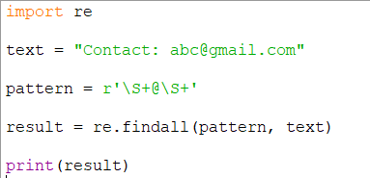

IMPLEMENTATION

Slide 7
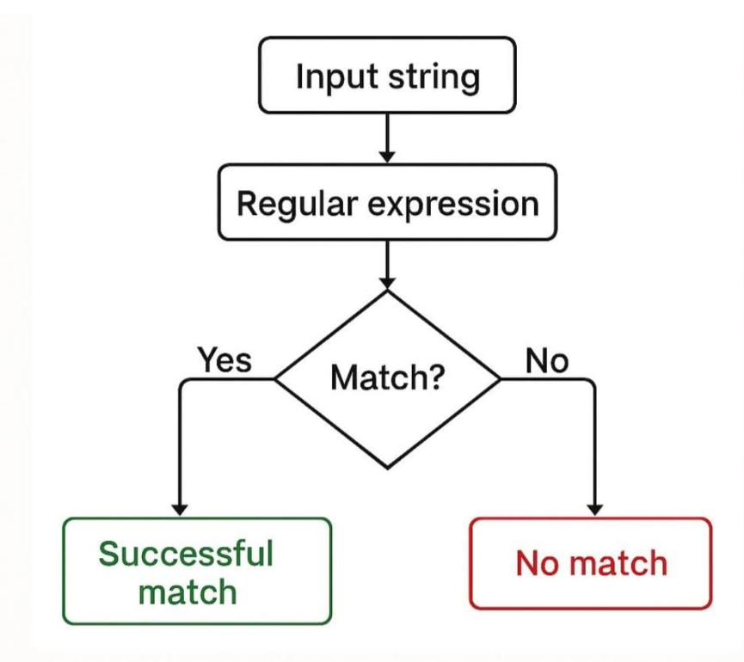
Conclusion
Regular Expressions are essential for efficient text processing.
They help search, validate, extract, and replace text accurately.
Regex is widely used in real-world applications across various industries.
Understanding Regex improves coding efficiency and problem-solving skills.
It remains an important tool in modern programming and data management.

Slide 8


