Slide 1
Front-end

Slide 2
Contents
Regular Expression
Pseudo Classes
Pseudo Elements
Position Property
Specificity
Accessibility
Z-index property
Browser dev tools
SEO

Slide 3
What is a Regular Expression?
Regular Expression are used to perform powerful pattern-matching and search-and-replace on text and performs validation.
Validate that a piece of text (or a portion of that text) matches some pattern
Find fragments of some text that match some pattern
Extract fragments of some text
Replace fragments of text with other text
Eg : b[aeiou]bble - contains {babble, bebble, bibble, bobble, bubble}

Slide 4
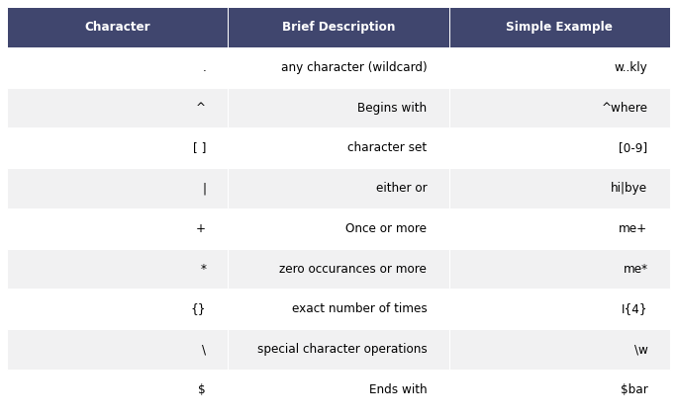
Patterns

Slide 5
List of Meta characters
Meta character | Description
\ | Regex uses backslash ( \ ) for two purposes: for metacharacters such as \d (digit), \D (non-digit), \s (space), \S (non-space), \w (word), \W (non-word). to escape special regex characters
^ | Matches the beginning of input.
$ | Matches the end of input.
* | Matches the preceding character zero or more times. For example, zo* matches either z or zoo.
+ | Matches the preceding character one or more times. For example, zo+ matches zoo but not z.
? | Matches the preceding character zero or one time. For example, a?ve? matches the ve in never.
. | Matches any single character except a newline character.

Slide 6
Meta character | Description
Pattern | A regular expression is a pattern that the regular expression engine attempts to match in input text. A pattern consists of one or more character literals, operators, or constructs
x|y | Matches either x or y. For example, z|wood matches z or wood. (z|w)oo matches zoo or wood.
{n} | n is a non-negative integer. Matches exactly n times. For example, o{2} does not match the o in Bob, but matches the first two os in foooood.
{n,} | In this expression, n is a non-negative integer. Matches the preceding character at least n times. For example, o{2,} does not match the o in Bob and matches all the os in foooood. The o{1,} expression is equivalent to o+ and o{0,} is equivalent to o*.
{n,m} | The m and n variables are non-negative integers. Matches the preceding character at least n and at most m times. For example, o{1,3} matches the first three os in fooooood. The o{0,1} expression is equivalent to o?.
[xyz] | A character set. Matches any one of the enclosed characters. For example, [abc] matches the a in plain.
[^xyz] | A negative character set. Matches any character that is not enclosed. For example, [^abc] matches the p in plain.

Slide 7
Meta character | Description
[a-z] | A range of characters. Matches any character in the specified range. For example, [a-z] matches any lowercase alphabetic character in the English alphabet.
[^m-z] | A negative range of characters. Matches any character that is not in the specified range. For example, [m-z] matches any character that is not in the range m through z.
\A | Matches only at beginning of a string.
\b | Matches a word boundary, that is, the position between a word and a space. For example, er\b matches the er in never but not the er in verb.
\B | Matches a nonword boundary. The ea*r\B expression matches the ear in never early.
\d | Matches a digit character.
\D | Matches a non-digit character.
\f | Matches a form-feed character.

Slide 8
Meta character | Description
\n | Matches a newline character.
\r | Matches a carriage return character.
\s | Matches any white space including spaces, tabs, form-feed characters, and so on.
\S | Matches any non-white space character.
\t | Matches a tab character.
\v | Matches a vertical tab character.
\w | Matches any word character including underscore. This expression is equivalent to [A-Za-z0-9_].
\W | Matches any non-word character. This expression is equivalent to [^A-Za-z0-9_].
\z | Matches only the end of a string.
\Z | Matches only the end of a string, or before a newline character at the end.

Slide 9
Examples
Expression | String | Matched
.. | ac | 1 Match
^a | abc | 1 Match
[abc] | ac | 2 Matches
a|b | acb | 2 Matches
ma+n | woman | 1 Match
man*n | mannn | 1 Match
a{2,3} | aabc daaat | 2 matches (at aabc and daaat)
\bfoo | a football | Match
a$ | formula | 1 match

Slide 10
What are Pseudo Classes?
A pseudo-class is used to define a special state of an element.
For example, it can be used to:
Style an element when a user mouses over it
Style visited and unvisited links differently
Style an element when it gets focus
Syntax: selector : pseudo-class{
property : value;
}

Slide 11
What are Pseudo Elements?
A CSS pseudo-element is used to style specified parts of an element.
For example, it can be used to:
Style the first letter, or line, of an element
Insert content before, or after, the content of an element
Syntax: selector :: pseudo-element{
property : value;
}

Slide 12
What is a Position Property?
The position property specifies the type of positioning method used for an element (static, relative, fixed, absolute or sticky.
There are five different position values:
Static
Relative
Fixed
Absolute
Sticky

Slide 13
What is Specificity?
If there are two or more CSS rules that point to the same element, the selector with the highest specificity value will "win", and its style declaration will be applied to that HTML element.
Think of specificity as a score/rank that determines which style declaration are ultimately applied to an element.

Slide 14
What is z-index property?
The z-index property is used to displace elements on the z-axis i.e in or out of the screen. It is used to define the order of elements if they overlap on each other.
Elements with a higher index will be placed on top of elements with a lower index. Z index only works on positioned elements ( position : absolute , position : relative , or position : fixed ).

Slide 15
What are Browser Dev Tools
Developer tools are built directly into the browser. These are the tools that are browser dependent. Most of these tools are common among various browsers and do a range of things, from inspecting elements of a currently-loaded HTML, CSS, and JavaScript.

Slide 16
What is Accessibility?
“Accessibility” generally means having web content and a user interface that can be understood, navigated, and interacted with by a broad audience. This includes people with visual, auditory, mobility, or cognitive disabilities.

Slide 17
Tips to make accessible
Choose a content management system that supports accessibility
Use headings correctly to organize the structure of your content
Include proper alt text for images
Give your links unique and descriptive names
Use color with care
Design your forms for accessibility
Use tables for tabular data, not for layout
Ensure that all content can be accessed with the keyboard alone in a logical way
Make dynamic content accessible

Slide 18
SEO-Search engine optimization
SEO means Search Engine Optimization and is the process used to optimize a website's technical configuration, content relevance and link popularity so its pages can become easily findable, more relevant and popular towards user search queries, and as a consequence, search engines rank them better.
Actual activities:
1.On page SEO
2.Off page SEO
3.Technical SEO

Slide 19
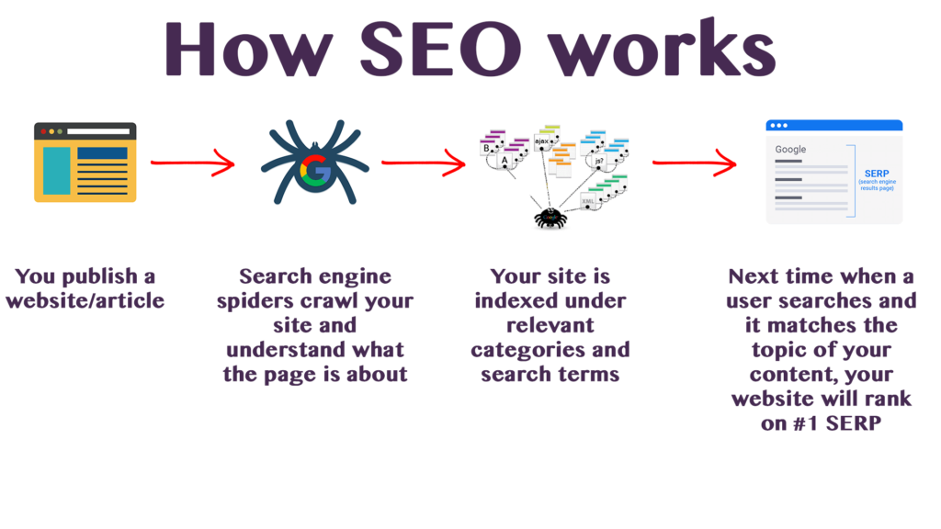
How SEO Works

Slide 20
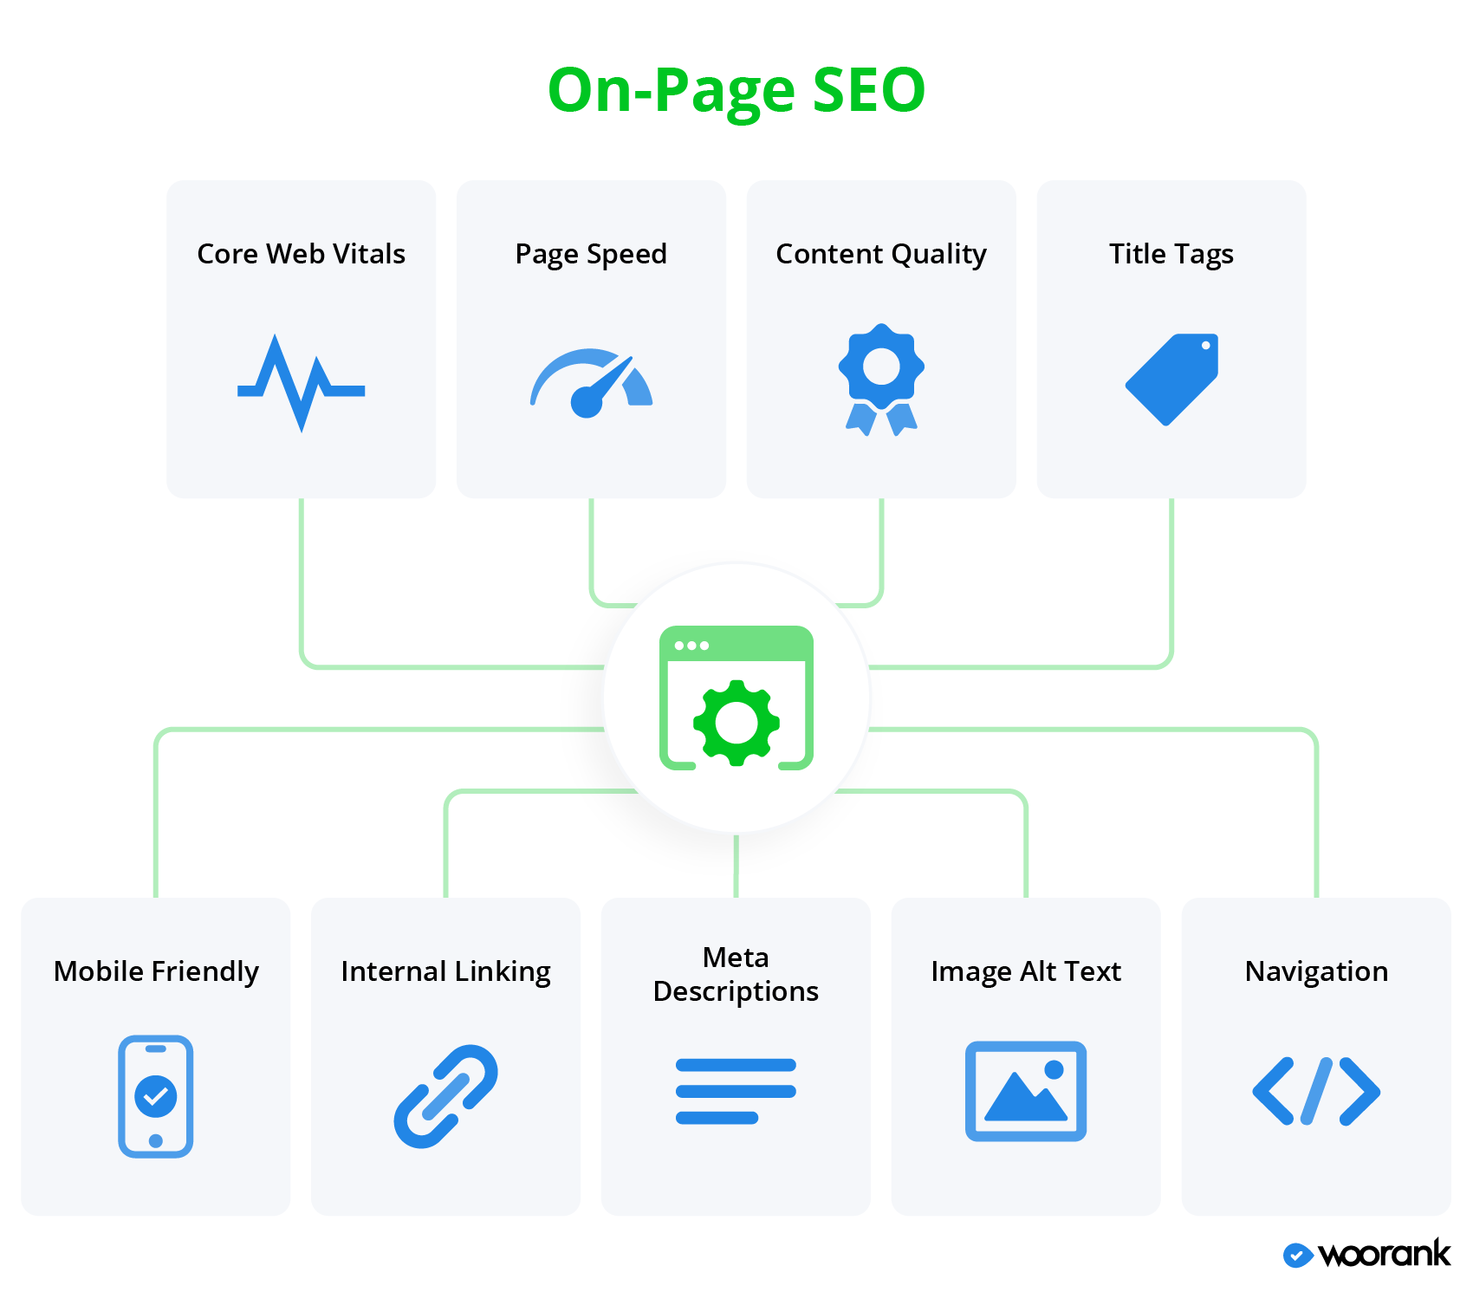
On Page SEO:

Slide 21

Off-page SEO

Slide 22
Technical SEO
It refers to improving the technical aspects in order to increase the ranking of its pages in search engines.
Making a website faster, easier to crawl, secure, doesn’t have dead links, understandable for search engines are the pillars of technical optimization.

