Slide 1
Digital Portfolio
STUDENT NAME: M.DHARANI DHARAN
REGISTER NO AND NMID: 212405369 AND 7BBE5B558A9361EB76E4A5E4914725BC
DEPARTMENT: BCA
COLLEGE: Apollo Arts And Science College Chennai /
MADRAS UNIVERSITY

Slide 2
PROJECT TITLE
PERSONAL PORTFOLIO WEBSITE USING FRONT-END DEVELOPMENT

Slide 3


AGENDA
Problem Statement
Project Overview
End Users
Tools and Technologies
Portfolio design and Layout
Features and Functionality
Results and Screenshots
Conclusion
Github Link
3/21/2024 Annual Review

Slide 4

PROBLEM STATEMENT
In today's digital era, students need a professional way to showcase their skills, projects, and achievements.
Traditional resumes lack interactivity and creativity.
Recruiters and employers prefer digital portfolios for quick, detailed insights.
Problem: Lack of a personalized, interactive, and easily accessible digital platform to present student profiles.

Slide 5

PROJECT OVERVIEW
The project is a web-based digital portfolio designed to showcase academic achievements, technical skills, and project work.
The portfolio provides a professional online identity accessible anytime, anywhere.
It ensures structured presentation of information through a visually appealing and responsive interface.
Designed to serve as a bridge between students and recruiters by enabling effective communication of skills.

Slide 6

WHO ARE THE END USERS?
👨‍🏫Professors/Evaluators - Assess projects &knowledge
💼Employers/Recruiters - Quick view of skills &achievements
🤝Clients/Collaborators - Understand capabilities for projects
🌍Peers & Visitors - Explore work and connect

Slide 7

TOOLS AND TECHNIQUES
Development - HTML (structure), CSS (styling), JavaScript (interactivity).
Design - Font Awesome icons, custom images, profile photo.
Hosting & Control - GitHub, GitHub Pages.
Features - Responsive design, smooth scrolling ,interactive buttons.

Slide 8
PORTFOLIO DESIGN AND LAYOUT
Design Style:
Dark theme with vibrant accent colors (yellow & orange) for contrast.
Clean typography with emphasis on headings and highlights.
Rounded buttons and glowing effects for an engaging Look.
Layout Structure:
Header Navigation - Home, About, Skills, Projects, Contact.
b. Hero Section - Profile image, name, and role introduction.
c . About Me - Short description of skills, passion, and mission.
d. Skills Section - Progress bars for HTML, CSS, and JavaScript.
e .Projects Showcase - Highlighted cards with titles and descriptions.
f. Contact Form - Simple form for direct communication.
Key Features:
Responsive design for mobile and desktop.
Smooth animations and hover effects .
User - friendly navigation with clear section flow.
8

Slide 9
FEATURES AND FUNCTIONALITY
✅ Navigation bar with smooth scrolling.
✅ Interactive skill & project showcase.
✅ Contact form validation with JavaScript.
✅ Mobile-friendly responsive design.
✅ Professional look with icons & visuals.

Slide 10
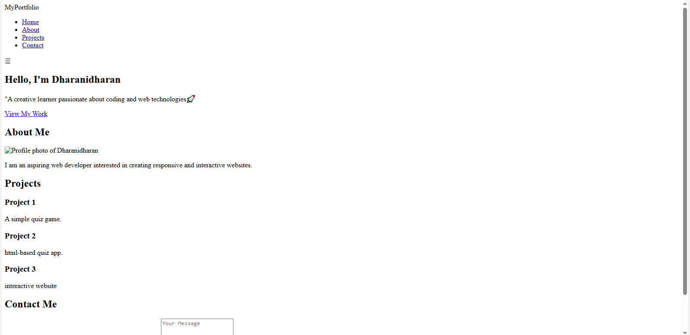
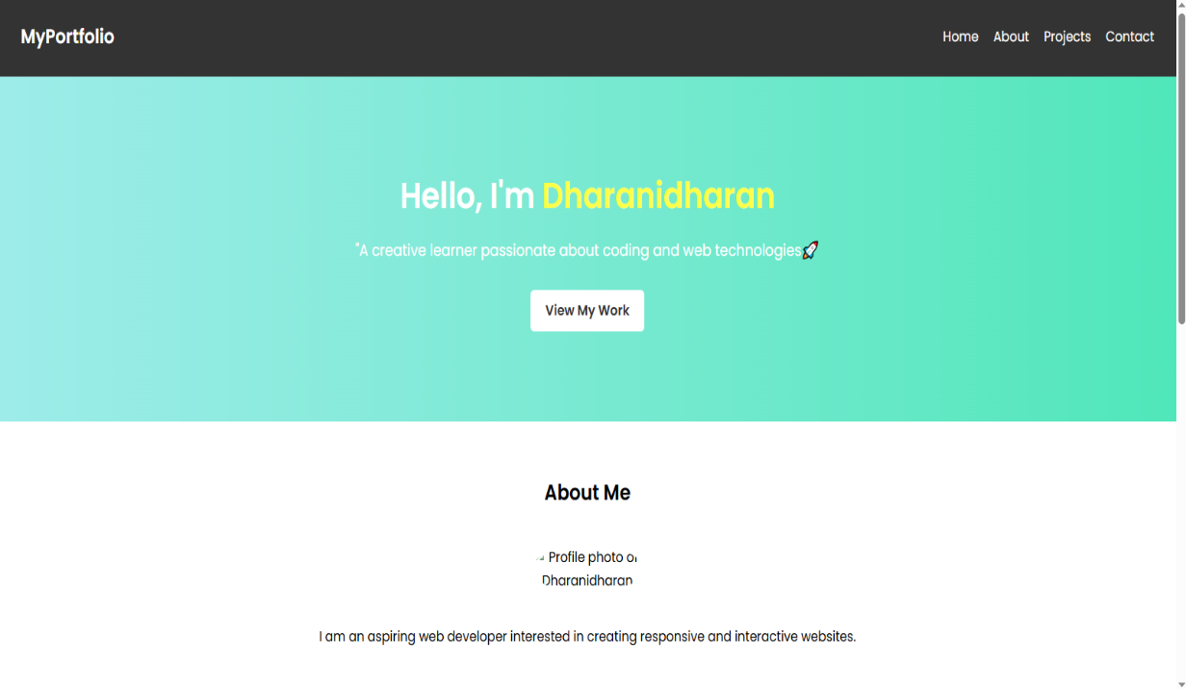
RESULTS AND SCREENSHOTS
BEFORE ADDING CSS : AFTER ADDING CSS:
3/21/2024 Annual Review
10

Slide 11
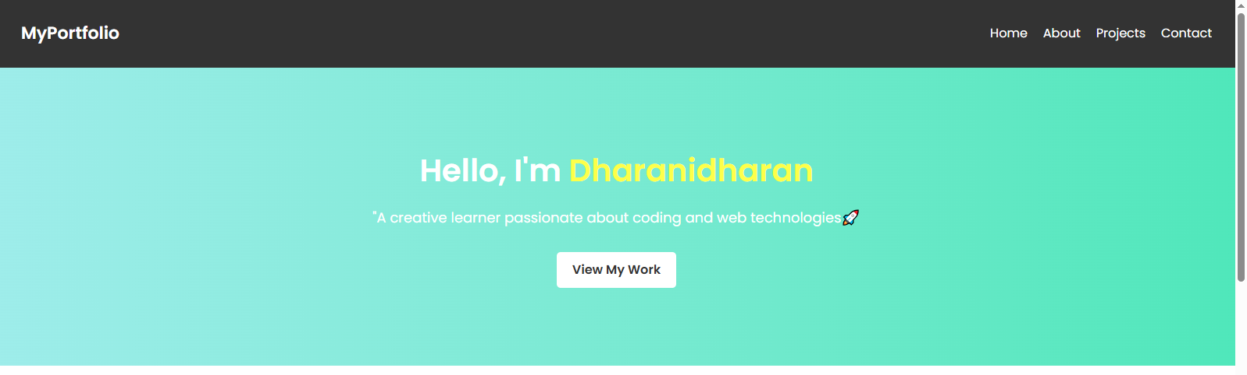
HOME SECTION:

Slide 12

ABOUT SECTION

Slide 13
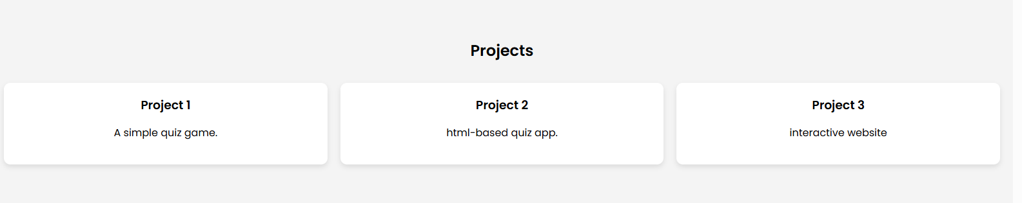
PROJECT SECTION:

Slide 14

CONTACT SECTION:

Slide 15
CONCLUSION
The digital portfolio provides a modern way to present my skills and projects.
It serves as a dynamic resume for professors, recruiters, and clients .
Built with HTML, CSS, and JavaScript, it is responsive, interactive, and easy to update.
15

Slide 16
GITHUB LINK:
https://dharanibca24aascc-cmyk.github.io/TNSDC-FWD-Digitalportfolio/

