Slide 1
Digital Portfolio
STUDENT NAME: DHARANIDHARAN V S
REGISTER NO: 2422j0114
NMID: E6C234123A18B3FA8704E2EFC07F687C
DEPARTMENT: BCA
COLLEGE: KPR COLLEGE OF ARTS, SCIENCE AND RESEARCH

Slide 2
                PROJECT TITLE:
                Web Development Portfolio
Using HTML, CSS, and JavaScript

Slide 3


AGENDA
Problem Statement
Project Overview
End Users
Tools and Technologies
Portfolio design and Layout
Features and Functionality
Results and Screenshots
Conclusion
Github Link
Results and Screenshots
3/21/2024 Annual Review

Slide 4

PROBLEM STATEMENT
In the digital age, users expect fast, accessible, and seamless online experiences across all devices. However, many existing websites suffer from poor user interfaces, lack of mobile responsiveness, and slow loading times, which lead to high bounce rates and reduced user engagement. Additionally, small businesses and individuals often struggle to find cost-effective, customized solutions that meet their unique needs.

Slide 5

PROJECT OVERVIEW
This project focuses on creating a personal portfolio website using HTML, CSS, and JavaScript. The portfolio will serve as a digital resume for students to present their skills, academic projects, and achievements in a structured and visually appealing way.
HTML will be used to design the structure and content of the website.
CSS will provide styling, layouts, and responsiveness across devices.
JavaScript will add interactivity, such as navigation menus, animations, and form validation.

Slide 6

WHO ARE THE END USERS?
. Recruiters & Employers
. Teachers / Academic Evaluators
. Peers & Collaborators
. General Audience / Clients

Slide 7

TOOLS AND TECHNIQUES
Tools:
. Visual Studio Code (VS Code)
. Web Browsers (Chrome)
. Git Hub
Techniques:
. HTML
. CSS
. JavaScript

Slide 8
POTFOLIO DESIGN AND LAYOUT
1)Header / Navigation Bar
2)Home / Introduction Section
3)About Section
4)Projects Section
5)Contact Section
6)Footer
8

Slide 9
FEATURES AND FUNCTIONALITY
Features:
Clean and responsive design
Easy navigation with a header menu
Separate sections: About, Projects, Contact
Functionality:
HTML: Provides structure for sections and content
CSS: Adds styling, color schemes, and responsive layout
JavaScript:
  Form validation
  Button actions (alerts, navigation)
  Interactive elements (menu toggle, animations)

Slide 10
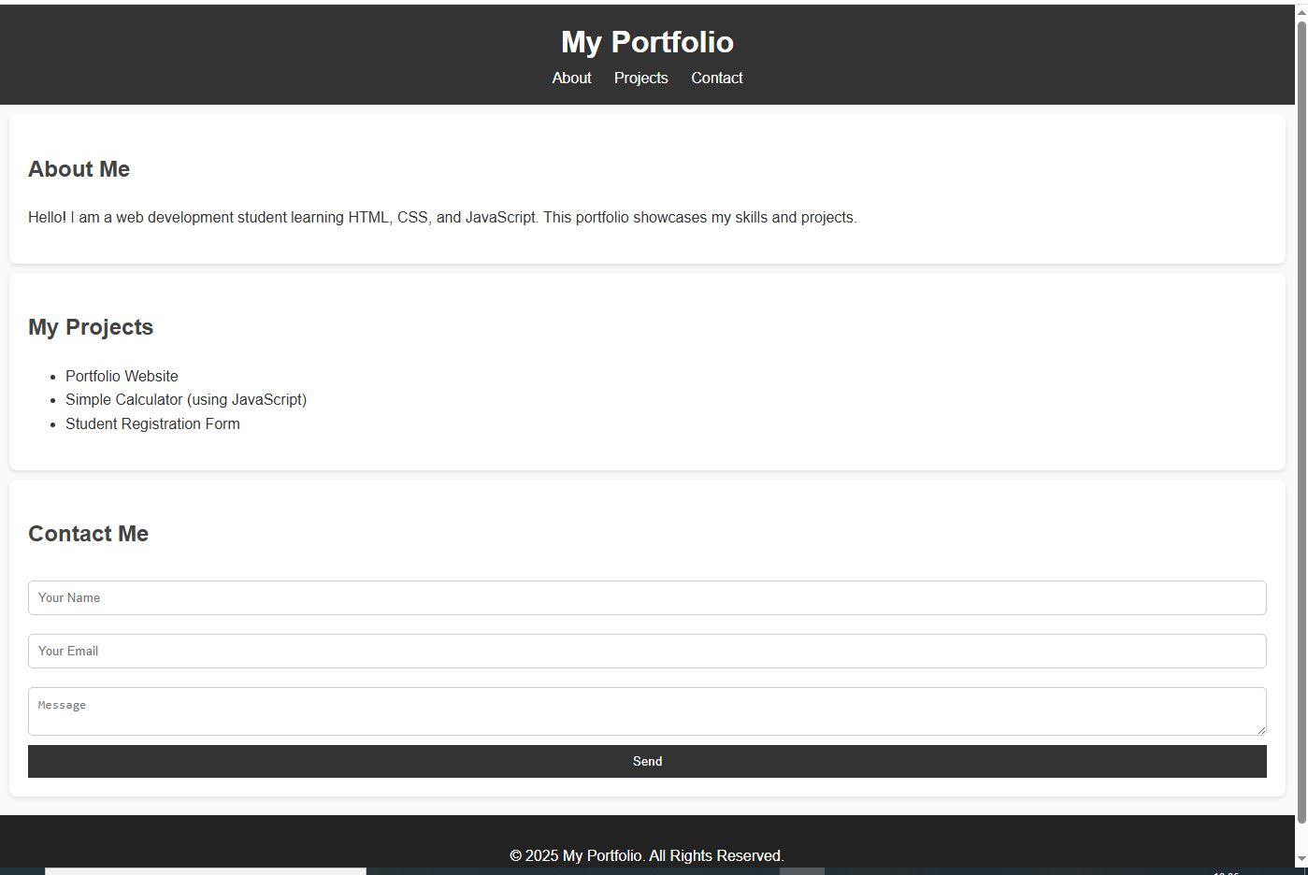
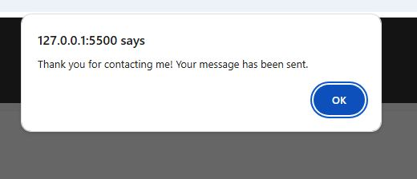

RESULTS AND SCREENSHOTS
3/21/2024 Annual Review
10

Slide 11
CONCLUSION
A portfolio website was created using HTML, CSS, and JavaScript to showcase skills and projects.
The site provides a simple, responsive, and interactive platform for students.
The project enhanced knowledge of front-end web development and practical implementation.
11

