Slide 1
IPL-SPA: An Angular Single Page Application
A Comprehensive Angular Project on IPL Teams
By Dharanika S

Slide 2
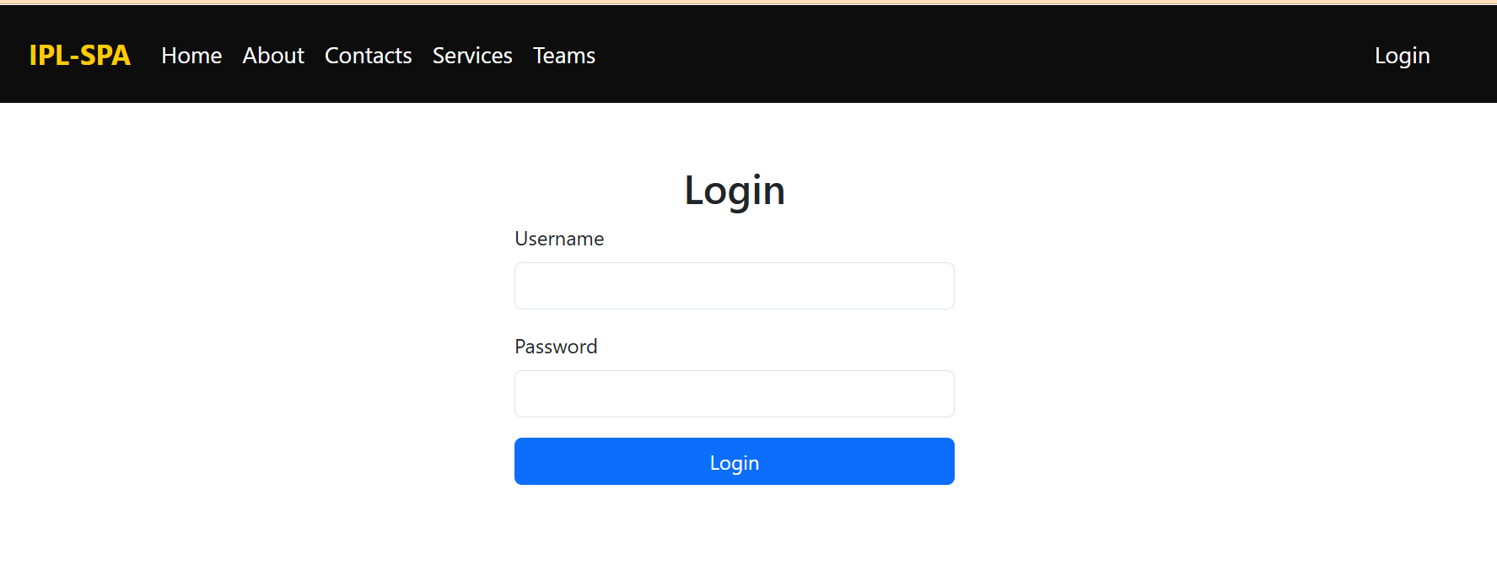
Introduction
I choose IPL-SPA because of my passion for sports. This project showcases an Angular-based Single Page Application (SPA) with dynamic features.

Slide 3
Project Requirements
Components
Parent-Child Components
Directives (Structural, Attribute)
@Input, @Output
Routing & Parameters
Local Storage
Routing Guard
Services & Observables
API Calls
Form Handling (Template & Model Based)
Built-in & Custom Pipes

Slide 4
Authentication & Auth Guard
Implemented authentication where users must log in to access the site.
Default Credentials:
- Username: admin
- Password: 12345
Auth Guard restricts unauthorized access and redirects to the login page.

Slide 5
Navigation & Components
The application contains:
- Home
- About
- Contact
- Services
- Teams
- Logout
Each component is structured to provide detailed IPL-related information.

Slide 6
Home Page Features
Displays IPL team cards (MI, RCB, CSK, KKR, DC, SRH).
- 'View Details' fetches team details from team-detail component (teams.json).
- Includes a form to register new teams dynamically.

Slide 7
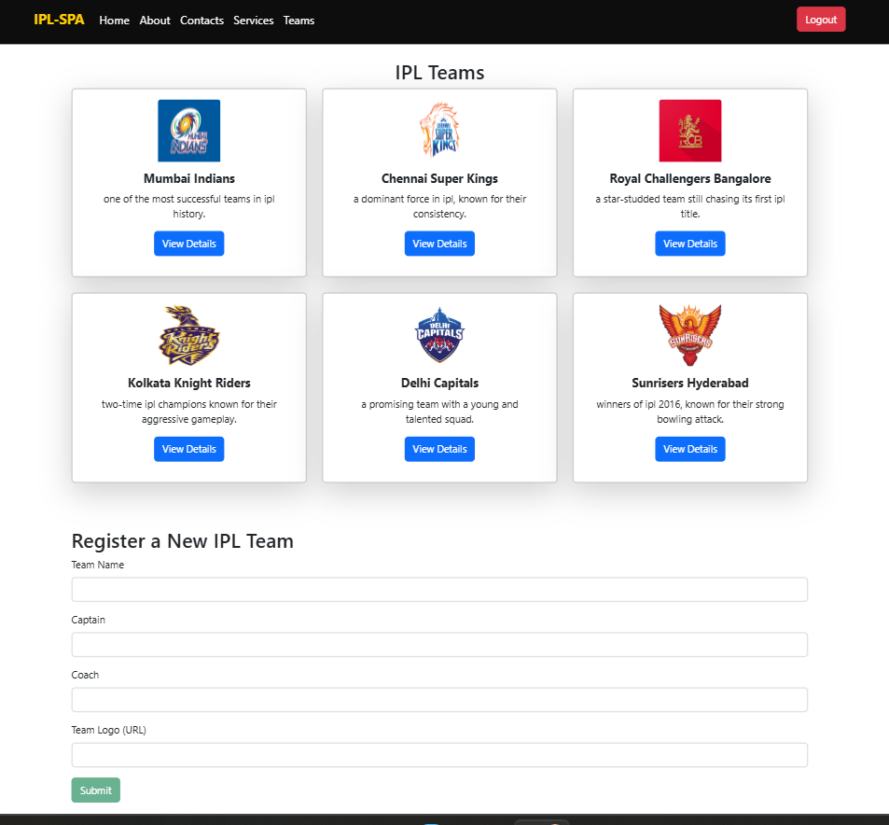

Slide 8
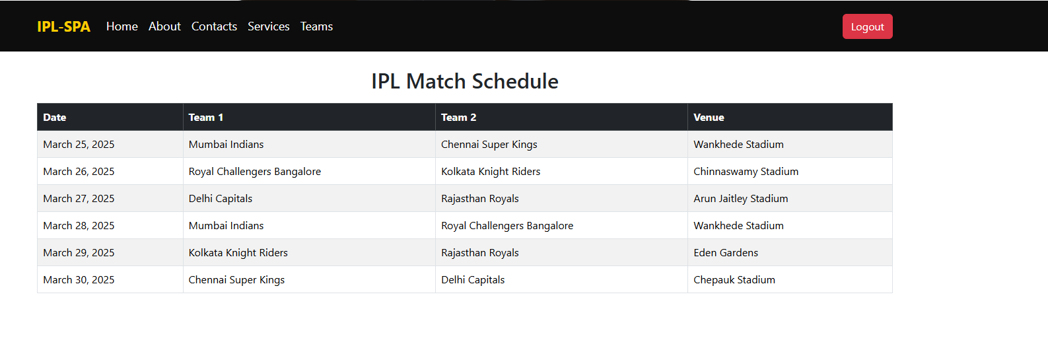
About Us - Matches
Displays match history for default IPL teams.
Showcasing past games, results, and key statistics.

Slide 9
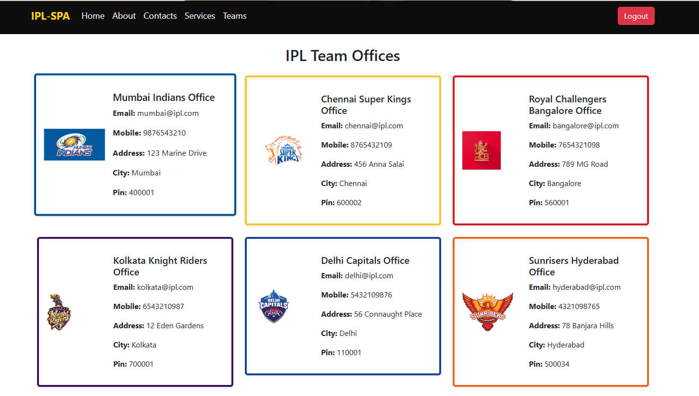
Contact Page
Provides team contact details including:
- Email
- Phone Number
- Social Media Handles

Slide 10
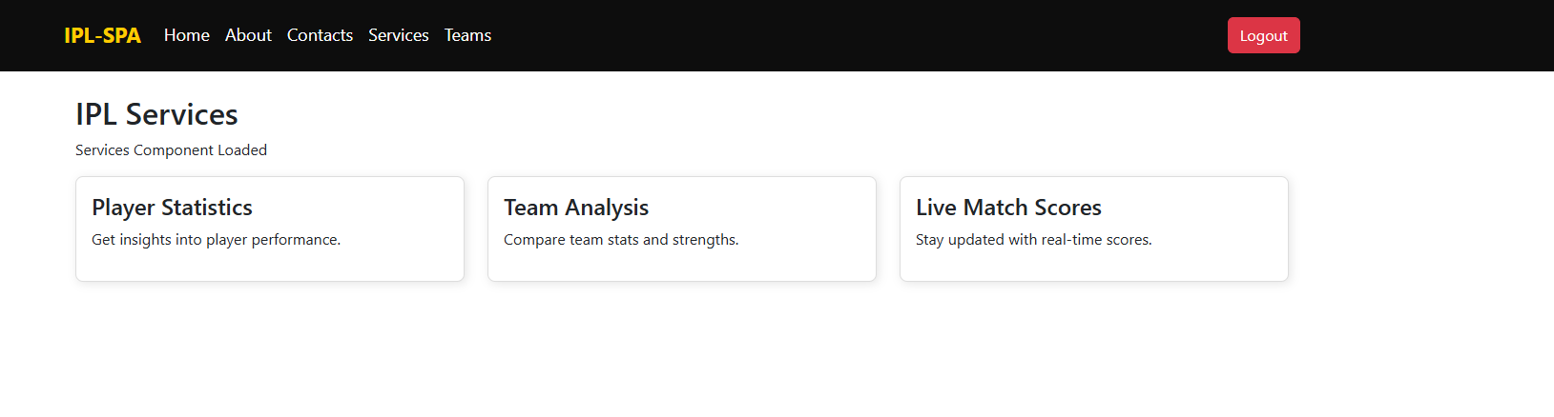
Services Page
Player Statistics: Displays player data
Live Score: Fetches real-time match scores
Team Analysis: Provides in-depth team performance insights

Slide 11
Live Score API Integration
Fetched live match data using CricAPI:
API: https://api.cricapi.com/v1/countries?apikey=1048b4cd-d976-4683-a699-c90864097c57&offset=0
Displays real-time scores and match updates.

Slide 12
Teams Page - Pipes Usage
**Custom Pipe:** highlightChampion (Adds 🏆 for title winners)
**Built-in Pipes:**
-Uppercase (Captain Name)
- Currency (Team Value)
- Date Formatting (Founded Date)

Slide 13
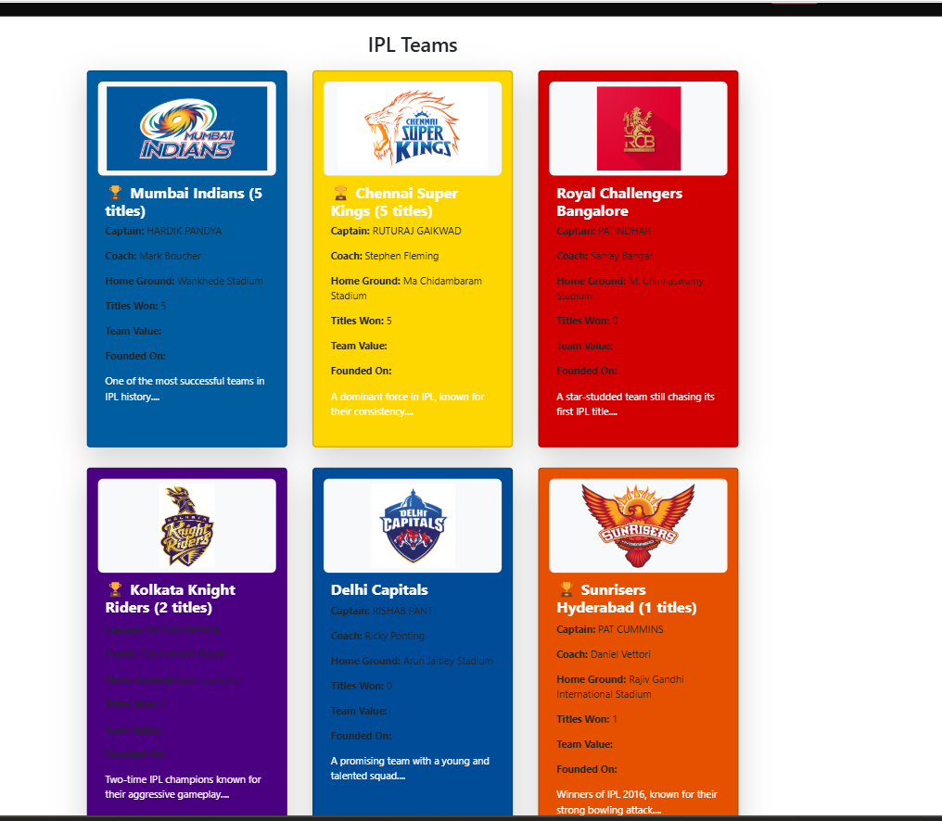

Slide 14
Conclusion & Future Enhancements
- Implemented a dynamic, interactive IPL SPA with authentication, API integration, and various Angular concepts.
Future Scope:
- Add user authentication roles (Admin/User)
- Implement real-time match updates
- Enhance UI with animations

