Slide 1



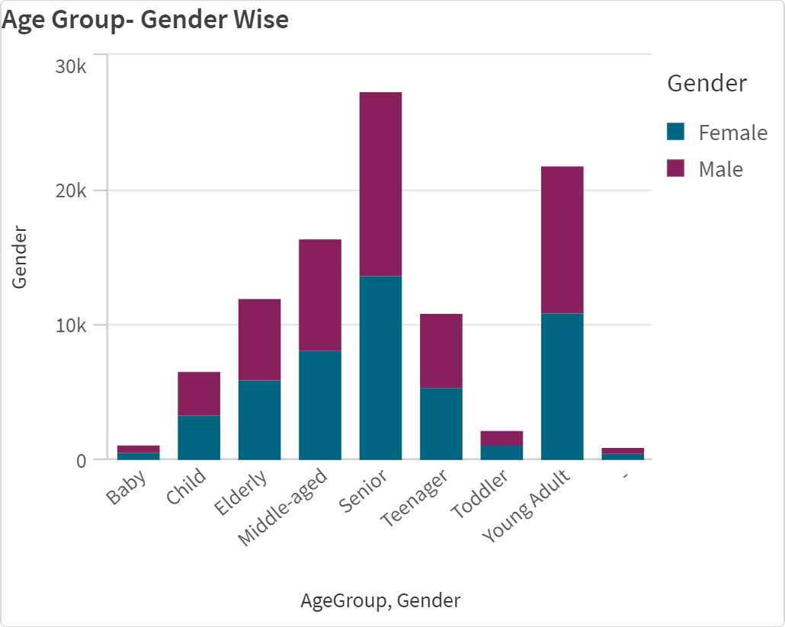


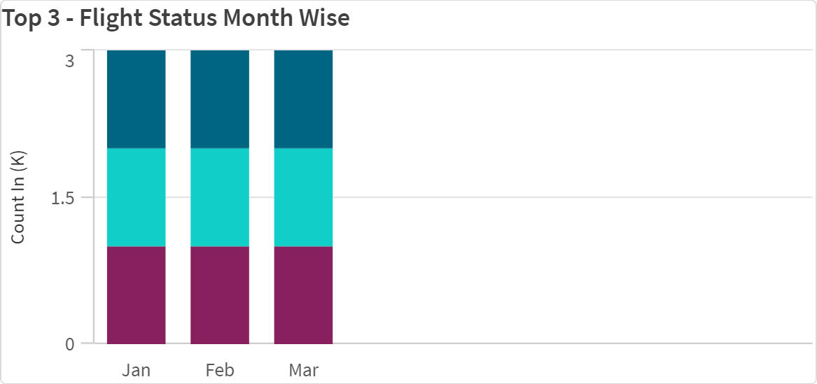

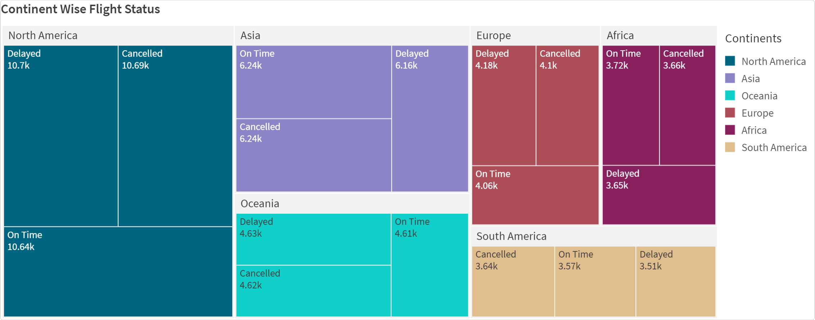


Exploring Insights From Synthetic AirLine Data Analysis With Qlik
This Chart Shows Gender in Age-Group Wise
This Chart Shows the Top 3 -Flight Status Month Wise
This Chart
Shows Continent Wise Flight Status

Slide 2



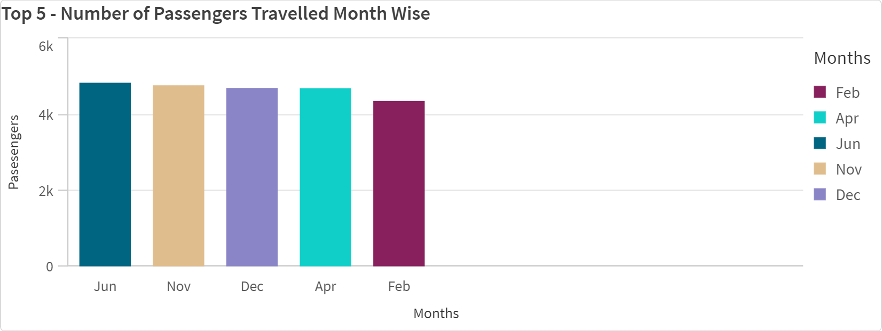




Exploring Insights From Synthetic AirLine Data Analysis With Qlik
This Chart Shows the
top-3 Number of Passengers Travelled Month Wise

