Slide 1
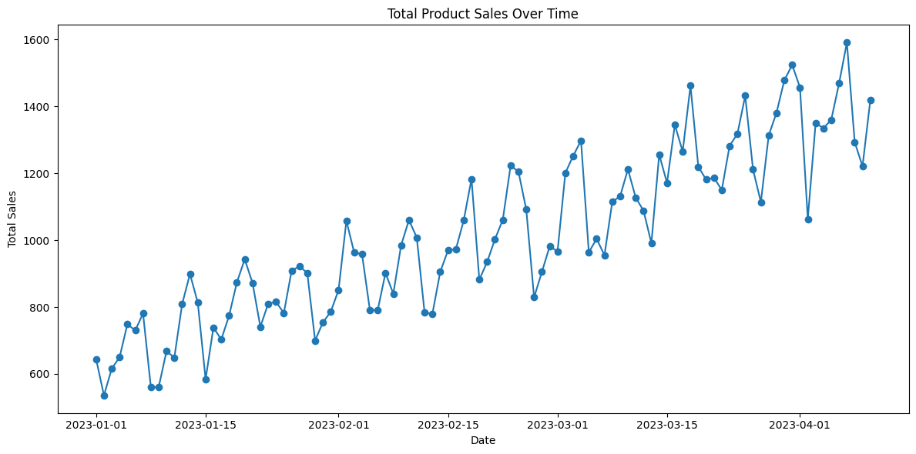
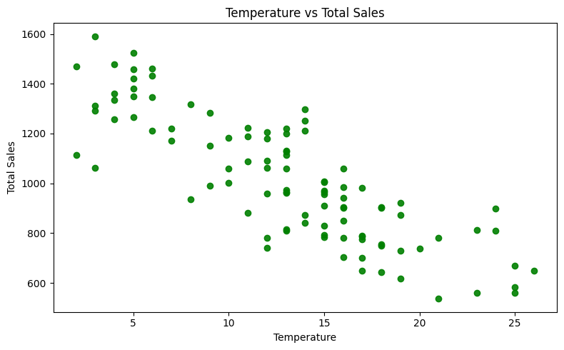
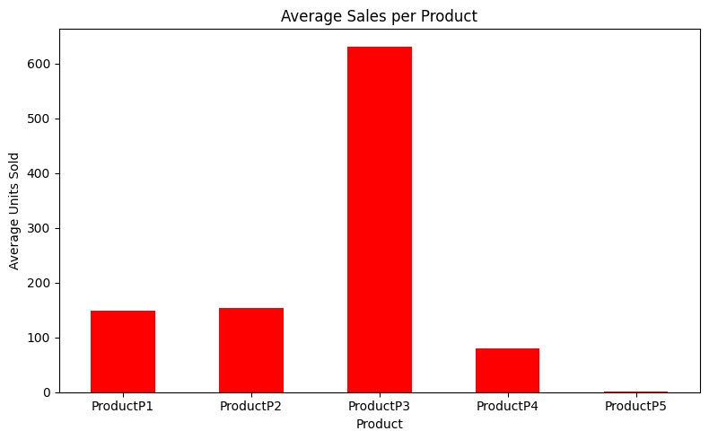
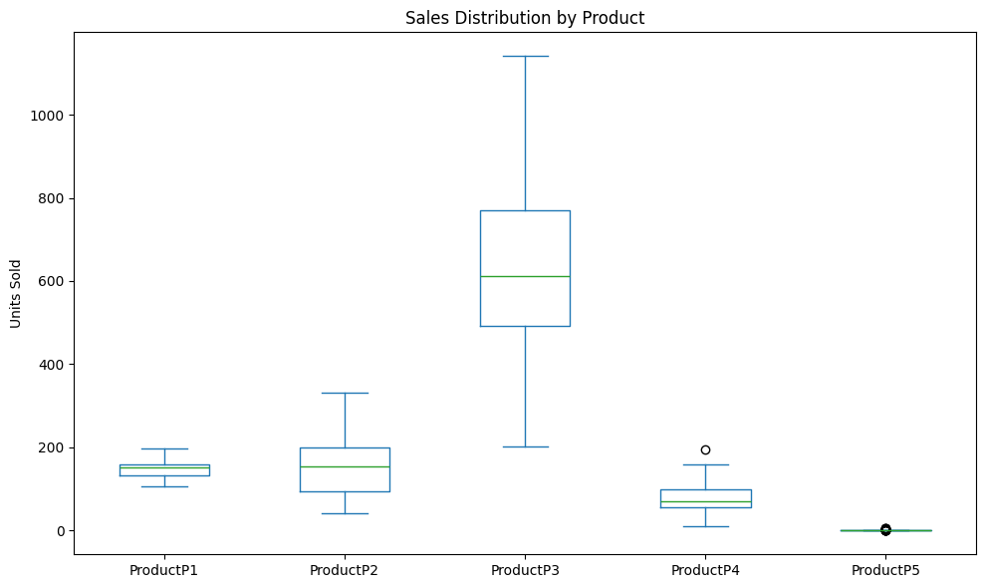
Can Product Sales Be Better Understood through Data Visualization?
Total Sales Over Time (Line Chart)
📈 Total Sales Over Time 🧾 Insight: P3 leads sales. Fluctuations are minor; overall stable trend. 🎯 Story: Indicates consistent demand, helpful for inventory planning.
Temperature vs. Total Sales (Scatter Plot)
📊 Price vs Total Sales 🧾 Insight: No strong link; slightly higher sales at price = 1. 🎯 Story: Sales are price-insensitive, possibly inelastic demand.
Average Sales per Product (Bar Chart)
🌡 Temperature vs Total Sales 🧾 Insight: Clustered around 17–20°C, no major impact. 🎯 Story: Weather doesn’t drive sales, but anomalies could be studied.
Sales Distribution by Product (Box Plot)
🔥 Product Correlation 🧾 Insight: P3 & P4 show slight correlation; others are independent. 🎯 Story: Products behave independently; bundles may help P3–P4.

