Slide 1
NEWYORKER
Senior Data Engineering Exercise

Slide 2
Requirements
Parse the JSON data of the yelp dataset
Load the data to the table
Interesting queries
Dockerize the application

Slide 3
Challenge-Repo
Source : https://www.yelp.com/dataset/challenge
Technologies Used: Spark, Scala, Hive, Docker with SMACK components
Docker set-up: https://github.com/dharanisugumar/yelp_docker_spark
Application: https://github.com/dharanisugumar/yelp-dataset-challenge

Slide 4
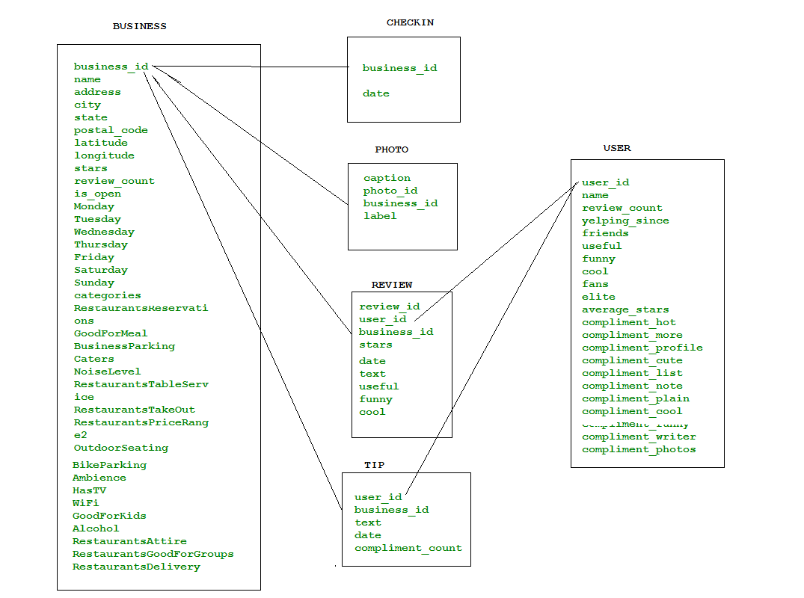
Data Model
Business.json
Checkin.json
Photo.json
Review.json
Tip.json
User.json

Slide 5
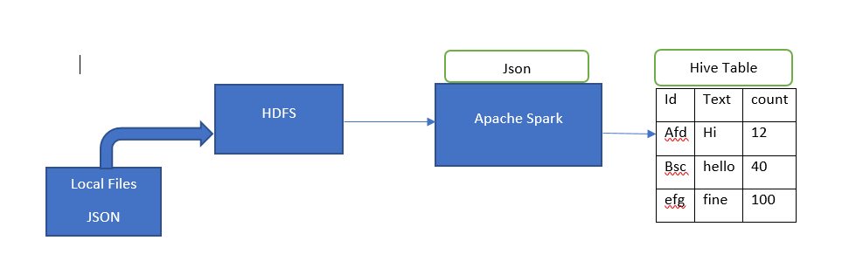
Architecture
KAFKA

Slide 6
Implementation-1
Source Directory=> ftp server
Get the list of files present inside the directory
Transfer the files from common server to HDFS for spark to read and process
Class FileRead
getConf, getFileSystem,getSftpChannel, sourceFileExists, copyFile
Sftp pw: PwdReader.Get("Challenge Application", HDFS_CURRENT_USER+SFTP_PASSWORD )
Once the files are copied to HDFS, check the number of files
number of files>0, iterate through the files and parse the json data
Parse json: spark.read.json(path) => dataframe

Slide 7
Parsing the json data
Json data:
{"user_id":"UPw5DWs_b-e2JRBSt37Ag","business_id":"VaKXUpmWTTWDKbpJ3aQdMw",
"text":"Great for watching games, ufc, and whatever else tickles yer fancy",
"date":"2014-03-27 03:51:24","compliment_count":0}
Parsed data:
user_id | business_id | text | date | compliment_count
UPw5DWs_b-e2JRBSt37Ag | VaKXUpmWTTWDKbpJ3aQdMw | Great for watching games, ufc, and whatever else tickles yer fancy | 2014-03-27 03:51:24 | 0

Slide 8
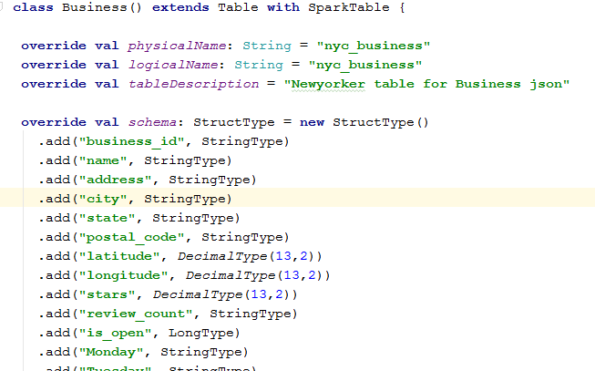
Implementation-2
Create a schema for every json
Example:

Slide 9
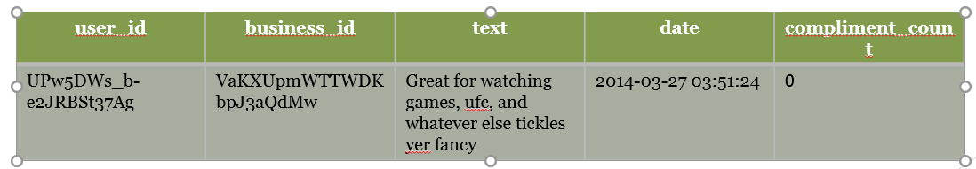
Implementation-3
Create a managed table
Write the data finally to the managed table
dataframe.write.mode(SaveMode.Overwrite)
.insertInto(tableName.physicalName)
Select * from default.nyc_user

Slide 10
Queries
Read the table data using spark.table(“nyc_business”)
Register it as temp table
Write Spark-Sql query

Slide 11
Queries List
Q1: Query to list all the review, photo, checkin, tip against business data
Q2: Query to know the user who wrote the review and the review comments and user ratings on the products
Q3: Query to get the photo and business information
Q4: Query to list down the distinct list of categories for the business
Q5: Query to get the review counts, stars, review comments on Saturdays and Sundays for the business city and state
Q6: Query to get the years the user was elite
Q7: Query to get the list of users who wrote the tips
Q8: Query to find out which user has sent maximum number of reviews
Q9: Query to find out the total review count, review stars, rank, dense_rank, percent_rank, row_number, average stars for the user and review data

Slide 12
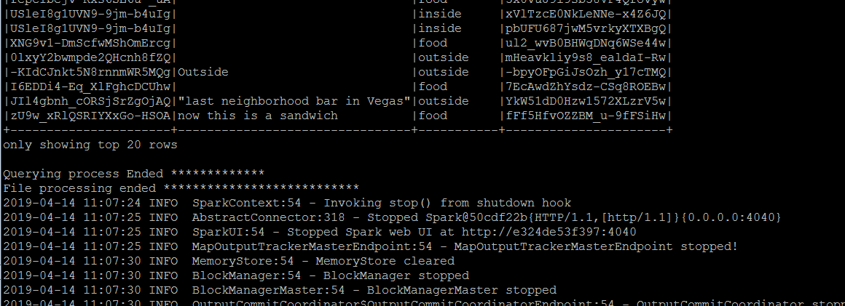

Slide 13
Challenges Faced
Not a valid json!
"attributes":{"RestaurantsReservations":"True","GoodForMeal":"{'dessert’: False, 'latenight': False, 'lunch': True, 'dinner': True, 'brunch': False, 'breakfast’: False}","BusinessParking":"{'garage': False, 'street': False, 'validated': False, 'lot’: True, 'valet': False}“
Spark.read.json(path)
Df.attributes.GoodForMeal.dessert => Error!!
RestaurantsReservations | GoodForMeal | BusinessParking
True | {'dessert’: False, 'latenight': False, 'lunch': True, 'dinner': True, 'brunch': False, 'breakfast': False}" | "{'garage': False, 'street': False, 'validated': False, 'lot': True, 'valet': False}“

Slide 14
Resolution
val res = Source.fromFile(srcPath).getLines. map{line=>line.replaceAll("'","").replaceAll("\"","").replace(“\{","{\"").replace(",","\",\"").replace(":","\":").replace("\":","\":\"").replace("}","\"}").replace("\"{\"","{\"").replace("\"}\"","\"}").replace("\":\"0",":0").replace(" ","")}.toSeq
val ds = spark.createDataset[String](res)(Encoders.STRING)
ds.coalesce(1).write.mode(SaveMode.Overwrite).json(s"${tgtPath}valid.json")
Spark.read.json(s"${tgtPath}valid.json“)
df.attributes.garage returns false
bp.garage | bp.street | bp.validated | bp.lot | bp.valet
False | False | False | True | False

Slide 15
Packaging
Package the spark application
Start spark master and worker using docker-compose up
Copy the application jar to the specified directory
Copy the input dataset yelp_dataset.tar to the specified directory
Run docker run -p 2222:22 --name yelp-challenge-app -e ENABLE_INIT_DAEMON=false --network docker-spark_default -v `pwd`:/opt --link spark-master:spark-master -t yelp/challenge-app /bin/bash /yelp_processor.sh yelp_dataset.tar

Slide 16
RAM : 512MB
HDD : 30GB
CPU : 1
Total timetaken : ~25mins

Slide 17
Thank you

