Slide 1
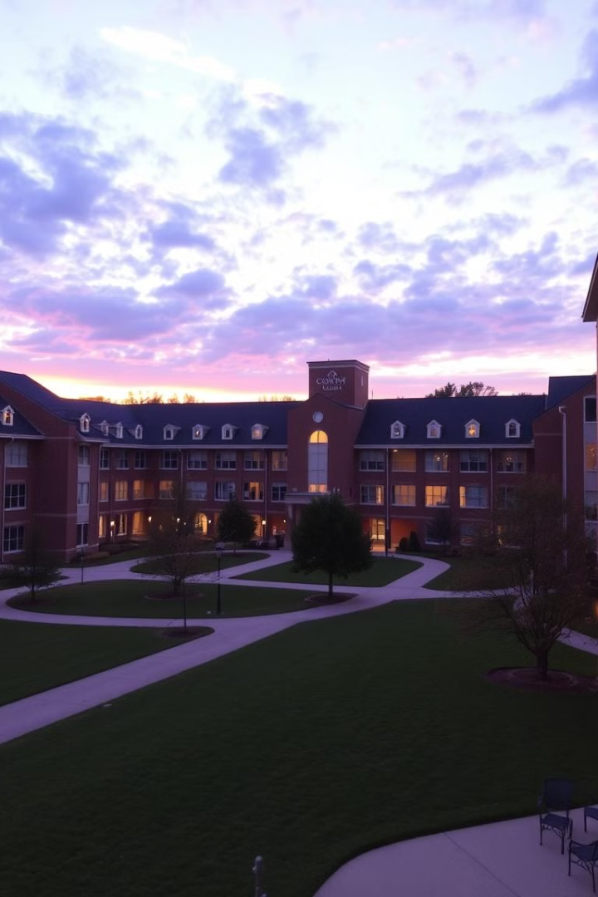
Streamlining College Operations with Tiram.AI
This presentation outlines a comprehensive college management system built with Tiram.AI, designed to enhance efficiency and user experience for administrators, faculty, and students. We aim to create a functional, user-friendly, and scalable solution adaptable to real-world college operations. Our system integrates essential features to streamline administrative tasks, enhance faculty engagement, and improve student experience, from enrollment to feedback.
PK
by Prakki Krishna Karthik

Slide 2
User-Centric Design: Access for All
At the heart of our system are three key user roles, each with a dedicated interface: unknown link, unknown link, and unknown link. This design ensures that users can access the system from any device, promoting flexibility and convenience.
Administrator
Faculty
Student
Full control over system settings and user accounts.
Tools to manage courses, assignments, and student interactions.
Access to course materials, grades, and campus resources.

Slide 3
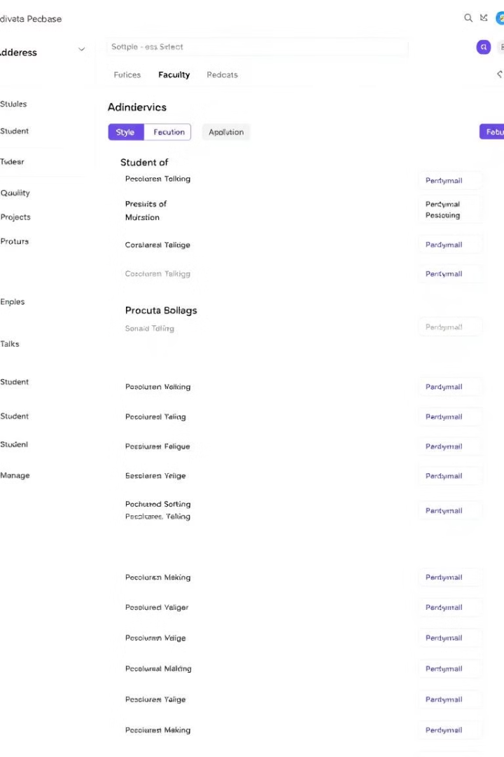
Centralized Student & Faculty Management
Our system provides a centralized hub for managing student and faculty records. Administrators can easily add, update, and view profiles, ensuring data accuracy and accessibility.
Streamlined Data Entry
Comprehensive Profiles
Intuitive forms for quick and accurate data input.
Detailed information on students and faculty, including contact details, academic history, and performance records.
Advanced Search Capabilities
Efficiently locate specific records using various search criteria.

Slide 4




Seamless Course & Enrollment System
Our system offers a robust mechanism for students to enroll in courses and for faculty to manage course assignments, enhancing the academic experience. Students can easily browse available courses and register, while faculty can efficiently manage their course rosters and assignments.
Course Catalog
Easy browsing of available courses
Enrollment
Simple course registration
Management
Efficient assignment management

Slide 5
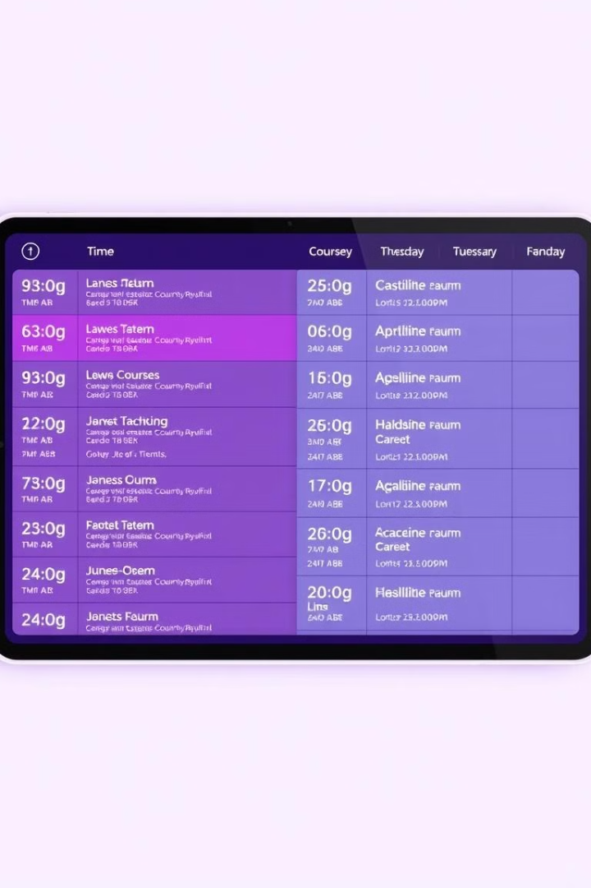



Automated Attendance & Timetable Scheduling
Tracking student attendance and automating timetable creation are essential for efficient college management. Our system offers automated attendance tracking and timetable generation.
Automated Attendance
Timetable
Alerts

Slide 6



Interactive Event & Notice Board System
Keep students and faculty informed with our dynamic event and notice board system. Administrators can easily post and manage campus events, deadlines, and important announcements, ensuring everyone stays connected.
1
Notifications
2
Deadlines
3
Events

Slide 7
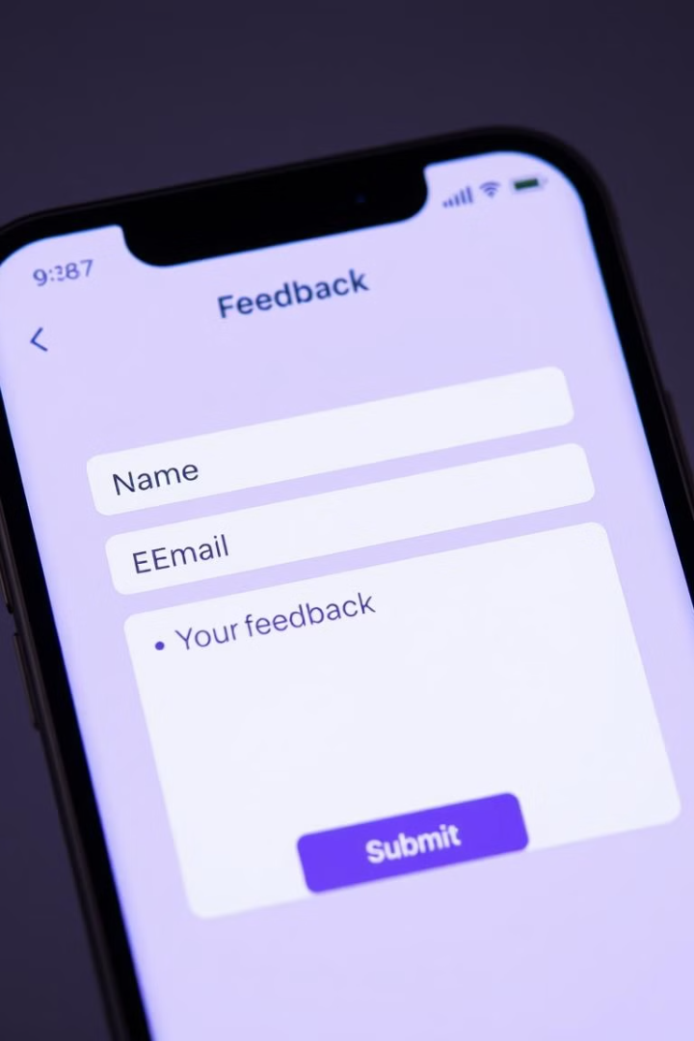



Feedback & Grievance Management
Foster open communication with our feedback and grievance management system. Students and faculty can submit feedback or raise concerns, ensuring transparency and continuous improvement.
Feedback
Grievances
Anonymous

Slide 8

Key Takeaways & Next Steps
Our Tiram.AI-powered college management system offers a comprehensive solution to streamline operations, enhance user experience, and promote efficiency. From student and faculty management to feedback collection, our system covers essential aspects of college administration. We are committed to continuous improvement and adaptation to meet the evolving needs of your institution.
3
5
User roles
Key features
100%
Commitment

