Slide 1


Building a Website using Tiram AI: A Step-by-Step Guide
Welcome to this step-by-step presentation on how to build a website similar to Tiram AI. This guide will walk you through the essential steps, technologies, and considerations for creating a functional and engaging web application. We will cover everything from initial setup to deployment, providing you with a solid foundation to bring your vision to life.
PK
by Prakki Krishna Karthik

Slide 2

Project Setup and Development Environment
First, set up your development environment. Install Node.js and npm (or yarn). Create a new React project using Create React App: npx create-react-app tiram-ai. This command scaffolds a basic React application with all the necessary configurations. Next, navigate into your project directory: cd tiram-ai. Start the development server with npm start.
Install Node.js
Create React App
Start Development Server
Download and install Node.js to manage dependencies.
Use Create React App for easy project setup.
Run npm start to see your app in the browser.

Slide 3
Implementing Basic Layout and Components
Design the basic layout using JSX and CSS. Create core components like Navigation, Header, and Footer. Use functional components and hooks for managing state. Ensure your layout is responsive by using media queries or a CSS framework like Bootstrap or Material-UI. This will make your website adaptable to different screen sizes. Structure your components for reusability and maintainability.
Navigation Component
Header Component
Footer Component
Create a navigation bar for easy site navigation.
Design a header with a logo and main title.
Implement a footer with copyright information and links.

Slide 4
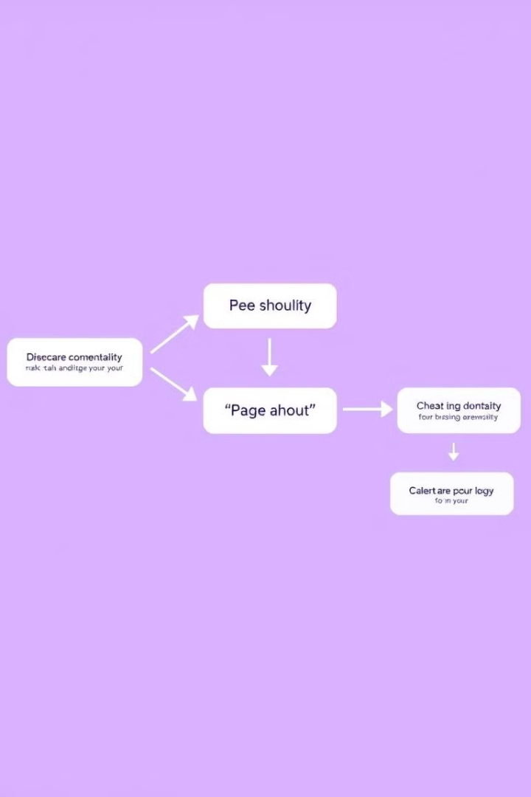



Setting Up Routing with React Router
Install React Router: npm install react-router-dom. Import BrowserRouter, Route, and Switch components. Define routes for different pages like Home, About, and Contact. Use the Link component for navigation. Configure your routes within the BrowserRouter component. This setup enables seamless navigation between different sections of your website, creating a single-page application experience.
Install React Router
Add React Router to your project.
Define Routes
Set up routes for different pages.
Use Link Component
Navigate between pages using Link.

Slide 5



Implementing API Calls and Data Fetching
Utilize useEffect hook to fetch data on component mount. Use fetch or a library like Axios to make API requests. Handle loading and error states appropriately. Store fetched data in component state using useState. Map over the data to render dynamic content. Ensure error handling to provide a smooth user experience. This step is crucial for integrating external data sources into your website.
Rendering Data
1
Display the fetched data.
Store in State
2
Manage data using useState.
Fetch Data
3
Make API calls with useEffect.

Slide 6

Styling the Website
Use CSS or a CSS-in-JS library like Styled Components to style your website. Define a consistent color palette and typography. Implement a responsive design using media queries. Pay attention to spacing, alignment, and visual hierarchy. Use CSS modules to scope styles to individual components. Focus on creating a visually appealing and user-friendly design. Consistency in styling will enhance the overall user experience.
Consistent Design
CSS or CSS-in-JS
Maintain a consistent look and feel.
Choose your preferred styling method.
1
2
3
Responsive Design
Use media queries for different devices.

Slide 7




Testing Your Application
Write unit tests for individual components using Jest and React Testing Library. Implement end-to-end tests using Cypress or Selenium. Test different scenarios, including happy paths and edge cases. Ensure your tests cover all critical functionality. Use linters and formatters to maintain code quality. Automated testing helps catch bugs early and ensures code reliability.
Unit Tests
E2E Tests
Linters

Slide 8

Deployment and Hosting
Choose a hosting platform like Netlify, Vercel, or AWS. Build your React application for production: npm run build. Deploy the generated build files to your hosting provider. Configure domain settings and SSL certificates. Monitor your application for performance and errors. Implement continuous integration and continuous deployment (CI/CD) pipelines for automated deployments. This ensures your website is accessible and reliable for users.
1
Choose Hosting
2
Build for Production
Select a suitable hosting platform.
Create optimized build files.
3
Deploy Files
Upload build files to the hosting provider.

