Slide 1
HR ANALYTICS PROJECT
HR HEADCOUNT
ANALYSIS DASHBOARD
Turning workforce data into actionable HR insights
GENDER
COUNTRY
JOB TITLE
Power BI Dashboard • Headcount • Demographics • Business Units • Job Titles

Slide 2
01 | PROJECT
02
The business problem
Why workforce headcount needs analytics
FROM NUMBERS → DECISIONS
TRACK
HR creates large volumes of employee data that must be turned into clear insight.
How many employees do we have, and how is the count changing?
Is the workforce balanced by gender and age?
Which countries and business units carry the headcount?
Which job titles and departments dominate the structure?
ANALYZE
GROW

Slide 3
02 | OVERVIEW
03
Headcount overview
Workforce snapshot from the HR dashboard
500
267
233
3
1993–2022
Total Headcount
Female (53.4%)
Male (46.6%)
Countries
Hire date range
ANALYTICS WORKFLOW
01
02
03
04
DATA
ANALYZE
VISUALIZE
INSIGHT
Prepare & clean
Compare headcount
Power BI dashboard
HR actions

Slide 4
03 | OBJECTIVES
04
What this dashboard answers
01
GENDER
02
AGE
03
COUNTRY
Measure the female / male split of the workforce
Understand the age-group distribution
Compare headcount across Brazil, China and United States
04
BUSINESS UNIT
05
JOB TITLE
06
TREND
See how headcount is spread across units
Identify the most common roles
Track headcount volume over time

Slide 5
04 | DATA
05
Dashboard filters & dimensions
Interactive slicers let HR drill into any segment
DATE
DEPARTMENT
COUNTRY
EMPLOYEE
Hire date range
11-05-1993 to 19-12-2022
Accounting
Engineering
Finance
Human Resources
IT
Brazil
China
United States
Full Name selector
Export Data option
CORE METRICS
Headcount
Gender
Age group
Business unit
Job title

Slide 6
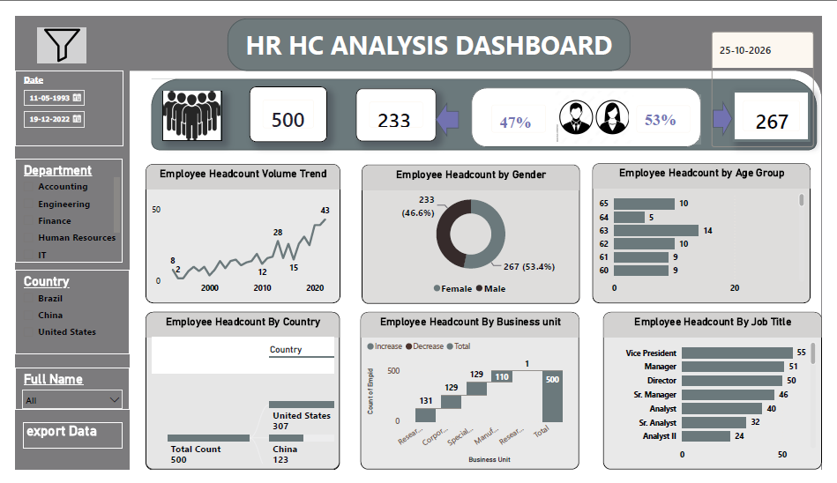
05 | DASHBOARD
06
HR HC Analysis Dashboard
Executive view of headcount, demographics and structure

Slide 7
06 | DEMOGRAPHICS
07
Gender split
Female employees slightly outnumber male employees
FEMALE EMPLOYEES
267
53.4% of 500 employees. Male: 233 (46.6%), a gap of only 34.

Slide 8
07 | REGIONAL
08
Headcount by country
United States holds the majority of the workforce
307
United States
123
China
70
Brazil
Brazil = 500 total minus United States and China (not labelled on the dashboard).

Slide 9
08 | ROLES
09
Headcount by job title
Senior leadership titles lead the distribution
TOP TITLE
55
Vice Presidents are the largest group, followed by Managers (51) and Directors (50).

Slide 10
09 | DEMOGRAPHICS
10
Headcount by age group
Visible age groups 60–65 on the dashboard
LARGEST GROUP
14
employees are aged 63, the highest among ages 60–65. Age 64 is the smallest at 5.

Slide 11
10 | STRUCTURE
11
Headcount by business unit
Five units contribute to the total of 500
LARGEST UNIT
131
Four units hold 129–131 employees each, except Manufacturing at 110, while one unit has just 1.

Slide 12
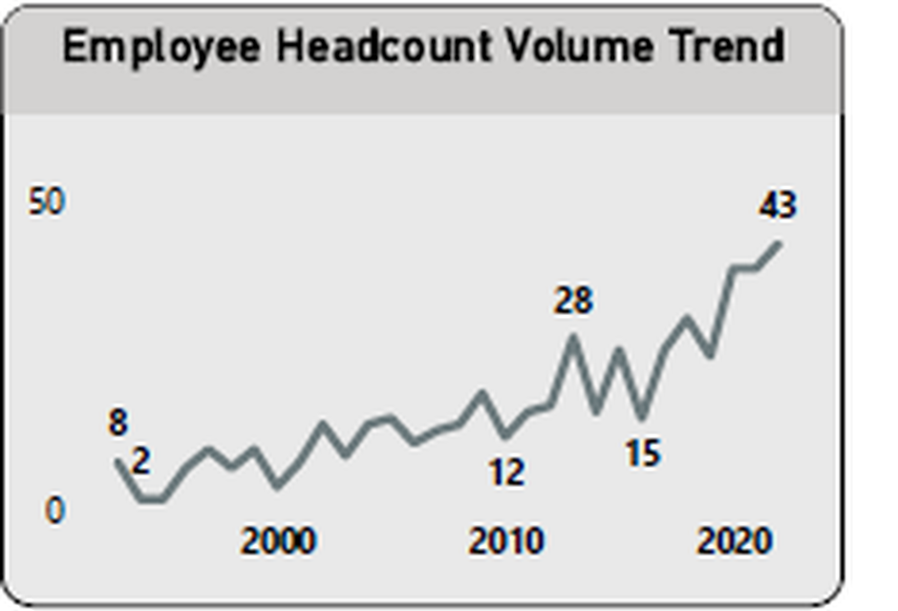
11 | TREND
12
Employee headcount volume trend
Hiring volume has risen steadily since 1993
8
Early hiring level
28
Mid-period peak
43
Highest recent volume

Slide 13
12 | FINDINGS
13
Four findings to remember
01
FEMALE-LED WORKFORCE
02
US DOMINATES
267 female employees (53.4%) vs 233 male (46.6%).
307 of 500 employees are in the United States; China has 123.
03
TOP-HEAVY TITLES
04
GROWING HIRING
Vice President (55), Manager (51) and Director (50) lead job titles.
Yearly headcount volume rose from 8 to a recent high of 43.

Slide 14
THANK YOU
HR Headcount Analysis Dashboard • Questions & discussion

