Slide 1
DATA ANALYTICS PROJECT
SOCIAL MEDIA
ENGAGEMENT ANALYSIS
Turning social media data into actionable insights
INSTAGRAM
YOUTUBE
FACEBOOK
TWITTER
Power BI Dashboard • Engagement • Reach • Content • Platforms

Slide 2
The business problem
01 | PROJECT
Why social media performance needs analytics
FROM NUMBERS → DECISIONS
TRACK
Social platforms create huge volumes of audience interaction data.
↓
ANALYZE
Which platform creates the strongest engagement?
Which media types attract more interactions?
Which content categories perform best?
How does engagement trend over time?
↓
GROW

Slide 3
Project overview
02 | OVERVIEW
A complete workflow from social media data to interactive insight
10K
1bn
151M
7.4M
2bn
Total Posts
Total Reach
Total Likes
Total Shares
Total Impressions
ANALYTICS WORKFLOW
01
02
03
04
DATA
ANALYZE
VISUALIZE
INSIGHT
Prepare & clean
Compare metrics
Power BI dashboard
Business actions

Slide 4
What this project aims to answer
03 | OBJECTIVES
01
PLATFORM
02
CONTENT
03
TREND
Compare Facebook, Twitter, YouTube and Instagram
Identify high-performing media types and categories
Study engagement over time and by day of week
04
POSTS
05
DECISION
06
DASHBOARD
Find the top performing posts and what they share
Turn findings into practical recommendations
Create an interactive Power BI experience

Slide 5
Dataset & analytical dimensions
04 | DATA
The dashboard combines interaction, exposure and audience measures
PLATFORM
CONTENT
INTERACTION
TIME
AUDIENCE
Facebook
Twitter
YouTube
Instagram
Video • Image • Short
Livestream • Story
Reel • Thread • Tweet
Likes • Shares
Engagement
Day of week
Posting date
(Jan 2024 – Aug 2025)
Reach • Impressions
Followers
CORE DASHBOARD FILTERS
Platform
Traffic Source
Account Type
Day of Week
Media Type
Performance

Slide 6
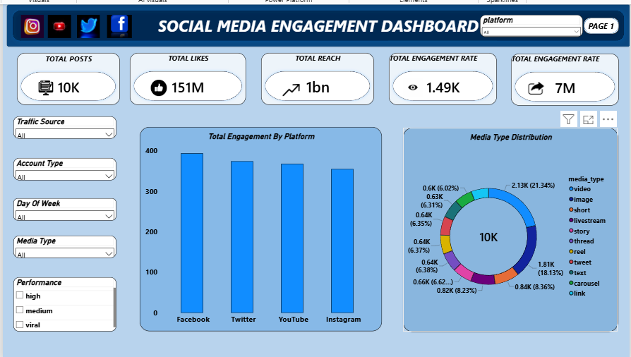
Social Media Engagement Overview
05 | DASHBOARD 01
Executive view of posts, likes, reach, shares and platform mix

Slide 7
Platform performance
06 | INSIGHTS
Facebook leads total engagement; the four platforms sit within a narrow band
KEY TAKEAWAY
Facebook
#1 on engagement
About 10% ahead of Instagram, the lowest of the four.

Slide 8
Media type distribution
07 | INSIGHTS
Video and Image make up almost 40% of all 10K posts
KEY TAKEAWAY
21.3%
Video share
Video is the most used format at 2.13K posts, followed by Image at 1.81K.
Story, Thread, Reel, Tweet, Text and Carousel each hold roughly 6–7% of posts.

Slide 9
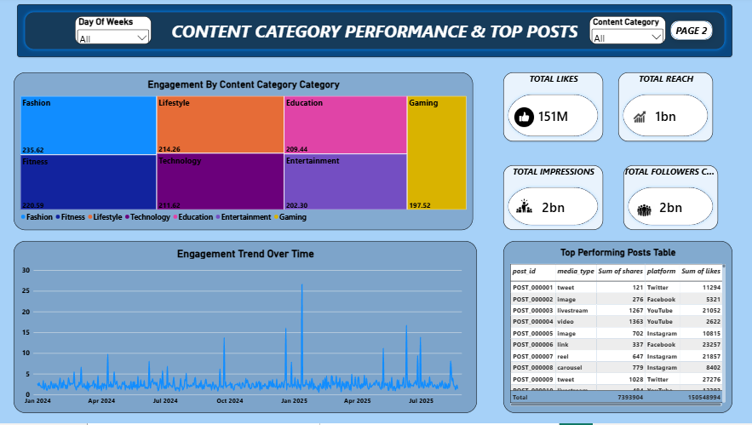
Content Category Performance & Top Posts
08 | DASHBOARD 02
Category engagement, trend over time and the top performing posts

Slide 10
Content category performance
09 | INSIGHTS
Fashion leads; Gaming trails by roughly 19%
KEY TAKEAWAY
235.6
Fashion engagement
Top of seven categories. Gaming is lowest at 197.5, so the spread is modest.

Slide 11
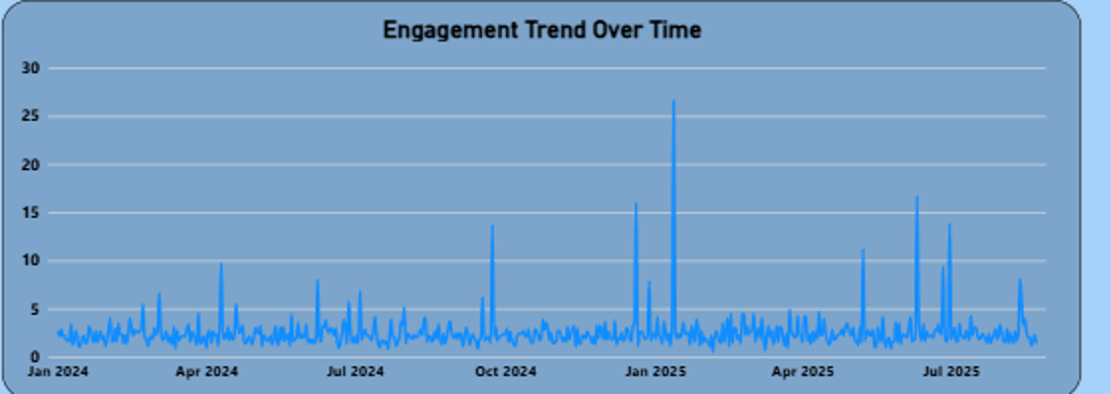
Engagement trend over time
10 | INSIGHTS
Jan 2024 – Aug 2025: a steady baseline with occasional viral spikes
KEY TAKEAWAY
~27
Peak, around Jan 2025
Baseline stays near 2–3 with spikes above 10. Study what drove the peaks.
Engagement trend, Jan 2024 – Aug 2025 (from dashboard)

Slide 12
Top performing posts
11 | TOP POSTS
Sample rows from the dashboard table; shares and likes vary widely by post
Post ID | Media type | Platform | Shares | Likes
POST_000009 | tweet | Twitter | 1,028 | 27,276
POST_000006 | link | Facebook | 337 | 23,257
POST_000007 | reel | Instagram | 647 | 21,857
POST_000003 | livestream | YouTube | 1,267 | 21,052
POST_000001 | tweet | Twitter | 121 | 11,294
POST_000005 | image | Instagram | 702 | 10,815
POST_000008 | carousel | Instagram | 779 | 8,402
150.5M
Total likes in table
7.39M
Total shares in table

Slide 13
Four findings to remember
12 | FINDINGS
01
FACEBOOK LEADS
02
VIDEO + IMAGE DOMINATE
Highest platform engagement, but all four platforms are close.
Together about 39% of all posts (2.13K video, 1.81K image).
03
FASHION WINS
04
SPIKES DRIVE PEAKS
Top category at 235.6; Gaming lowest at 197.5.
Engagement peaks near 27 against a 2–3 baseline.

Slide 14
Recommendations
13 | ACTION
How the analysis can support better social media decisions
01
Prioritize winners
Lean on video and image formats and the top categories in planning.
02
Think platform-first
Adapt content to each platform rather than copying one approach.
03
Study the spikes
Review the peak posts and repeat what made them work.
04
Time your posts
Use day-of-week filters to test stronger publishing windows.
05
Measure outcomes
Track reach, engagement and shares together.

Slide 15
Limitations & future scope
14 | NEXT STEPS
CURRENT LIMITS
FUTURE SCOPE
Insights depend on the available dataset.
Engagement does not capture sentiment or content quality.
Date range covers Jan 2024 – Aug 2025 only.
Add follower growth and audience demographics.
Perform sentiment analysis on comments.
Build predictive models for engagement.
Extend to campaign-level comparisons.

Slide 16
CONCLUSION
From social media data
to smarter decisions.
The dashboard brings platform, content, trend and top-post metrics into one interactive view.
TRACK
ANALYZE
GROW
THANK YOU

