Slide 1
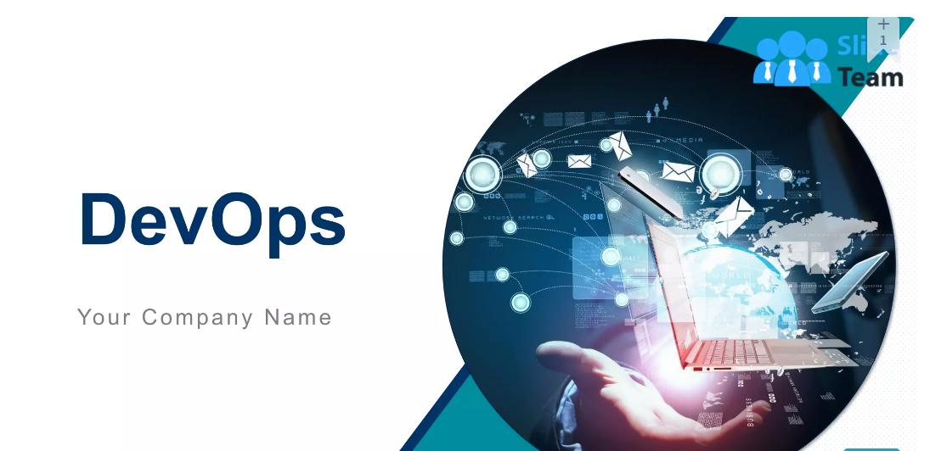

DevOps Development and Operations
My Topics

Slide 2
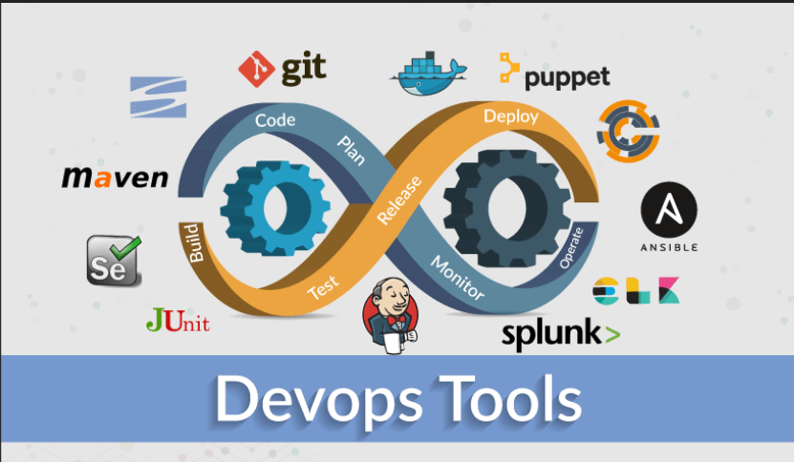

Slide 3
Server Admin Tools
Linux
A lot of people now think of the technical term “DevOps” as just a catch-all for those tasks which create infrastructure, build software, and get it running in production.
Mainly used Tool
Need to learn commands
Unix
Secondary Tool same as per Linux commands

Slide 4
Source code management(SCM)
There are 3 tools for store a data code of a project
Git /Bit Bucket/Git Lab
Need to learn about Git
Mainly all are preferred Git Tool
Tracking the changes and updates. We are able to see who made which changes. Git also provides when and why a change was made.

Slide 5
Built Tool
There are 2 Tools to built an application
Maven/Gradle
Artifactory Tool
Need to learn on Maven Tool
The java build tool provided by Apache to help in the build, documentation and dependency process of projects with any level of complexity written in Java and C# that uses Project Object Model (POM)
Mostly all are used maven tool for a built Application

Slide 6
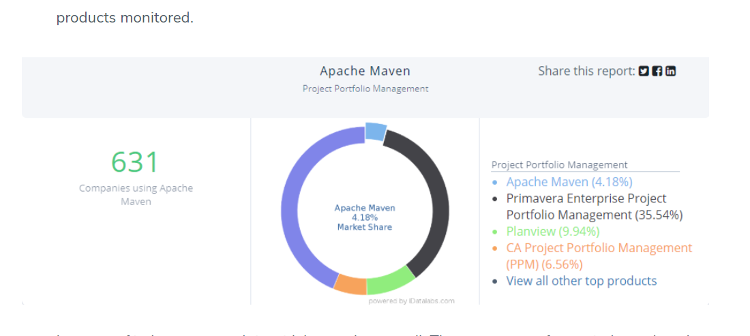
Scope of Maven Tool
Mostly all are used maven tool for a built Application

Slide 7
Continuous integration Tool (CI)
Jenkins is mostly used tool to deploy the build (Need to learn)
1. Lowers the Effort of Converting CLI to GUI Everybody loves one-button click philosophy, both users and engineers. ...
2. The Pipeline Integrates Individual Jobs for a Bigger Purpose Imagine that individual Jenkins jobs are small tools. ...
3. Keeps People in Sync, Especially in Slack ...
4. Auditing the Previous Run Is Possible and Effortless ...
5. Project Management Now Has More Accurate Data Support

Slide 8
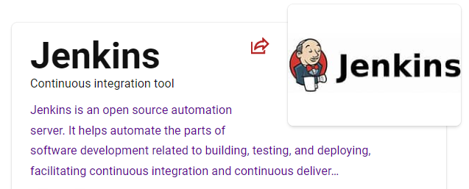

Slide 9
Web servers
Apache
Ngnix
Tomcat
Need to learn Apache Server

Slide 10
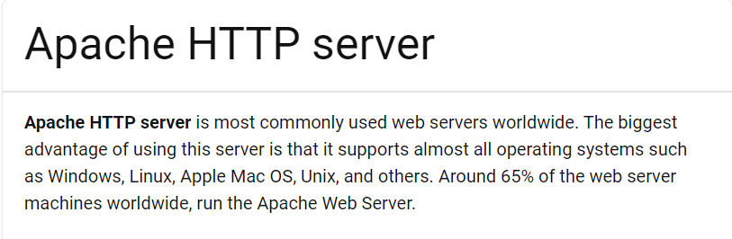
Apache server

Slide 11
Data Base
Structure Query language (SQL)
No Structure Query language (No SQL)
My SQL
Postgres SQL
MS SQL
Need to learn on Postgres sql
Mongo DB
Cossindra
Dynamo DB
Need to learn on Mongo DB

Slide 12
Cloud Tools
AWS(Amazon Web Service)
AZURE
GCP(Google Cloud Platform)
Need to learn on GCP
Wondering how GCP devops can benefit your business?
What is gcp devops?
Google offers a collection of cloud computing services called Google Cloud Platform. It covers services for application development, computes, and storage. Google cloud developed products like machine learning, analytics, and big data.

Slide 13
Configuration Tools
Ansible (Ansible, the most popular and well-known technology, allows developers to avoid repetitive tasks and strategize things.)
Puppet
Chef
Need to Learn on Ansible tool

Slide 14
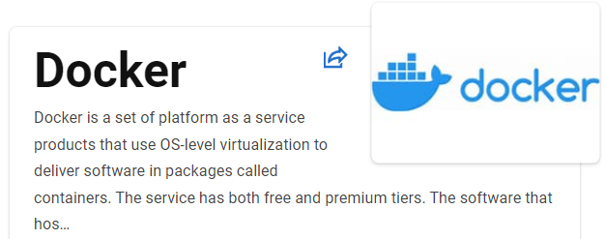
Container Tool
Docker
This tool is used to make infrastructure by using this tool
Need to learn on Docker Tool

Slide 15
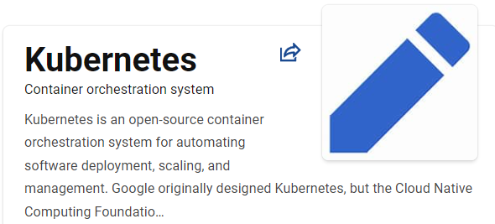
Container Archestars
Kuberenetes
Open shift
Need to learn on kubernetes

Slide 16
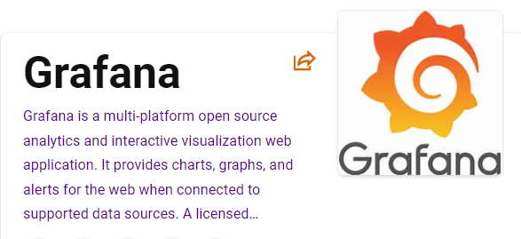
Monitoring Tool
Gafana
Data Dog
Nagios
Need to learn on Gafana

Slide 17
THANK YOU

