Slide 1
GIS DATA Types
Vector data :
Points
Lines
Polygons
Rastor data (real world phenomena)
Thematic or discrete
temperature, elevation, or spectral data such as satellite images and aerial photographs.
Scanned maps or drawings and building photographs

Slide 2
Vector data

Slide 3
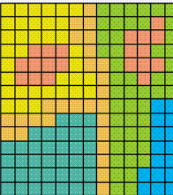
Raster data

Slide 4
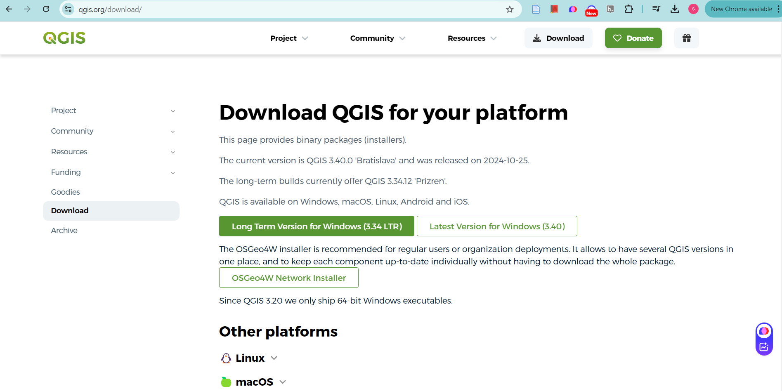
https://qgis.org/download/

Slide 5
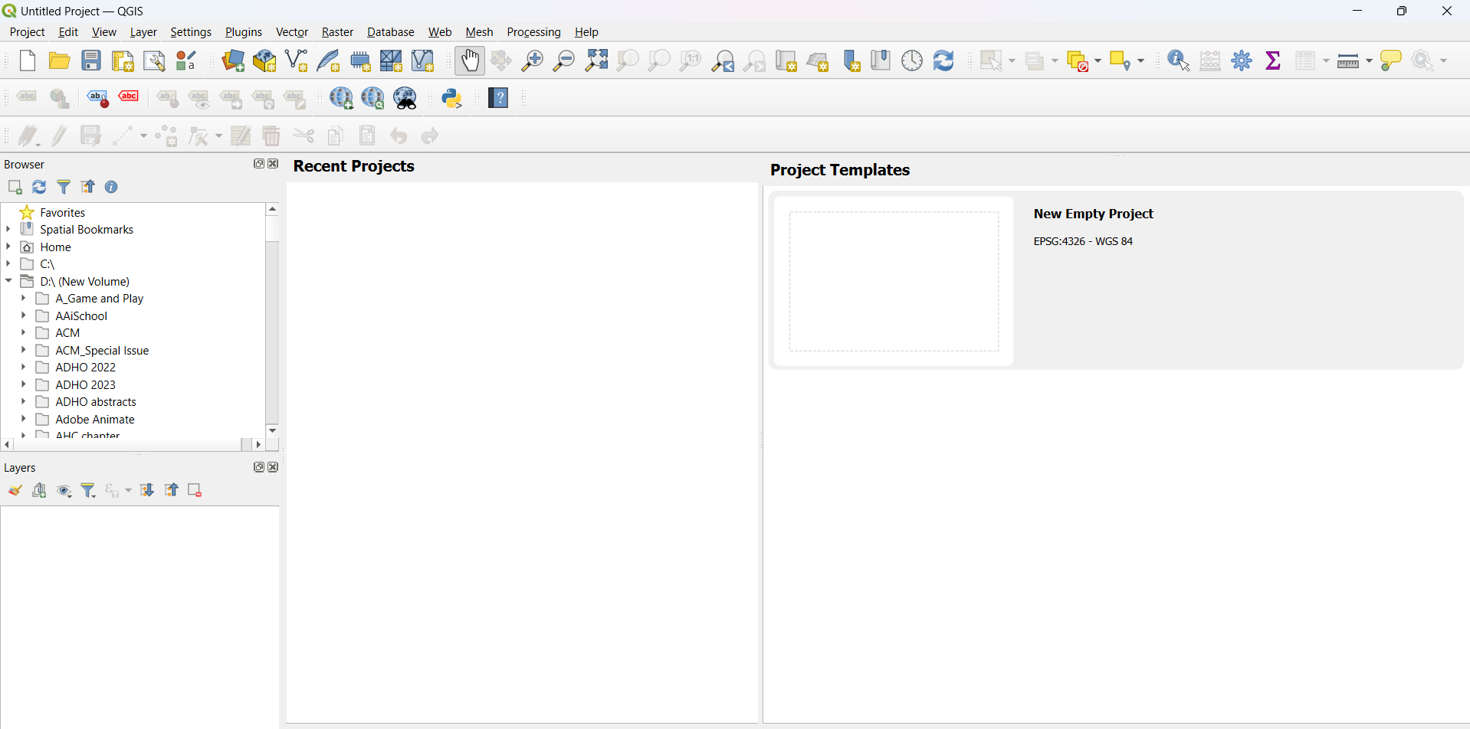

Slide 6
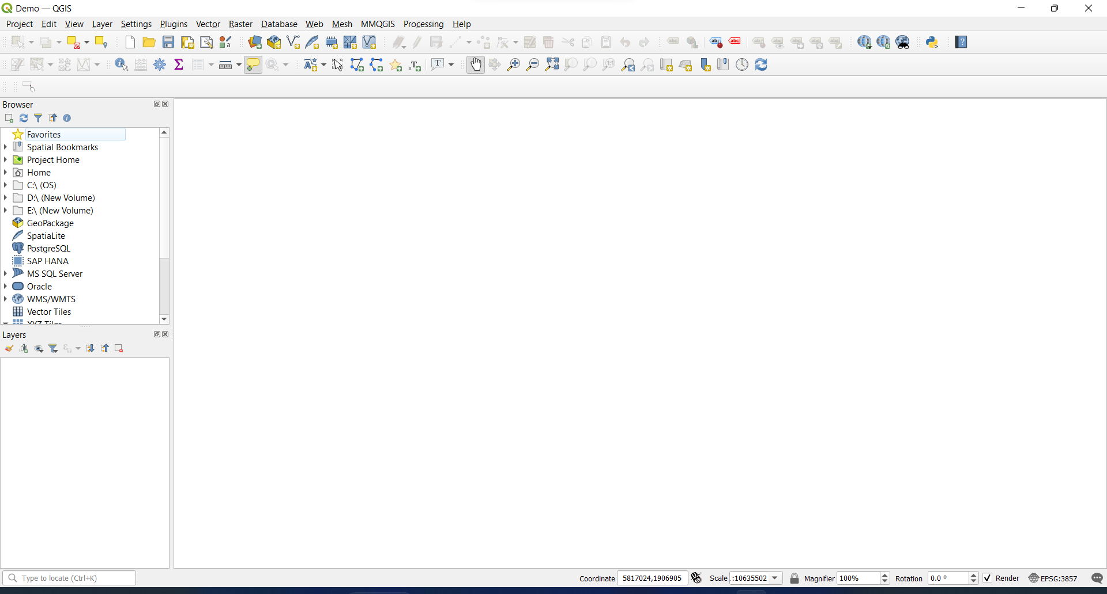
Tool bar
Browser panel
Canvas
Layer panel

Slide 7
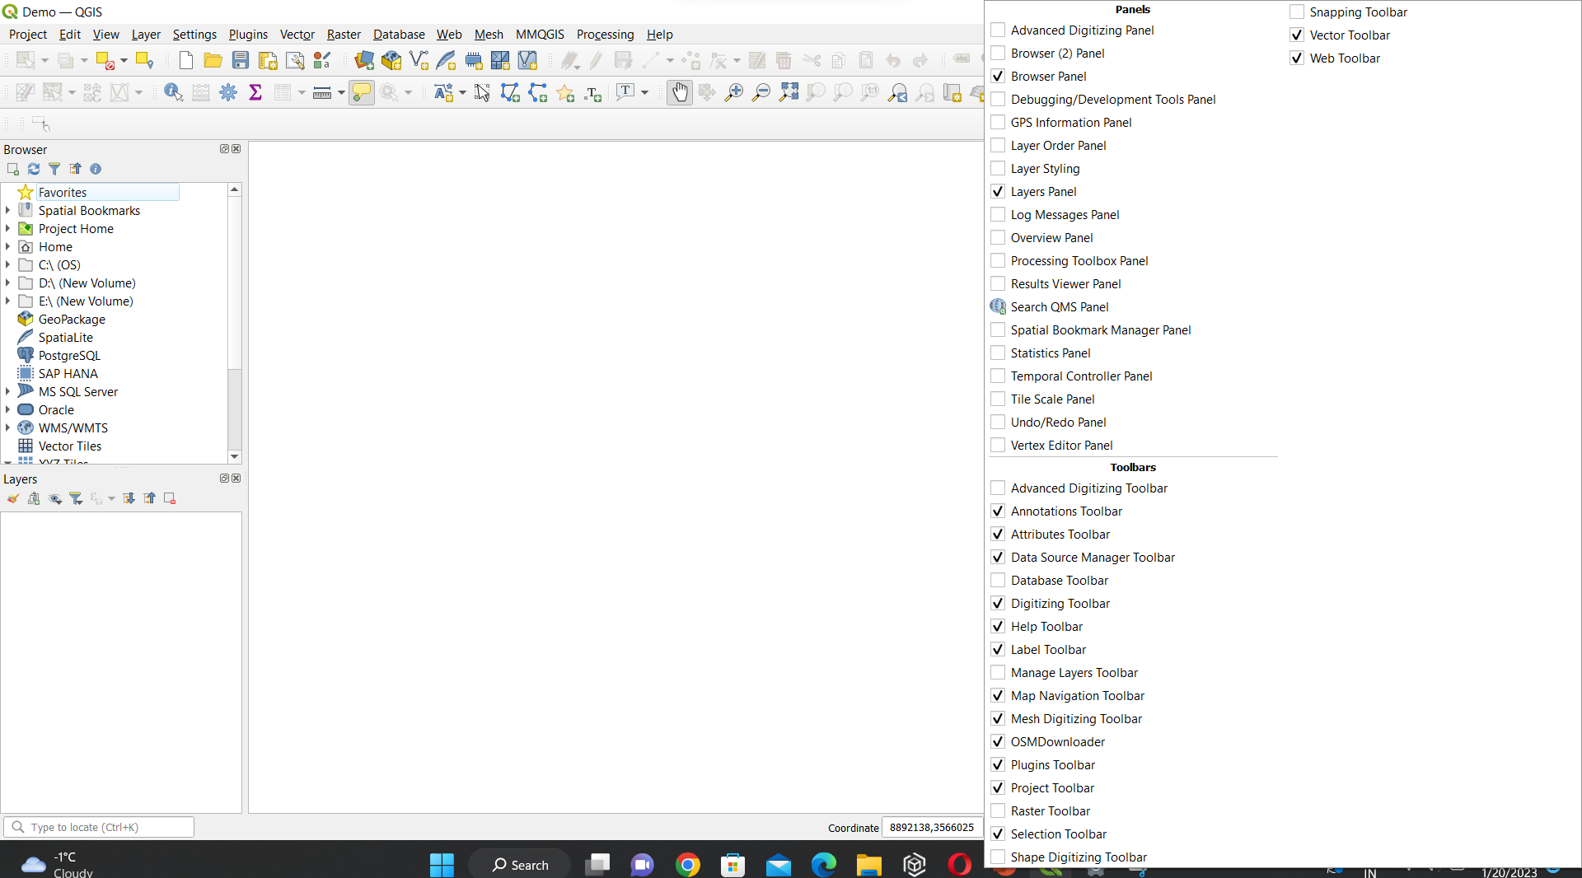
Right click above canvas to access the entire panels

Slide 8

Map Navigation tool bar

Slide 9

Attribute display and other processing tools

Slide 10

Attribute tool bar

Slide 11
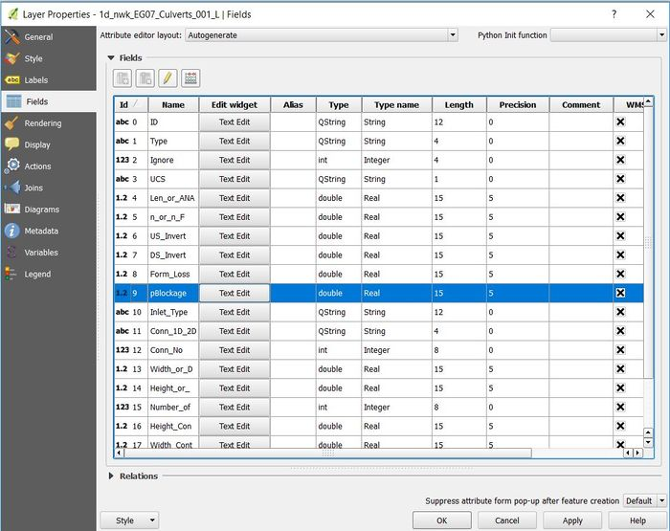
Attribute table
To add vector and other additional details about vector data

Slide 12
Explore the panels
Base map plugin
Main group and subgroup layers (ex. Coimbatore and Jaffna: Waterbodies and Place names
Base map to the main group
Create Layers: polygon and point
Digitizing vectors
Exporting the map

