Slide 1
DataSpark: Illuminating Insights for Global Electronics
Insights and Recommendations for Global Electronics to enhance marketing strategies, customer satisfaction and drive business growth.
By
Dharanya E.

Slide 2
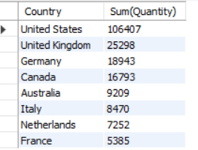
Question No. 1: What is the total number of products sold as per country? Data Retrieved:
Insights:
As per the table above, United States is the Country which has sold maximum products.
France is the Country with minimum quantity of products sold.

Slide 3

Question No. 2: Which gender is most preferring our products? Data Retrieved:
Insights:
As per the above table, we have more Male customers compared to Female.
But, as the difference in count of Male and Female customer is meagre, gender has negligible effect on sales.

Slide 4
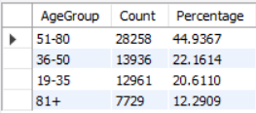
Question No. 3: Which age group of customers contribute more to our sales? Data Retrieved:
Insights:
As per the above data, the customers of age group between 51 and 80 have contributed more to sales.
We must target to reach out to the people with age between 19 to 35, as this seems to be low and these are people who might need most electronics products.

Slide 5
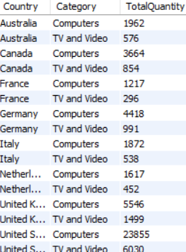
Question No. 4: What is the top selling and least selling product in each country? Data Retrieved:
Insights:
As per above data, Computers are the most sold products in all countries and TV and Video are least sold products.

Slide 6
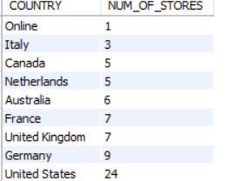
Question No. 5: What is the total number of stores in each county? Data Retrieved:
Insights:
It seems that United States has the maximum number of stores, and Italy the least.
It seems the number of stores is having effects on sales.

Slide 7
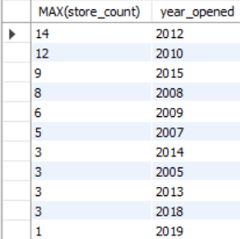
Question No. 6: Are we opening more stores as the year passes? Data Retrieved:
Insights:
As per the data above, the maximum number of stores were opened in 2012.
From the year 2005 to 2013, there was steady increase in the number of stores opened, and from 2013 it started declining, and we have opened 9 stores in 2015, which again an increase in number of stores.
And as of 2019, we have opened only one store.

Slide 8
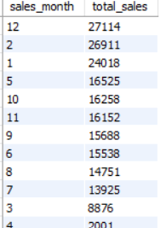
Question No. 7: In which season the sales are high? Data Retrieved:
Insights:
As per above table, December month has the highest sale.
And the months, December, January, February has the higher sales compared to other months, this might be because of Christmas and New Year season.
And the months, March and April has the lowest sale rate.
Other months are having average sales rate.

Slide 9
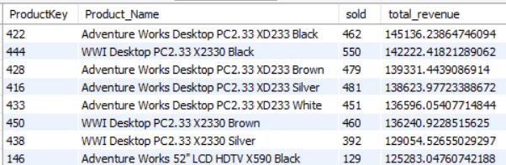
Question No. 8: Which is the top performing product ? Data Retrieved:
Insights:
As per the above data, “Adventure Works Desktop PC2.33 XD233 Black” is the top performing product as this product gives more revenue.

Slide 10
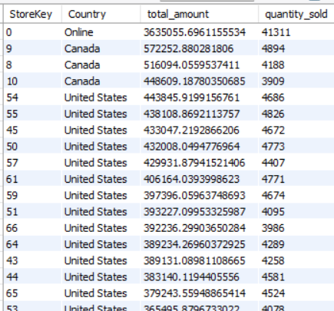
Question No. 9: Which store perform better in sales? Data Retrieved:
Insights:
The in online platform is higher when compared to physical stores.
A stores in Canada has sold the highest quantity, and then the stores in United States follows.

Slide 11
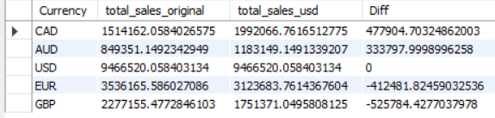
Question No. 10: What is the impact of Currency in sale? Data Retrieved:
Insights:
The Currency CAD and AUD is favorable during the sales period, benefiting the company.
EUR and GRB might indicate losses due to unfavorable rates.

Slide 12
Question No. 11: What are the top five products with maximum profit? Data Retrieved:
Insights:
As per above data, “DVD Storage Binders” are the products with most profit.

Slide 13
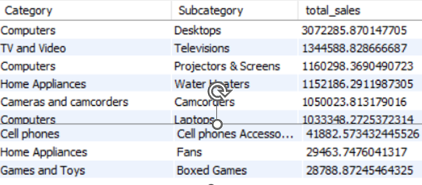
Question No. 12: In which category and subcategory the sales are more? Data Retrieved:
Insights:
We could see that Desktops are the most sold product which is under the category “Computers”.
And the products under the “Games and Toys” are the least sold.

Slide 14
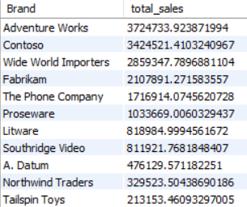
Question No. 13: Which is the most popular Brand? Data Retrieved:
Insights:
“Adventure Works” is the most popular brand among all.
“Tailspin Toys” and “Northwind Traders” comes under least popular brand.

Slide 15
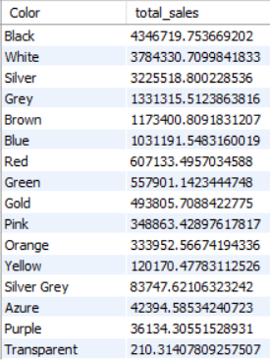
Question No. 14: Does color of products impact the sale? Data Retrieved:
Insights:
As per the above data, the colors “Black”, “White”, and “Silver” are most favourable colors of products choosed by customers.

Slide 16
Recommendations
We can leverage the high sales in “United States” by product promotions and campaigns.
Loyalty programs might be suitable in US for encouraging repeat purchases.
We can use social media as platforms for advertising and seek influencer partnerships to reach people on age group 19 to 35.
For TV and Video products, we can consider promotional discounts and offers to increase sales.
We can set 2015 as benchmark and work towards opening more stores.
We can include new inventory products and launch special promotions on holidays (December, January, February).

Slide 17
Since online sales are higher, invest in enhancing the online shopping experience. Optimize the website for mobile devices, improve customer service, and consider exclusive online offers to attract more customers.
Since USD sales are the most stable and highest, focus marketing and sales strategies in regions that transact in USD.
“DVD Storage Binders” yield high profits, analyze what makes it more profitable and apply it to other products.
For less popular brands, consider rebranding efforts or discontinuing those brands.
Stock products in the most favored colors (Black, White, Silver) more prominently.

