Slide 1

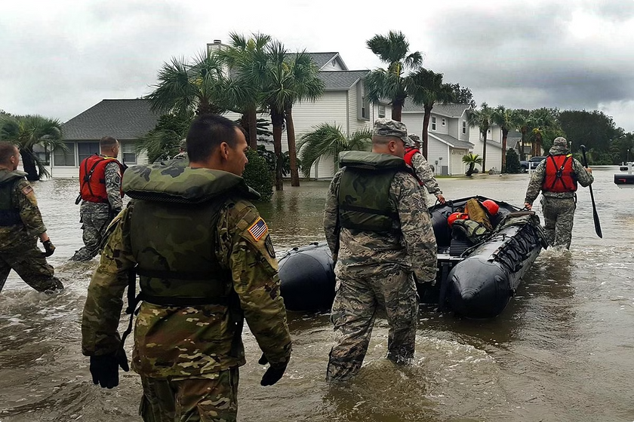
Disaster Management
BY
M.V.Deekshitha 1602-22-733-009
E.Sannihith 1602-22-733-049

Slide 2
Problem Statement
Natural disasters and emergencies often result in chaotic responses due to the lack of proper communication, coordination, and resource management.
Resource Mismanagement
Lack of real time information
Inefficient allocation of resources leads to shortages or overuse during disasters.
Absence of up-to-date data hampers timely decision-making and response efforts.
Communication Barriers
Delayed Response
Difficulty in coordinating between agencies and affected communities delays response and recovery.
Slow or disjointed actions result in increased casualties and damage during emergencies.

Slide 3
Enhancing Disaster Response
This disaster management platform is a real-time solution that enhances disaster response by enabling efficient communication, resource allocation, and real-time alerts. It connects communities, volunteers, and authorities to streamline coordination during disaster situations.
Alerts & Notifications
Resource Management
Central Hub
Provide real-time info on emergencies, critical alerts.
Coordinate supplies and personnel effectively.
For missing persons reports, rescue camp details, and community appeals.
1
2
3
4
5
Communication Hub
Disaster preparedness
Central platform for missing persons, rescue camps, and community appeals.
Wikipedia on various disasters, awareness, DO's and Don'ts

Slide 4





Leveraging Technology
Data-Base
Seamless Integration
Data Interpretation
MongoDB for flexible, document-based storage.
Express.js, React.js, and Node.js for backend and frontend.
Weather API, Geolocation & Maps API, Disaster Information API, Social Media API

Slide 5
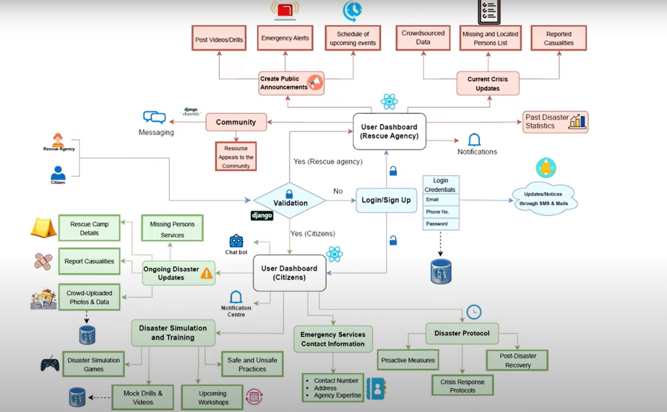
Work-Flow Diagram

Slide 6
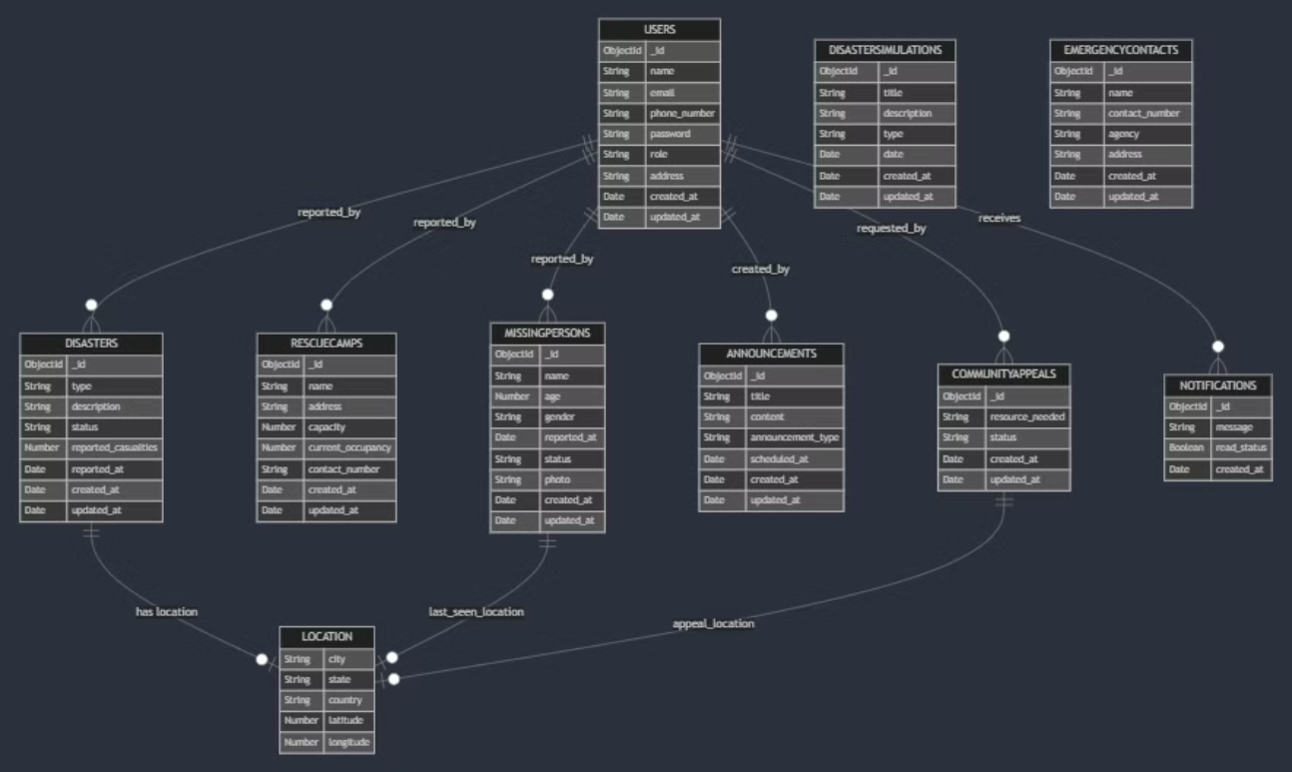
Database Schema

Slide 7
Future Advancements
AI-Powered Analysis
Multilingual Support
Machine Learning Insights
1
2
3
Predict disaster impact and optimize resource allocation.
Cater to diverse communities during emergencies.
Improve disaster prediction using historical data.
Conclusion
This disaster management platform provides a comprehensive, real-time solution that connects communities, volunteers, and authorities. By streamlining communication and resource management, it enhances disaster response efforts and recovery. Future enhancements aim to further improve prediction and response capabilities.

