Slide 1


Personal Finance Manager
TEAM MEMBERS:
Dhanush M [927623BAM011]
Dhareesh B [927623BAM012]
Dharnisha N [927623BAM013]
Dhivashya M R [927623BAM014]
Dhivyasathya R [927623BAM015]

Slide 2
PROBLEM STATEMENT / DESCRIPTION:
Create a personal finance management tool using Pandas for budgeting and expense tracking.
Users can input income, expenses, and financial goals, and the program generates reports and visualizations to help users manage their finances effectively.

Slide 3
ABSTRACT :
Take control of your finances with our Personal Finance Management Tool! Easily track your income, expenses, and savings each month.
Set and visualize your financial goals, empowering you to make informed financial decisions.
Understand where your money is going, and get personalized suggestions for smarter spending and saving habits.
Whether you're budgeting for the short term or planning for the long term, our tool makes managing your money simple and rewarding.
Start your journey to financial success today!

Slide 4
PROPOSED SOLUTION :
Input Validation: Ensure inputs like amounts are valid numbers.
Error Handling: Catch and handle errors gracefully.
Savings Goal Tracking: Allow users to set and track savings goals over time.
Expense Categories: Let users create custom expense categories for better tracking.
More Visuals: Add more charts to show spending trends.
Budgeting: Help users set spending limits and track adherence.
Income Variations: Handle different income frequencies.

Slide 5
REAL LIFE APPLICATION:
Budgeting: Users can accurately track their income and expenses, enabling better budgeting decisions.
Goal Setting: By inputting financial goals, users can visualize their progress and stay motivated to achieve them.
Expense Analysis: The program provides insights into spending habits by categorizing and visualizing expenses, helping users identify areas for potential savings.
Financial Awareness: Users gain a clearer understanding of their financial situation, empowering them to make informed decisions about spending and saving.
Long-Term Planning: Tracking expenses over multiple months allows users to plan for future expenses and savings goals, fostering financial stability and security.

Slide 6
HARDWARE AND SOFTWARE REQUIREMENTS:
Hardware Requirements:
Computer: Any modern computer capable of running Python will suffice
Input Device: A keyboard for user input.
Display: A monitor or screen to display the program output.
Internet Connection: Required for installing Python and libraries (optional).

Slide 7
HARDWARE AND SOFTWARE REQUIREMENTS:
Software Requirements:
Python: The program is written in Python, so you'll need to have Python installed on your computer. You can download Python from the official website: https://www.python.org/downloads/
Integrated Development Environment (IDE): While not strictly necessary, using an IDE can make coding and debugging easier. Popular choices include PyCharm, Visual Studio Code, and Jupyter Notebook.
Required Libraries: The program uses the following libraries.
Pandas: For data manipulation and analysis.
Matplotlib: For data visualization.
You can install these libraries using pip, Python's package manager, by running the following commands in your command line or terminal:
pip install pandas
pip install matplotlib
Operating System: The program should work on any major operating system such as Windows, macOS, or Linux.

Slide 8
PROJECT CODE:
import pandas as pd
import matplotlib.pyplot as plt
def input_income_sources():
print("Enter your income sources for the month (Enter 'done' when finished):")
income_sources = {}
while True:
source = input("Source: ").capitalize()
if source == "Done":
break
amount = float(input("Amount (₹): "))
income_sources[source] = amount
return income_sources
def calculate_total_income(income_sources):
return sum(income_sources.values())
def input_expenses():
total_expenses = 0
expenses = {}
print("\nEnter your expenses for the month (Enter 'done' when finished):")
while True:
category = input("Expense category: ").capitalize()
if category == "Done":
break
amount = float(input(f"Enter your {category} expenses for the month (₹): "))
expenses[category] = amount
total_expenses += amount
return total_expenses, expenses
def input_goals():
goals = float(input("\nEnter your financial goals for the month (₹): "))
return goals

Slide 9
PROJECT CODE:
def generate_report(income, expenses, goals):
net_savings = income - expenses
if net_savings < 0:
net_savings = 0
print("\n------ Financial Report ------")
print(f"Total Income: ₹{income}")
print(f"Total Expenses: ₹{expenses}")
print(f"Savings: ₹{net_savings}")
if net_savings >= goals:
print("Congratulations! You've met your financial goal for the month.")
else:
print("You're short of your financial goal for the month. Keep saving!")
def visualize_income_expenses(income, expenses):
plt.figure(figsize=(8, 4))
plt.pie([income, expenses], labels=["Income", "Expenses"], autopct='%1.1f%%', colors=['lightgreen', 'salmon'])
plt.title("Income vs. Expenses")
plt.axis('equal')
plt.show()

Slide 10
PROJECT CODE:
def visualize_expenses(expenses_df):
plt.figure(figsize=(10, 6))
plt.bar(expenses_df['Category'], expenses_df['Amount'], color='skyblue')
plt.xlabel('Expense Category')
plt.ylabel('Amount (₹)')
plt.title('Monthly Expenses Breakdown')
plt.xticks(rotation=45)
plt.show()
def calculate_total_expenses(expenses):
return sum(expenses.values())
def calculate_savings(income, expenses):
savings = income - expenses
if savings < 0:
return 0
return savings

Slide 11
PROJECT CODE:
def track_single_month():
print("\n------ Monthly Finance Tracker ------")
income_sources = input_income_sources()
total_income = sum(income_sources.values())
print(f"\nTotal income for the month: ₹{total_income}")
total_expenses, expenses = input_expenses()
goals = input_goals()
generate_report(total_income, total_expenses, goals)
visualize_income_expenses(total_income, total_expenses)
expenses_df = pd.DataFrame(list(expenses.items()), columns=['Category', 'Amount'])
visualize_expenses(expenses_df)
savings_month = calculate_savings(total_income, total_expenses)
if total_expenses > total_income:
print("Your expenses exceed your income. Consider reducing expenses or increasing income.")
else:
print(f"You have ₹{savings_month} left after expenses. Consider saving some of it.")
_

Slide 12
PROJECT CODE:
def main():
print("Welcome to the Personal Finance Management Tool!")
track_single_month()
track_multiple_months = input("\nDo you want to track expenses over multiple months? (yes/no): ").lower()
if track_multiple_months == 'yes':
while True:
track_single_month()
choice = input("Enter 'y' to input expenses for another month, or 'n' to exit: ").lower()
if choice != 'y':
break
if _name_ == "_main_":
main()

Slide 13
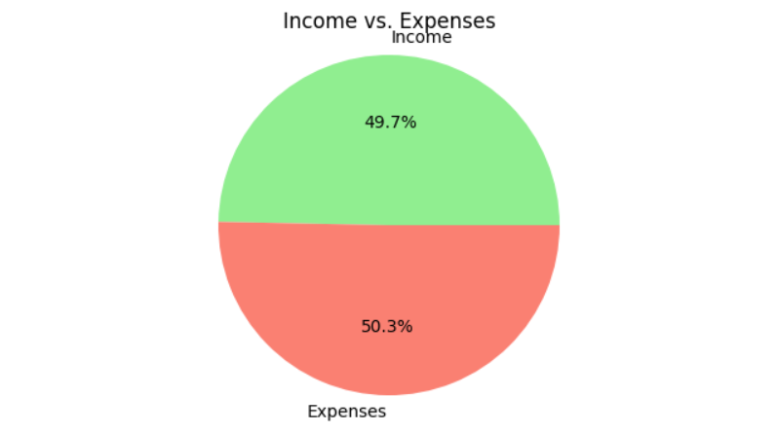
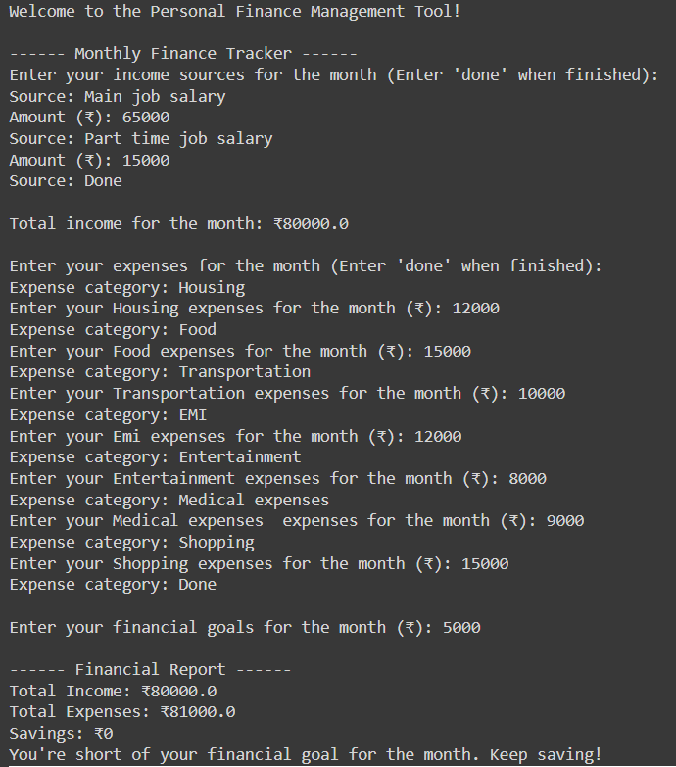
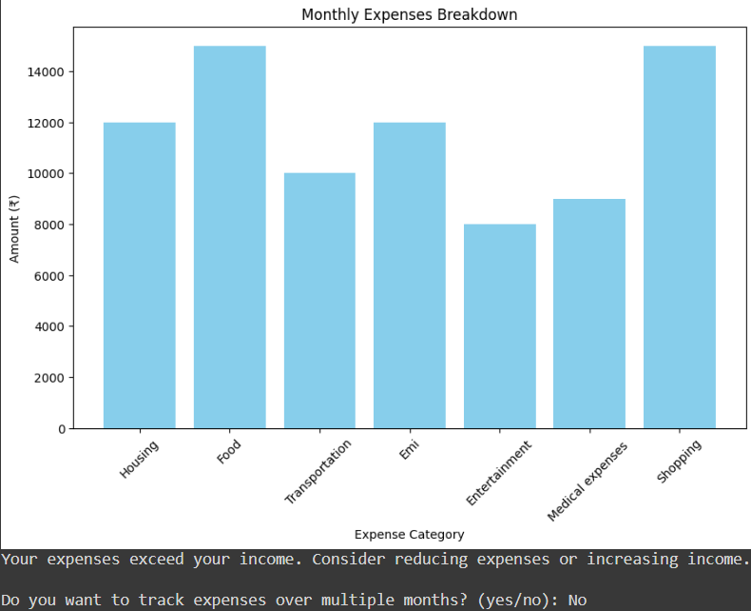
OUTPUT:

Slide 14
Thank you
Thank you for viewing the Personal Finance Management Tool to take control of your finances.
We appreciate your trust in our solution and are committed to helping you achieve financial success. Should you have any feedback, suggestions, or questions, please feel free to reach out.
Wishing you prosperity and financial well-being on your journey ahead!

