Slide 1

Project Title: Online Movie Ticket Booking System
FSD PROJECT REVIEW
Presented To:
CAPGEMINI
Team 2:
Karthik Raj S
Vigneshe B
Hariharan Dhanapathy

Slide 2
Problem Statement
The traditional way of going to cinemas can be difficult for customers as customers need to know the availability of seats, show timings, and movie options, especially when there are multiple cinemas in a location.
The present solution for a online booking system is not sufficient as there needs to be certain more implementations like having age restrictions and checking whether kids under certain age are allowed to watch a movie, and loyalty programs.

Slide 3
Objectives
The previous slide which deals with the problem statement gives way to these objectives which are kept in mind while designing the website:
Implement a fully functioning online movie ticket booking system.
Implement a responsive high level customer or user interaction with seamless access to their ticket information.
Implement a loyalty program for returning users.
Implement notification alert for people who have children and are going to a movie with age restrictions.
Implement a system where reviews and ratings for movie theatres could be entered.

Slide 4
Features
Convenience: Online movie ticket booking provides a convenient way for people to buy movie tickets from the comfort of their own homes or on the go, without having to wait in long queues at the box office.
Time-saving: Online ticket booking saves time as customers can book their tickets in advance and avoid the last-minute rush.
Availability: Online movie ticket booking ensures that customers have access to all available seats in the theater, giving them the freedom to choose the best seats as per their preference.

Slide 5
Assumptions and Future Implementations
Assumptions:
Multiple reservations by the same user would be treated as different tuples rather than aggregating the seat information to enhance clarity.
The number of seats is fixed to a particular number for all screens to ensure consistency.
Future Implementations:
Payment Interface would be added for booking each movie ticket.
Implement Order snacks option while booking.
An automatic API fetch to load in the most recent released films rather than having a static implementation of Movies database.

Slide 6




Technology Stack
Frontend | Reactjs
Backend | Spring Boot
Database | MySQL
ORM | JPA(Hibernate)
Testing | Junit and Mockito
Code Coverage | Eclemma by Jococo

Slide 7
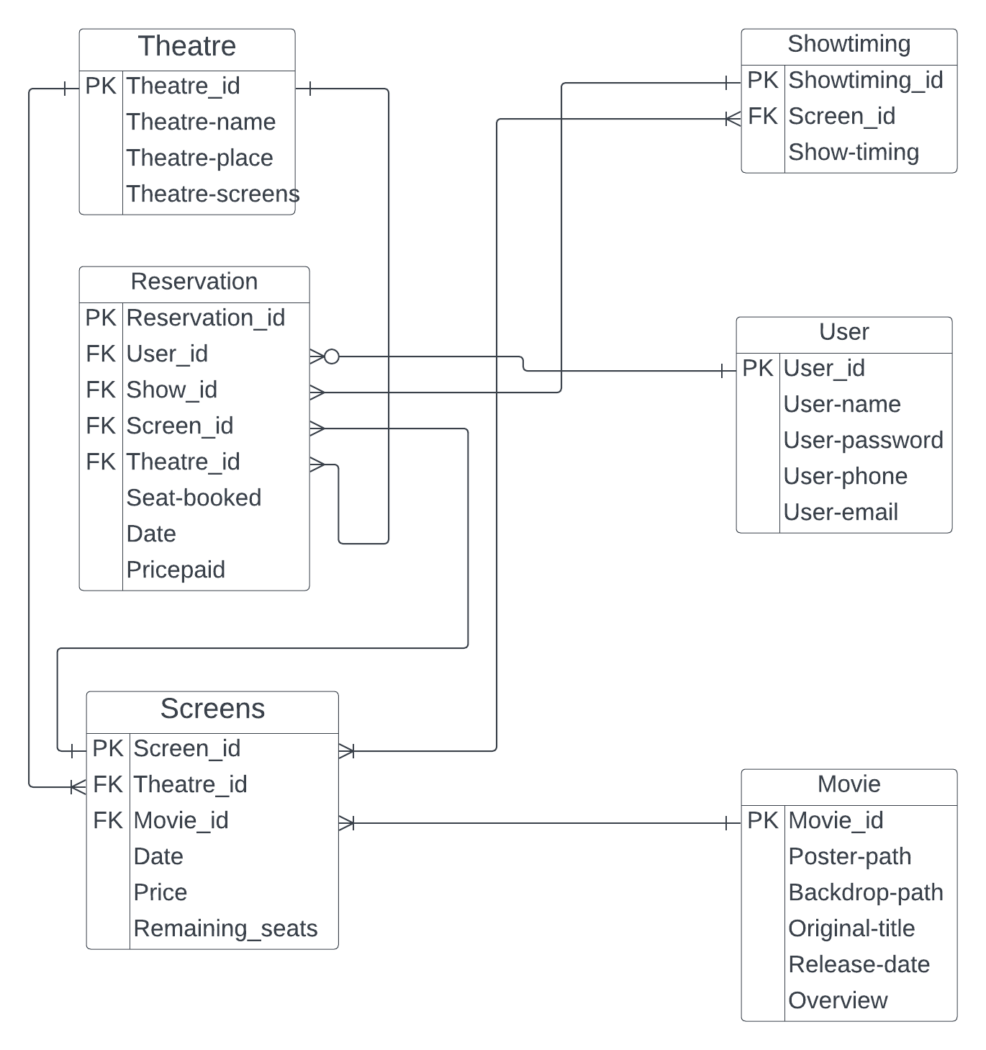
Entity-Relationship Diagram

Slide 8
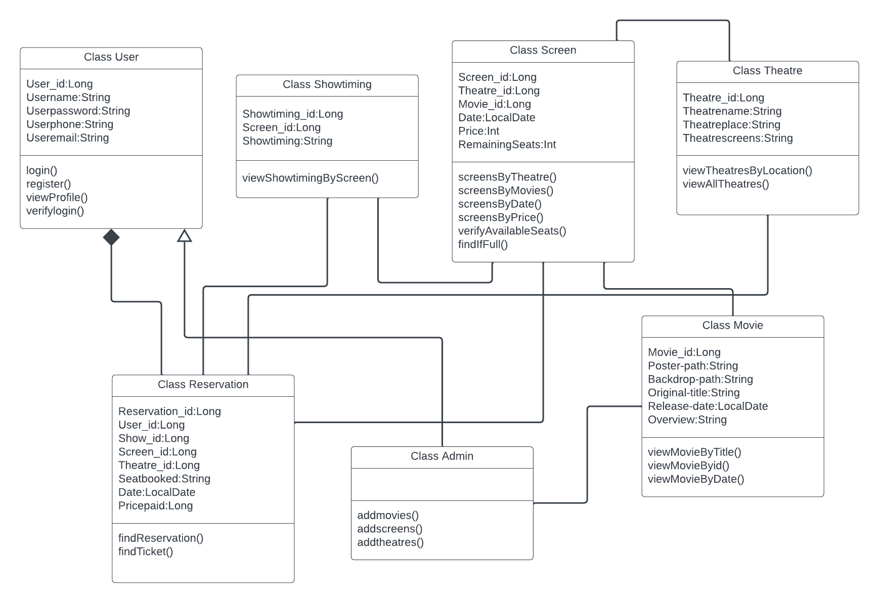
Class Diagram

Slide 9
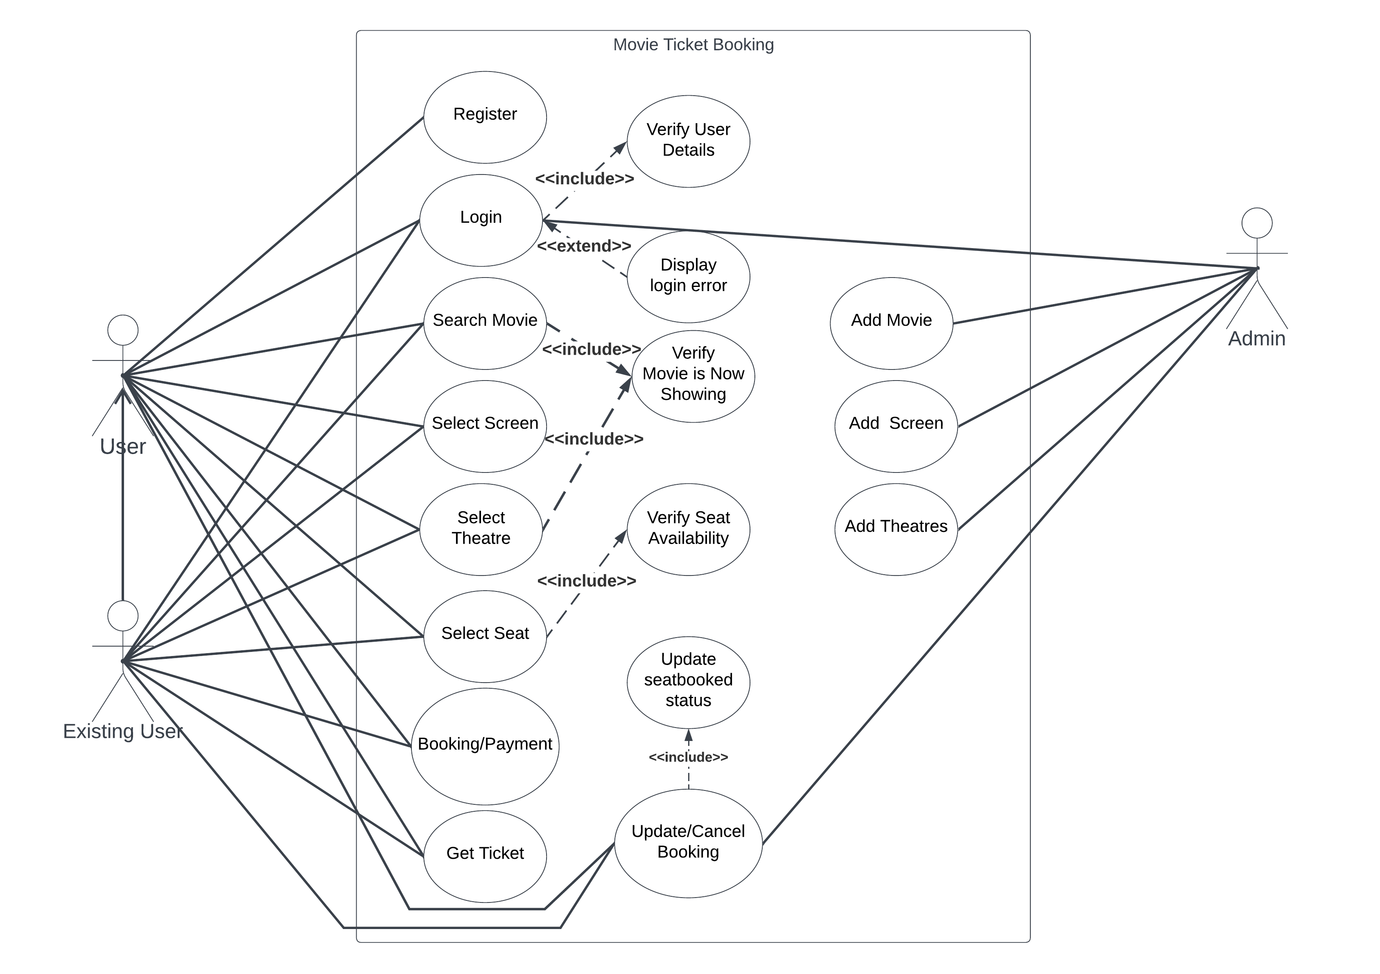
Use-Case Diagram

