Slide 1
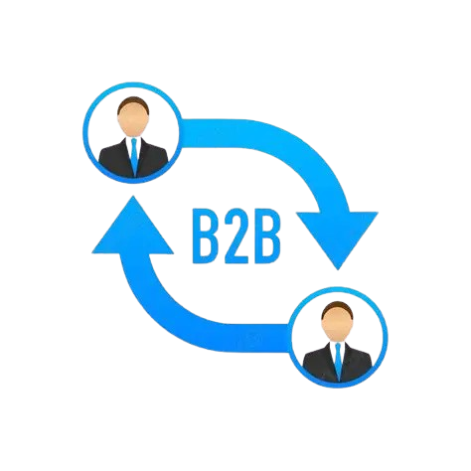
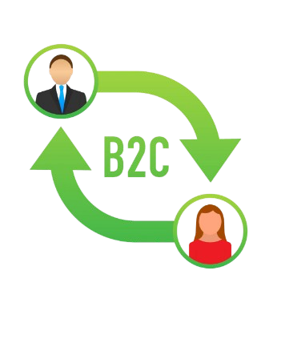
B2B
B2C
VS.
The Battle for Seattle’s Soul
Dharini & Akanksha

Slide 2
Cascadia Ventures
We are interns at Cascadia Ventures!
On of our senior partners believes Seattle's economy is changing, He wants to pivot the entire $500 million budget to B2C companies!
Our boss, Sarah disagrees. She thinks Seattle's DNA is B2B and they "hype" around consumer apps is just a distraction.
Our mission is to dig into data, find statistics and discover the truth. Is Seattle really changing into a B2B economy or staying B2C?

Slide 3
The Data Reality
Our sources
Dataset A – The Investments Records (Crunchbase via Kaggle)
WHY IS OUR DATA CREDIBLE?
Our data is from Crunchbase
An online database and research program that provides information about companies, startups, and funding activity.
Dataset B - The Global Ecosystem Rankings (Startup Blink via Kaggle)
WHY IS OUR DATA CREDIBLE?
- Our data is from Startup Blink
A global startup ecosystem research and mapping platform that helps, people, governments and companies understand how startup communities work around the world.

Slide 4

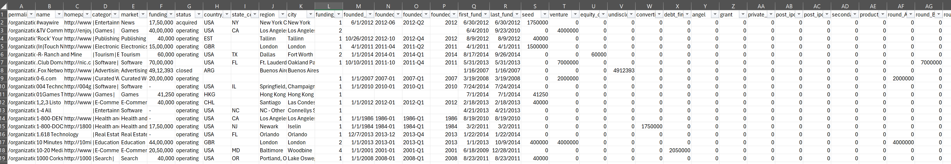

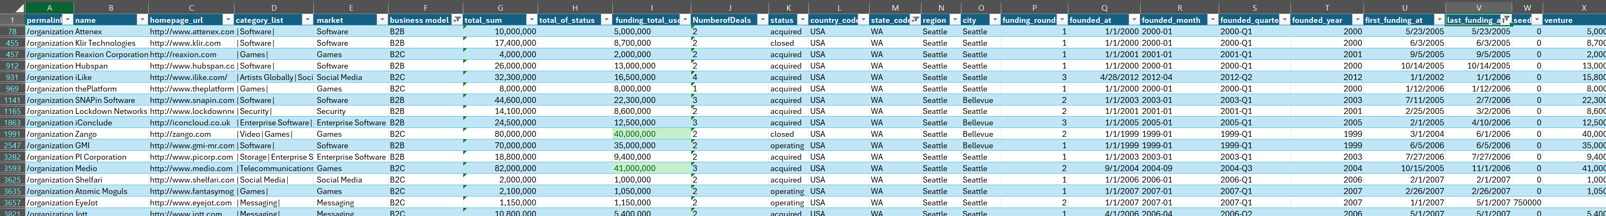
Cleaning!

Slide 5
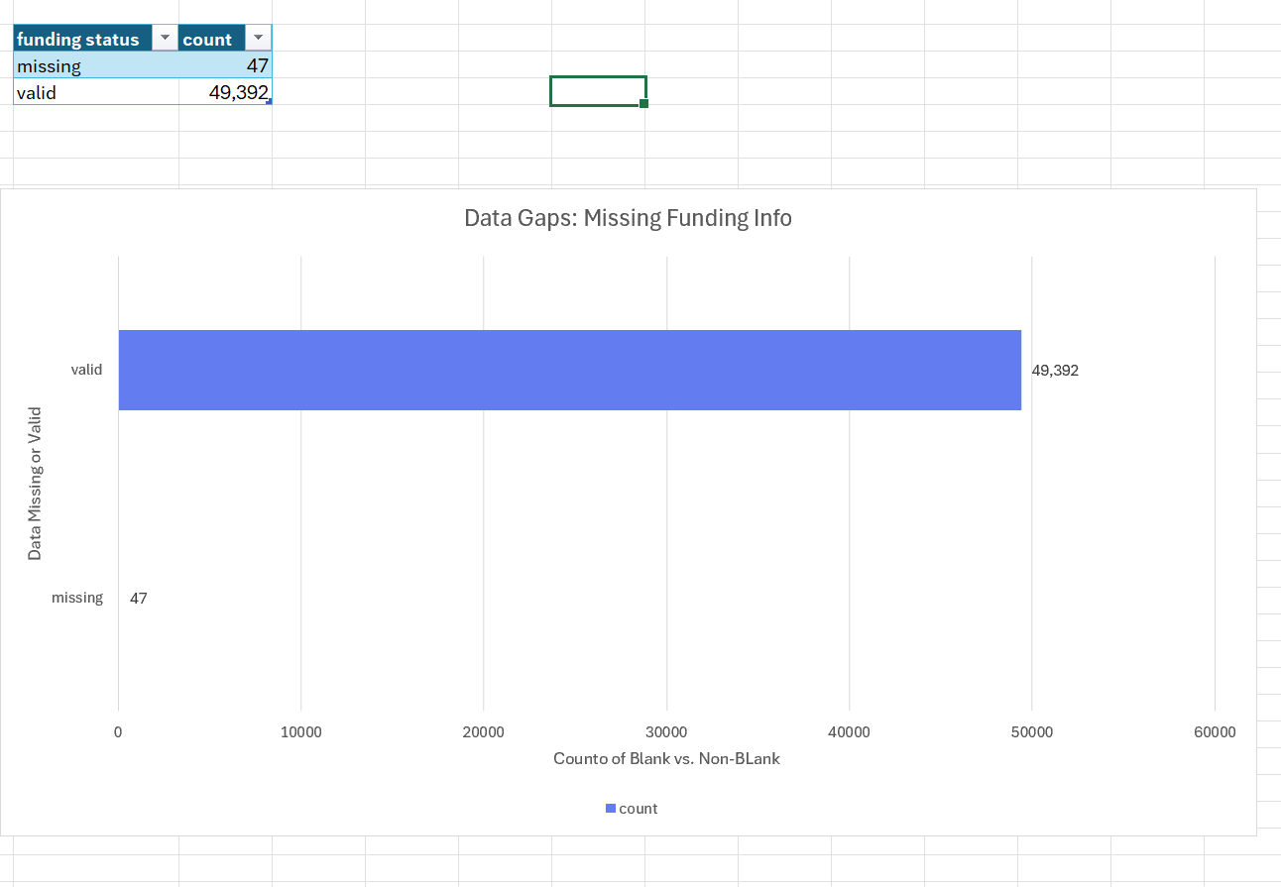

Slide 6
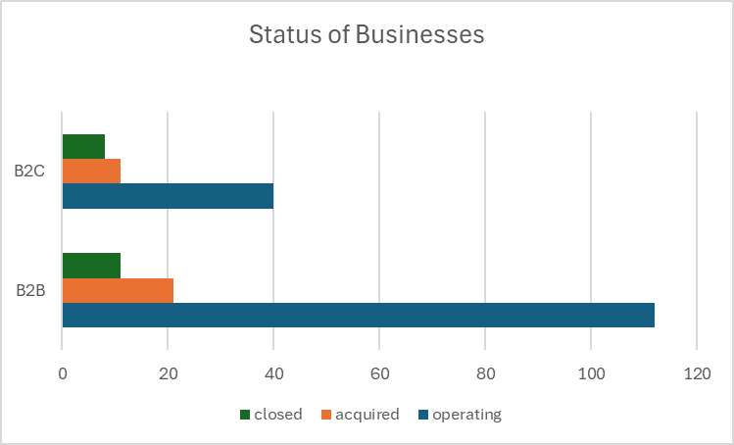
Between 2005-2015...

Slide 7
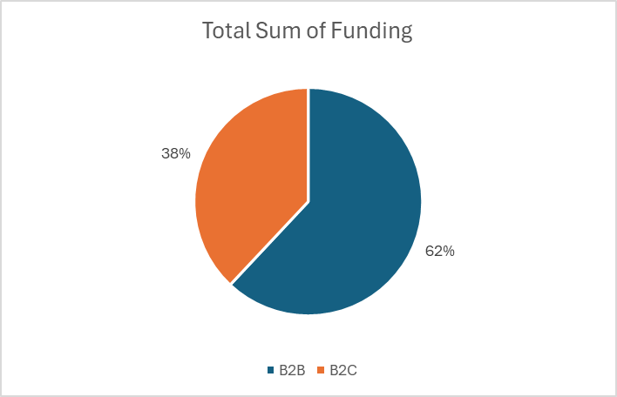
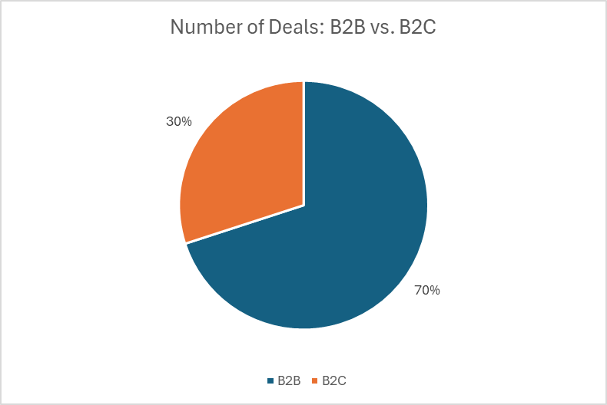
Between 2005-2015...

Slide 8
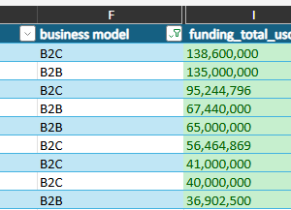
Unicorn
The top 10 companies with the highest funding – highlighted in green
Although, B2C has higher finding than B2B businesses, due to our previous data, we noticed that B2C businesses have had more deals. So, all we need to do is create deals with bigger B2B businesses. So, all our boss Sarah needs to do is invest in bigger B2B businesses as there are a vast amount of them
6
4

Slide 9
Recommendation
Our recommendation is to NOT change the funding to fund B2C companies and instead keep it the way it is: allocate the funds for B2B companies.

