Slide 1
Laravel Certification Course
Name-Dharini Patel
Enrollment id-23000079

Slide 2
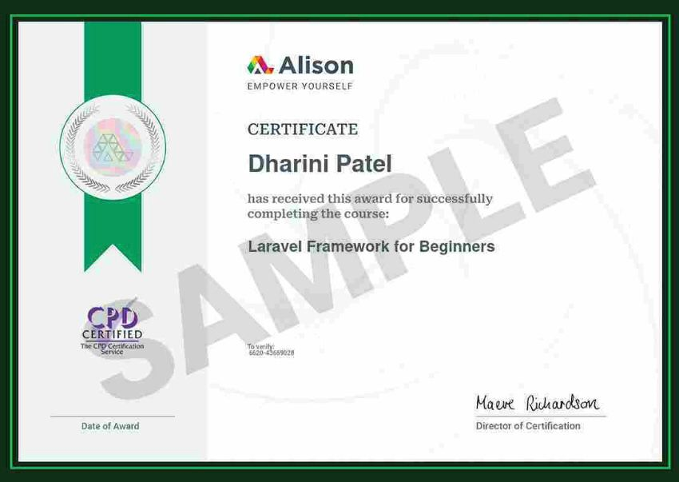

Slide 3
Introduction to Laravel
Laravel is a free, open-source PHP web framework designed to make developing web applications easier, faster, and more organized. Created by Taylor Otwell, Laravel follows the MVC (Model-View-Controller) architectural pattern, which separates application logic, data handling, and user interface into distinct parts, making the application more modular and maintainable.
Laravel's commitment to an elegant syntax, task simplification, and an extensive toolbox underscores its dedication to empowering developers, fostering creativity, and expediting the development of sophisticated and feature-rich web applications.

Slide 4
Advantages
Scalability and Maintainability
Extensive Ecosystem
Community Support and Documentation
Modern Tooling and Features

Slide 5
MVC Architecture
The Model-View-Controller (MVC) architecture is a software design pattern used in web development to separate an application into three interconnected components: Model, View, and Controller. In Laravel, the MVC architecture is pivotal in structuring and organizing code. Here's an overview of each element and its significance within Laravel:

Slide 6
Model
The Model represents the data and business logic of the application. It interacts with the database, encapsulating data access,manipulation and validation

Slide 7
View
The View is responsible for presenting the data to the users. It comprises the user interface elements, such as HTML, CSS, and sometimes JavaScript, that users interact with.

Slide 8
Controller
The Controller acts as an intermediary between the Model and View.It handles user requests, processes input, interacts with the Model to retrieve data, and passes the data to the View for presentation.

Slide 9
Laravel Framework Key Folders
In a fresh Laravel project, you'll typically find several important folders and files. These folders organize different aspects of the applications structure, including configuration, controllers, views, models, and more. Here's a brief description of some key folders you'll encounter in a standard Laravel project:

Slide 10
app: This directory is the heart of your application. It contains folders like:-
Console: Contains artisan commands.- Exceptions: Manages exception handling.
Http: Contains controllers, middleware, form requests, and route definitions.
Models: Houses your application's data models
Providers: Manages service providers.
bootstrap: This directory holds the files responsible for bootstrapping the Laravel application and loading the necessary components.
config: Contains configuration files for different parts of your application,such as database connectons,cache settings and more.

Slide 11
database: Houses the database-related files:-
migrations: Contains database schema changes using migration files.
seeds: Holds seed files to populate the database with test data.

Slide 12
Laravel Framework Key Folders-2
public: The entry point of your application.This folder contains the index.php file and publicly accessible assets like CSS, JavaScript, and images
resources: This directory stores non-PHP resources like views, language files, and frontend assets:views: Contains the Blade templates for your application's Ul.lang: Holds language files for internationalization.
routes: Contains route definitions for your application, organizing how HTTP requests should be handled.
storage: Holds temporary files generated by your application,incuding logs,cache and session files.
tests: Contains test cases for your application.
vendor: This directory holds Composer dependencies, including the Laravel framework itself and other libraries/packages used in your project.

