Slide 1
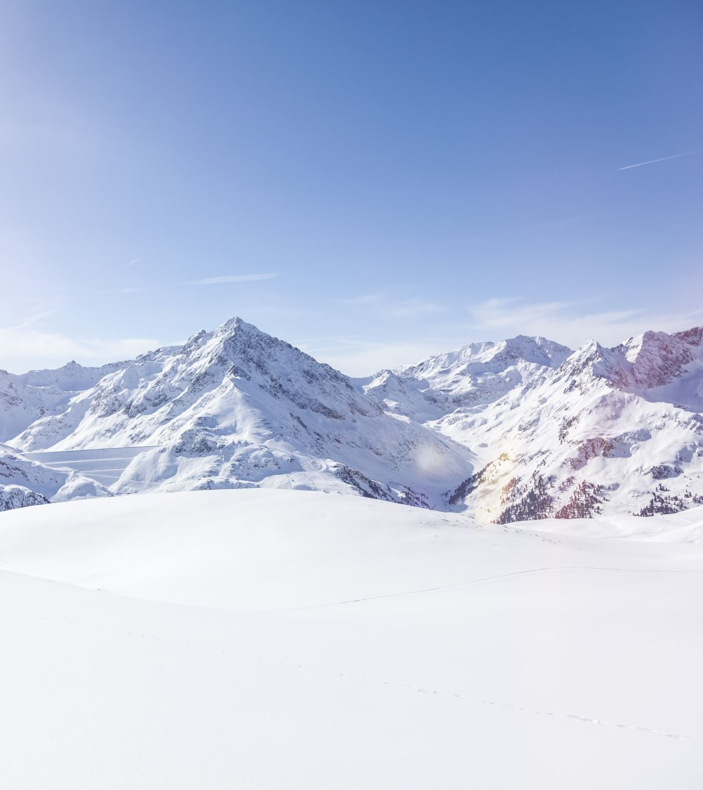
Big Mountain Ski Resort
Dharit Sura

Slide 2
Pricing Case Study
Problem Statement – How can Big Mountain Resort better price the tickets by capitalizing all its facilities and offset their recent additional operating cost by $1.54M this season.
Context - Big Mountain Resort offers spectacular views of Glacier National Park and Flathead National Forest, with access to 105 trails. Every year about 350,000 people ski or snowboard at Big Mountain. The business wants guidance on how to better price the tickets by using all the facilities effectively.
Criteria for success - The resort must find a way to absorb $1.54M per year in increased maintenance costs within their current market. Define opportunities to market user experience to justify increased ticket prices to cover added costs.
Scope – 330 resorts in USA having the same market share. Revenue from ticket sales will be compared to operational costs to find the balance of ticket price to support above average ticket prices.
Constraints – New added chair lift increases the operational costs by $1.54M. Distinguish facilities of the resort so that prices we can keep the same prices or increase it.
DataSource – CSV file with 330 resorts
Stakeholders – Jimmy Blackburn, Alesha Eisen

Slide 3
Exploratory data analysis
We calculated the resort densities along with population of each state and determined how the pricing was distributed across each state.
Using the correlation graph, we were able to determine the facilities which highly correlated to the tickets price like Vertical drop, fastQuads, runs, chairs, days open and Snow Making_ac are very useful.
We see that the more chairs a resort must move people around, relative to the number of runs, ticket price rapidly plummets and stays low.
We also saw that having no fast quads may limit the ticket price, but if your resort covers a wide area then getting a small number of fast quads may be beneficial to ticket price.
When Big Mountain resort was compared with other state resorts, we see that our resort ranks high or is well above the average market in every category that is directly dependent for the ticket pricing. This supports our initial idea of having a pricing strategy that is above the average price.

Slide 4
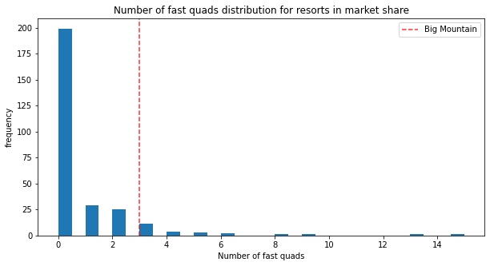
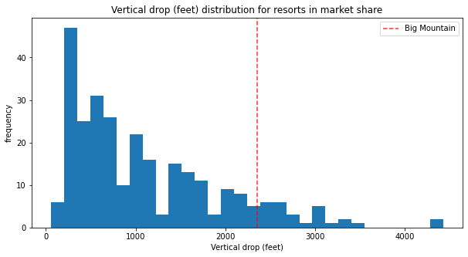
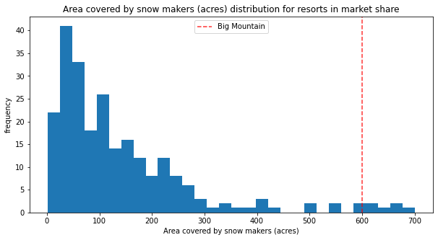
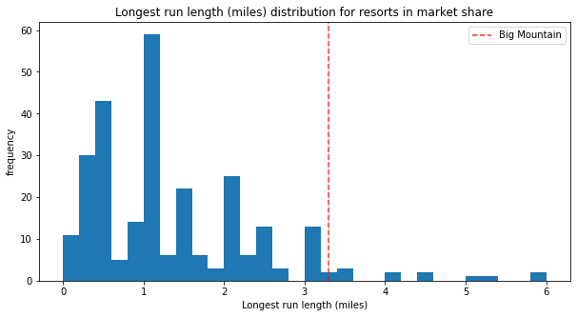

Slide 5
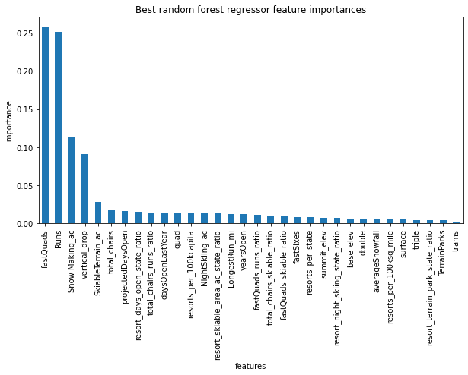
Preprocessing
In the first step we developed a dummy regressor model by using the mean of prices. This helped in establishing a baseline for comparison and using the mean absolute error we were off by an average of $19.
In the process of building the linear model, missing values were imputed with the median values. The base linear model, was off by about $9.
Through selectkbest, 8 features were to be focused on: vertical_drop, Snow Making_ac, total_chairs, fastQuads, Runs, LongestRun_mi, trams, and SkiableTerrain_ac.
Further, a random forest model was developed. It revealed that the top four features to consider are fastQuads, Runs, Snow Making_ac, and vertical_drop.
We continued with RF model since the mean absolute error of the model was lower than linear model.

Slide 6
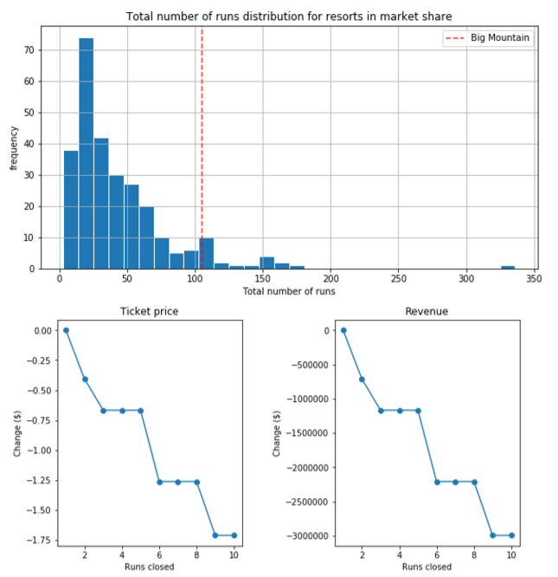
Scenarios
The impact of closing 10 of the least used runs in order to cut the costs.
Based on our modeling the following outcome was achieved
Closing one run will have no impact on Ticket price or revenue.
Closing 2 runs reduce support for ticket price and so revenue by $0.4 and $750,000 respectively.
Closing 3 runs, it seems they may as well close 4 or 5 as there’s same loss in ticket price and revenue by $0.67 and $1.25M respectively.
Closing 10 runs reduce support for ticket price and so revenue by $1.71 and $3.0M respectively.

Slide 7
By increasing the vertical drop & adding a run to a point 150 feet lower down. It requires the installation of an additional chair lift to bring skiers back up, without additional snow making coverage. This resulted in supporting the idea of increasing the ticket price by 10.62% or $8.61 and an expected increase in the revenue by $15M over the season.
Same as above but adding 2 acres of snow making cover resulted in the best case where we can increase the ticket price by 12.22% or $9.9 and have an increased revenue by $17M over the season.
By increasing the longest run by 0.2 mile to boast 3.5 miles length & an additional snow making coverage of 4 acres resulted in no change.

Slide 8
Recommendations
Based on our analysis we strongly recommend that the ticket prices should be increased irrespective of the new additions. Our resort has ranked well above average in all major categories. Hence, the current price of $81 is low in comparison to the facilities that are being provided at the resort.
After running multiple scenarios, I can recommend that by adding 1 run, Vertical drop by another 150ft, an additional total chair and Snow making_ac by 2 acres we see the highest increase in the ticket prices and revenue by $9.9 and $17,322,717, respectively. This is inline with the new addition of new chair at the start of the season and can easily offset the $1.54M operating cost.
Other strategy that I would like to suggest is to develop a more robust pricing strategy for weekdays and weekends. We can also manipulate the prices effectively for peak and off seasons.
We can also try to do seasonal pass for the visitors and get some additional funds upfront for our improvement costs. By doing so we will ensure recurring payments and have a fixed set of income.

Slide 9
Future work
Although our modeling is good enough there are surely ways through which, we can improve and have better pricing model.
Our model is currently missing weekday, peak and off-peak season prices which need to calibrated inorder to better predict the prices over the seasons.
We also need to know the operating costs of each facilities or the total operational costs that Big mountain is having and compare it against the improvement costs inorder to get an estimate of the overall increase in the revenue and ticket prices.
We can also take into considerations of the variance in the number of visitors that visit the resort. Due to which our ticket prices need to be adjusted so the revenue doesn’t drop drastically.
We can use better ML algorithms like XGBoost or GradientBoosting and hypertune the parameters in a more robust mechanism to have a higher accuracy in the predictions.

