Slide 1


Building a News Research Tool
BY:-Dharmendra KUMAR
DATE:- OCTOBER 2025

Slide 2

Agenda
Ø Challenges
Ø Manual news analysis is time-consuming
Ø Too much data → information overload
Ø Analyst reports often have subjective bias
Ø Our Solution
Ø AI-driven summarization of articles
Ø Automated sentiment detection for faster insights

Slide 3


Project Overview
Goal
Automate news collection & summarization for equity research Key Features
Fetch latest news from APIs (NewsAPI / GNews)
Summarize content using LLMs (LangChain + OpenAI) Sentiment detection (Positive / Negative / Neutral) User-friendly Streamlit web interface

Slide 4
Working
Pipeline Overview
Data Source → NewsAPI
Processing → LangChain + LLM
Output → Summarized Insights
Frontend → Streamlit UI

Slide 5




Environment Setup
Environment setup means preparing the system with all required tools, libraries, and configurations needed for the project. It ensures smooth execution, avoids conflicts, and provides an isolated workspace for development.
⚙️ Setup
Requirements
Installed libraries:
langchain, streamlit,
newsapi-python, openai
API Keys: OpenAI +
NewsAPI
Secure storage using
.env file

Slide 6





LangChain Setup
LangChain setup involves configuring the LangChain framework to build applications powered by large language models (LLMs). It includes installing LangChain, setting up API keys (like OpenAI), and connecting necessary components such as text loaders, embeddings, and chains. This setup allows seamless interaction between data, models, and tools for intelligent, automated workflows.
📝 Content
Config file:
langchain_config.py
PromptTemplate for summarization
LLMChain with OpenAI / Groq

Slide 7
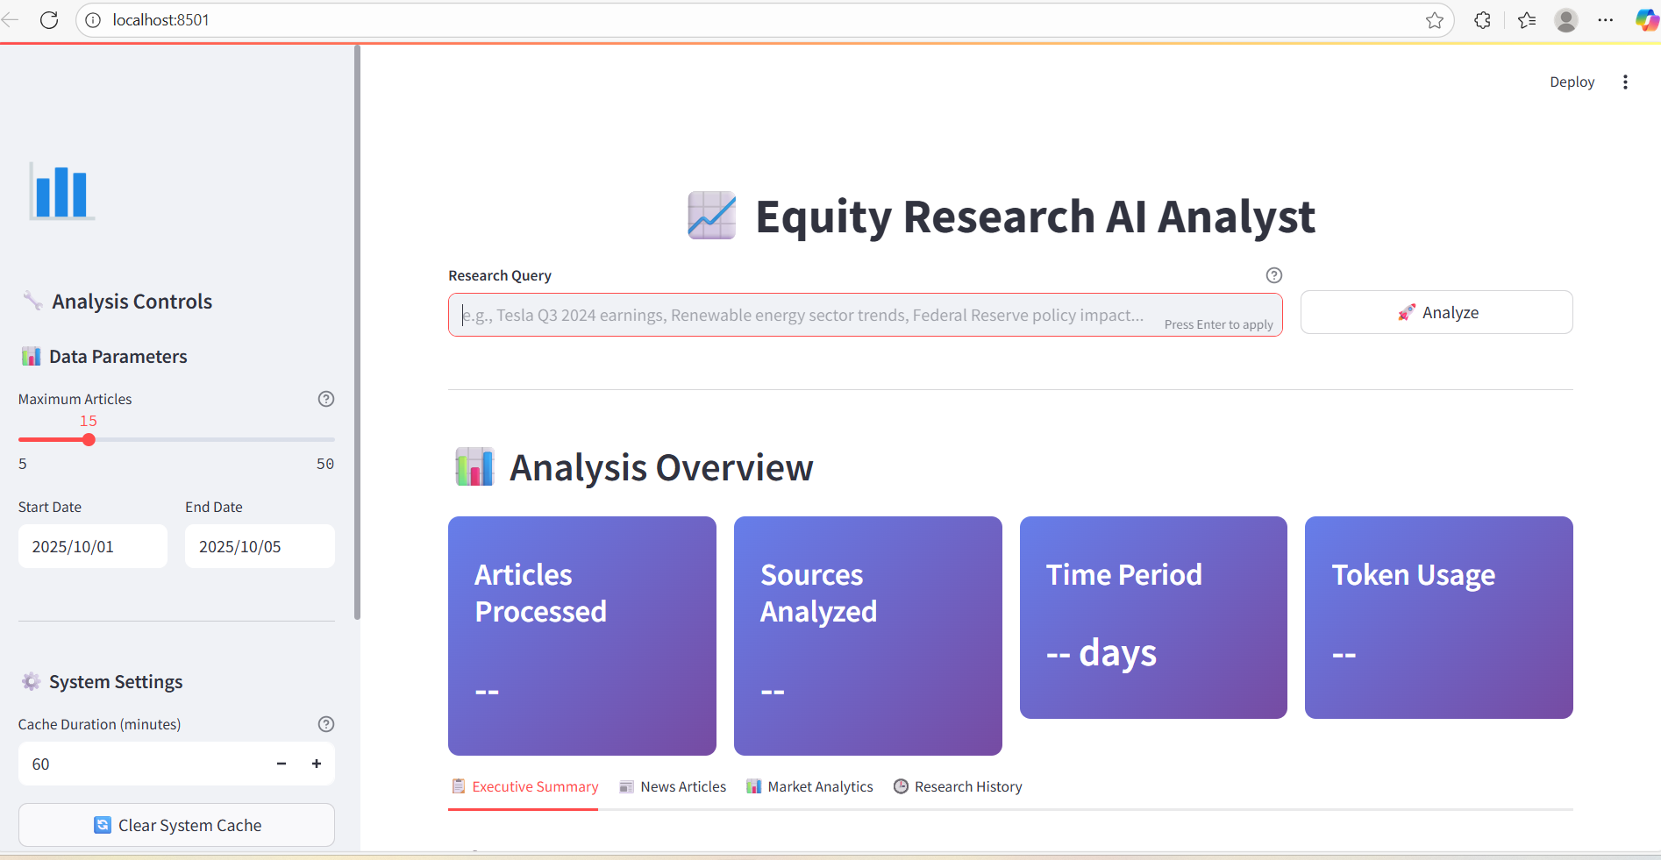
Dashboard Design

Slide 8
Remote Work Over Time
Connected to NewsAPI
Functions implemented:
Extract descriptions
Combine summaries
Fetch articles

Slide 9




Summaries
📝 Content
Improved prompt: Query + Summaries
Generated overall article insights
Added sentiment analysis:
✅ Positive | ❌ Negative |
⚪ Neutral

Slide 10
📊 Checked relevance & accuracy of insights
✅ Pipeline tested end- to-end
📝 Verified query handling
How it works(Testing)
📝 Core
Content
Query
| Result
|
"Tesla stock news" | 8 articles → Summary ✅
“Stock Market News" | 6 articles → Insights ✅

Slide 11
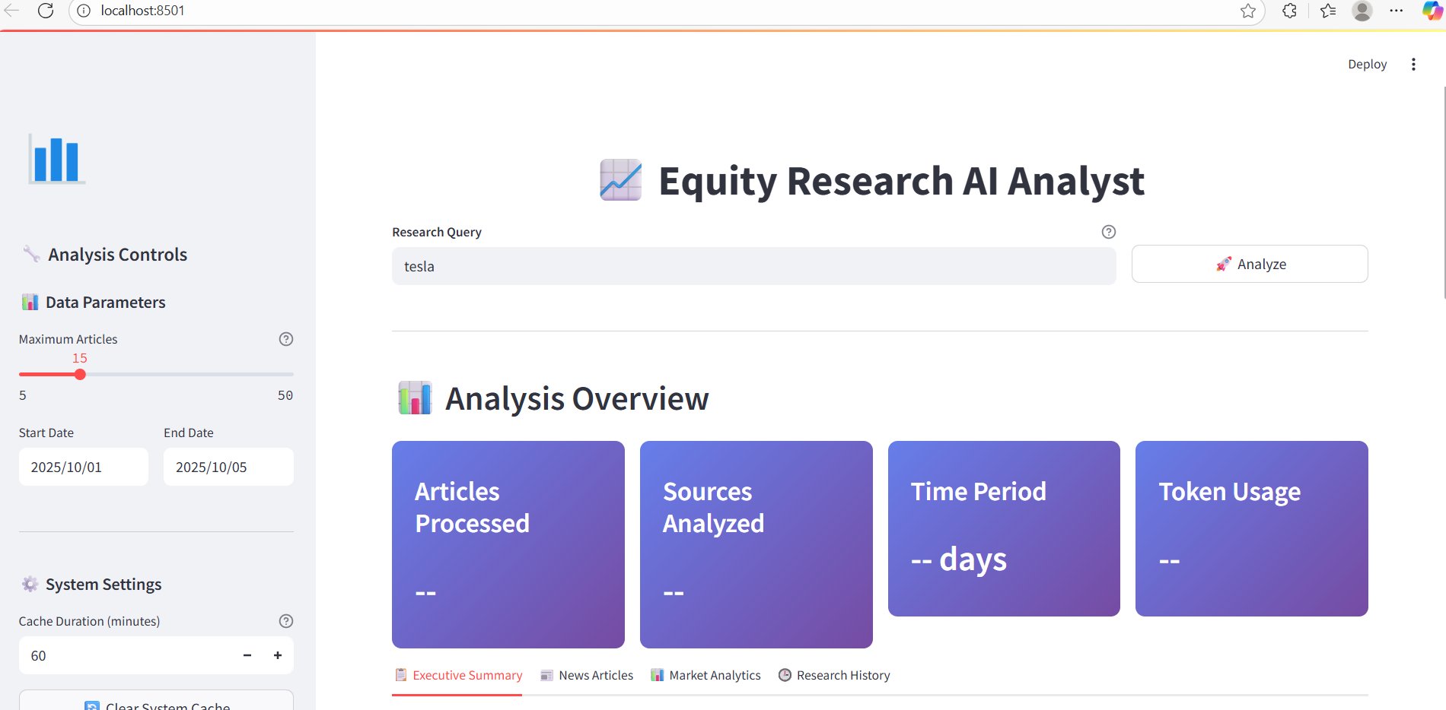
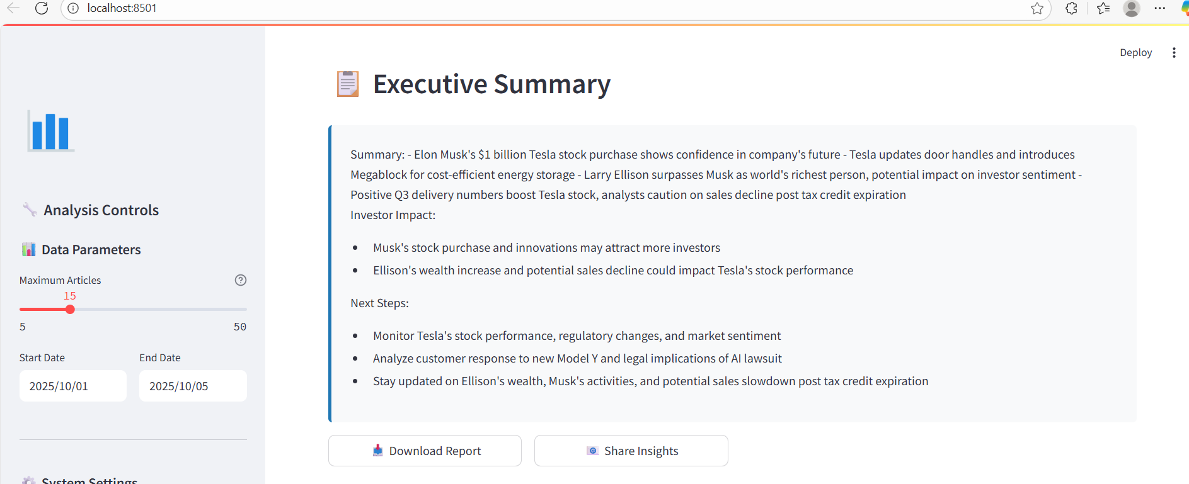
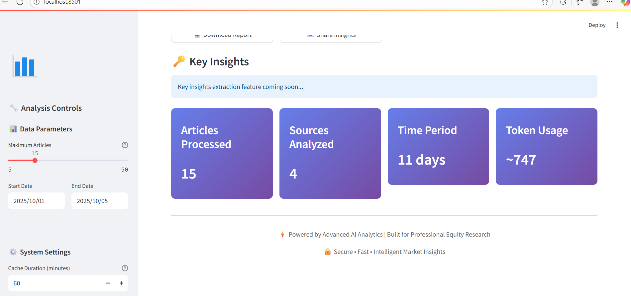
Testing Output

Slide 12





☎ Code fully documented with comments
🗂 README & requirements.txt created
📝 Core Content
🏗 Project structure cleaned for deployment
🚀 Ready for real-
world use
Deployment

Slide 13

Delivered an AI-assisted equity research tool that fetches, summarizes, and analyzes news.
Key skills demonstrated: LangChain, Streamlit, APIs, LLMs, PDF generation.
Interactive features:
Per-article summaries and overall summary tabs Sentiment detection (Positive / Negative / Neutral) Downloadable PDFs for reports
Search history with filters and export options
Conclusion
Future Enhancements:
Multi-language support for global news
Financial trend detection and predictive insights Advanced analytics dashboard with visualizations User authentication and personalized experience

Slide 14

Thank You

